Slide 1
Part 3
Graphics development for mobile systems

Slide 2
Mobile Graphics
Heterogeneity
OS
programming
languages
architecture
3D APIs
IDEs
Notes:
Mobile development is nowadays very heterogeneous. There are many architectures, OS, Prog. Lang., 3D APIs, dev. Environments…

Slide 3
Mobile Graphics
Heterogeneity
OS
programming
languages
IDEs
3D APIs
Notes:
The objective of this presentation is to unwrap the complexity and try to provide a brief overview on the available options and solutions in order to develop with minimal pain.

Slide 4
Mobile Graphics
Android
iOS
Windows Phone
Firefox OS, Ubuntu Phone, Tizen…
OS
Programming Languages
Architectures
3D APIs
Cross-development
C++
Obj-C / Swift
Java
C# / Silverlight
Html5/JS/CSS
X86 (x86_64): Intel / AMD
ARM (32/64bit): ARM + (Qualcomm, Samsung, Apple, NVIDIA,…)
MIPS (32/64 bit): Ingenics, Imagination.
OpenGL / GL ES
D3D / ANGLE
Metal / Mantle / Vulkan (GL Next)
Qt
Marmalade / Xamarin /
Muio
Monogame / Shiva3D / Unity / UDK4 / Cocos2d-x
Notes:
This will be the roadmap, which I will skip since it will remain mainly for quick reference.

Slide 5


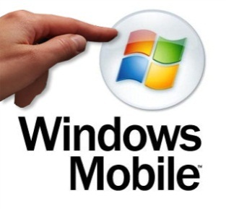
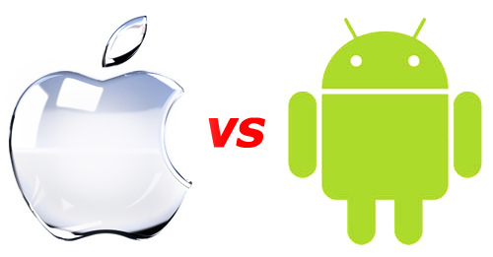

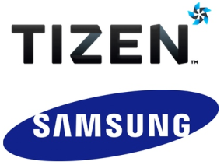

Operating Systems

Slide 6
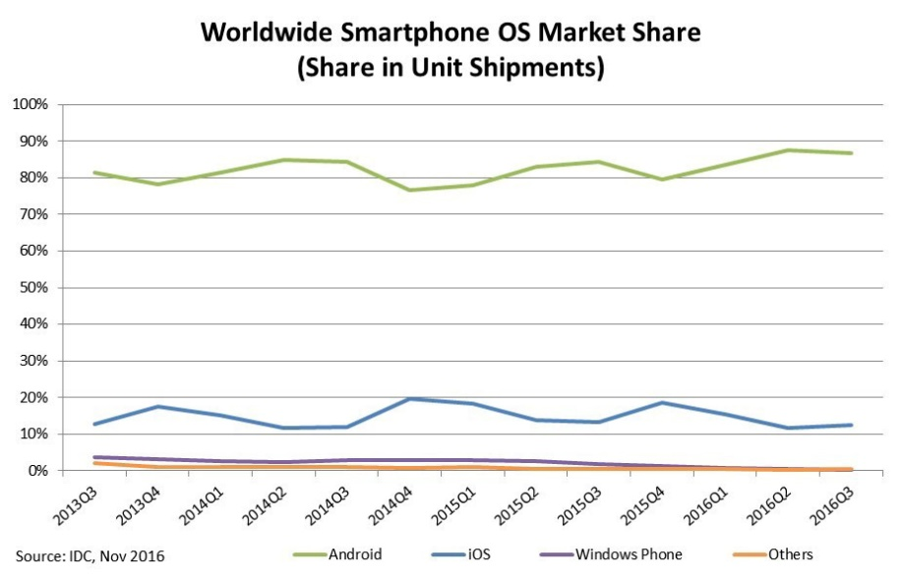
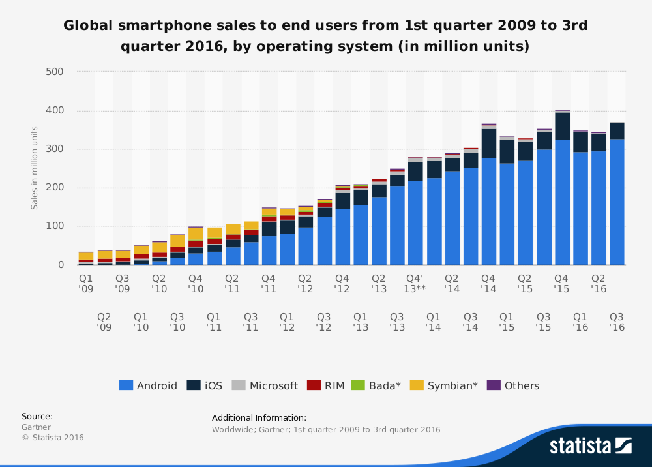
Operating Systems
Linux based (Qt…)
Ubuntu, Tizen, BBOS…
Web based (Cloud OS)
ChromeOS, FirefoxOS, WebOS
Windows Phone
iOS (~unix + COCOA)
Android (JAVA VM)
Notes:
Most part linux based (Except Windows Phone)
Some HTML5 framework (as OS API) – web based
Some Qt framework – Ubuntu Phone
IOS – unix based COCOA framework
Android – Java Virtual Machine

Slide 7
Operating Systems
 | arm | x86 | mips | 3D driver | OpenCL support | C/C++ | Main API
android | v | v | v | GLES 3 | wary / dev drivers - renderscript | yes | Java
ios | v |  |  | GLES 3 | only for sys | yes, through obj-c | objective-C
Winphone 10 | v | v |  | D3D / ANGLE | DirectCompute | yes | .NET Silverlight
tizen | v |  |  | GLES 3 | yes | yes | C++
firefox OS | v | v |  | GLES 3 | no | no | HTML5/JS/CSS
ubuntu touch | v | v |  | GLES 3 | ? | yes | HTML5, QML

Slide 8
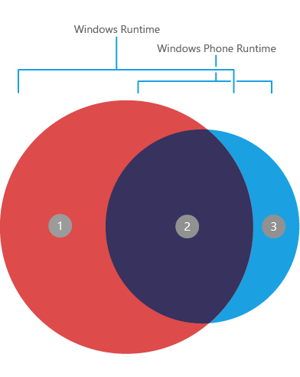
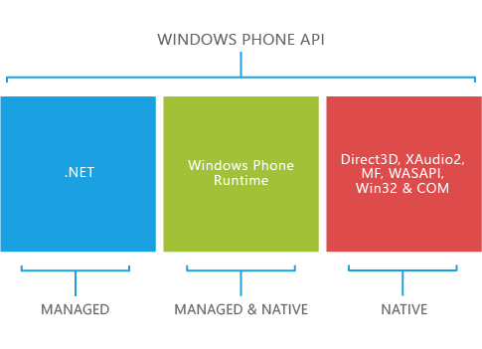
Operating Systems
Windows 10
Windows development – Visual Studio 2017
Good debugging / compiler / integration
Great integration and deployment
Universal Windows Platform (UWP)
API access
C#, VB.NET, and C++
3D API
D3D
OpenGL access through ANGLE
Advantages
Visual Studio, interoperability with iOS
HW is quite selected/homogeneous
Disadvantages
~OpenGL wrapper just recently!

Slide 9
Operating Systems
iOS
Development under MacOS
Xcode – good IDE/debug
Clang compiler!
API access
Objective-C, swift
Library programming
C++ support
Advantages:
Homogeneous hardware (biggest issues are resolution related)
State-of-the-art CPU/GPU (PowerVR SGX 54X/554, G6400)
Good dev tools (Xcode + Clang)
Inconvenients:
Closed platform
Requires iDevice for development/shipment (mostly)

Slide 10
Operating Systems
Android
Development in Eclipse
Java-based – integrated debugging (non-trivial for NDK)
GCC / clang compilers
Advantages
Wide variety of hardware configurations (CPU/GPU)
Java based + C++ as dynamic library (JNI or NDK+NativeActivity)
Open source
Toolchain provided for Windows/Linux/MacOS (GCC + Clang)
Faster access to new hardware / functionality!
Inconvenients
Heterogeneous device base (hard to target all configurations)
Not so integrated IDE -- ~mixed pieces

Slide 11
Operating Systems
App development -- publishing
WinPhone & iOS requires less effort for distribution
Easy to reach the whole user base
Android has a wide variety of configuration that require tuning
User base is typically reached in an incremental way (supporting more configs)
Many HW configurations (CPU/GPU) give more options to explore ☺
WinPhone has not yet the same market share
Variety of configurations
Research
A matter of taste ? Dev. Platform ?
Linux → Android (OpenGL support!)
Mac → iOS (OpenGL support!)
Windows → Windows Phone (OpenGL support?) / Android ?? ☺

Slide 12
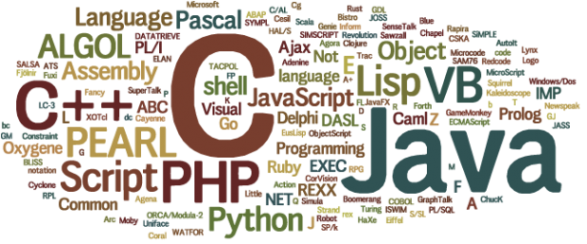
Programming Languages
http://www.tops-int.com/blog/which-programming-languages-are-used-for-web-desktop-and-mobile-apps/

Slide 13
Programming Languages
C/C++
Classic, performance, codebase, control
Objective C
Bit different style (message based), well-documented API for iOS, mainly COCOA/iOS
Java
Android is VM/JIT based, ~portability (API), well-known, extended, codebase
C#
VM based, ~Java evolution, MONO (Win, Android, iOS)
Swift
Apple new language, simplicity, performance, easy, LLVM-based compilers
HTML5/JS
Web technologies, extended, compatibility
Perl, Python, Ruby, D, GO (Google), Hack (facebook), …
More options, not so popular ?
Notes:
WinPhone -

Slide 14








3D APIs

Slide 15
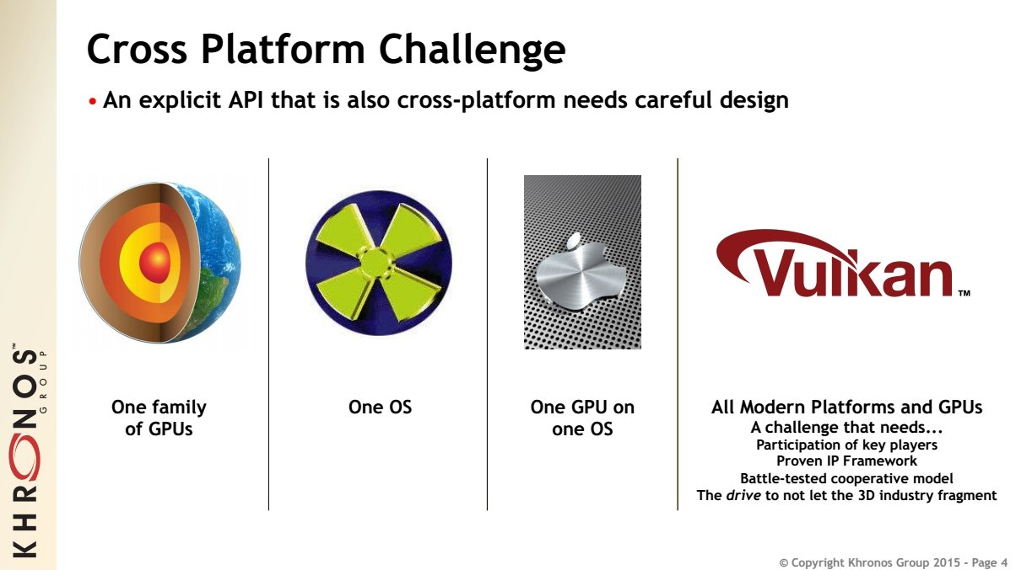
3D APIs
OpenGL Next
5.0
Mantle
Direct3D
Metal

Slide 16
3D APIs
Direct 3D
3D API from M$ for Win OS (XBOX)
ANGLE library provides GL support on top of D3D
Mantle
AMD 3D API with Low-level access → D3D12 | GL_NG
Metal
Apple 3D API with low-level access
OpenGL Desktop/ES/WebGL
GL for embedded systems, now in version 3.0
GLES3.1 ~ GL4.4 (GL_NG/Vulkan is coming…)

Slide 17
3D APIs
Direct 3D
Games on Windows (mostly) / XBOX
Define 3D functionality state-of-the-art
OpenGL typically following
3D graphic cards highly collaborative
Multithread programming
Proprietary – closed source – M$
Tested & stable – good support + tools
Metal
Apple 3D API with low-level access
Much in the way of Mantle?
buffer & image, command buffers, sync…
Lean & mean → simple + ~flexible
Win &
Game research
Mac/iOS future ?

Slide 18

3D APIs
Mantle
AMD effort – low level – direct access – 3D API
Direct control of memory (CPU/GPU) – multithreading done well
User-required synchronization
API calls per frame <3k → 100K
Resources: buffer & image ☺
Simplified driver → maintenance (vendors)
High level API/Framework/Engines will be developed ☺
Pipeline state
shaders + targets (depth/color…) + resources + geometry
Command queues + synchronization
Compute / Draw / DMA(mem. Copy)
Bindless – shaders can refer to state resources
OpenGL NEXT seems to move into ‘Mantle direction’
Direct 3D 12 already pursuing low-level access
Notes:
http://techreport.com/review/25683/delving-deeper-into-amd-mantle-api

Slide 19

3D APIs
OpenGL (Desktop/ES/WebGL)
Open / research / cross-platform
Lagging in front of D3D → Legacy support ☹
No more FIXED PIPELINE (1992)!! -- scientific visualization…
GLSL (2003)…GL 3.1(2009) → deprecation/no fixed pipeline
Compatibility profile → legacy again…(till GL 4)
Core profile
GLSL → shader required
VAO
group of VBO
we need a base VAO for using VBO!
Simplifying → VBO + GLSL only!

Slide 20
3D APIs
OpenGL ES 1.1
Fixed pipeline – no glBegin/End – no GL_POLYGON -- VBO
OpenGL ES 2 (OpenGL 1.5 + GLSL) ~ GL4.1
No fixed pipeline (shaders mandatory), ETC1 texture compress..
OpenGL ES 3 ~ GL4.3
Occlusion queries + geometry instancing
32bit integer/float in GLSL
Core 3D textures, depth textures, ETC2/EAC, many formats…
Uniform Buffer Objects (packed shader parameters)
OpenGL ES 3.2 ~ GL4.5
Compute shaders (atomics, load/store)
Separate shader objects (reuse)
Indirect draw (shader culling…)
NO geometry/tessellation

Slide 21
3D APIs
No glBegin/glEnd
GLSL is mandatory
OpenGL 4.5 ~ GLES 3.2
ES3.1 is subset of 4.4 → direct map!
ES2.0/ES3.0 mostly like 3.3/4.3
Removed 1D textures (2D with H=1)
Removed lots of texture formats (float coming in 3.0)
No GEOMETRY/TESSELLATION
Recall compressed texture formats (ETC2/EAC…)
GLSL for ES provides “precision” qualifier (lowp/medp/highp)
When possible → try to go with smallest subset (ES2/3/3.1)
ES3.1 is already quite complete ☺ -- should converge at some point!
OpenGL NEXT ? Probably not → Vulkan

Slide 22
3D APIs
GPGPU
OpenCL
On Android it is not much loved
Use GPU vendor SDK provided libs ☺
On iOS is only accepted for system apps
Use old-school GPGPU (fragment shader -> FrameBuffer)
RenderScript
Google solution for processing using GPU…
Too niche! ~ Android
Compute shaders
GLES 3.2!!! General solution!!
DirectCompute on D3D

Slide 23
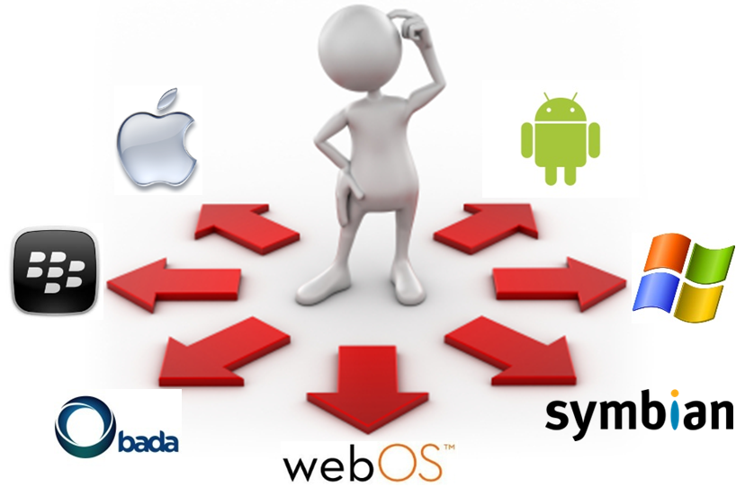
Cross-development
http://www.appian.com/blog/enterprise-mobility-2/are-mobile-platform-choices-limiting-enterprise-process-innovation

Slide 24
Cross-development
C++
QtCreator – Qt > 5.4 – free non-commercial / GPL
Marmalade – free license
Cocos-2dx -- free
C#
Xamarin – free basic license
Mono for Android, Monotouch for iOS
HTML5/JS
Appcelerator / Titanium – free dev. license
PhoneGap / Cordova ~ browser view ☺ -- free
COCOA/Objective-C
Marmalade – Juice -- free license
Ruby
RhoMobile -- free license

Slide 25
Cross-development
C++
QtCreator
Marmalade
Cocos-2dx
C#
Xamarin
Mono for Android, Monotouch for iOS
HTML5/JS
Appcelerator
PhoneGap / Cordova ~ browser view ☺
Intel XDK (on top of Cordova)
Titanium
COCOA/Objective-C
Marmalade – Juice
Ruby
Rho
Platform API access through framework
Many options – no size fits all
Notes:
Access mobile platform API through framework (monetization -> QtMonetisation)

Slide 26
Cross-development
C++ use case: QtCreator
Qt (~supports android, iOS, windows phone, linux, windows, mac)
Provides API abstraction for UI, in-app purchases, ~touch input
HOWTO (i.e. android):
Android SDK
Android NDK (native C++ support, toolchain, libraries, GL, CL…)
Point environment variables ANDROID_SDK, ANDROID_NDK to folders
Create new android project
Play!
Notes:
Go for Qt > 5.4 (touch events were tricky in previous versions)
Use QOpenGLWidget instead of QGLWidget
Enable touch events on each widget:
QWidget::setAttribute(Qt::WA_AcceptTouchEvents);

Slide 27
Mobile Graphics – Development
Conclusions
1) Native + platform UI …
C++ [any language] → LLVM compiler → target platform
Platform Framework front-end → 1 for each platform
Performance + flexibility
Call native code from platform code (JNI, Object C, …)
2) Native through framework …
Qt | Marmalade …
C++ code uses framework API
Framework API abstracts platform API [N platforms]
BUT less flexible integration ?
3) Go web → HTML5/JS …
Rewrite or Use Emscripten → JS code + WebGL
~Free portability (chrome / firefox / IE … ?)
BUT performance is 0.5X at most with asm.js

Slide 28

Questions and contacts

