Slide 1
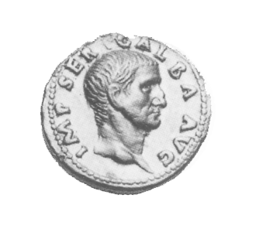
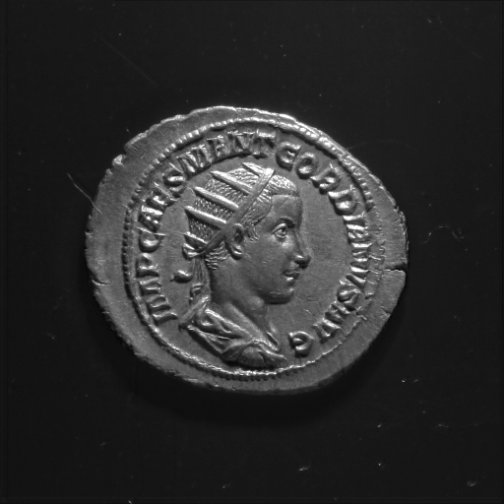

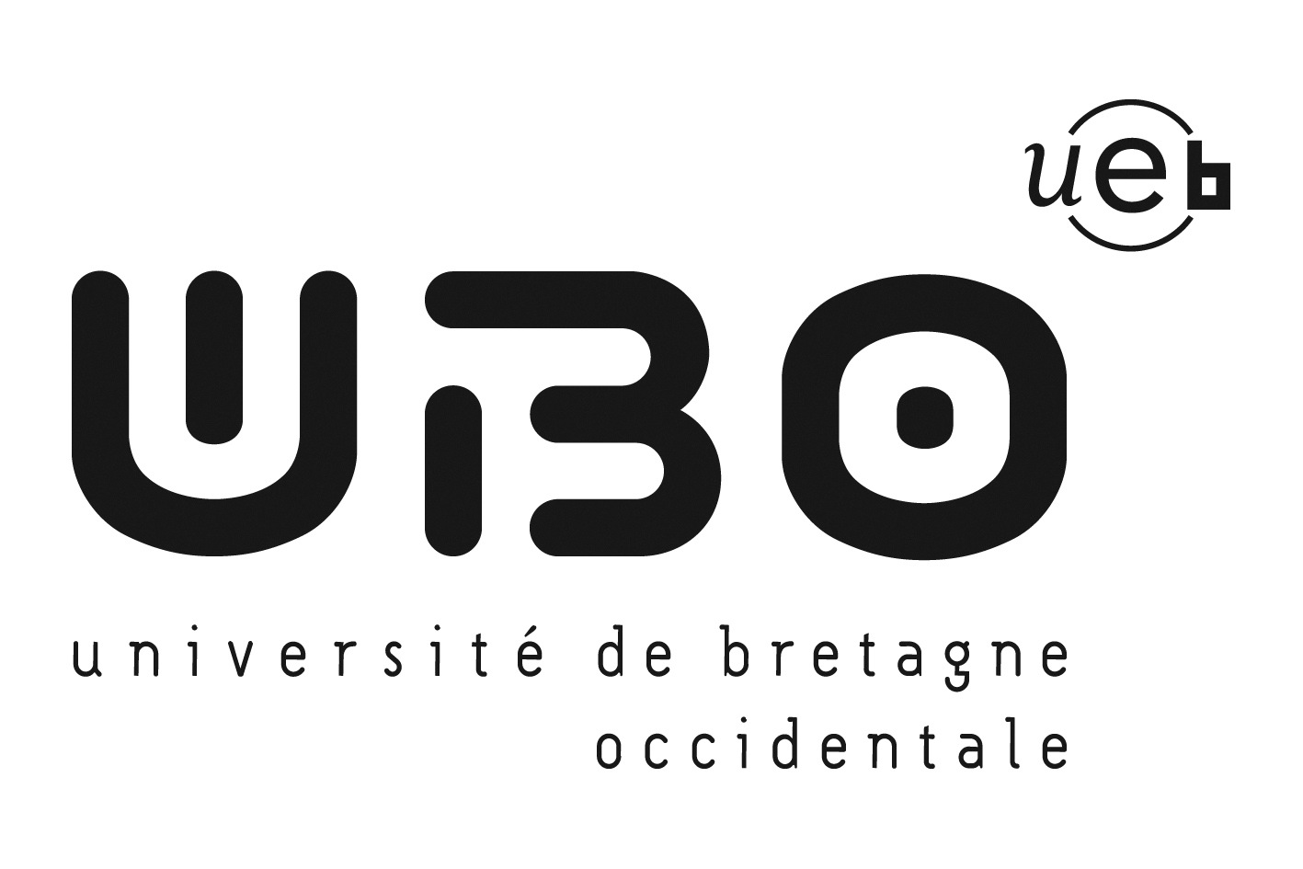
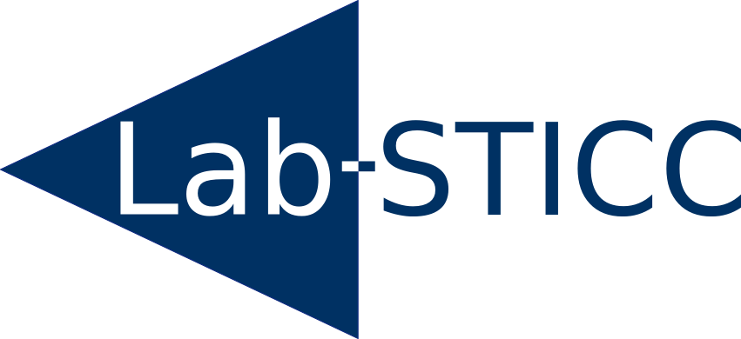

IBISA: Making Image-Based Identification of Ancient Coins Robust to Lighting Conditions
Sylvain Marchand
Lab-STICC - CNRS, University of Brest, France

