Slide 1
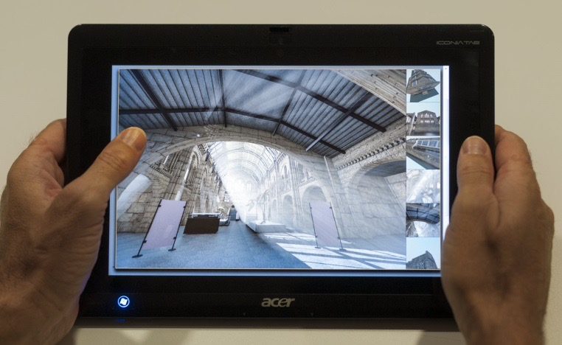
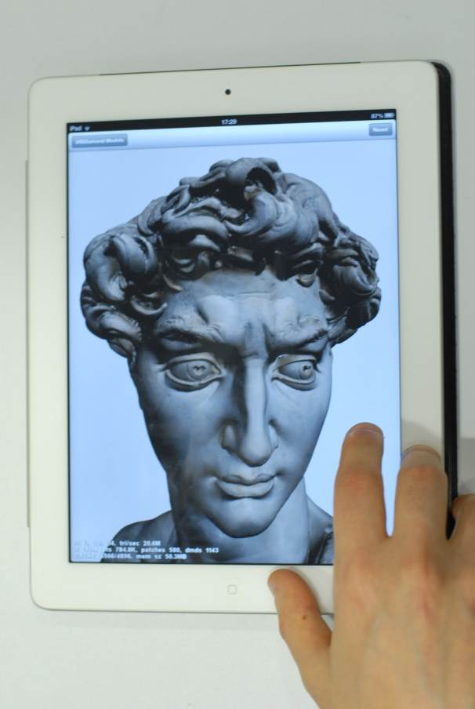
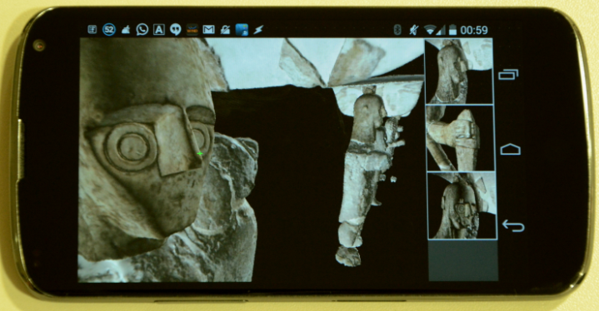
Mobile Graphics – EG 2017 Tutorial
Marco Agus
Enrico Gobbetti
Fabio Marton
Giovanni Pintore
Pere-Pau Vázquez
April 2017
(Tentative slides)

Slide 2
Outline
Part 1: Evolution of the mobile graphics world
Part 2: Graphics development for mobile systems
Part 3: Mobile graphics application trends
Part 4: Mobile metric capture and reconstruction
Part 5: Scalable mobile visualization

Slide 3
Part 1
Graphics development for mobile systems

Slide 4
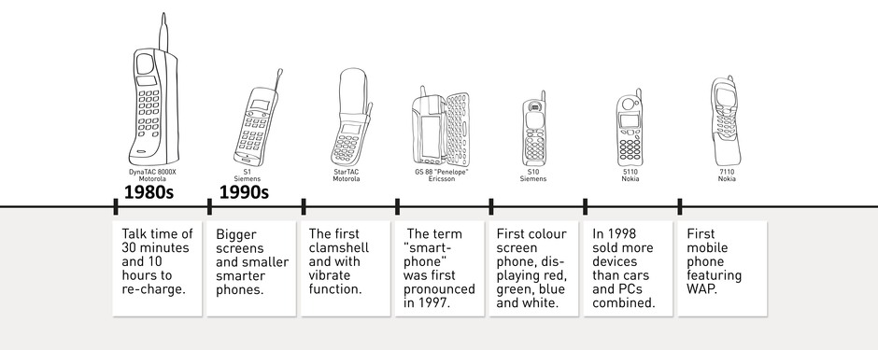
Mobile evolution (1/3)

Slide 5
Mobile evolution (1/3)
Color display

Slide 6
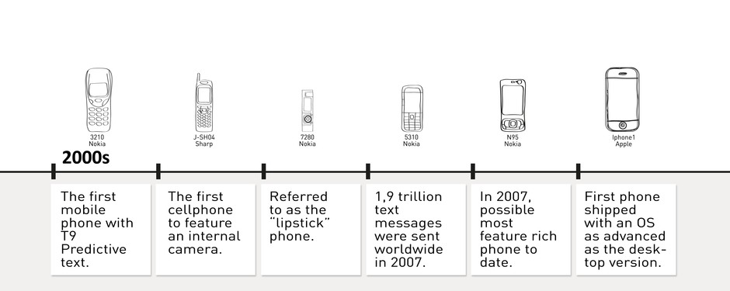
Mobile evolution (2/3)

Slide 7
Mobile evolution (2/3)
Smartphones, OS

Slide 8
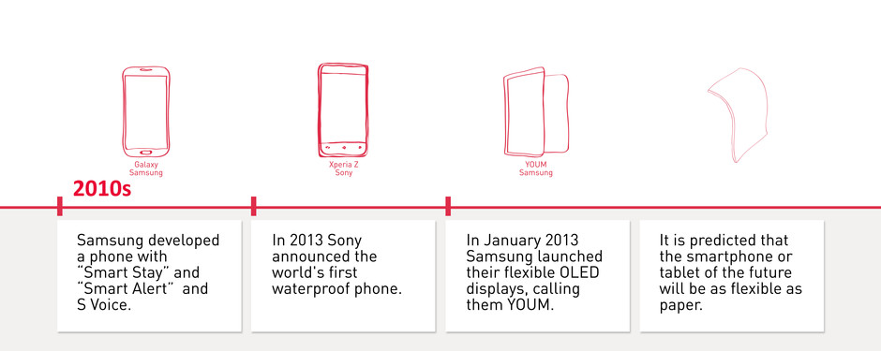
Mobile evolution (3/3)

Slide 9
Mobile evolution (3/3)
High resolution displays

Slide 10
Mobile evolution (3/3)
Similar evolution for PDAs, and tablets

Slide 11
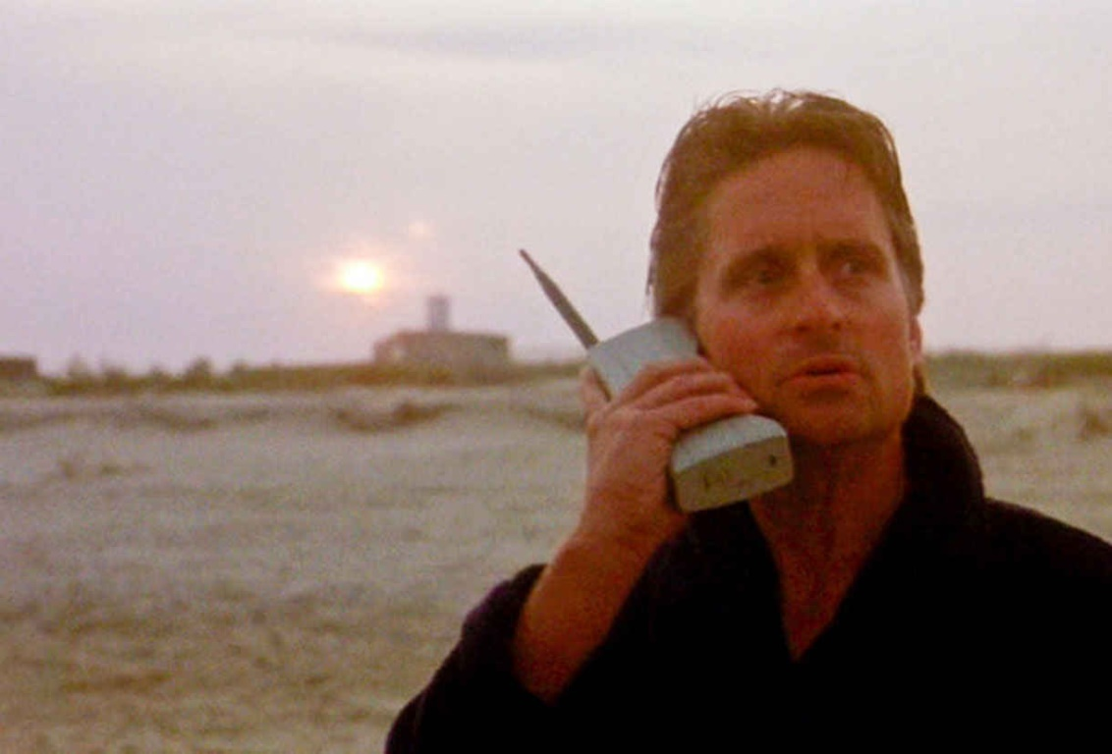
Mobile evolution…. in movies
Money never sleeps…..This is your wake-up call, pal…
GO TO WORK
Motorola DynaTac
  Nickname “brick phone”
  Weight: over 2 pounds
  Cost: thousands of dollars
  Battery life: around 35 minutes.
Wall Street, 1987
Michael Douglas in Gordon Gekko

Slide 12

Mobile evolution… in movies
Hello Neo…
Do you know who this is?
Nokia 8110
  Nickname “banana phone”
  145g, display monochrome, Smart SMS
  It costed 1000 eur
The Matrix, 1999
Laurence Fishburne in Morpheus

Slide 13
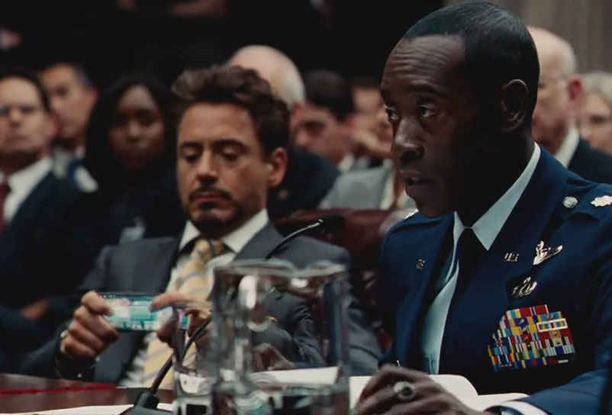
Mobile evolution

Slide 14

Mobile evolution

Slide 15

Mobile evolution

Slide 16

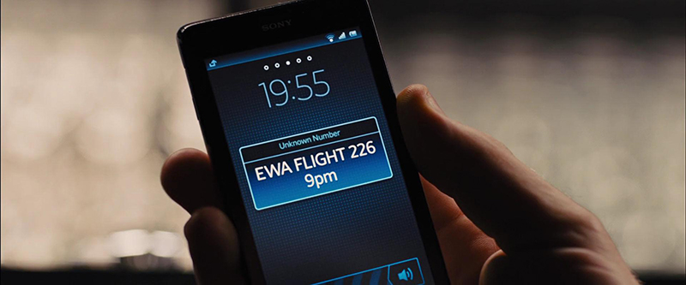
Mobile evolution… in movies
Sony Xperia T
  Smartphone Android
  Display 4.6” 1280x720
  It costed 600 eur
  13 Mpixel camera + position sensors
Skyfall, 2012
Daniel Craig in James Bond

Slide 17

Mobile evolution… in movies
Future devices?
  Transparent and foldable high resolution screens
  Gesture interfaces
  Wearable / integrated to body
Iron Man 3, 2013
Robert Downey Jr in Tony Stark

Slide 18


Mobile evolution

Slide 19
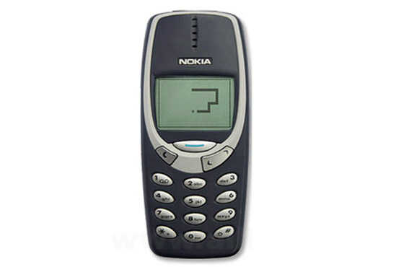

Mobile evolution... in games
Nokia Snakes
  From 1997 an estimated 350 Mdevices, making it one of the most widely distributed games ever created.
  Installed on Nokia devices until 2007

Slide 20


Mobile evolution… in games
Angry Birds (Rovio)
  first released for Apple's iOS in December 2009
  2 billion downloads across all platforms
  widespread diffusion end popolarity
  Adventure parks (Finland and Malaysia)

Slide 21
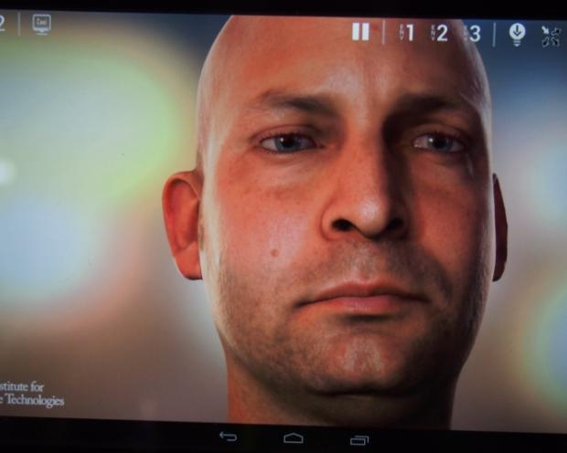

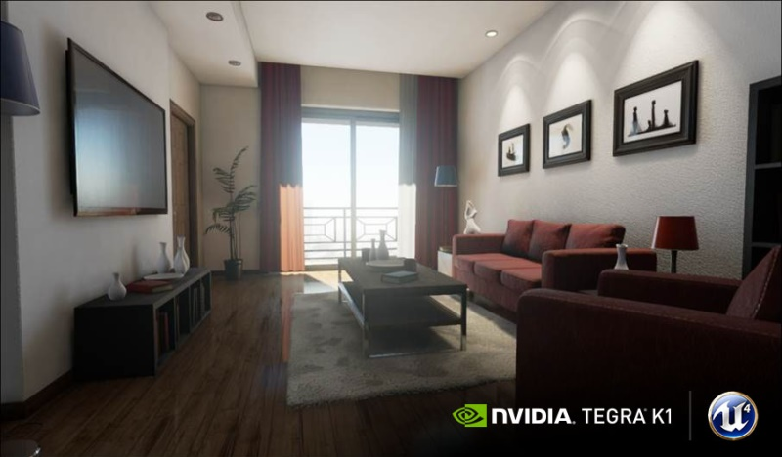
Mobile evolution… in games
Unreal Engine (GDC & Google I/O 2014)
  running on an Nvidia Tegra K1 processor
  will support Google Tango and Samsung Gear VR
  easy porting of games
  sophisticated 3d effects

Slide 22
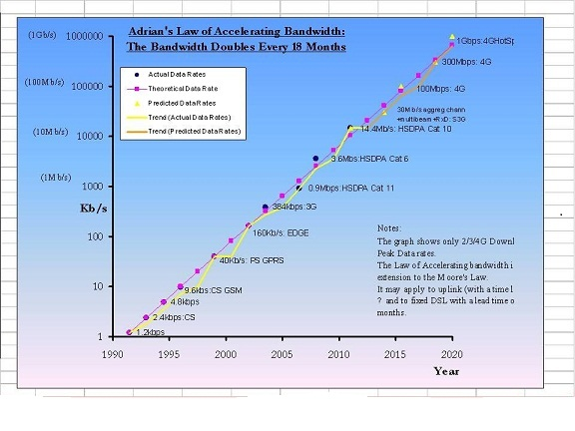
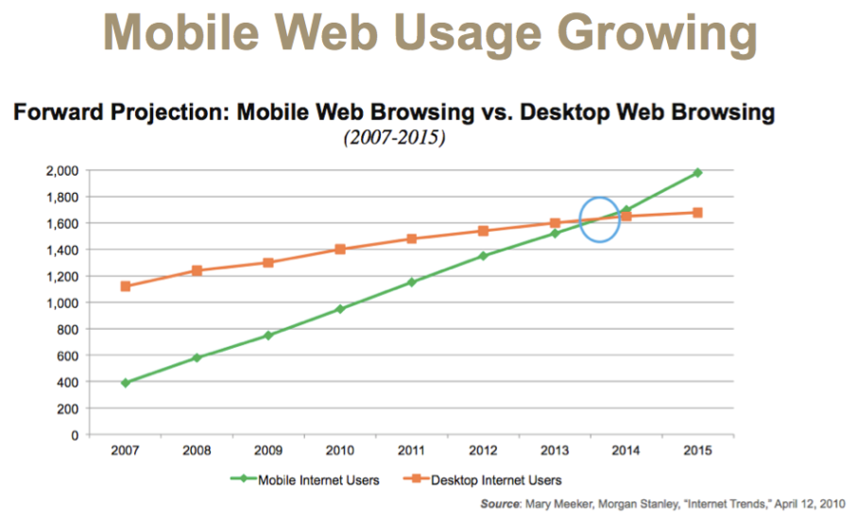
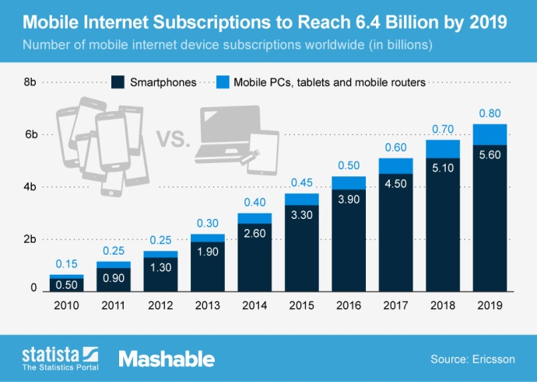
Mobile connectivity evolution
Bandwidth is doubling every 18 months
Mobile internet users overcame desktop internet users
2017 smartphone traffic expected at 2.7 GB per person per month

Slide 23
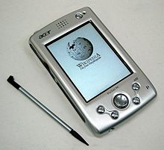
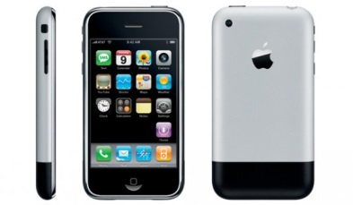
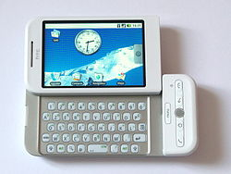
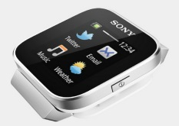
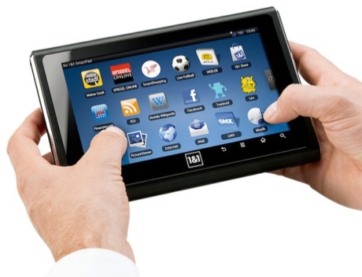
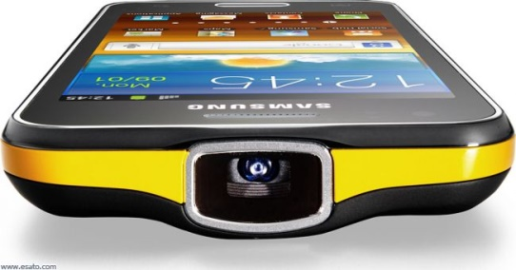
Displays and User Interface
Before 2007 – old days
  PDA → Palm OS/ Windows Pocket / Windows CE
  Stylus interaction (touch screens at early stages)
Touch era
  2007 – iOS /iPhone
  2008 – Android / HTC Dream or G1
  Touch-enabled devices (no stylus required)
Nowadays
  Wearables → <2”
  Smartphones → 3-6”
  Tablets → >7-10”
  DLP projectors integrated

Slide 24
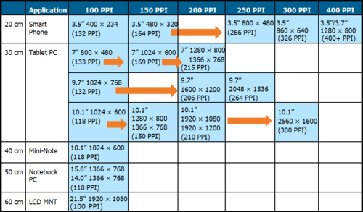
Display characteristics
500 ppi
5.1”/5.5” 2560x1440 (>500 PPI)
10.1”
3840x2160
(438 PPI)

Slide 25
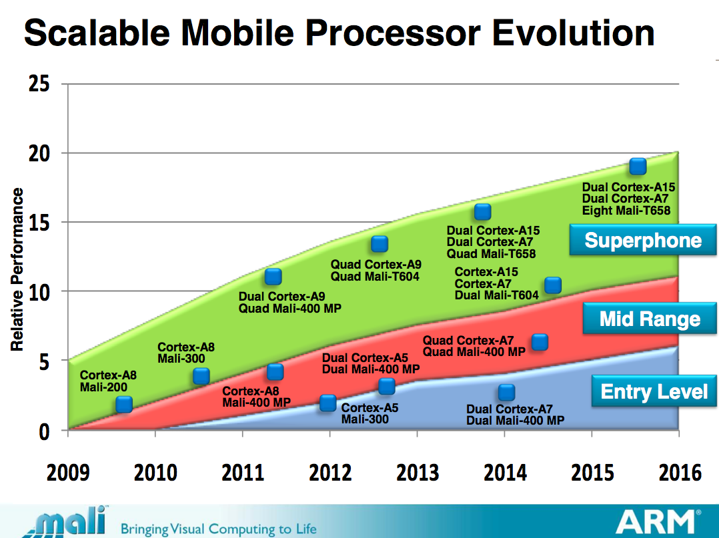
Chip evolution (1/2)

Slide 26
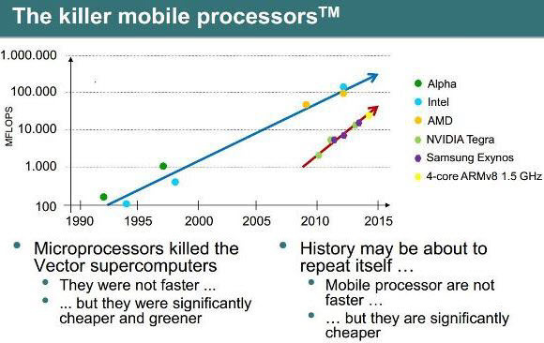
Chip evolution (2/2)

Slide 27
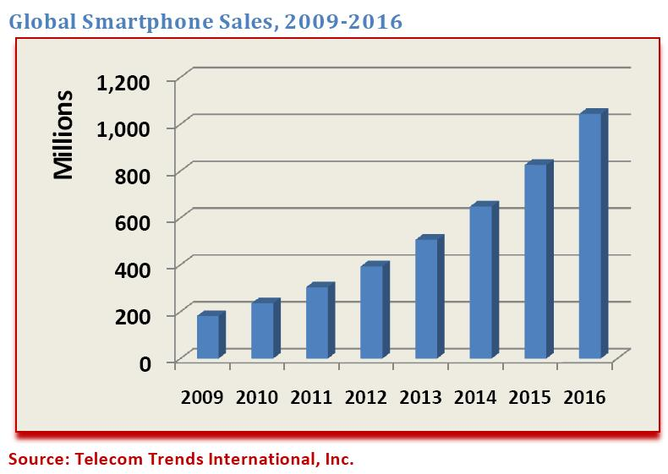
Scenario
Modern smartphones (tablets) are compact visual computing powerhouses
DIFFUSION: more than 4.6 billion mobile phone subscriptions
  [Ellison 2010]
NETWORKING: High speed internet connection (typical 1GB/month plan)
  3G - < 0.6-3Mbps ~ 100KB/s - 400KB/s (latency ~ 100-125ms)
  4G – < 3-10Mbps ~ 400KB/s - 1MB/s (latency ~ 60-70ms)
  5G - 1Gbps (from 2016?)
MEMORY: Increasing RAM and storage space
  RAM 1-3GB
  Storage 8-64GB
COMPUTING: Increasing processing power
  CPU 4-8 core @ 2.5Ghz
  GPU 72-192 cores (~ALUs)

Slide 28
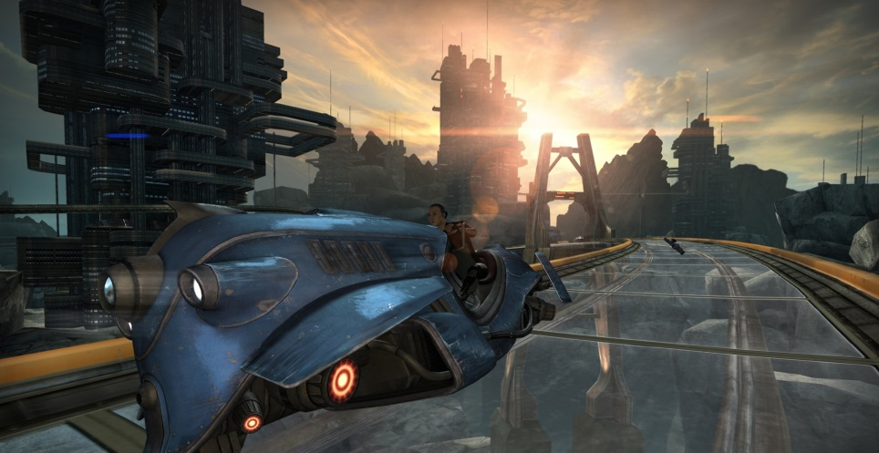
Scenario
More than 4.6 billion mobile phone subscriptions
  [Ellison 2010]
High speed internet connection (typical 1GB/month plan)
  3G - < 0.6-3Mbps ~ 100KB/s - 400KB/s
  4G – < 3-10Mbps ~ 400KB/s - 1MB/s
Increasing RAM and storage space
  RAM 1-3GB
  Storage 8-64GB
Increasing processing power
  CPU 4-8 core @ 2.5Ghz
  GPU 72-192 cores (~ALUs)
http://unity3d.com/es/unity/multiplatform/mobile

Slide 29
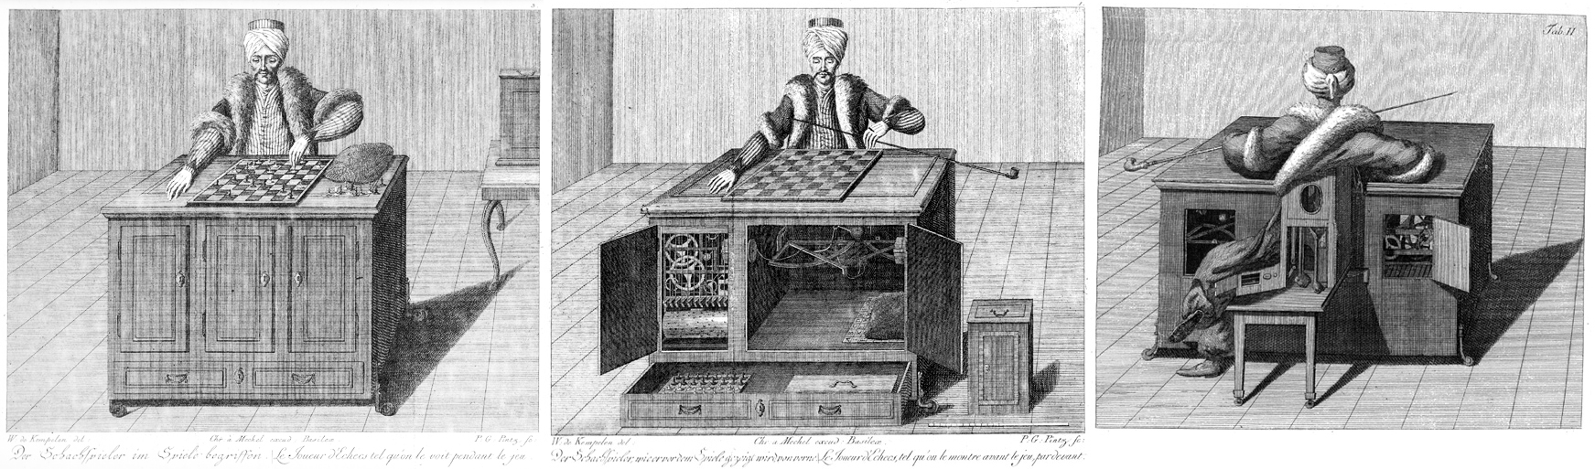
Where are we going?
Powerful devices for acquiring, processing and visualizing information
Accessibility of information (anybody, any time, anywhere)
Immense potential (integration of acquisition, processing, visualization, cloud computing, and collaborative tasks)

Slide 30

Questions and contacts

