Slide 1
Part 4
Mobile metric capture and reconstruction

Slide 2
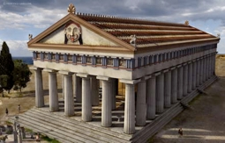
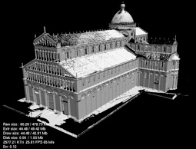
Acquisition vs Modeling
Modeling Subjective Reality
Acquisition Objective reality

Slide 3
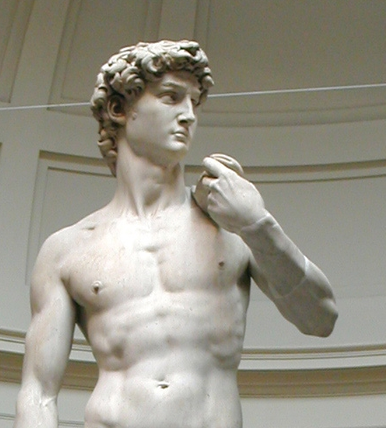
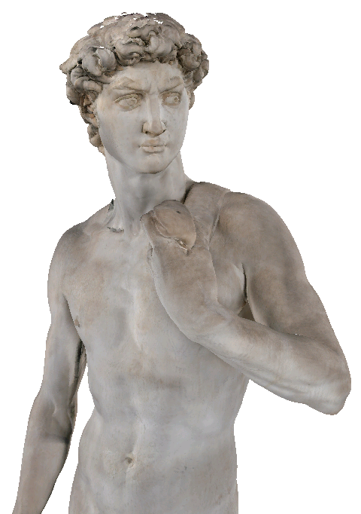
Acquisition – Measurable models

Slide 4
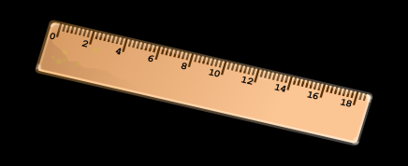
Acquisition – Measurable models
75.3cm
75.3cm

Slide 5
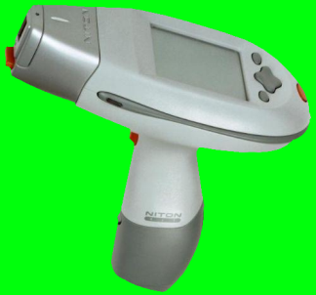
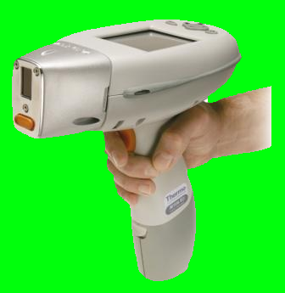
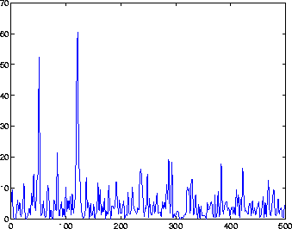
Acquisition – Measurable models
75.3cm
75.3cm

Slide 6
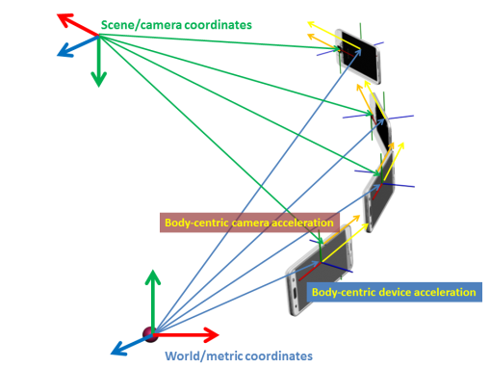
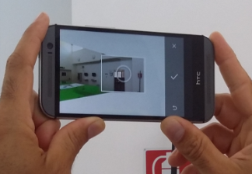
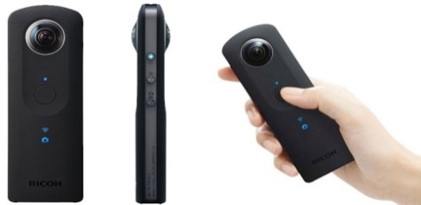
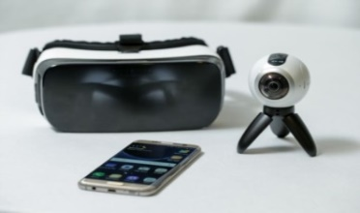
Mobile metric acquisition
Commodity on-board instruments
Camera
Images
Video
Sensors
Accelerometer
Magnetometer
Gyroscope
New generation devices
i.e. SPC spherical panoramic camera
One shot full-view panoramic images
360 videos
Integrated IMU
Network

Slide 7
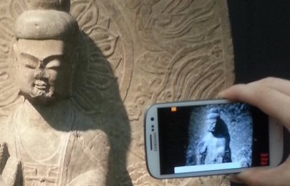
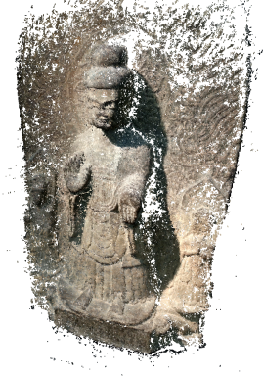
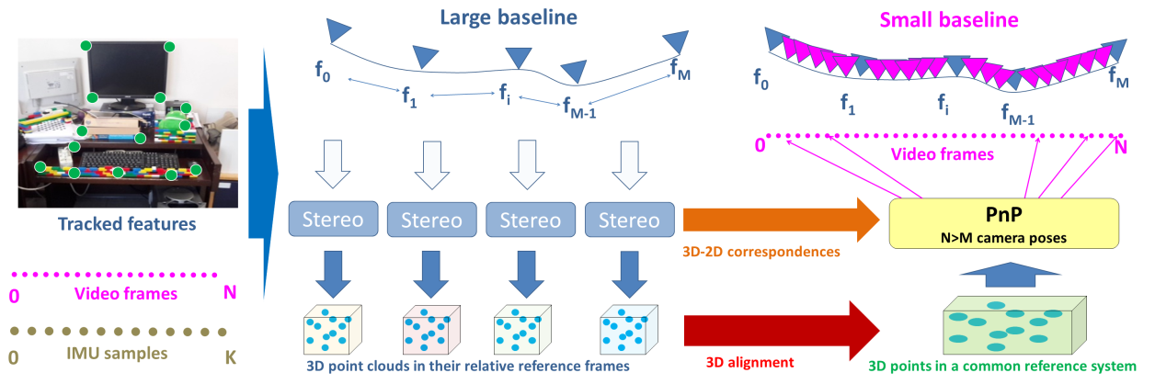
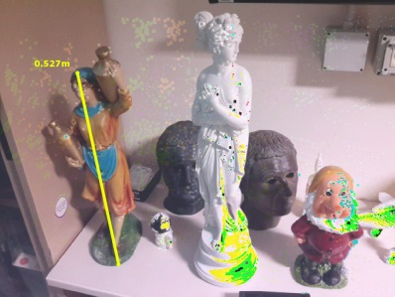
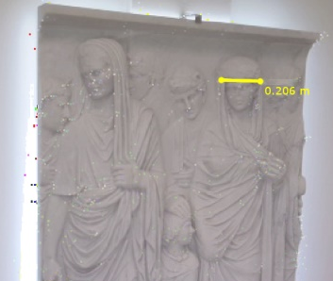
Mobile metric reconstruction
Image-based
Single image
Vanishing points prior
Geometric context prior
Unified omnidirectional camera model
Multi-view
SfM pipelines
Mobile metric SfM pipeline
Tanskanen et al. ICCV2013
Garro et al. VMV2016

Slide 8
Real-world applications: reconstruction of indoor scenes
Context
Manual modeling
Contractors create a floor plan respecting point-to-point laser measures
High performance methods
3D laser scanning/unstructured point clouds sources
i.e. Mura et al.: Automatic room detection and reconstruction in cluttered indoor environments with complex room layouts. Computers & Graphics, 2014
Computer vision/cost effective methods
Interactive
i.e. Kim et al.: Interactive acquisition of residential floor plans. In:Proc. IEEE ICRA, pp. 3055-3062 (2012)
Semi-automatic: Images/SfM
i.e. Furukawa et al.: Reconstructing building interiors from images. In: Proc. ICCV (2009)

Slide 9
Reconstruction of indoor scenes
Manual modeling
Contractors create a floor plan respecting point-to-point laser measures
High performance methods
3D laser scanning/unstructured point clouds sources
i.e. Mura et al.: Automatic room detection and reconstruction in cluttered indoor environments with complex room layouts. Computers & Graphics, 2014
Computer vision/cost effective methods
Interactive
i.e. Kim et al.: Interactive acquisition of residential floor plans. In:Proc. IEEE ICRA, pp. 3055-3062 (2012)
Semi-automatic: Images/SfM
i.e. Furukawa et al.: Reconstructing building interiors from images. In: Proc. ICCV (2009)
Require high-level skills
(computer experts, 3D modelers, or CAD operators)
Less performance
but less skills required

Slide 10
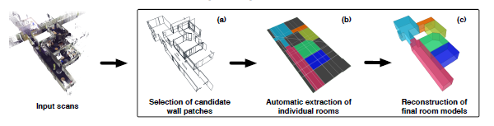
Context: high performance methods
"Magic always comes with a price, Deary“ Rumplestiltskin
Once Upon a Time, ABC TV series
Limitation: lack in structure
Details vs structure
Need for complementary semi-automatic methods
Semi-automatic methods
These usually have the goal of identifying walls, ceilings, and floors
3D laser scanning/unstructured point clouds sources
Mura et al.: Automatic room detection and reconstruction in cluttered indoor environments with complex room layouts. Computers & Graphics, 2014

Slide 11
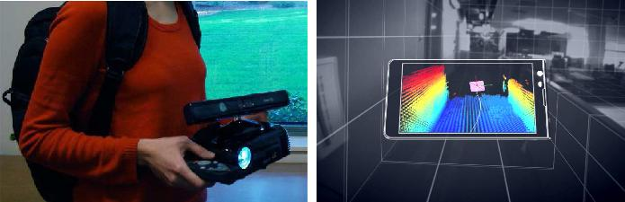
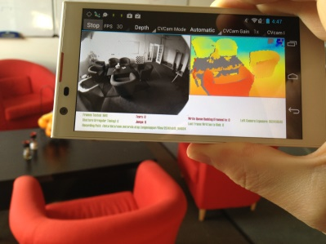
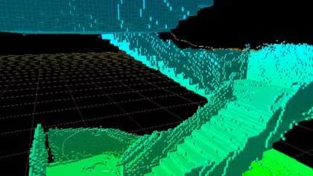
Context: interactive methods
New generation: Google Project TANGO
Integrated depth sensor
Mobile IMU (inertial measurement unit)
Background: depth sensors
Es. Kinect based
Kim et al.: Interactive acquisition of residential floor plans. In:Proc. IEEE ICRA, pp. 3055-3062 (2012)
Localization problems
Short range
Limited bounding volume
Track ambiguities (pose registration)
Map ambiguities (localization)

Slide 12
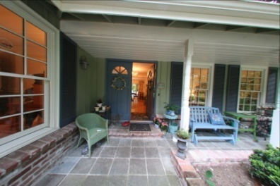
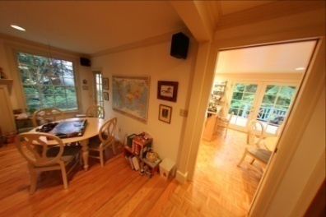
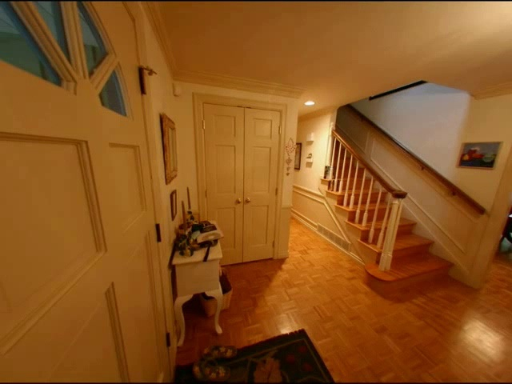
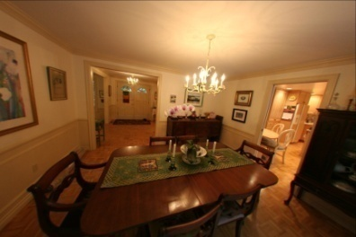
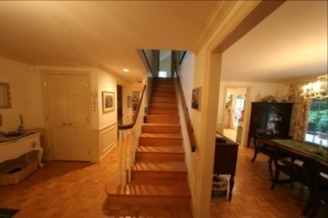
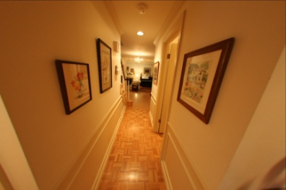
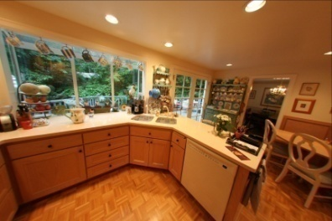
Context: image-based methods
Automatic system for indoors/outdoors
Goal: to reconstruct a simple 3D indoor model from multiple images
Cost effective

Slide 13
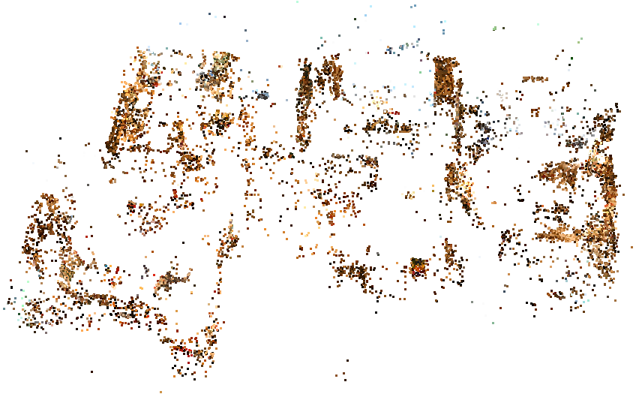
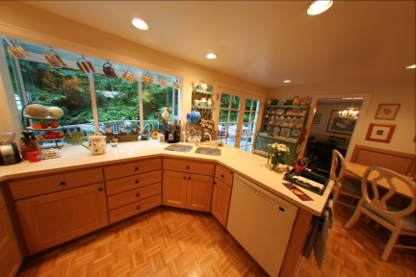

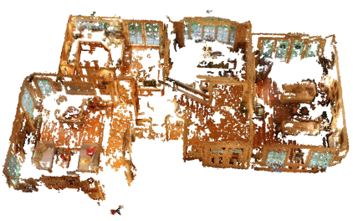
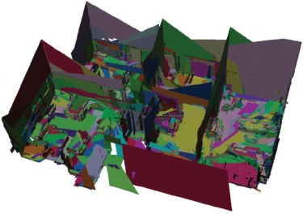
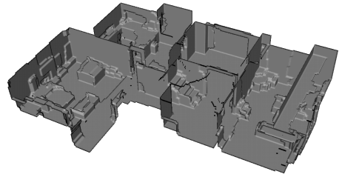
Multiview pipeline example
Structure-from-Motion
Bundler by Noah Snavely
Structure from Motion for unordered image collections
http://phototour.cs.washington.edu/bundler/
Images
SFM
MVS
MWS
Merging

Slide 14
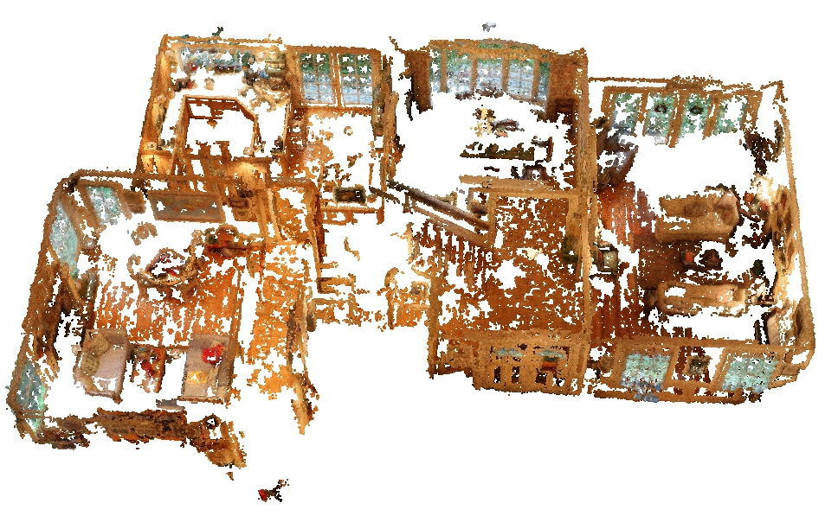
Multiview pipeline example
Multi-view Stereo
PMVS by Yasutaka Furukawa and Jean Ponce
Patch-based Multi-View Stereo Software
http://grail.cs.washington.edu/software/pmvs/
Images
SFM
MVS
MWS
Merging

Slide 15
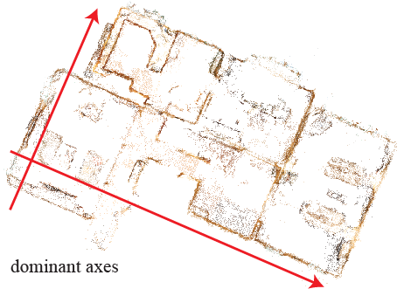
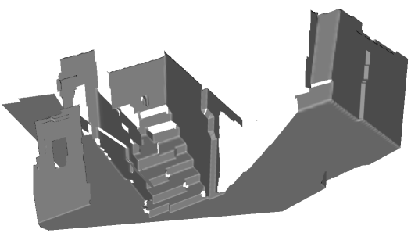
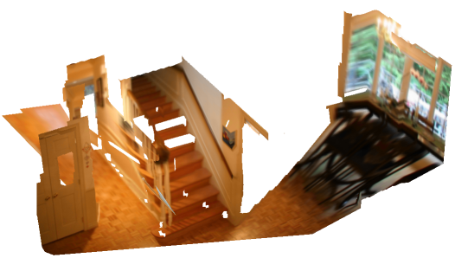
Multiview pipeline example
Manhattan-World Stereo
[Furukawa et al., CVPR 2009]
Per-view depth maps using Markov random fields
Images
SFM
MVS
MWS
Merging

Slide 16
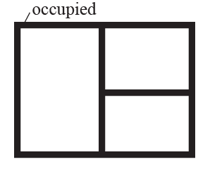
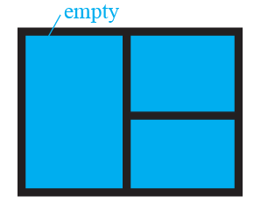

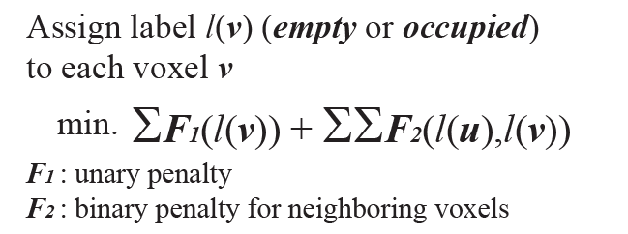
Multiview pipeline example
Axis-aligned depth map merging
Volumetric MRF [Vogiatzis 2005, Sinha 2007, Zach 2007, Hernández 2007]
Images
SFM
MVS
MWS
Merging

Slide 17
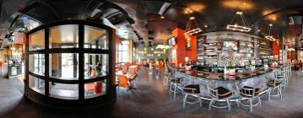
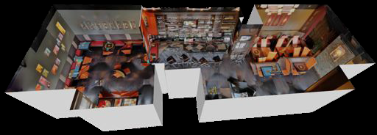
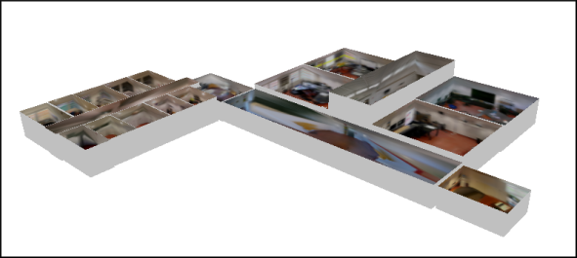
Image-based methods: limitations
These methods produce high resolution 3D models and related aligned images but
Lack of information about structure, real depth and scale
Do not manage curved walls, sloped ceiling, etc.
Do not return measurable models
Heavy use of Manhattan World assumptions
MVS methods require textured surfaces, work poorly for many architectural scenes
MW: scene structure is piecewise-axis-aligned-planar (i.e. corners must form right angles)
Next step
Cabral R., Furukawa Y.: Piecewise planar and compact floor plan reconstruction from images. The IEEE Conference on Computer Vision and Pattern Recognition (2014)
G. Pintore et al. Omnidirectional image capture on mobile devices for fast automatic generation of 2.5D indoor maps. In Proc. IEEE WACV2016
Notes:
Examples of approaches are…

Slide 18
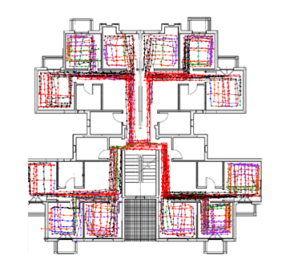
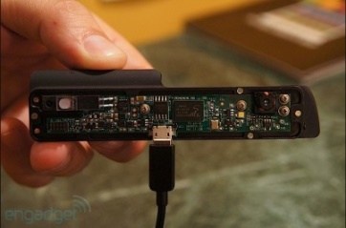
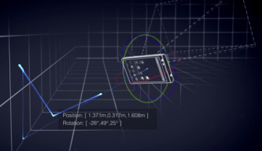

Mobile devices to create floor plans
Many real-world applications focused on the structure of a building rather than the details of the model
Definition of thermal zones
Estimation for circulation of people in commercial/public/office buildings
Support for evacuation simulation
…
Growing interest
Goal: Allow any user to reconstruct building interiors without the assistance of computer experts, 3D modelers, or CAD operators
Next generation: Google Project Tango, PrimeSense Capri (Apple)
SLAM-based methods [i.e. Shin et al.: Unsupervised construction of an indoor floor plan using a smartphone. IEEE Trans. Systems, Man, and Cybernetics (2012)]
Notes:
Such kind of multi-room mapping are useful in many real-world applications

Slide 19
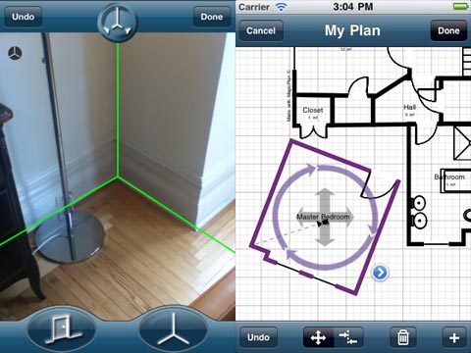
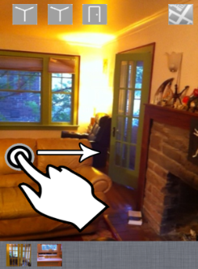
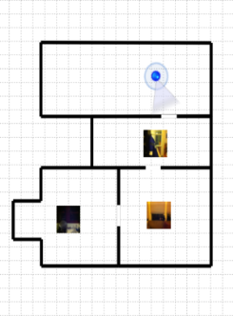
Mobile devices for multi-room mapping
MagicPlan - http://www.sensopia.com
Floor corners marked via an augmented reality interface
Manual editing of the room
Floor plan merged manually
Limits:
Considerable errors: user must guess corner positions if occluded
Time consuming (editing time)
Sankar and Seitz: Capturing indoor scenes with smartphones (UIST2012)
Rooms geometrically calculated from the horizontal heading of the observer
Corners marked during video playback
Limits:
Works only with Manhattan World scenes
Rooms have arbitrary dimensions: need for manual scaling
Manual identification of matching doors
Notes:
In this context there is a growing interest in using mobile devices to create floor plans
Several works are already available:
MagicPlan reconstructs floor plans by marking floor corners visible from the room's center via an augmented reality interface. This approach manages also \emph{non-Manhattan world} scenes,
but requires manual editing for room assembly and is susceptible to error when floor corners are occluded by furniture, requiring
the user to guess their positions.

Slide 20
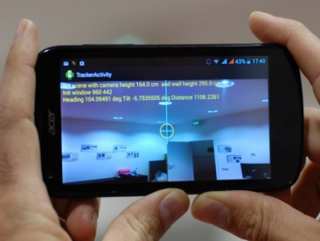

Mobile devices for multi-room mapping
Sensors fusion approach
Pintore et al.Interactive mapping of indoor building structures through mobile devices. In Proc. 3DV Workshop on 3D Computer Vision in the Built Environment, December Tokyo, 2014
Pintore et al. Effective Mobile Mapping of Multi-room Indoor Structures. The Visual Computer, 30(6--8): 707-716, 2014
Compared to previous work
Able to manage scenes not necessary limited to the Manhattan World assumption
Produce 2D floor plans
Automatically scaled to their metric dimensions
Accurate enough to be used for simulations and interactive applications
20
Notes:
We present a system to easily capture building interiors and automatically generate floor plans scaled to their metric dimensions. The proposed approach is able to manage scenes not necessarily limited to the \emph{Manhattan World} assumption, exploiting the redundancy of the instruments commonly available on commodity smartphones, such as accelerometer, magnetometer and camera. Without specialized training or equipment, our system can produce a 2D floor plan and a representative 3D model of the scene accurate enough to be used for simulations and interactive applications.

Slide 21







Mobile devices for multi-room mapping
Scene capture
Video of the room
Ideal trajectory targeting the boundaries of the walls
Every sample contains:
3 angles θ, γ, ρ individuating boundary point at the current instant
A time index t identifying the corresponding video frame
Tracking of the passage to next room
Matching doors/ graph update
Scene processing
Combination of measures and images: room scaled to metric units
Rooms placement step exploiting the scene graph information
Notes:
Starting approximately from the center of the room, the user acquires a 360 degrees video of the environment, targeting with the phone camera the upper or lower boundaries of the walls, with a movement which traces an ideal trajectory along the intersection of the wall with the floor or with the ceiling.
When a room acquisition is completed the user moves to the next one aiming the phone camera to the exit door, whereas the application tracks his direction and updates a graph with the interconnections between the rooms.

Slide 22




Mobile devices for multi-room mapping
Samples acquired imposing a linear trajectory
Segment l_{i} (a,b): 2D line fitting the samples between θ_{i-1} and θ_{ι}
But…
Fitting directly the samples results in an inaccurate reconstruction
Model approximation
Instruments/human errors
Occurrence of b in the den.: slope ∂χ² / ∂b = 0 non linear
Weights w_{m} calculated from the m video frames lying in the interval
S_{d}
θ_{d}

Slide 23



Mobile devices for multi-room mapping
Simplified equation
Can be minimized to determine a and b
For each line
Fitting values: σ²_{a},σ²_{b},Q
Scale and direction error
Q depends from specific method
Placement of the rooms
R₀ best fitting values room
M_{i,i+1} 2D transform from the matching door extremities
Path to each room from the graph
Absolute room positions
M_{R3} = M_{2,3} * M_{1,2} * M_{0,1}
M_{R4} = M_{1,4} * M_{0,1}
…
R₀
Origin
M_{0,1}
R₁
M_{1,2}
M_{1,4}
R₂
R₄
M_{2,3}
R₃

Slide 24







Mobile devices for multi-room mapping
Enhancement
Pintore et al.Interactive mapping of indoor building structures through mobile devices. In Proc. 3DV Workshop on 3D Computer Vision in the Built Environment, December Tokyo, 2014
For each wall: coefficient of determination
Weighted sum of residuals
Weighted variance
Each wall is marked as reliable or unreliable
If the wall is unreliable we perform a further measurement step

Slide 25

Mobile devices for multi-room mapping
For each room
Set of corners: {c₀…c_{n}}
{φ_{0…}φ_{n}} constant corner angles (calculated from walls orientation)
All possible closed polygons P(δ, c_{i})
for:
δ varying between 0…360 degrees
C_{i} possible starting point between {c₀…c_{n}}
intersections {p₀…p_{n}} with the rays ray(origin, θ_{i} )
Minimization of: d(d_{c}, φ_{c}) = (1-λ) d_{c} + λ φ_{c}
d(d_{c}, φ_{c}) includes:
Angular error (absolute orientation, i.e. magnetometer)
Distance error (manly user’s handle of device)
Ideal case: p₅ coinciding with c₅

Slide 26






Mobile devices for multi-room mapping
Discussion
Errors (10cm to 40 cm)
Device sensors
User handle
The approximate structure can be exploited to bootstrap other methods (i.e. from unstructured point clouds sources, images, etc.)
Future trend: integration of even more instruments on mobile devices (i.e. depth sensors)
Full mobile pipeline to real-time capture, render and elaborate a 3D indoor environment

Slide 27

Image-based A&R methods
Many advantages (see previous talks)
Standard/perspective images
Cost effective
Implicit alignment between geometry and images
…
Limitations
Single-view: standard/perspective images lack information about the real depth
Multi-view: require textured surfaces, and therefore work poorly for many architectural scenes
Both approaches try to infer 3D clue imposing heavy constraints
i.e. Manhattan World

Slide 28


Image-based A&R methods
Single-view example
A. Flint, C. Mei, D. Murray, and I. Reid. A dynamic programming approach to reconstructing building Interiors. In Proc. ECCV, pages 394–407. Springer, 2010
A. Flint, D. Murray, and I. Reid. Manhattan scene understanding using monocular, stereo, and 3d features. In Proc. ICCV, pages 2228–2235, Nov 2011
D. C. Lee, M. Hebert, and T. Kanade. Geometric reasoning for single image structure recovery. In Proc. CVPR, pages 2136–2143, 2009

Slide 29


New approaches: omnidirectional images
Sources
Specific sensors (fisheye camera, etc.)
Images stitching (Microsoft ICE, Google PhotoSphere, etc.)
Increasing diffusion
Advantages
Wide field of view
Minimize the possibility of fatal occlusions
Help the tracking of features
Contain more information than images from conventional cameras
Potentially require less computation

Slide 30





New approach: omnidirectional images
Common projections
Fisheye
Cylindrical
...
Equirectangular
Constraints
All the corners must be visible
Good stitching
Vertical lines aligned with the gravity vector
180 degrees
360 degrees
Fisheye
Cylindrical
Equirectangular

Slide 31

Reconstruction from equirectangular images
Planar and compact floorplan reconstruction from images
R. Cabral and Y. Furukawa. Piecewise planar and compact floorplan reconstruction from images. In Proc. CVPR, June 2014.
H. Yang and H. Zhang. Modeling room structure from indoor panorama. In Proc. VRCAI, 2014
Exploit previous work on perspective images
Original unstitched images needed
Virtual projections to recover views

Slide 32



Reconstruction from equirectangular images
Planar and compact floorplan reconstruction from images

Slide 33
Reconstruction from equirectangular images
Planar and compact floorplan reconstruction from images
Limitations
3D data from MVS needed: original unstitched images required, inherits MVS problems (b and c)
Geometry reasoning basically based on heavy piecewise planarity assumptions (d)
Prior model needed

Slide 34

Reconstruction from equirectangular images
Possible solutions
Palazzo Sanjust - De Candia, V. Canelles, Cagliari
Chateau de Sermaise, France
Ambiguity in vanishing points detection
What kind of model i need?
How many corners?
Unknown angles

Slide 35




Reconstruction from equirectangular images
Projection in central catadioptric systems
Bermudez-Cameo et al.: Hypercatadioptric line images for 3d orientation and image rectification. Robotics and Autonomous Systems, 2012

Slide 36




Reconstruction from equirectangular images
Different view, different domain: G_{h} transform
Geometric reasoning based on Pintore and E. Gobbetti. Effective mobile mapping of multi-room indoor structures. The Visual Computer, 30,2014. Proc. CGI 2014
G_{h} maps all the points of the image in 3D space as if their height was h
γ
0
θ
360

Slide 37



Reconstruction from equirectangular images
Model recovery
γ
Gradient map
0
360
θ
Transform
Accumulation points

Slide 38



Reconstruction from equirectangular images
Shape and measures estimation
Input: height of the point of view h_{e} (easy to estimate with a mobile device)
Input: mobile image stitching (popular, i.e. Google PhotoSphere,etc.)
Output: height of the walls h_{w}
Output: strong couples (M-samples)

Slide 39

Reconstruction from equirectangular images
Shape and measures estimation
Input: height of the point of view h_{e}
Output: height of the walls h_{w}

Slide 40


Reconstruction from equirectangular images
Multi-room structure
Minimal mobile tracking
Doors matching
Room shape
Global optimization
2N parameters
M-samples

Slide 41


Examples

Slide 42



Conclusions
New methods to automatically recover the shape of an indoor environment
Not restricted to the Manhattan World assumption
No need for externally calculated 3D data
Designed to exploit the features of modern mobile devices
Sensors fusion
Capability to generate high-quality panorama images
Can be easily extended to sloped ceiling
Future trend
Hane et al. Real-time direct dense matching on fisheye images using plane-sweeping stereo. In Proc. 3DV, volume 1, pages 57–64, Dec 2014

