Slide 1
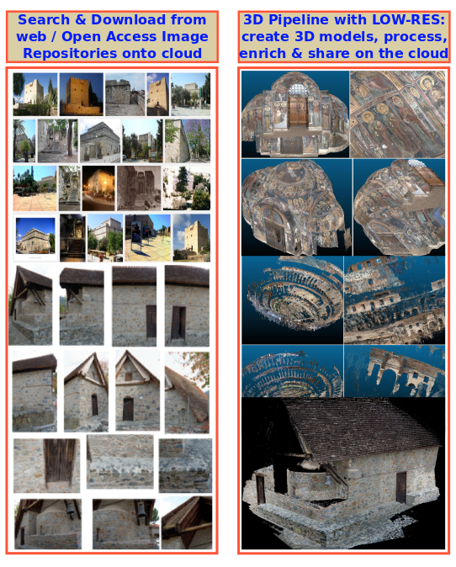

Cloud-based 3D Reconstruction of Cultural Heritage
Monuments using Open Access Image Repositories
Andreas Hadjiprocopis, Konrad Wenzel, Marinos Ioannides, Dieter Fritsch, Michael Klein, Paul S.Johnsons et al.
Cyprus University of Technology; University of Stuttgart ,Germany; 7Reasons Gmbh
A large number of photographs of cultural heritage items and monuments is publicly available in various Open Access Image Repositories (OAIR) and social media sites. Developments in Photogrammetry such as Structure from Motion (SfM), provide a simple and cost-effective method of generating relatively accurate camera orientations and sparse and dense 3D point clouds from 2D images. Our main goal is to provide a software tool able to run on desktop or cluster computers or as a back end of a cloud-based service, enabling historians, architects, archaeologists and the general public to search, download and reconstruct 3D point clouds of historical monuments from images from the web in a cost-effective manner. The end products can be further enriched with metadata and published. We implemented a workflow for searching and retrieving photographs of historical monuments from OAIR, such as Flickr and Picasa, and using them to build dense point clouds using SfM and dense image matching techniques. Computational efficiency is improved by a technique which reduces image matching time by using an image connectivity prior derived from low-resolution versions of the original images. Benchmarks for two large datasets showing the respective efficiency gains are presented.

