Slide 1


Presenting female rulers of Medieval Balkans countries using VR and AR technologies
Professor Selma Rizvić, PhD
Faculty of Electrical Engineering Sarajevo, University of Sarajevo,
Bosnia and Herzegovina

Slide 2


SHELeadersVR project
EACEA Creative Europe grant, 2022-2025
Digital presentation of female rulers from Bosnia and Herzegovina, Serbia, Montenegro, Albania and North Macedonia using VR and AR technologies
VR application – museums
AR application – archaeological locations
Selected queens:
Jelena Gruba, BH
Milica Hrebeljanovic, Serbia
Vojsava Tribalda, Albania
Izabeta Crnojevic, Montenegro
Maria Paleologina. North Macedonia

Slide 3
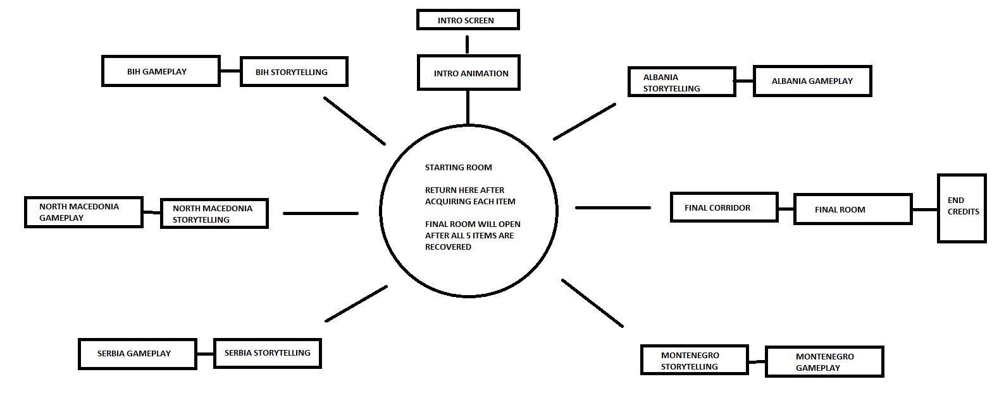
VR application structure

Slide 4
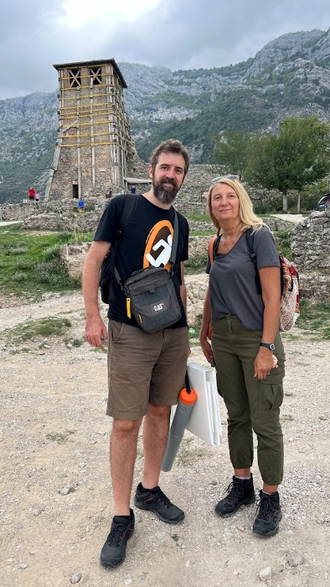
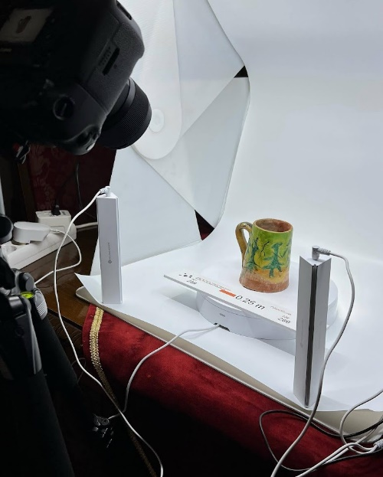
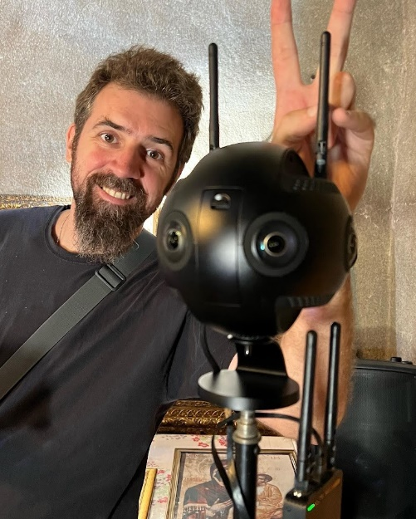
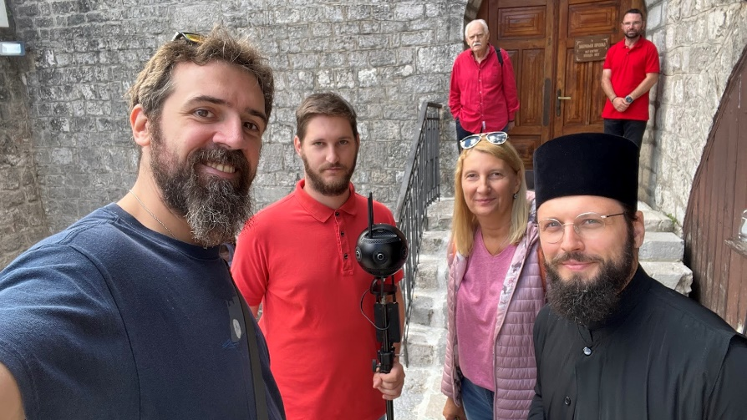
SHEleadersVR progress 2022
Favorite
Edit
Zoom
Info
Collecting historical information
Logo and website design
Scenario development
Filming 360 videos and digitization of museum exhibits
Defining application structure for VR and AR
Creating Production Bible
Edit
Zoom
Share

Slide 5
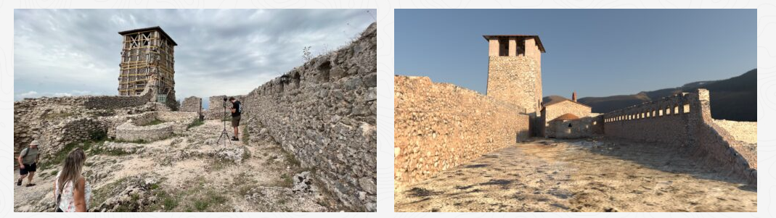
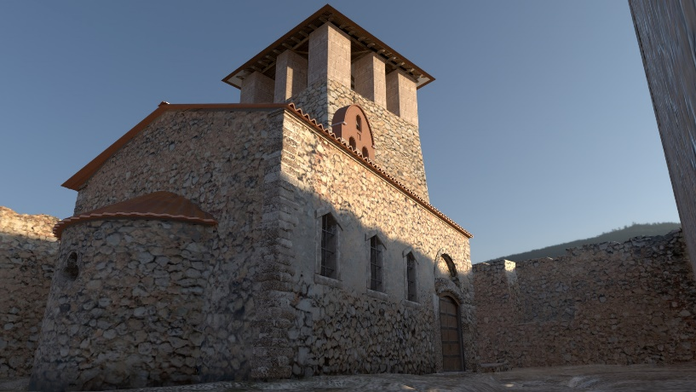
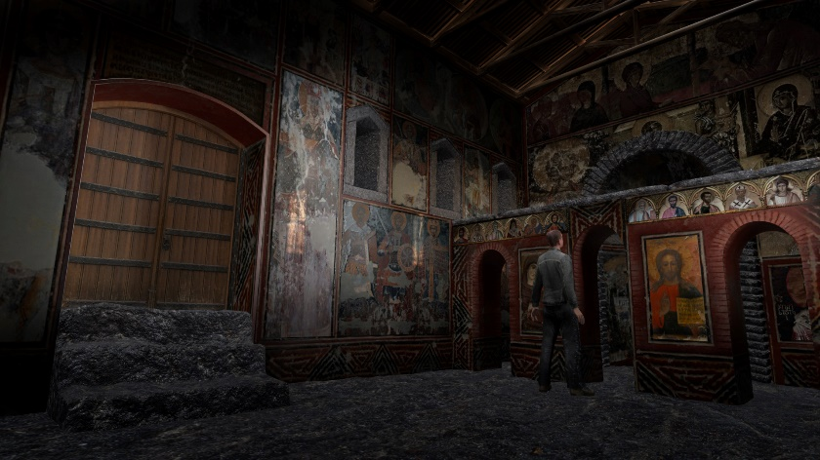
SHEleadersVR progress 2023
Favorite
Edit
Zoom
Info
3D reconstructions of historical locations
Old basilica, Kruje, Albania
Edit
Zoom
Share

Slide 6
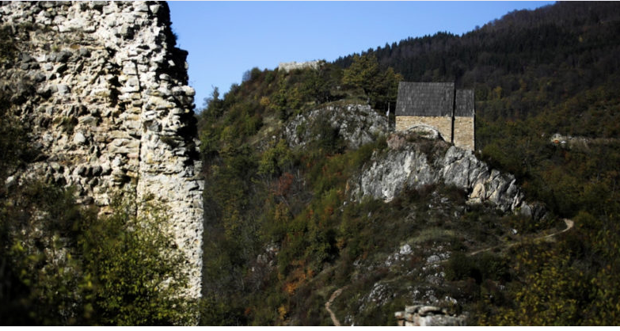
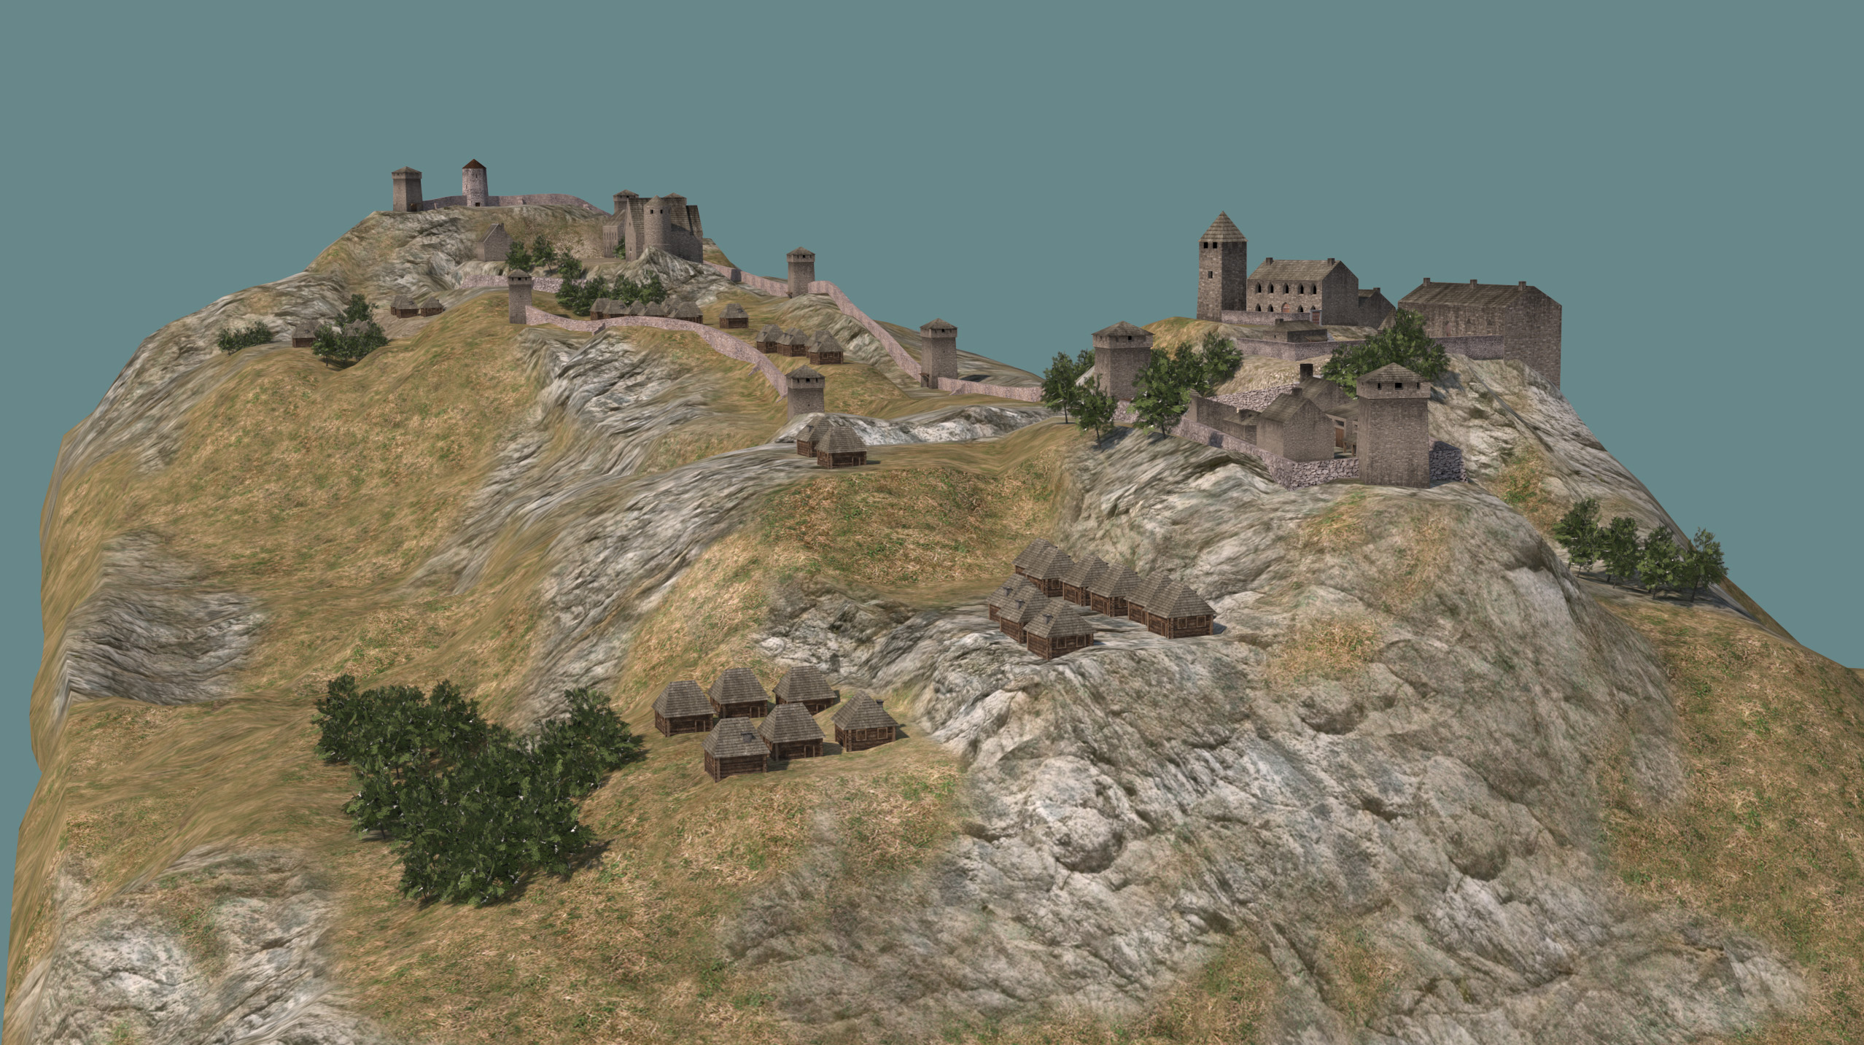
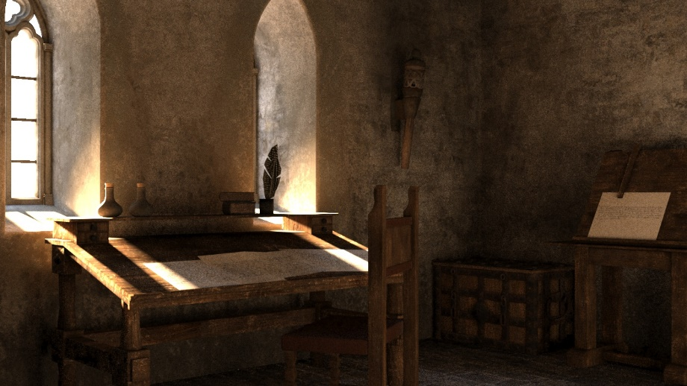
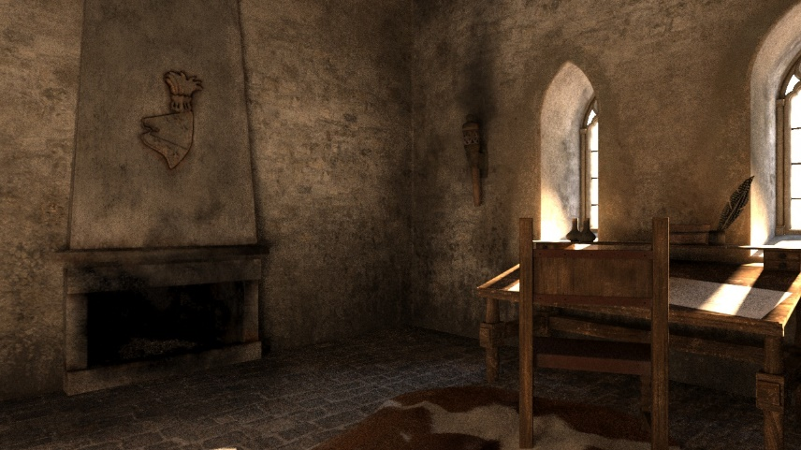
SHEleadersVR progress 2023
Favorite
Edit
Zoom
Info
Share
Say something
3D reconstructions of historical locations
Bobovac castle, Bosnia and Herzegovina
Edit
Zoom

Slide 7
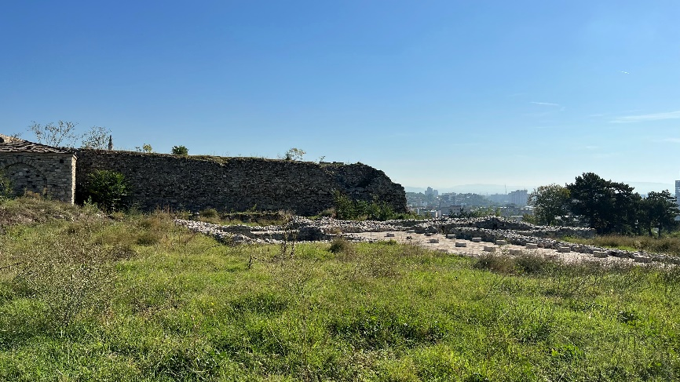
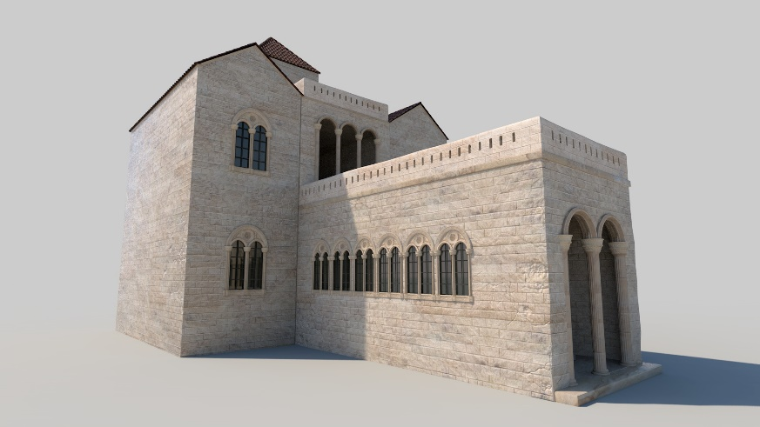
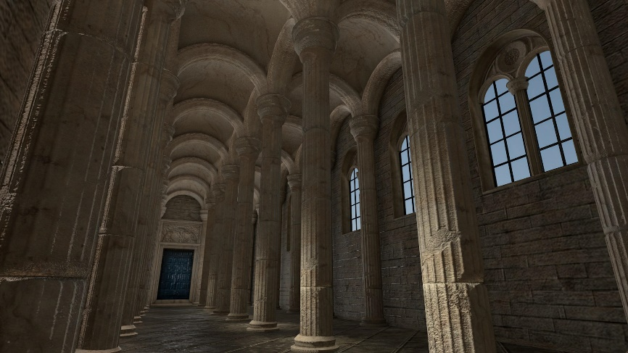
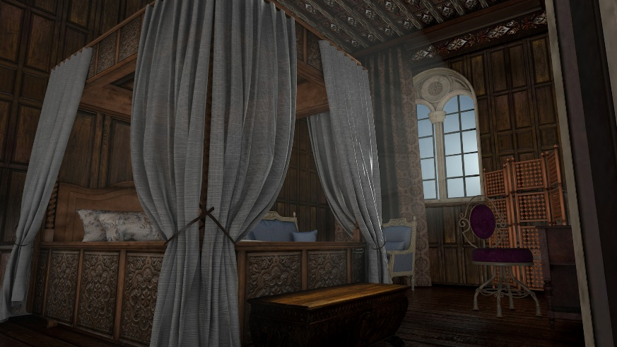
SHEleadersVR progress 2023
Favorite
Edit
Zoom
Info
Share
Say something
3D reconstructions of historical locations
Royal palace Skopje, N. Macedonia
Edit
Zoom

Slide 8
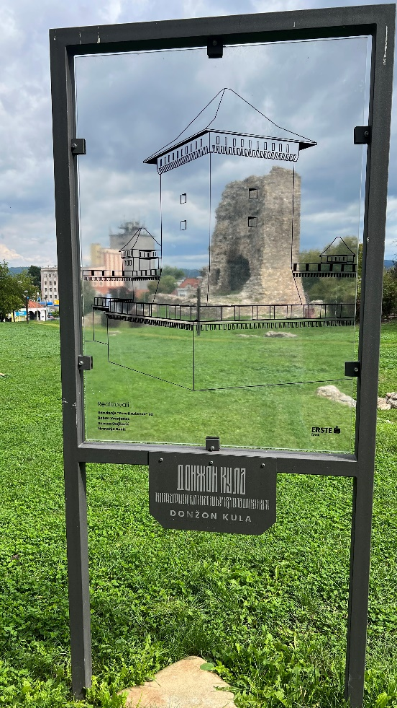
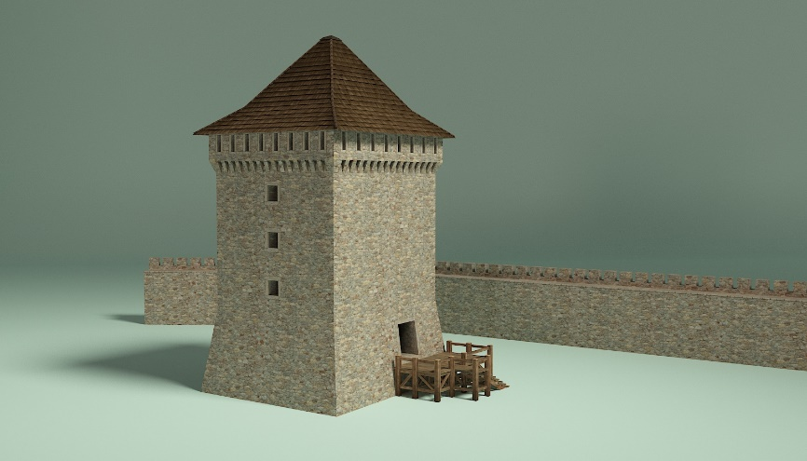
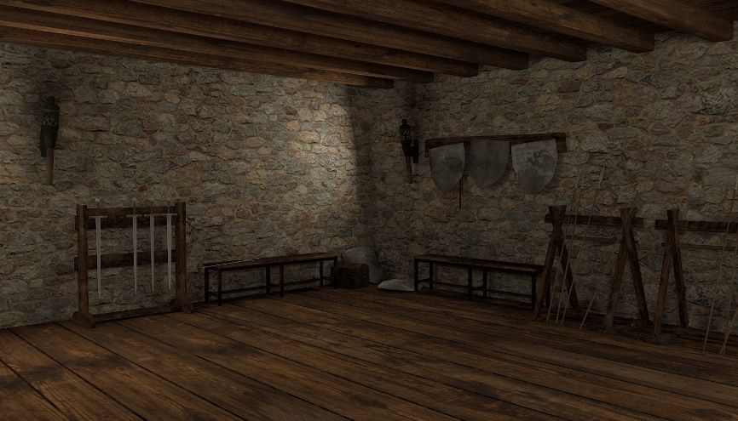
SHEleadersVR progress 2023
Favorite
Edit
Zoom
Info
Share
Say something
3D reconstructions of historical locations
Donžon tower, Fortress in Kruševac, Serbia
Edit
Zoom

Slide 9
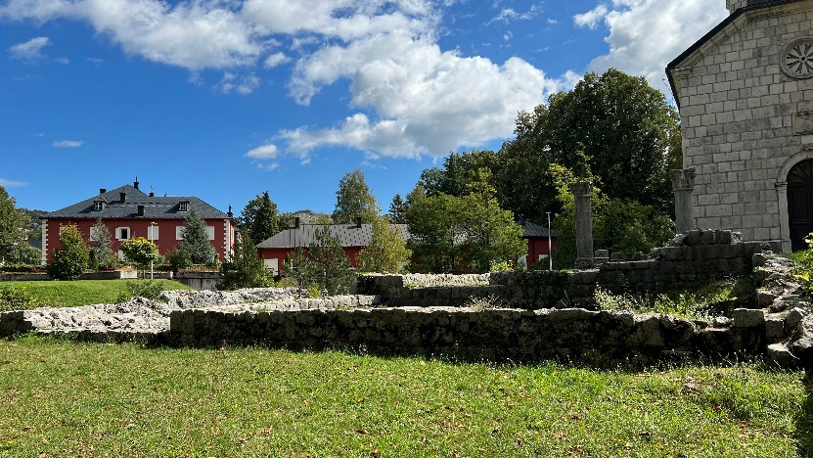
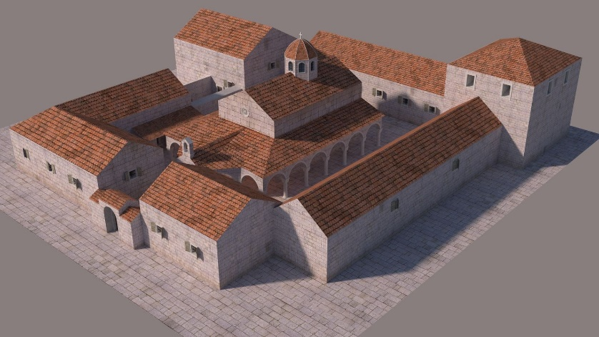
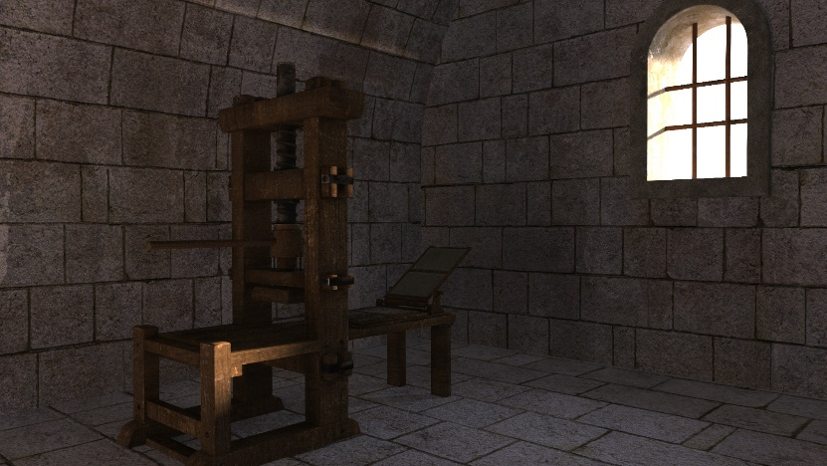
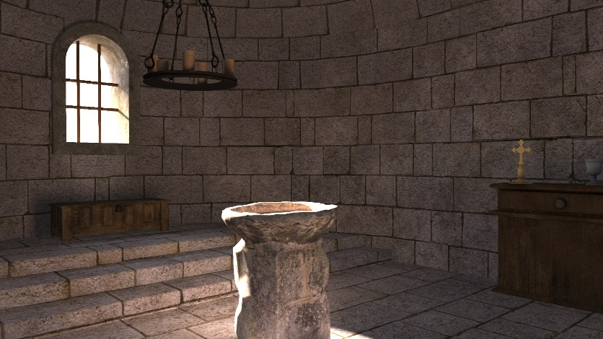
SHEleadersVR progress 2023
Favorite
Edit
Zoom
Info
Share
Say something
3D reconstructions of historical locations
Old monastery, Cetinje, Montenegro
Edit
Zoom

Slide 10
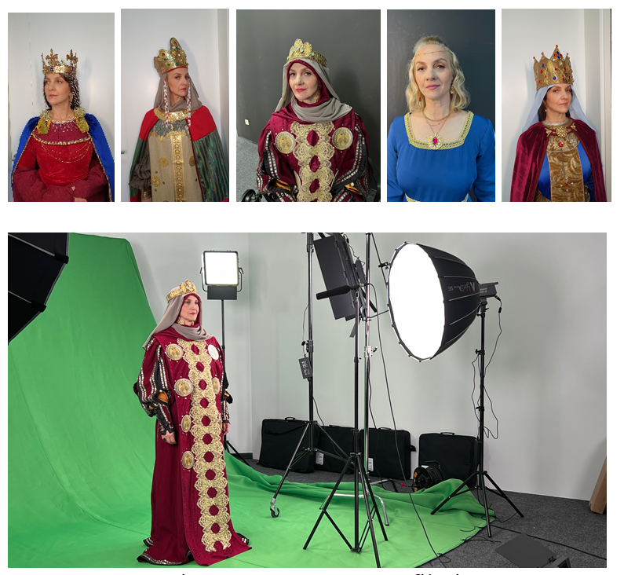
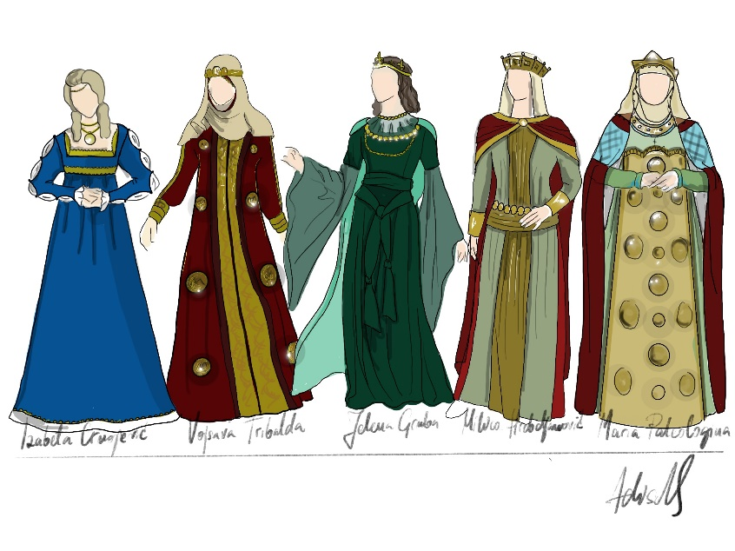
SHEleadersVR progress 2023
Favorite
Edit
Zoom
Info
Share
Say something
Green screen filming
Famous Bosnian actress Selma Alispahic played all 5 queens
Edit
Zoom

Slide 11
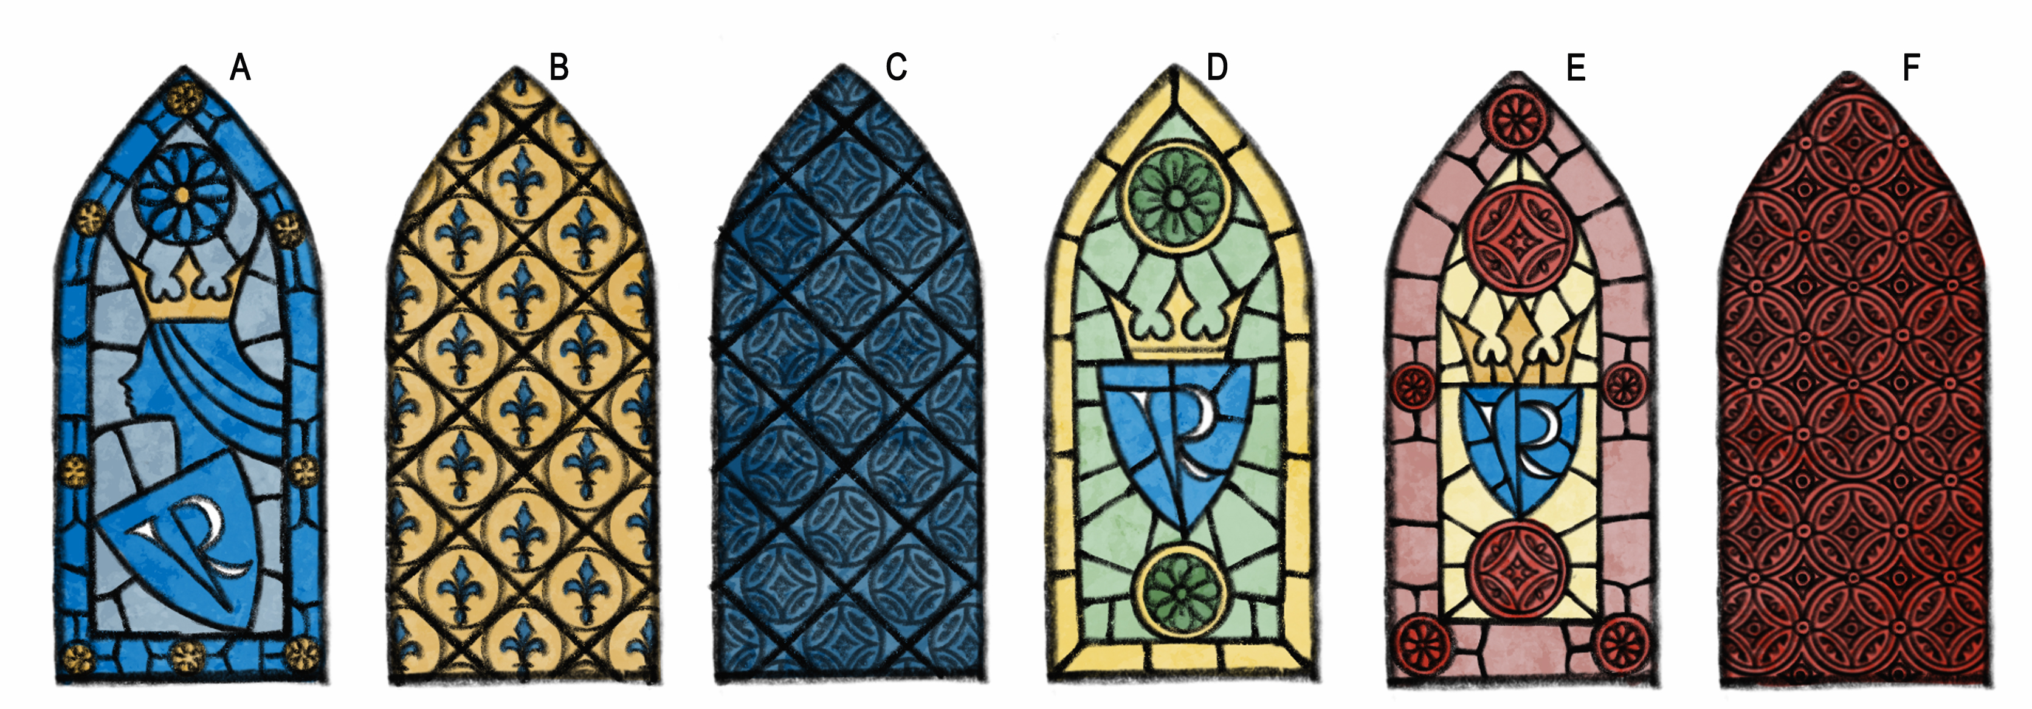

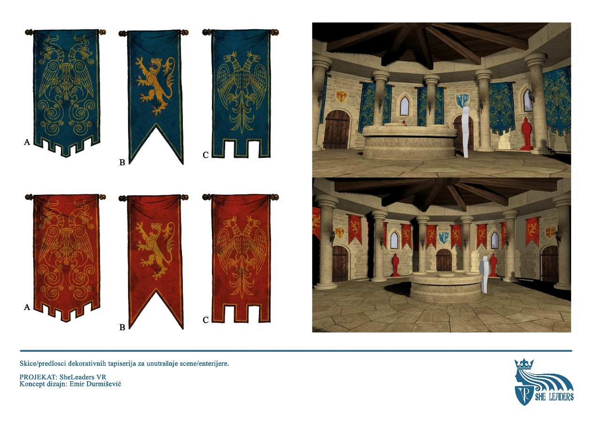
SHEleadersVR progress 2023
Favorite
Edit
Zoom
Info
Share
Say something
Concept art
Edit
Zoom

Slide 12

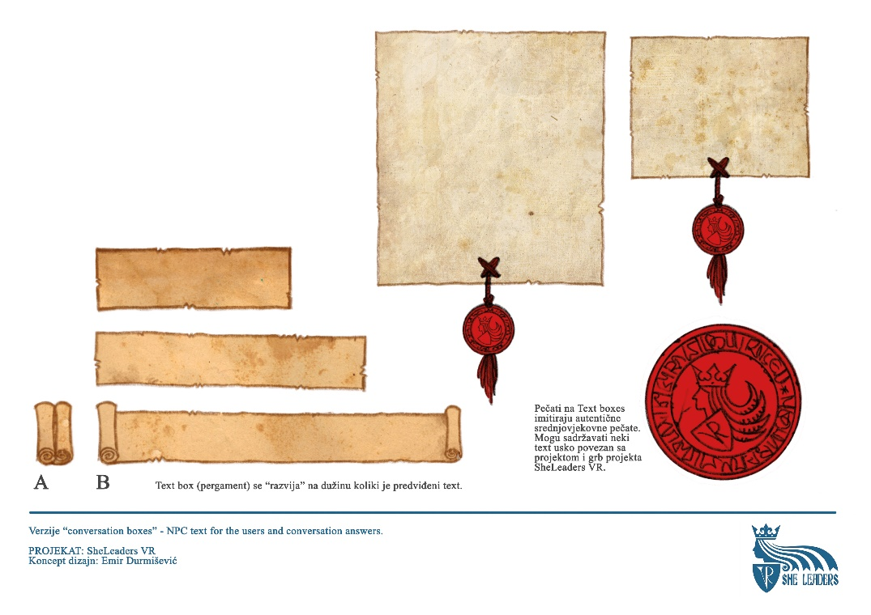
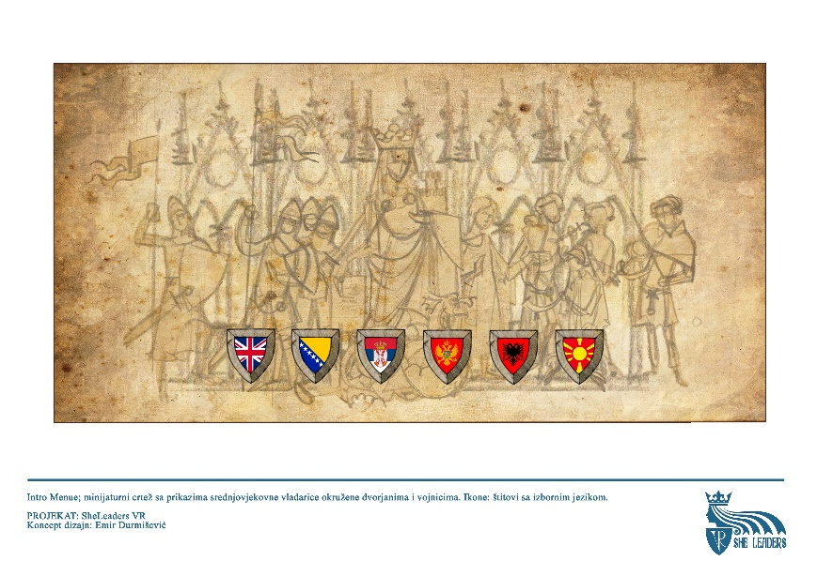
SHEleadersVR progress 2023
Favorite
Edit
Zoom
Info
Share
Say something
UI design
Edit
Zoom

Slide 13

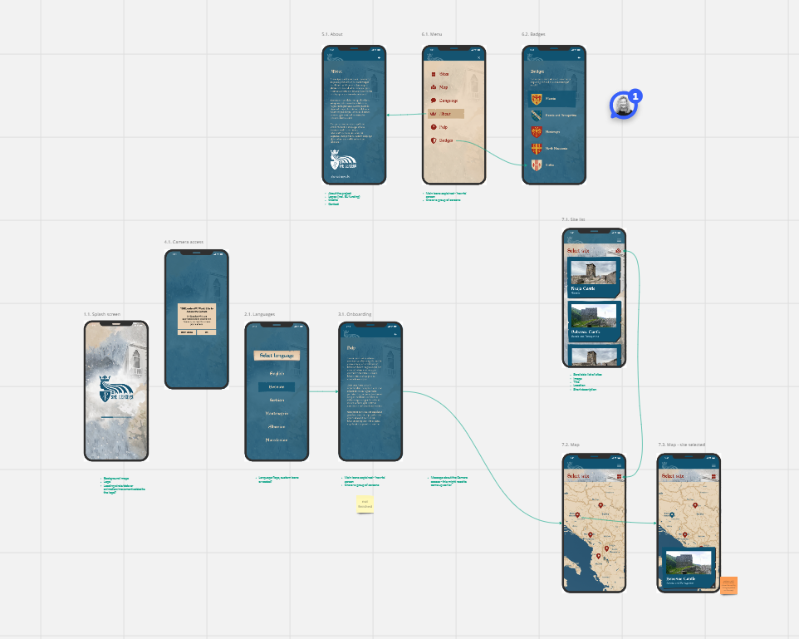
SHEleadersVR progress 2023
Favorite
Edit
Zoom
Info
Share
Say something
AR application design
Edit
Zoom

Slide 14
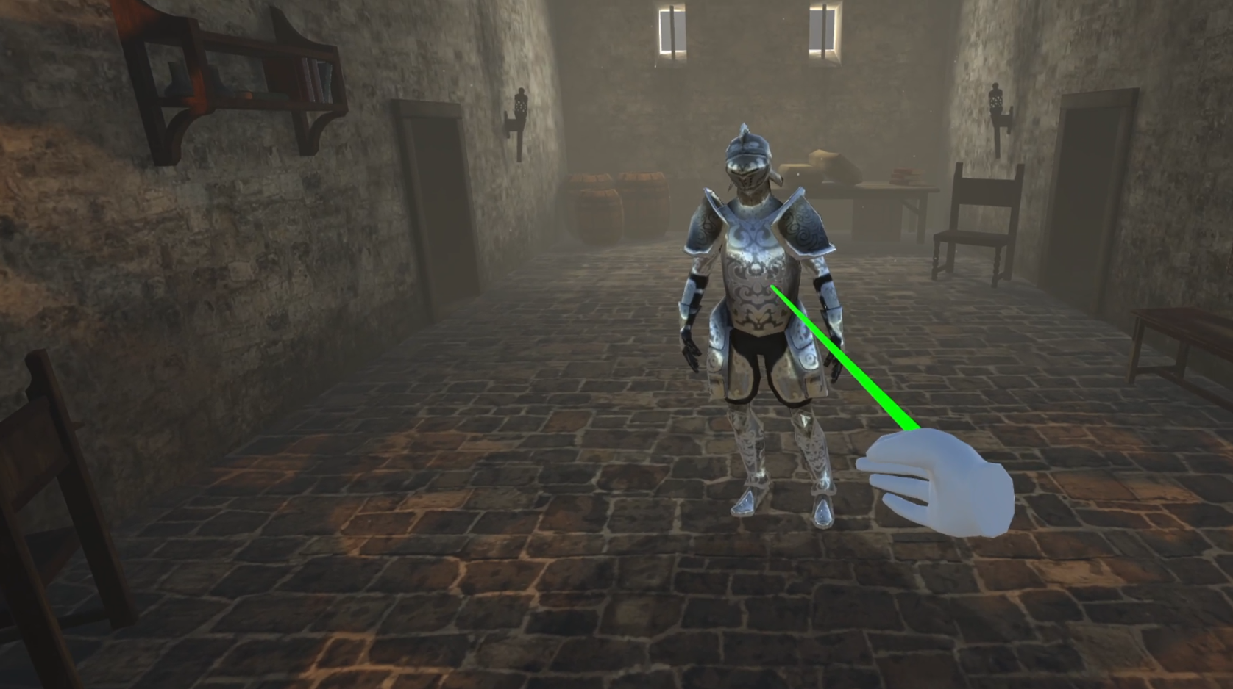
SHEleadersVR progress 2023
Favorite
Edit
Zoom
Info
Share
Say something
First version of VR gameplay
https://youtu.be/NmvjJH1dmkI
Edit
Zoom

Slide 15
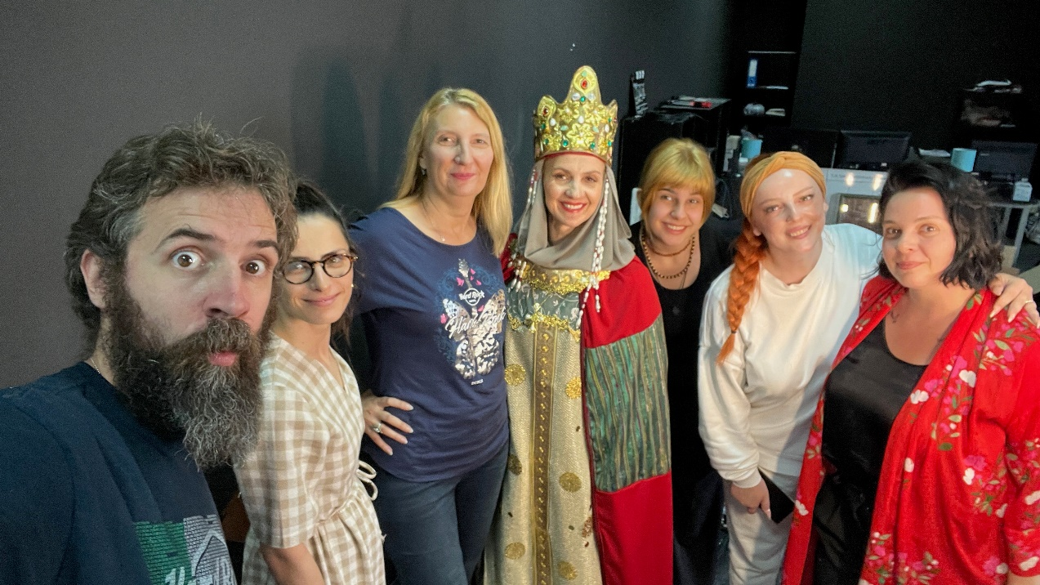
SHEleadersVR progress TODO
Favorite
Edit
Zoom
Info
Share
Say something
Finalization of VR and AR applications (end of 2023)
User testing and fine tuning (2024)
Installation in museums (2024)
Promotion and dissemination (2025)
Edit
Zoom

Slide 16
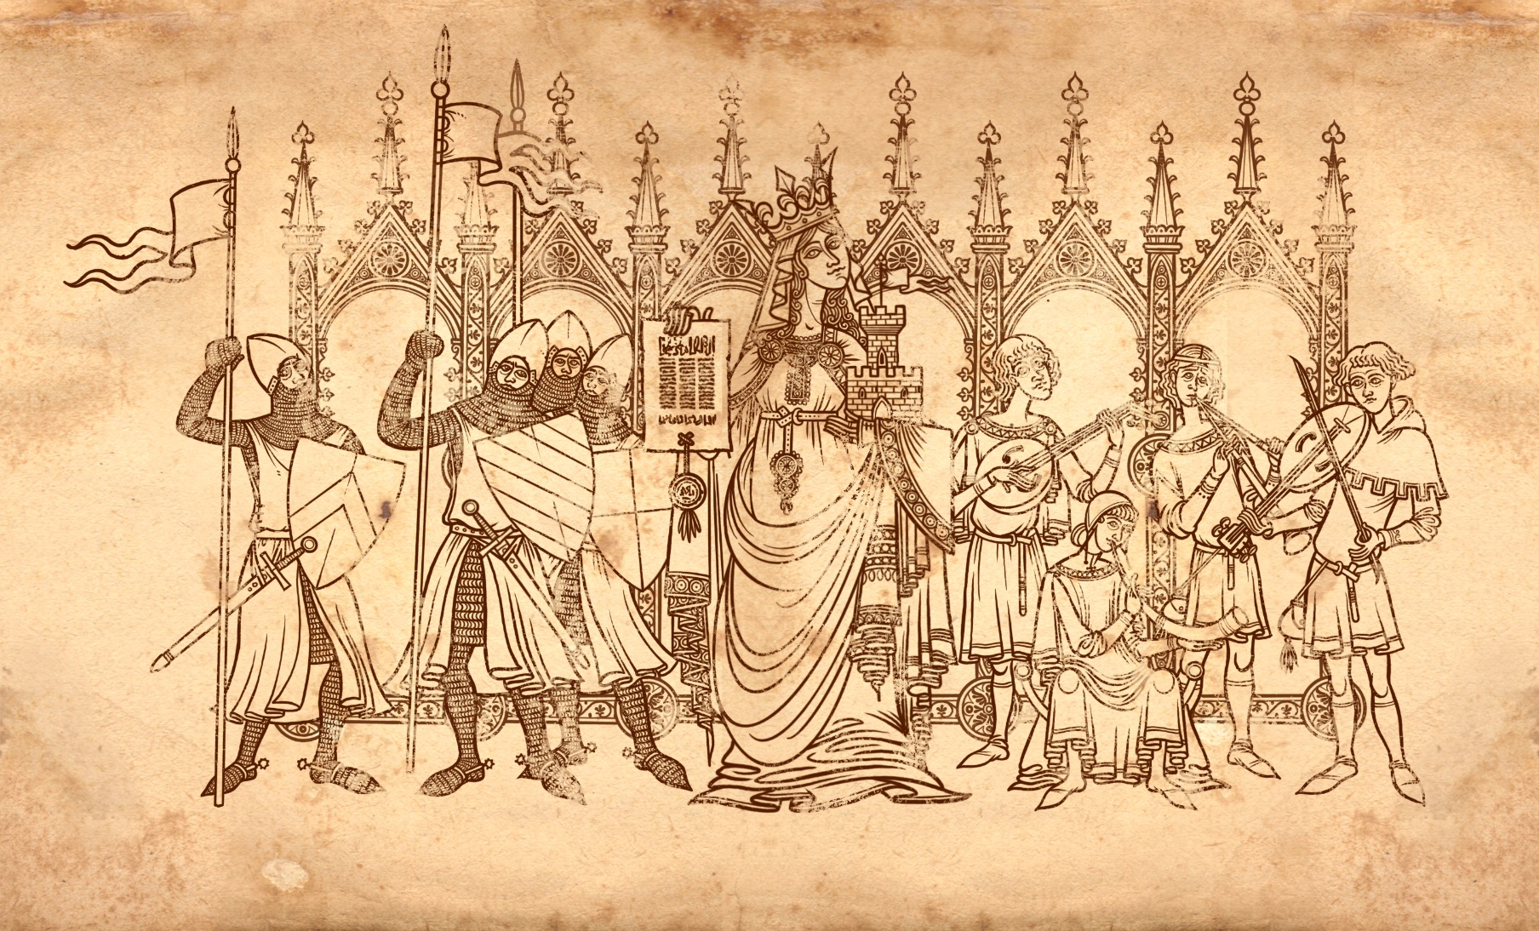


Thank you!
www.sheleadersvr.ba
http://people.etf.unsa.ba/~srizvic/sgg.htm

