Slide 1
Part 5
Scalable mobile visualization

Slide 2
Scalable Mobile Visualization
Big/complex data…
Detailed scenes from modeling or capturing…
... and/or complex rendering
Global illumination, volumetric integration…
… and/or dynamic update
Interaction/animation need high fps (10s to 100s)

Slide 3
Scalable Mobile Visualization
… on machines with low-power CPUs and limited memory…
… much less than desktop counterparts
=> no “brute force” solution applicable
=> need for “smart methods” to adapt rendering quality and/or exploit at best the reduced rendering power

Slide 4
Scalable Mobile Visualization. Outline
Large meshes
High quality illumination: full precomputation
High quality illumination: smart computation
Volume data
Interaction

Slide 5
LaRGE MESHES
Scalable Mobile Visualization

Slide 6
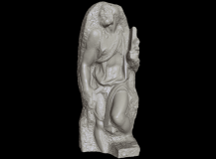
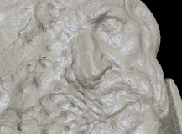
A real-time data filtering problem!
Models of unbounded complexity on limited computers
Need for output-sensitive techniques (O(N), not O(K))
We assume less data on screen (N) than in model (K →∞)
Need for memory-efficient techniques (maximize cache hits!)
Need for parallel techniques (maximize CPU/GPU core usage)
Storage
Screen
View parameters
I/O
Projection + Visibility + Shading
O(K=unbounded) bytes (triangles, points, …)
Limited bandwidth
(network/disk/RAM/CPU/PCIe/GPU/…)
10-100 Hz
O(N=1M-100M) pixels

Slide 7
A real-time data filtering problem!
Models of unbounded complexity on limited computers
Need for output-sensitive techniques (O(N), not O(K))
We assume less data on screen (N) than in model (K →∞)
Need for memory-efficient techniques (maximize cache hits!)
Need for parallel techniques (maximize CPU/GPU core usage)
Small
Working Set
Storage
Screen
View parameters
I/O
Projection + Visibility + Shading
O(K=unbounded) bytes (triangles, points, …)
Limited bandwidth
(network/disk/RAM/CPU/PCIe/GPU/…)
10-100 Hz
O(N=1M-100M) pixels

Slide 8
Output-sensitive techniques
At preprocessing time: build MR structure
Data prefiltering!
Visibility + simplification
Compression
At run-time: selective view-dependent refinement from out-of-core data
Must be output sensitive
Access to prefiltered data under real-time constraints
Visibility + LOD
COARSE
FINE

Slide 9
Output-sensitive techniques
At preprocessing time: build MR structure
Data prefiltering!
Visibility + simplification
Compression
At run-time: selective view-dependent refinement from out-of-core/remote data
Must be output sensitive
Access to prefiltered data under real-time constraints
Decoding, Visibility + LOD
FRONT
Occluded / Out-of-view
Inaccurate
Accurate

Slide 10
Our contributions: GPU-friendly output-sensitive techniques
Chunk-based multiresolution structures
Amortize selection costs over groups of primitives
Combine space partitioning + level of detail
Same structure used for visibility and detail culling
Seamless combination of chunks
Dependencies ensure consistency at the level of chunks
Complex rendering primitives
GPU programming features
Curvilinear patches, view-dependent voxels, …
Chunk-based external memory management
Streaming, compression/decompression, block transfers, caching

Slide 11
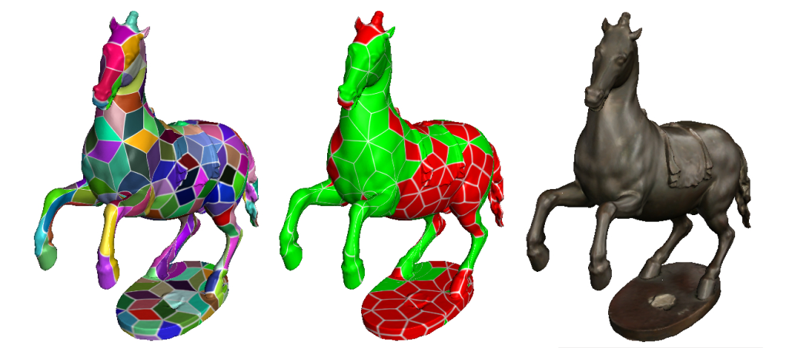
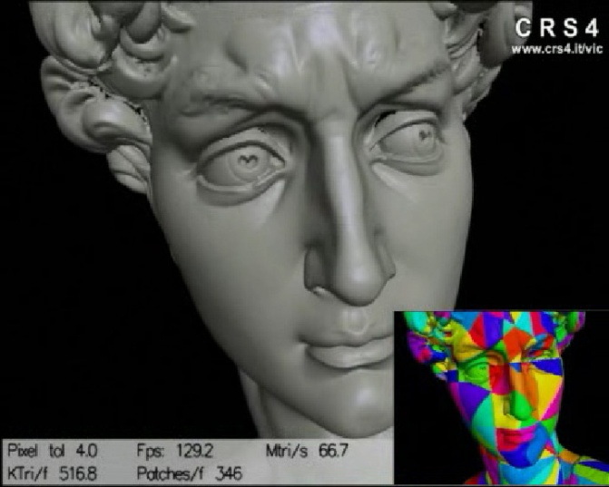
Our Contributions: chunked multiresolution structures
Two approaches
Fixed coarse subdivision
Adaptive QuadPatches
Multiresolution inside patch
Adaptive coarse subdivision
Compact Adaptive TetraPuzzles
Global multiresolution

Slide 12
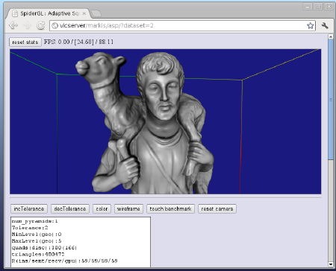

Adaptive Quad Patches Simplified Streaming and Rendering for the Web
Represent models as fixed number of multiresolution quad patches
Image representation allows component reuse!
Natural multiresolution model inside each patch
Adaptive rendering handled totally within shaders!
Works with topologically simple models
Javascript!

Slide 13

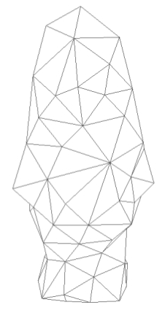

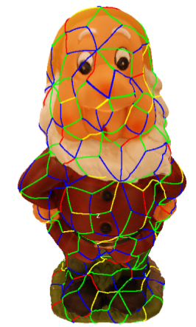
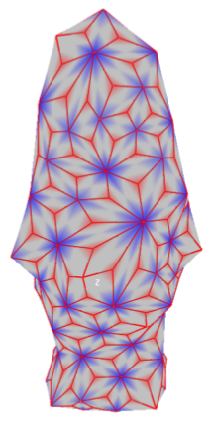

Pre-processing (Reparameterization)
Generate clean manifold triangle mesh
Poisson reconstruction [Kazhdan et al. 2006]
Remove topological noise
Discard connected components with too few triangles
Parameterize the mesh on a quad-based domain
Isometric triangle mesh parameterization
Abstract domains [Pietroni et al. 2010]
Remap into a collection of 2D square regions
+Vertex in tri. Barycenter / +Quad at each edge
Resample each quad from original geometry
Associates to each quad a regular grid of samples (position, color and normal) -> image
Multiresolution inside quad (image mip pyramid)
Base coarse mesh
Quad-based mesh

Slide 14
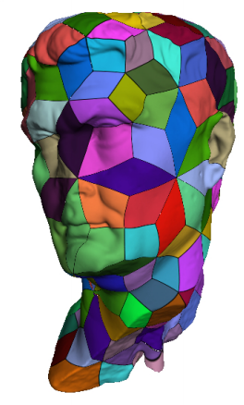
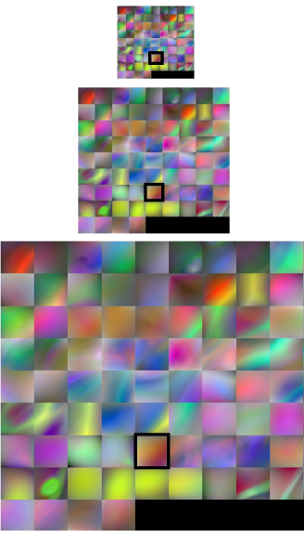
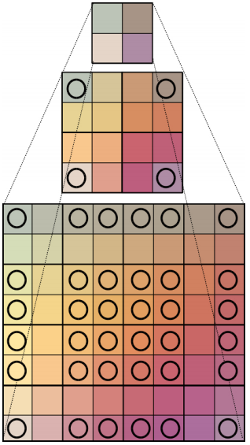
Pre-processing (Multiresolution)
Collection of variable resolution quad patches
Coarse representation of the original model
Multiresolution pyramids
Detail geometry, Color, Normals
Shared border information
Ensure connectivity

Slide 15
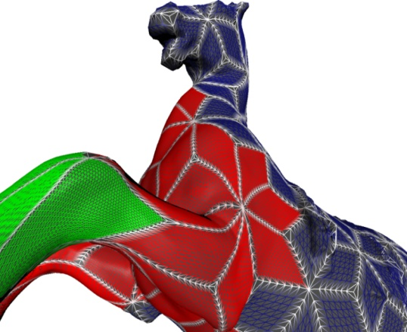

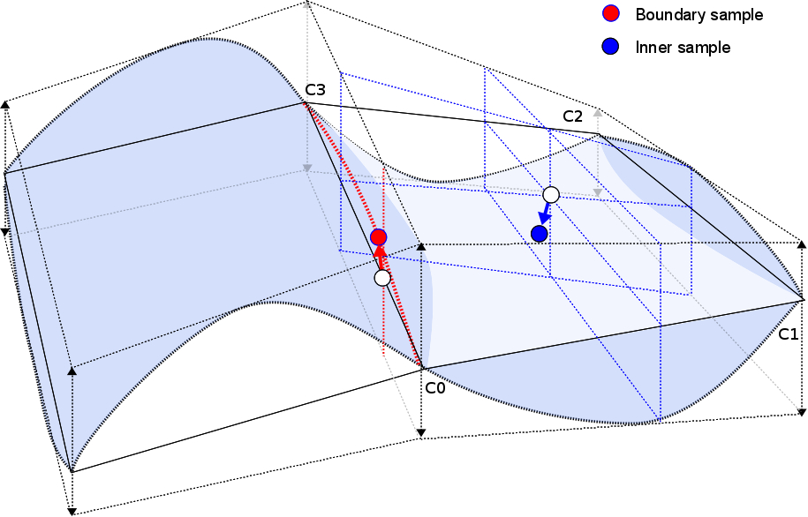
Adaptive rendering
1. CPU Lod Selection
Different quad LOD, but must agree on edges
Quad LOD = max edge LOD (available)
Use finest LOD available
Send VBO with regular grid (1 for each LOD)
2. GPU: Vertex Shader
Snap vertices on edges (match neighbors)
Base position = corner interpolation (u,v)
Displace VBO vertices
normal + displacement (dequantized)
3. GPU: Fragment Shader
Texturing & Shading
1,1
0,0 u,v

Slide 16
Rendering example
Patches Levels Shading

Slide 17

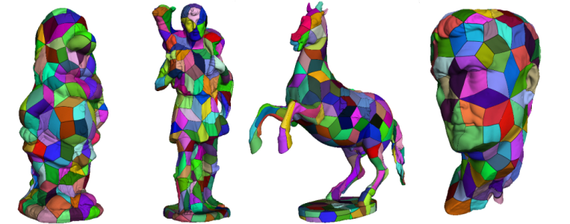
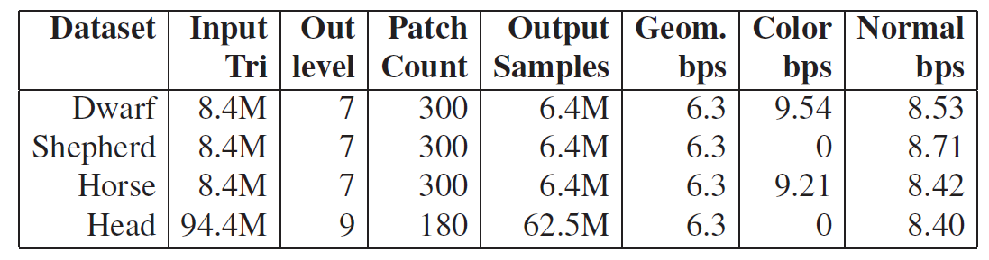
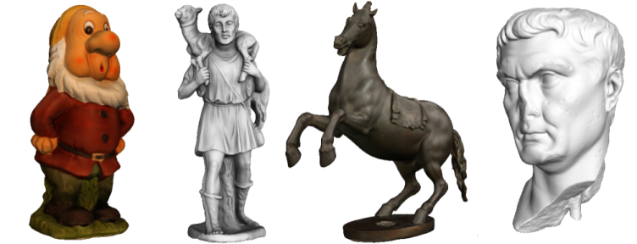
Results
Adaptive rendering
1 pixel accuracy – 37 fps (min 13 fps)
Network streaming
Required 312Kbps (max 2.8Mbps) for no delay
ADSL 8Mbps – 2 s fully refined model from scratch

Slide 18
Conclusions: Adaptive Quad Patches
Effective creation and distribution system
Fully automatic
Compact, streamable and renderable 3D model representations
Low CPU overhead → GPU adaptive rendering
WebGL
Desktop
Mobile
Limitations
Closed objects with large components (i.e,3D scanned objs)
Visual approximation (lossy)
Explore more aggressive compression techniques
Notes:
enhancement and application in this peculiar web-based environment has resulted in very positive performance measurements and user experience

Slide 19
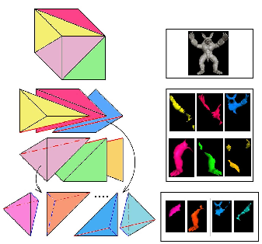
Compact Adaptive Tetra Puzzles Efficient distribution and rendering for mobile
Built on Adaptive TetraPuzzles [CRS4+ISTI CNR, SIGGRAPH’04]
Regular conformal hierarchy of tetrahedra
Spatially partition of input mesh
Mesh fragments at different resolutions
Associated to implicit diamonds
Objective
Mobile
Limited resources (512MB-3GB ram CPU/GPU)
Limited performance (CPU/GPU)
Compact GPU representation
Good compression ratio (maximize resource usage)
Low decoding complexity (maximize decoding/rendering performance)

Slide 20
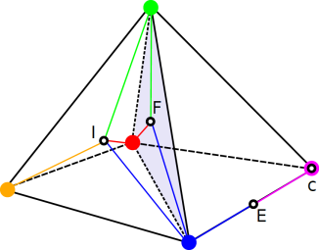
Our approach
Our contribution
Geometry clipped against containing tetrahedra
Barycentric coordinates used for local tetrahedra geometry reparameterization
Fully adaptive and seamless 3D mesh structure with local quantization
GPU friendly compact data representation
64bit = position (3 bytes) + color (3 bytes)+ normal(2 bytes)
Normals encoded using the octahedron approach by [Meyer et al. 2012]
Further compression for web distribution exploiting local data coherence for entropy coding
P_{barycentric} = λ₁*P₁+λ₂*P₂+λ₃*P₃+λ_{4*}P₄
P3
P2
P1
P4

Slide 21

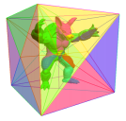
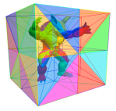
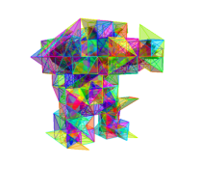
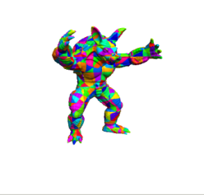
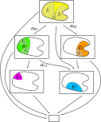



Overview
Construction
Start with hires triangle soup
Partition model
Construct non-leaf cells by bottom-up recombination and simplification of lower level cells
Assign model space errors to cells
Rendering
Refine graph, render selected precomputed cells
Project errors to screen
Dual queue
Partitioning
Constrained simplification +
Chunk error computation
Adaptive rendering
Cache
GPU
On-line
Ensure continuity → Shared information on borders

Slide 22
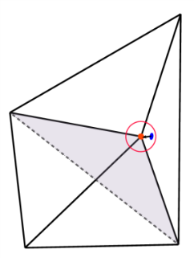
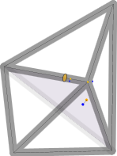
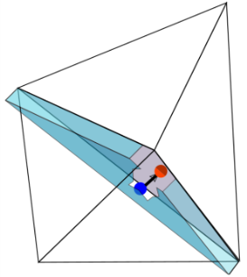
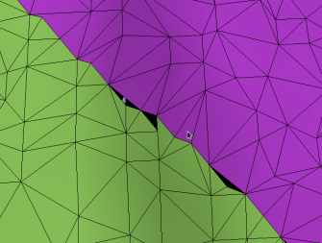
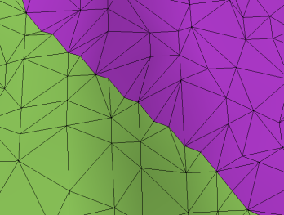
Pre-processing (Barycentric parametrization)
Tetrahedron geometry is reparameterized into barycentric coordinates
Triangles clipped on tetrahedron faces
Inner vertices (I)
4 tetrahedron corners
Vertices lying on tetrahedron faces
3 corners of the triangle defining the face
Ensure continuity between neighbors
Snap vertices on boundaries (<threshold)
Simplification (per diamond)
Inner versus all
Inner boundary versus same class
Outer boundary is fixed
1) Snap to corner
2) Snap to edge
3) Snap to face

Slide 23
Pre-processing (Barycentric parametrization)
Tetrahedron geometry is reparameterized into barycentric coordinates
Triangles clipped on tetrahedron faces
Vertices lying on tetrahedron faces (F)
3 corners of the triangle defining the face
Inner vertices (I)
4 tetrahedron corners
Vertices lying on edges (E)
2 corners defining the edge
Ensure continuity between neighbors
Simplification (per diamond)

Slide 24
Pre-processing (Barycentric parametrization)
Tetrahedron geometry is reparameterized into barycentric coordinates
Ensure continuity between neighbors
Snap vertices to corner/edge/face below some threshold
Simplification (per diamond)
1) Snap to corner
2) Snap to edge
3) Snap to face

Slide 25
Pre-processing (Barycentric parametrization)
Tetrahedron geometry is reparameterized into barycentric coordinates
Ensure continuity between neighbors
Simplification (per diamond)
Outer boundary is fixed
Inner boundary versus same class
Inner versus all

Slide 26
Pre-processing (Barycentric parametrization)
Tetrahedron geometry is reparameterized into barycentric coordinates
Triangles clipped on tetrahedron faces
Inner vertices (I)
4 tetrahedron corners
Vertices lying on tetrahedron faces
3 corners of the triangle defining the face
Ensure continuity between neighbors
Simplification (per diamond)
Inner versus all (I)
Inner boundary versus same class (F)
Outer boundary is fixed (outer faces/edges/corners)

Slide 27
Pre-processing (Barycentric parametrization)
Tetrahedron geometry is reparameterized into barycentric coordinates
Triangles clipped on tetrahedron faces
Inner vertices (I)
4 tetrahedron corners
Vertices lying on tetrahedron faces
3 corners of the triangle defining the face
Ensure continuity between neighbors
Simplification (per diamond)
Inner versus all
Inner boundary versus same class
Outer boundary is fixed
1) Snap to corner
2) Snap to edge
3) Snap to face

Slide 28
Rendering process
Extract view dependent diamond cut (CPU)
Required patches requested to server
Asynchronous multithread client
Apache 2 based server (data repository, no processing)
For each node (GPU Vertex Shader):
VBO containing barycentric coordinates , normals and colors (64 bits per vertex)
Decode position : P = MV * [C0 C1 C2 C3] * [Vb]
Vb is the vector with the 4 barycentric coords
C0..C3 are tetrahedra corners
Decode normal from 2 bytes encoding [Meyers et al. 2010]
Use color coded in RGB24

Slide 29
Results
Preprocessing (on 8 cores)
24k triangles/s
40 to 50 bits/vertex
Rendering (on iPad, tolerance of 3 pixels)
Average 30 Mtris/s
Average 37 fps
15 fps for refined views
(>2M triangles budget)
Rendering (on iPhone, tolerance of 3 pixels)
Average 2.8 Mtris/s
Average 10 fps
2.8 fps for refined views (>1M triangles budget)
Streaming Full screen view
30s on wireless,
45s on 3G
David 14.5MB (1.1 Mtri)
St. Matthew 19.9MB (1.8 Mtri)
Notes:
In this video we can see the rendering performance on the tested devices.
On the iPad, we have an average framerate of 37 fps, around 30 Mtris/s, and 15 fps on refined views, when exceeding the 2Mtris budget (defined cache size)
On the iPhone, the average frame rate is of 10 fps, with 2.8fps on refined views. This represents around 2.8Mtris/s.

Slide 30
Conclusions: Compact ATP
Effective distribution and rendering of gigantic 3D triangle meshes on common handheld devices
Compact, GPU friendly, adaptive data structure
Exploiting the properties of conformal hierarchies of tetrahedra
Seamless local quantization using barycentric coordinates
Two-stage CPU and GPU compression
Integrated into a multiresolution data representation
Limitations
Requires coding non-trivial data structures, hard to implement on scripting environments

Slide 31
Complex LiGHTING: Full precomputation…
Scalable Mobile Visualization

Slide 32
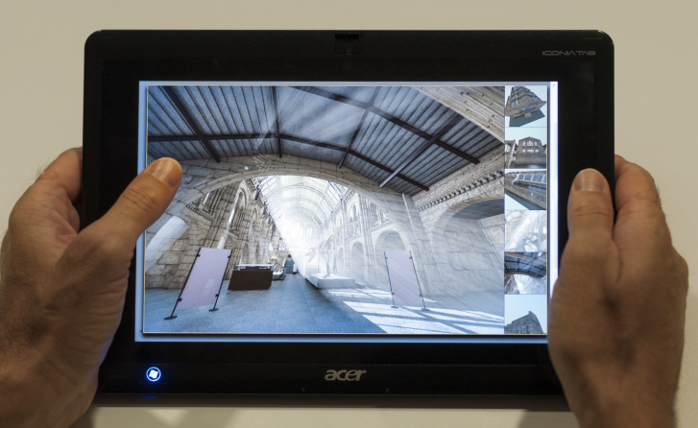
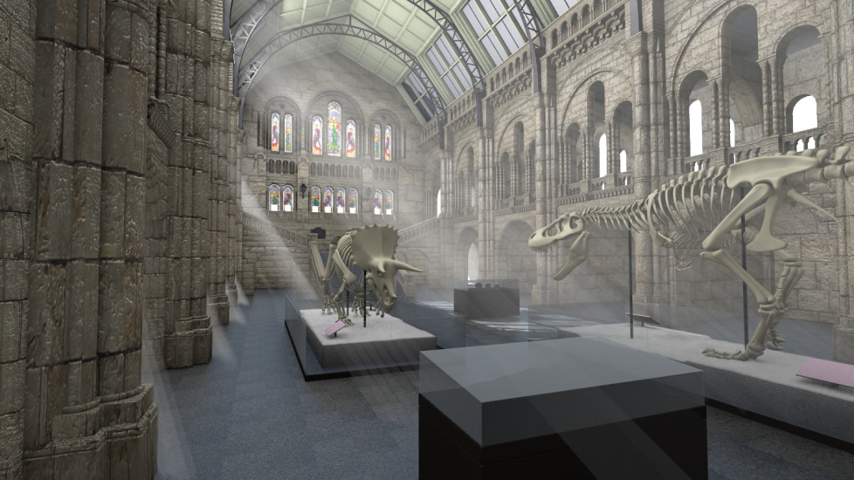
Explore Maps Ubiquitous exploration of scenes with complex illumination
Real-time limitations ~30Hz
Difficulties handling complex illumination on mobile/web platforms with current methods
Image-based techniques
Constraining camera movement to a set of fixed camera positions
Enable pre-computed photorealistic visualization

Slide 33
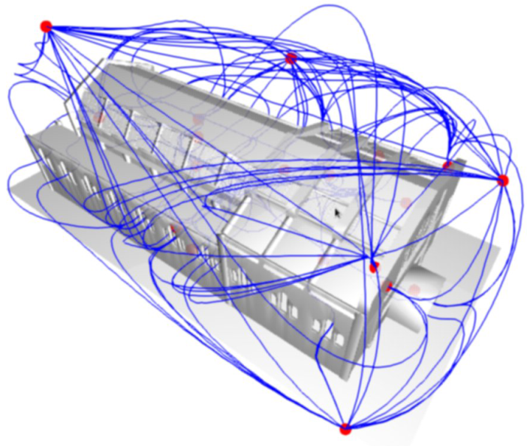
Scene Discovery
Iterative random probe placement and coverage optimization
Full scene coverage
Probe clustering and optimization (coverage + perceptual metrics)
Optimize coverage for browsing
Probe connection through common visible regions
Generate paths between probes
Path optimization smoothing
Mass-spring system
Explore Map

Slide 34
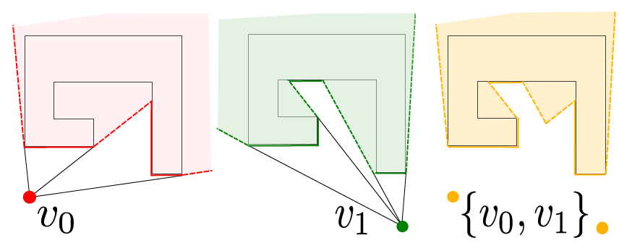
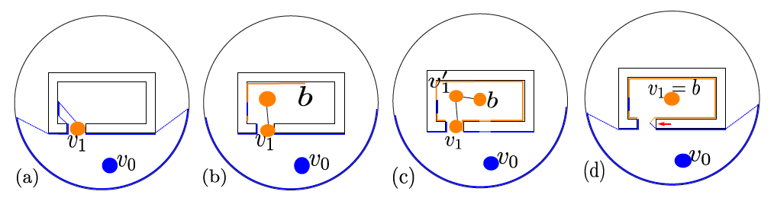
Scene Discovery
Objective: Full scene coverage !!!
Iteratively discover the scene by randomly placing new probes & optimizing
Set of probes S = {}
While ( coverage(S) < th ) {
Place new probe
Maximize probe coverage
}
Coverage optimization, by moving to the barycenter of seen geometry
Probe v0
Probe v1
Joint coverage
Temporal bounding sphere geometry

Slide 35
Scene Discovery
Goal
Set of probes that provides full coverage of the scene
Probe = 360° panoramic point of view
Set of arcs connecting probes that enable full scene navigation
Explore Map

Slide 36
Scene Discovery
Objective: Full scene coverage !!!
1. Add new probe in unseen area
2. Optimize view → move towards seen area barycenter
Repeat until convergence (no improvement | no movement) < threshold
3. Goto 1 while coverage < threshold
Probe v0
Probe v1
Joint coverage

Slide 37
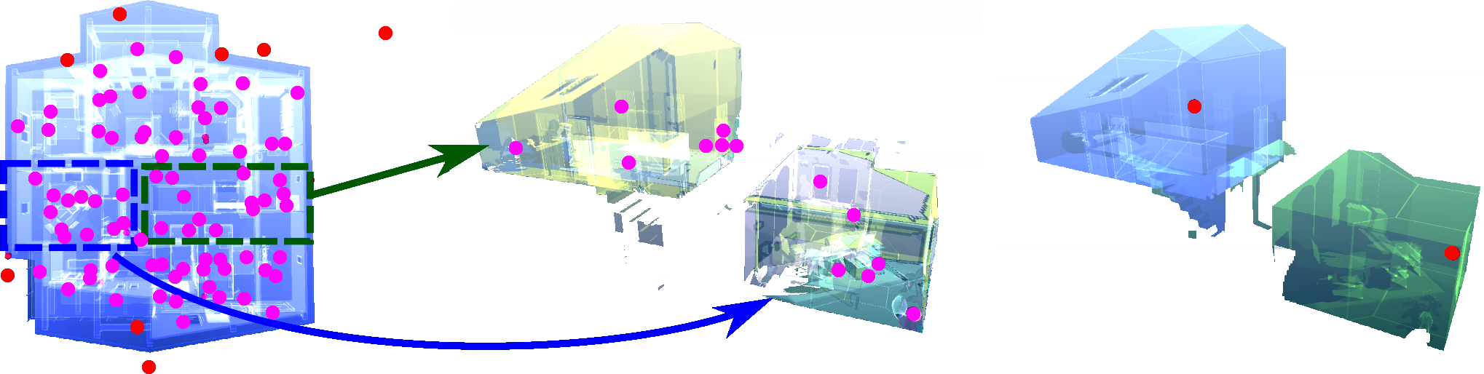
Probe optimization
Clustering → Cluster representative [Markov Cluster Algorithm, MCL]
Find natural clusters in graph – random walk
Visit probability encoded in arcs = %coverage overlap between nodes
Equivalent coverage, but better browsing experience
Probe synthesis
Optimization using a simulated annealing approach of:
coverage & perceptual metrics[Secord et al. 2011]

Slide 38
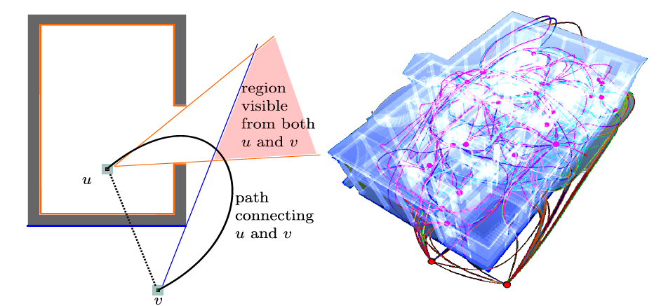
Connecting Probes
Search for a common visible region and choose the closest point in this region
A mass-spring system is used for optimizing and smoothing this path

Slide 39
Dataset Creation (rendering)
Input: Explore Map
Probes with full scene coverage
Transitions between “reachable” probes
Pre-processing
Photorealistic rendering (using Blender 2.68a)
panoramic views both for probes and transition arcs
We used 32 8-core PCs, for rendering times ranging from 40 minutes to 7 hours/model
1024^2 probe panoramas
256^2 transition video panoramas

Slide 40
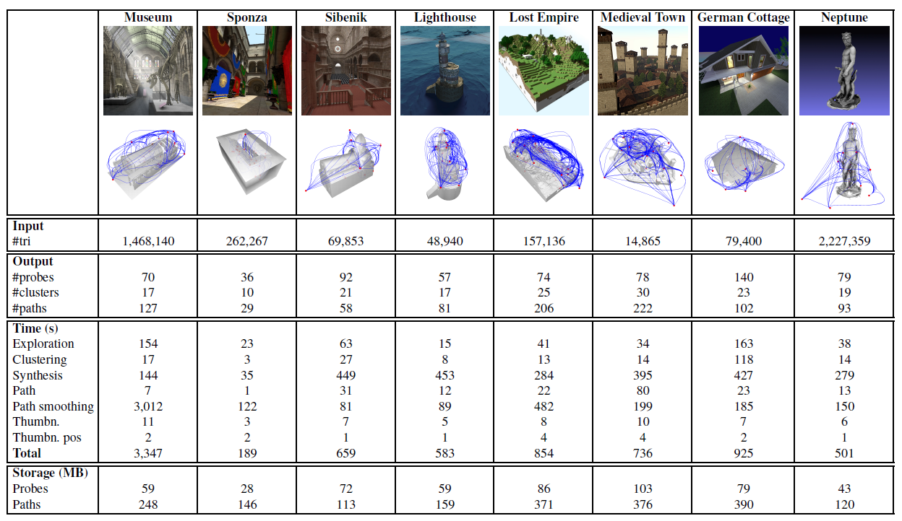
Explore Maps - Results
Notes:
We have performed tests on a variety of models in order to validate our approach.
Using standard compression formats for images and video the datasets typically consist of a few hundreds of megabytes, including probes and transition videos.

Slide 41
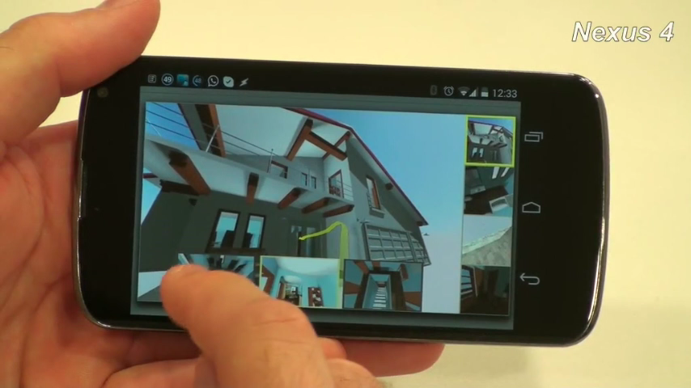
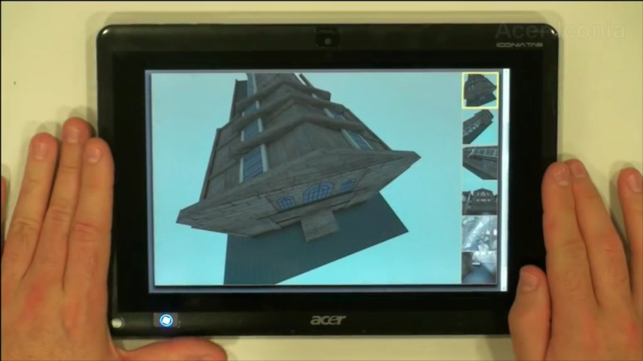
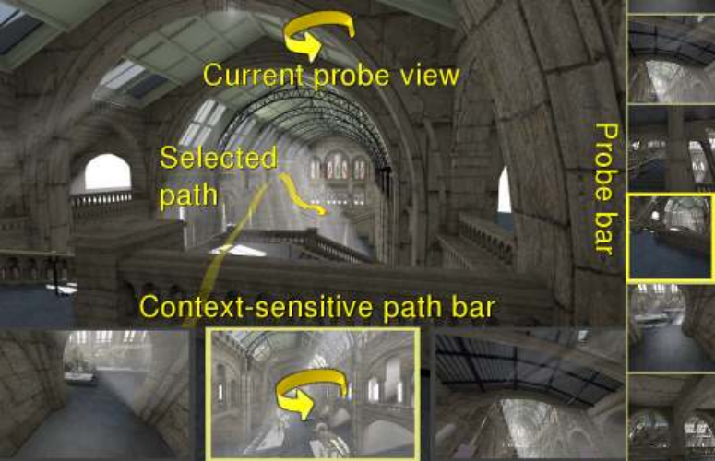
Interactive Exploration
UI for Explore Maps
WebGL implementation + JPEG + MP4
Panoramic images: probes + transition path
Closest probe selection
Path alignment with current view
Thumbnail goto
Non-fixed orientation

Slide 42
Conclusion: Interactive Exploration
Interactive exploration of complex scenes
Web/mobile enabled
Pre-computed rendering
state-of-the-art Global Illumination
Graph-based navigation → guided exploration
Limitations
Constrained navigation
Fixed set of camera positions
Limited interaction
Exploit panoramic views on paths → less constrained navigation

Slide 43
Complex LiGHTING: Smart computation
Scalable Mobile Visualization

Slide 44
High quality illumination
Introduction
Consistent illumination for AR
Soft shadows
Deferred shading
Ambient Occlusion

Slide 45
Consistent illumination for AR
High-Quality Consistent Illumination in Mobile Augmented Reality by Radiance Convolution on the GPU [Kán, Unterguggenberger & Kaufmann, 2015]
Goal
Achieve realistic (and consistent) illumination for synthetic objects in Augmented Reality environments

Slide 46
Consistent illumination for AR
Overview
Capture the environment with the mobile
Create an HDR environment map
Convolve the HDR with the BRDF’s of the materials
Calculate radiance in realtime
Add AO from an offline rendering as lightmaps
Multiply with the AO from the synthetic object

Slide 47
Consistent illumination for AR
Capture the environment with the mobile
Rotational motion of the mobile
In yaw and pitch angles to cover all sphere directions
Images accumulated to a spherical environment map

Slide 48
Consistent illumination for AR
An HDR environment map is constructed while scanning
Projecting each camera image
According to the orientation of the mobile
Using the inertial measurement unit from the device
Low dynamic range imaging is transformed to HDR
From multiple overlapping images with known exposure times [Robertson et al.]
Camera uses auto-exposure
Two overlapping images will have slightly different exposure
Alignment correction based on feature matching to compensate for the drift of the inertial measurement
Construction done on the mobile

Slide 49
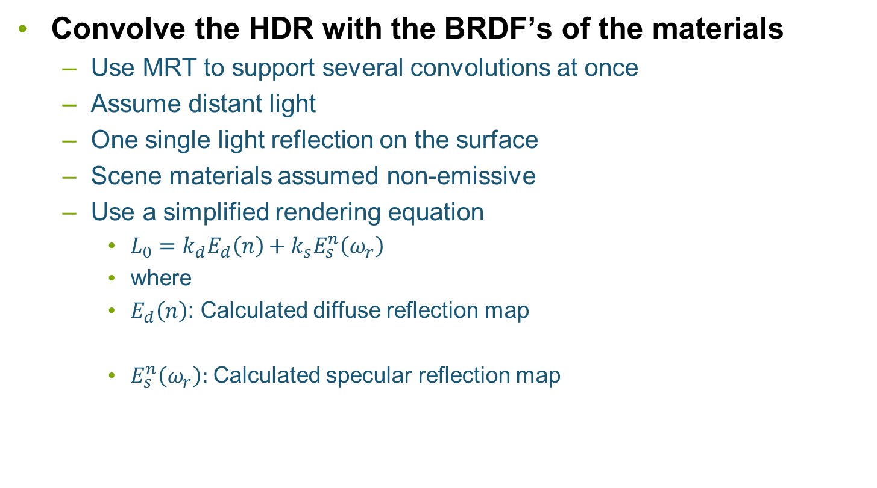
Consistent illumination for AR
Convolve the HDR with the BRDF’s of the materials
Use MRT to support several convolutions at once
Assume distant light
One single light reflection on the surface
Scene materials assumed non-emissive
Use a simplified rendering equation
$L_{0}=k_{d}E_{d}\left(n\right)+k_{s}E_{s}^{n}\left(ω_{r}\right)$
where
$E_{d}\left(n\right)$: Calculated diffuse reflection map
$E_{s}^{n}\left(ω_{r}\right):$Calculated specular reflection map

Slide 50
Consistent illumination for AR
Calculate AO from an offline rendering as lightmaps
Built for real and synthetic objects
Nee the geometry of the scene
Use a proxy geometry for the objects of the real world
Cannot be simply done on the fly
AO is then multiplied

Slide 51
Consistent illumination for AR
Results
Without AO With AO
Taken from [Kán et al., 2015]

Slide 52
Consistent illumination for AR
Performance
Resolution of reflection maps | Reflection maps calculation time
32x32 | 40ms
64x64 | 1.45s
128x128 | 6.36s
256x256 | 28.09s
512x512 | 2 min 38 s
1024x1024 | 23 min 1 s
3D model | # triangles | Framerate
Reflective cup | 25.6K | 29 fps
Teapot | 15.7K | 30 fps
Dragon | 229K | 13 fps

Slide 53
Consistent illumination for AR
Limitations
Materials represented by Phong BRDF
AO and most illumination is baked

Slide 54
Soft shadows using cubemaps
Efficient Soft Shadows Based on Static Local Cubemap [Bala & Lopez Mendez, 2016]
Goal
Soft shadows in realtime
Taken from https://community.arm.com/graphics/b/blog/posts/dynamic-soft-shadows-based-on-local-cubemap

Slide 55
Soft shadows using cubemaps
Overview
Create a local cube map
Offline recommended
Apply shadows in the fragment shader

Slide 56
Soft shadows using cubemaps
Local cubemap
Cubemap texture
Created as usual
Stores color and transparency of the environment
Position and bounding box
Approximates the geometry
Local correction
Using proxy geometry

Slide 57
Soft shadows using cubemaps
Generating shadows
Fetch texel from cubemap
Using the fragment-to-light vector
Correct the vector before fetching
Apply shadow based on the alpha value
Soften shadow

Slide 58
Soft shadows using cubemaps
Calculating corrected vectors
Environment map is accessed taking into account the scene geometry (bbox) and cubemap creation position
To provide the equivalent shadow rays
Softening shadows
Using mipmapping and addressing according to the distance
Implementation
Enable trilinear filtering
On rendering, calculate the distance to the bounding volume
Can be done in the correction phase
Normalize distance to the number of mipmaps
Query a level of detail

Slide 59
Soft shadows using cubemaps
Conclusions
Does not need to render to texture
Well, cubemaps must be pre-calculated
Requires reading multiple times from textures
Stable
Because cubemap does not change
Limitations
Static, since info is precomputed

Slide 60
Physically-based Deferred Rendering
Physically Based Deferred Shading on Mobile [Vaughan Smith & Einig, 2016]
Goal:
Adapt deferred shading pipeline to mobile
Bandwidth friendly
Using Framebuffer Fetch extension
Avoids copying to main memory in OpenGL ES

Slide 61
Physically-based Deferred Rendering
Overview
Typical deferred shading pipeline
G-Buffer Pass
Lighting Pass
Tone mapping
Postprocessing
Local Memory
Local Memory
Local Memory
G-Buffer
Depth/Stencil
Normals
Color
Light Accumulation
Tone mapped image

Slide 62
Physically-based Deferred Rendering
Main idea: group G-buffer, lighting & tone mapping into one step
G-Buffer Pass
Lighting Pass
Tone mapping
Postprocessing
Local Memory
G-Buffer & Light
Depth/Stencil
Normals
Color

Slide 63
Physically-based Deferred Rendering
Main idea: group G-buffer, lighting & tone mapping into one step
Further improve by using Pixel Local Storage extension
G-buffer data is not written to main memory
Usable when multiple shader invocations cover the same pixel
Resulting pipeline reduces bandwidth
G-Buffer Pass
Lighting Pass
Tone mapping
Postprocessing
Local Memory
Tonemapped image

Slide 64
Physically-based Deferred Rendering
Two G-buffer layouts proposed
Specular G-buffer setup (160 bits)
Rgb10a2 highp vec4 light accumulation
R32f highp float depth
3 x rgba8 highp vec4: normal, base color & specular color
Metallicness G-buffer setup (128 bits, more bandwidth efficient)
Rgb10a2 highp vec4 light accumulation
R32f highp float depth
2 x rgba8 highp vec4: normal & roughness, albedo or reflectance metallicness

Slide 65
Physically-based Deferred Rendering
Lighting
Use precomputed HDR lightmaps to represent static diffuse lighting
Shadows & radiosity
Can be compressed with ASTC (supports HDR data)
PVRTC, RGBM can also be used for non HDR formats
Geometry pass calculates diffuse lighting
Specular is calculated using Schlick’s approximation of Fresnel factor

Slide 66
Physically-based Deferred Rendering
Results (PowerVR SDK)
Fewer rendering tasks
meaning that the G-buffer generation, lighting, and tonemapping stages are properly merged into one task.
reduction in memory bandwidth
53% decrease in reads and a 54% decrease in writes
Limitations
Still not big frame rates

Slide 67
Ambient Occlusion in mobile
Motivation
Optimized Screen-Space Ambient Occlusion in Mobile Devices [Sunet & Vázquez, Web3D 2016]
Objective: Study feasibility of real time AO in mobile
Analyze most popular AO algorithms
Evaluate their AO pipelines step by step
Design architectural improvements
Implement and compare

Slide 68
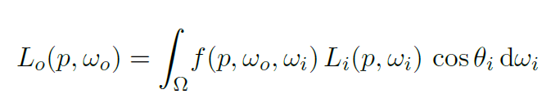
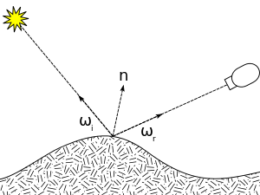
Ambient Occlusion in mobile
Rendering equation: Models interaction between light and objects
Describes how light reflects off a surface
Every beam of light incident at p in direction ω_{i}
Multiplied by the BRDF of the material, and added up
Light reflected towards eye
Surface reflectance
Incoming light
Angle weighting

Slide 69
Ambient Occlusion in mobile
Ambient Occlusion. Simplification of rendering equation
The surface is a perfect diffuse surface
The BRDF becomes a constant
Light potentially reaches a point p equally in all directions
But takes into account point’s visibility
Accounting for all visible directions on the upper part of the surface
Light from these directions reaches the surface
Light from these directions does not reach the surface

Slide 70
Ambient Occlusion in mobile
Typical approach (also called Ambient Obscurance)

Slide 71
Ambient Occlusion in mobile
AO typical implementations
Precomputed AO: Fast & high quality, but static, memory hungry
Ray-based: High quality, but costly, visible patterns…
Geometry-based: Fast w/ proxy structures, but lower quality, artifacts/noise…
Volume-based: High quality, view independent, but costly
Screen-space:
Extremely fast
View-dependent
[mostly] requires blurring for noise reduction
Very popular in video games (e.g. Crysis, Starcraft 2, Battlefield 3…)

Slide 72
Ambient Occlusion in mobile
Screen-space AO:
Approximation to AO implemented as a screen-space post-processing
ND-buffer provides coarse approximation of scene's geometry
Sample ND-buffer to approximate (estimate) ambient occlusion instead of shooting rays
Assassin’s Creed Unity

Slide 73
Ambient Occlusion in mobile
Optimizing the OpenGL pipeline
SSAO pipeline
Generate ND (normal + depth, OpenGL ES 2) or G-Buffer (ND + RGB…, OpenGL ES 3.+)
Calculate AO factor for visible pixels
Generate a set of samples of positions/vectors around the pixel to shade.
Get the geometry shape (position/normal…)
Calculate AO factor by analyzing shape…
Blur the AO texture to remove noise artifacts
Final compositing

Slide 74
Ambient Occlusion in mobile
Optimizing the OpenGL pipeline
G-Buffer. Depth storage. Precision analysis
Evaluated values: 8, 16, 32 bits
8 not enough
16 and 32 similar quality
Our results
Inconclusive (no performance differences)
Profile and decide

Slide 75
Ambient Occlusion in mobile
Optimizing the OpenGL pipeline
G-buffer storage. Normal storage
Store RGB normals: No further computation
Store RG normals:
Save some memory
Recover B with a square root
Our results
RGB normals are faster

Slide 76
Ambient Occlusion in mobile
Optimizing the OpenGL pipeline
AO calculation. Samples generation (disc and hemisphere sampling)
Desktops use up to 32
With mobile, 8 is the affordable amount
Pseudo-random samples produces noticeable patterns
Our proposed solution
Compute sampling patterns offline
2D: 8-point Poisson disc
3D: 8-point cosine-weighted hemisphere (Malley’s approach, as in [Pharr and Humprheys, 2010])
Scaling and rotating the resulting pattern ([Chapman, 2011])
Predictable, reproducible, robust

Slide 77
Ambient Occlusion in mobile
Optimizing the OpenGL pipeline
AO Calculation. Getting geometry positions. Transform samples to 3D
Typically apply inverse transform
Many floating point operations
Similar triangles achieve equivalent result with less floating point operations
Our results
Similar triangles are faster

Slide 78
Ambient Occlusion in mobile
Optimizing the OpenGL pipeline
Storing depth vs storing 3D positions in G-Buffer
Trades bandwidth for memory
Our results:
Depth slightly better
Profile for the application

Slide 79
Ambient Occlusion in mobile
Optimizing the OpenGL pipeline
Banding & Noise
A fixed sampling pattern produces banding (left)
Random sampling removes banding but introduces noise (middle)
SSAO output is typically blurred to remove noise (right)

Slide 80
Ambient Occlusion in mobile
Optimizing the OpenGL pipeline
Blurring
Typical Gaussian blur filters smooth out edges
User bilateral filter instead
Our results:
Bilateral filtering works better
Improve timings with separable filter

Slide 81
Ambient Occlusion in mobile
Optimizing the OpenGL pipeline
New contribution: Progressive AO
Amortize AO throughout many frames
Frame i - 1
Frame i
Partial AO
Subset of samples
ADD
Final AO
Partial AO
Subset of samples
ADD
Final AO

Slide 82
Ambient Occlusion in mobile
Optimizing the OpenGL pipeline
Naïve improvement: Reduce the calculation to a portion of the screen
Mobile devices have a high PPI resolution
Reduction improves timings dramatically while keeping high quality
Typical reduction:
Offscreen render to 1/4th of the screen
Scale-up to fill the screen

Slide 83
Ambient Occlusion in mobile
Results
Performance of optimizations

Slide 84
Ambient Occlusion in mobile
Results
Improvements obtained
Algorithm | Optimized (not progressive) | Optimized + progressive
Starcraft 2 | 17.8% | 38.5%
HBAO | 25.6% | 39.2%
Crytek | 23.4% | 35.0%
Alchemy | 24.8% | 38.2%

Slide 85
Ambient Occlusion in mobile
Conclusions
Developed an optimized pipeline for mobile AO
Analyzed the most popular AO techniques
Improved several important steps of the pipeline
Proposed some extra contributions (e.g. progressive AO)
Achieved realtime framerates with high quality
Developed techniques can be used in WebGL
Future Work
Further improvement of the pipeline
Developing “Homebrew” method
With all known improvements
Some extra tricks
Not ready for prime time yet

Slide 86
Volumetric DATA
Scalable Mobile Visualization

Slide 87
Rendering Volumetric Datasets
Introduction
Challenges
Architectures
GPU-based ray casting on mobile
Conclusions

Slide 88
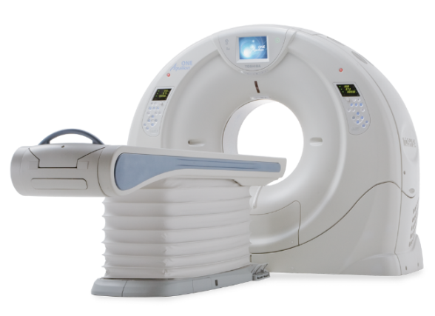
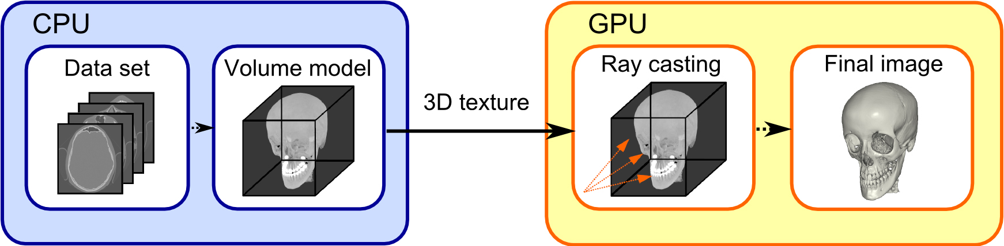
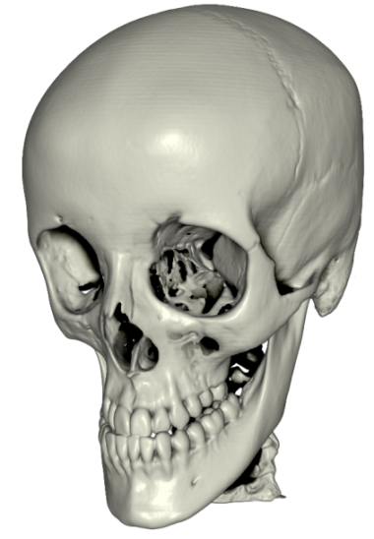
Rendering Volumetric Datasets
Capturing Rendering
3D texture
GPU- based ray casting
Output

Slide 89
Rendering Volumetric Datasets
Introduction
Volume datasets
Sizes continuously growing (e.g. >1024³)
Complex data (e.g. 4D)
Rendering algorithms
GPU intensive
State-of-the-art is ray casting on the fragment shader
Interaction
Edition, inspection, analysis, require a set of complex manipulation techniques

Slide 90
Rendering Volumetric Datasets
Desktop vs mobile
Desktop rendering
Large models on the fly
Huge models with the aid of compression/multiresolution schemes
Mobile rendering
Standard sizes (e.g. 512³) still too much for the mobile GPUs
Rendering algorithms GPU intensive
State-of-the-art is GPU-based ray casting
Interaction is difficult on a small screen
Changing TF, inspecting the model…

Slide 91
Rendering Volumetric Datasets
Challenges on mobile:
Memory:
Model does not fit into memory
Use client server approach / compress data
GPU capabilities:
Cannot use state of the art algorithm (e.g. no 3D textures)
Texture arrays
GPU horsepower:
GPU unable to perform interactively
Progressive rendering methods
Small screen
Not enough details, difficult interaction

Slide 92
Rendering Volumetric Datasets
Mobile architectures
Server-based rendering
Hybrid approaches
Pure mobile rendering
Server-based and hybrid rely on high bandwidth communication

Slide 93
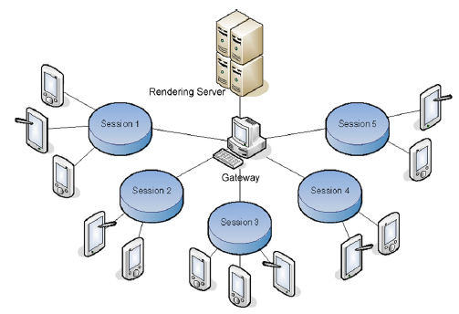
Rendering Volumetric Datasets
Server-based rendering
Park et al. Mobile Collaborative Medical Display System.
Moser and Wieskopf. Interactive Volume Rendering on Mobile Devices.

Slide 94
Rendering Volumetric Datasets
Hybrid approaches
Hard tasks performed by the server
Data processing, compression…
Rendering (partially) on mobile

Slide 95
Rendering Volumetric Datasets
Pure mobile rendering
Move all the work to the mobile
Nowadays feasible

Slide 96
Rendering Volumetric Datasets
Direct Volume Rendering on mobile. Algorithms
Slices
2D texture arrays
3D textures

Slide 97


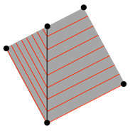
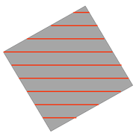

Rendering Volumetric Datasets
Axis-aligned
Slices
Typical old days volume rendering
Several quality limitations
Subsampling & view change
Improvement: Oblique slices [Kruger 2010]
View-aligned
Oblique

Slide 98
Rendering Volumetric Datasets
2D texture arrays + texture atlas [Noguera et al. 2012]
Simulate a 3D texture using an array of 2D textures
Implement GPU-based ray casting
High quality
Relatively large models
Costly
Cannot use hardware trilinear interpolation

Slide 99
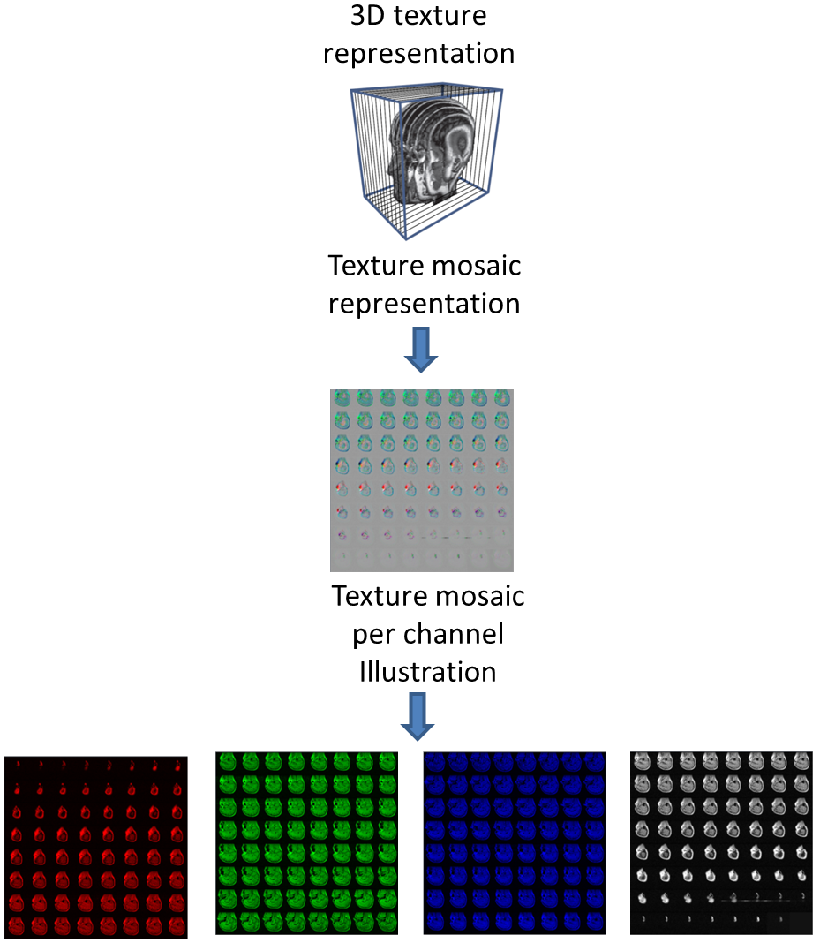
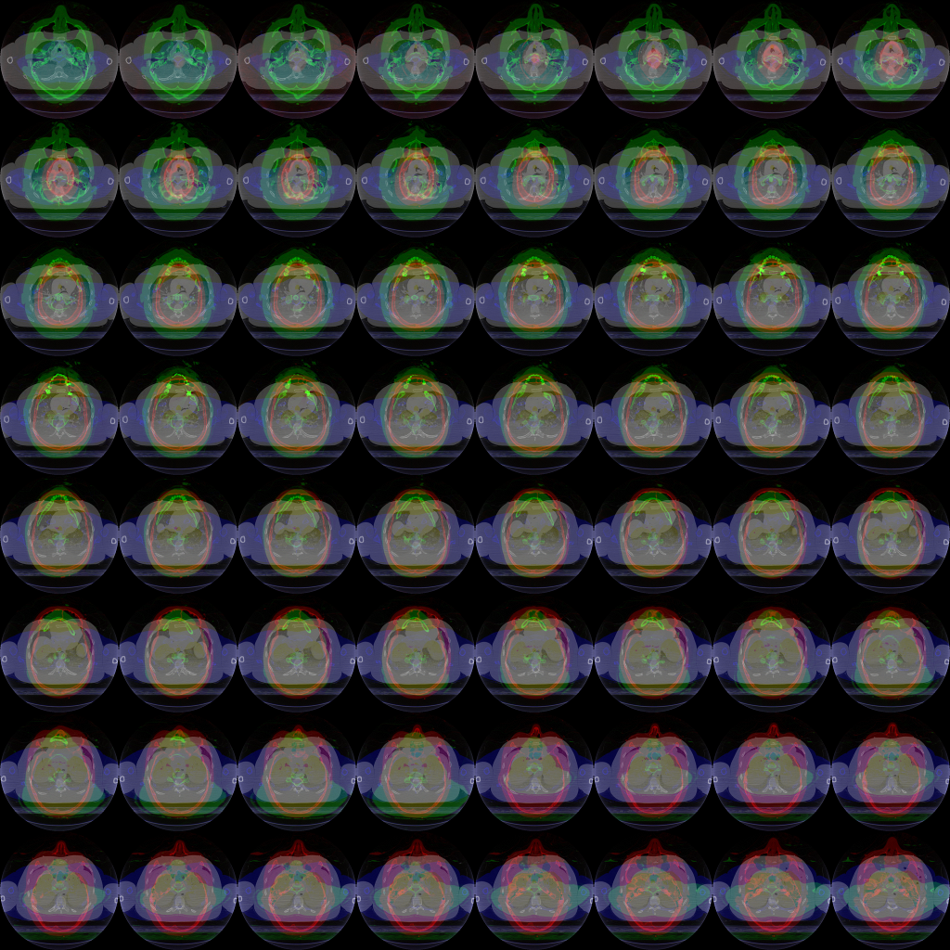
Rendering Volumetric Datasets
2D texture arrays + texture atlas

Slide 100
Rendering Volumetric Datasets
2D texture arrays + compression [Valencia & Vázquez, 2013]
Increase the supported sizes
Increase framerates
Compression format | Compression ratio | RBA format | RGBA format | GPU support | Overall performance | Overall quality
ETC1 | 4:1 | Yes | No | All GPUs | Good (RC) | Good
PVRTC | 8:1 and 16:1 | Yes | Yes | PowerVR | Not so good | Bad
ATITC | 4:1 | Yes | Yes | Adreno | Good (RC) | Good

Slide 101
Rendering Volumetric Datasets
2D texture arrays + compression
ATITC: improves performance from 6% to 19%. With an average of 13.1% and a low variance of performance.
ETC1(-P): improves performance from 6.3% to 69.5%. With an average of 32.6% and the highest variance of performance.
PVRTC-4BPP: improves performance from 4.7% and 36.% and PVRTC-2BPP: from 9,5% to 36,5%. The average performance of both methods is ~15% with high variance.

Slide 102
Rendering Volumetric Datasets
2D texture arrays + compression
Ray-casting: gain performance in average of 33%.
Slice-based: gain performance in average o f 8%.
Ray-casting frame rates are better in all cases compared to slice-based.

Slide 103
Rendering Volumetric Datasets
2D texture arrays + compression

Slide 104
Rendering Volumetric Datasets
2D texture arrays + compression

Slide 105



Rendering Volumetric Datasets
2D texture arrays + compression
a) Uncompressed dataset | b) Dataset compressed with ATI-I compression format | c) Dataset compressed with ETC1-P compression format

Slide 106



Rendering Volumetric Datasets
2D texture arrays + compression
Uncompressed | Compressed with PVRTC-4BPP | Compressed with PVRTC-2BPP

Slide 107
Rendering Volumetric Datasets
3D textures [Balsa & Vázquez, 2012]
Allow either 3D slices or GPU-based ray casting
Initially, only a bunch of GPUs sporting 3D textures (Qualcomm’s Adreno series >= 200)
Performance limitations (data: 256³ – screen resol. 480x800)
1.63 for 3D slices
0.77 fps for ray casting

Slide 108
Rendering Volumetric Datasets

Slide 109
Rendering Volumetric Datasets
2D slices

Slide 110
Rendering Volumetric Datasets
2D slices vs 3D slices vs raycasting

Slide 111
Rendering Volumetric Datasets
Transfer Function edition

Slide 112


Rendering Volumetric Datasets
Finger
Notes:
We have also implemented a transfer function editor.
*For that we have prepared a video

Slide 113

Rendering Volumetric Datasets
Low resolution when interacting
Refine when still
Samsung Galaxy S (512MB)

Slide 114
Rendering Volumetric Datasets
Using Metal on an iOS device [Schiewe et al., 2015]
Taken from [Schiewe et al., 2015]

Slide 115
Volume data. GPU ray casting on mobile
Using Metal on an iOS device [Schiewe et al., 2015]
Standard GPU-based ray casting
Provides low level control
Improved framerate (2x, to a maximum of 5-7 fps) over slice-based rendering
Models noticeably smaller than available memory (max. size was 256²x942)

Slide 116
Rendering Volumetric Datasets
Conclusion
Volume rendering on mobile devices possible but limited
Can use daptive rendering (half resolution when interacting)
3D textures in core GLES 3.0
Still limited performance (~7fps…)
Interaction still difficult
Client-server architecture still alive
Can overcome data privacy/safety & storage issues
Better 4G-5G connections
…

Slide 117
Interaction
Scalable Mobile Visualization

Slide 118



HuMoRS: Huge models Mobile Rendering System [Balsa et al. 2014]

Slide 119




Context
Cultural Heritage
Cultural Tourism
Pre-visit
Visit
Post-visit
Documentation
Immersion
Emotional possession
3D representation
+ additional information

Slide 120

HuMoRS

Slide 121
Related work
Massive model rendering - mobile
Existing solutions on desktop [STAR Yoon’08]
Recent results on mobile [Gobbetti’12 / Balsa’13]
Interactive exploration – mobile
Virtual trackball variations [Chen’88,Shoemake’92]
Constrained navigation [Burtnyk’06,McCrae’09,Marton’12]
Gestures – strokes [Decle & Hachet’09]
Automatic pivoting [Trindade & Raposo’11]
Image-assisted navigation
Images linked to viewpoints [Pintore’12]
Hot-spots [Andujar’12]
Image-clustering – distance [Ryu’10,Mota’08,Jang’09]

Slide 122

System Overview
Multiresolution framework [ATP - Balsa et al. 2013]
Interaction method [Virtual Trackball + automatic centering pivot]
Image-assisted exploration [close views proposal]

Slide 123


Interaction Method
Based on Virtual Trackball
Automatic centering pivot
Stochastic point sampling of the model
visible part only
Weighted average on X,Y,Z
Gaussian filter
Centered on clip space 0,0 for XY
Centered on near plane for Z (closer to obs)
Y
X
Clip space
Z
(-1,-1,-1)
(1,1,1)

Slide 124

Image-assisted exploration
Context-based guided exploration
Manual authoring
View information stored in server
Suggested close interesting views
Image-space distance sorting
Uniform point sampling from current view
Point set projected into current and candidate view
2D pair-wise distance are computed for each candidate view with respect to current
View filtering
Closest N views ← Knn search
Closest M < N views selected by image-space distance sorting

Slide 125
HuMoRS

Slide 126
Conclusions
Advantages
Natural multi scale navigation
Gesture based
No need for precise selection
Image assisted navigation
Limitations
No collision detection
Gesture interaction still imposes relevant occlusion on small screens

Slide 127
Summary
Interactive exploration of large mesh models
Fixed coarse subdivision -- Adaptive QuadPatches
Fixed number of patches, multiresolution inside patches
Simple, but limited by topology issues
Adaptive coarse subdivision -- Compact Adaptive TetraPuzzles
Multiresolution by combining a variable number of fixed-size patches
More general, but more complex
Interactive exploration of complex scenes
Guided navigation + Global Illumination, but limited freedom
Practical volume rendering on mobile devices
Almost there ? – too much fragment load → mobile GPU ☹☹☹

