Slide 1
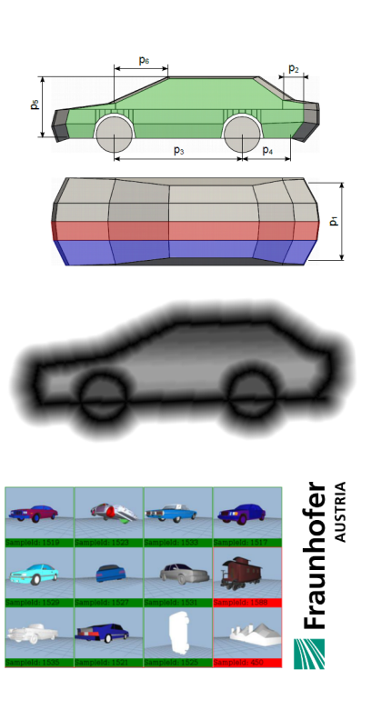
Content-based Retrieval of 3D Models using Generative Modeling Techniques
Harald Grabner, Torsten Ullrich, Dieter W. Fellner
TU Graz & Fraunhofer Austria Research GmbH
TU Darmstadt & Fraunhofer IGD, Germany
www.fraunhofer.at

