Slide 1
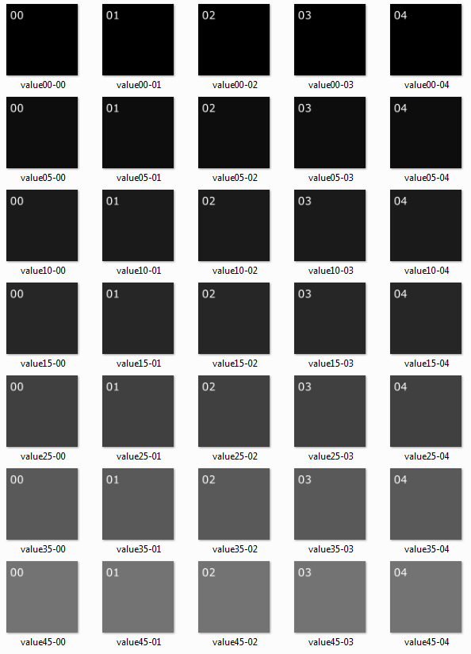
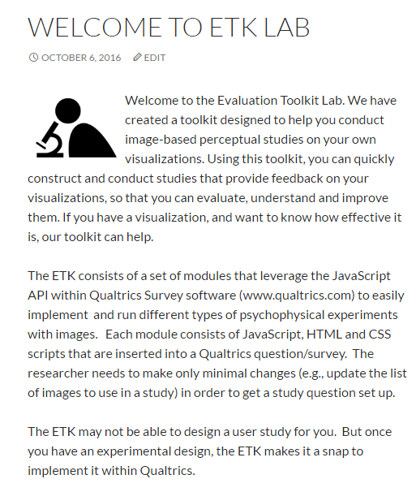
Tutorial: Creating a 2-Alternative Forced Choice Experiment using ETK: the Evaluation Toolkit
Design your experiment and create stimuli images
Trivial example included in ETK: 2AFC to determine discrimination threshold for “grey” not black
ETK homepage: etklab.org
GitHub: github.com/ascr-ecx/etk

Slide 2
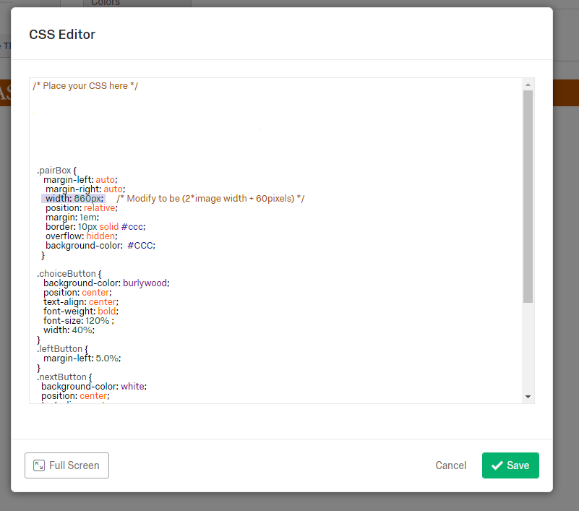
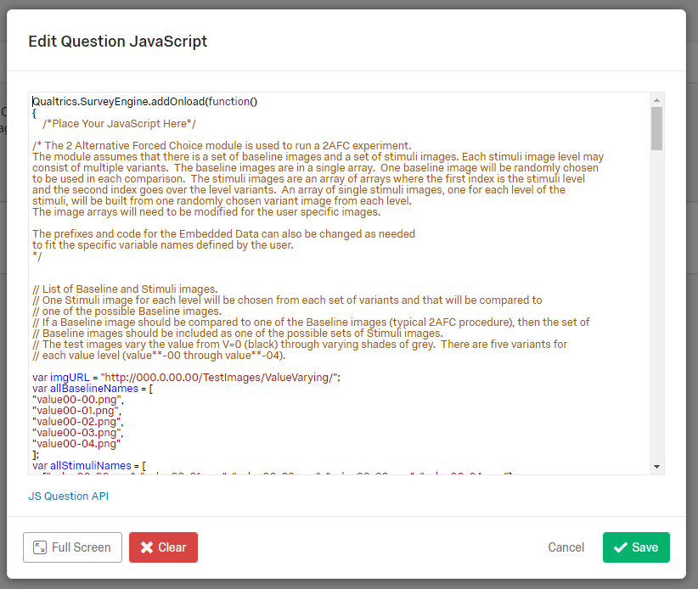
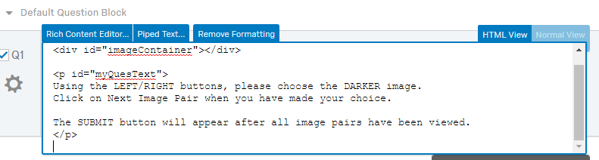
Create a Qualtrics survey; insert the ETK JavaScript, HTML & CSS files; modify as needed to point to array of your stimuli images

Slide 3
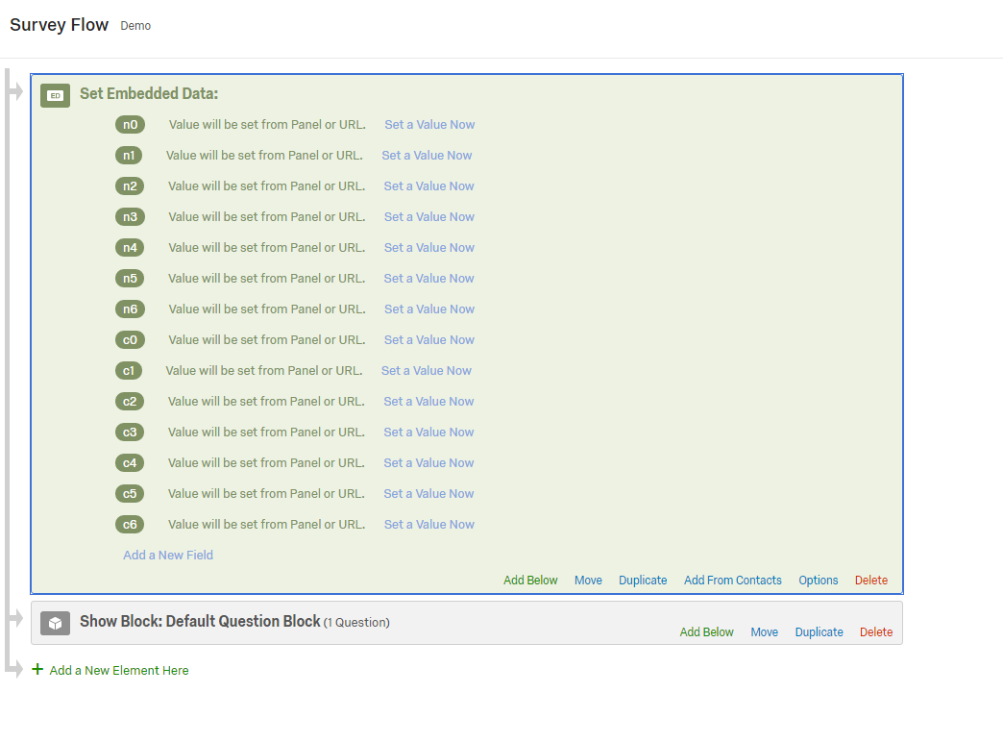
Create output variables

Slide 4
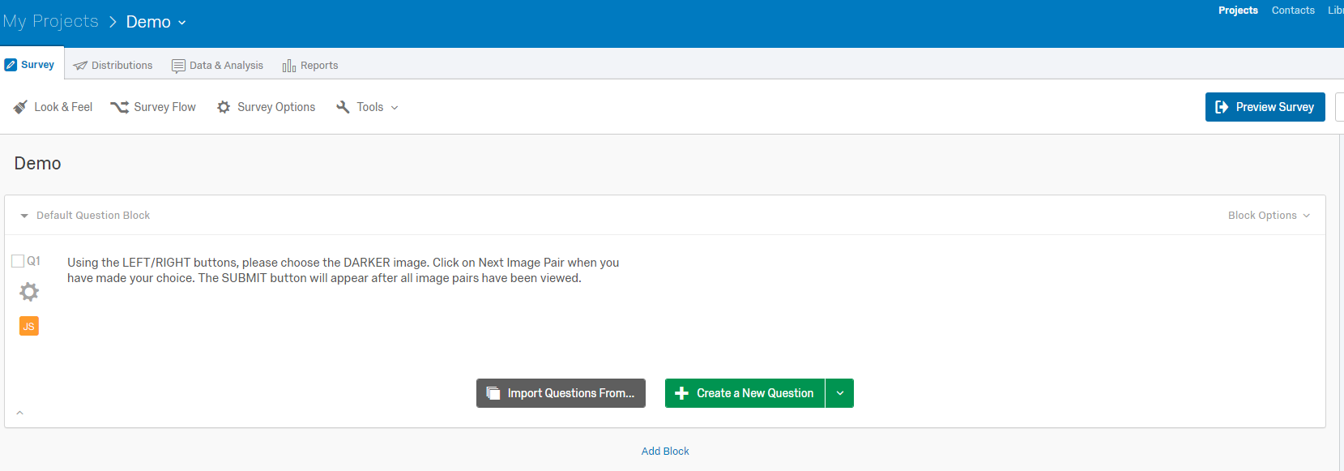
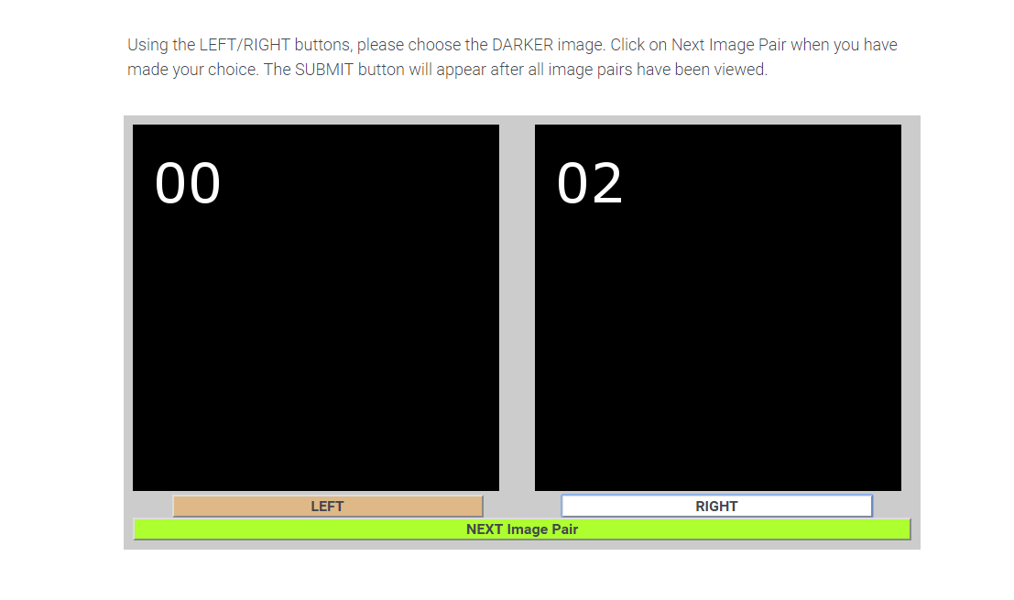
Now we are ready to preview the survey!
Study screenshot: Can you tell which is the darker image?

Slide 5
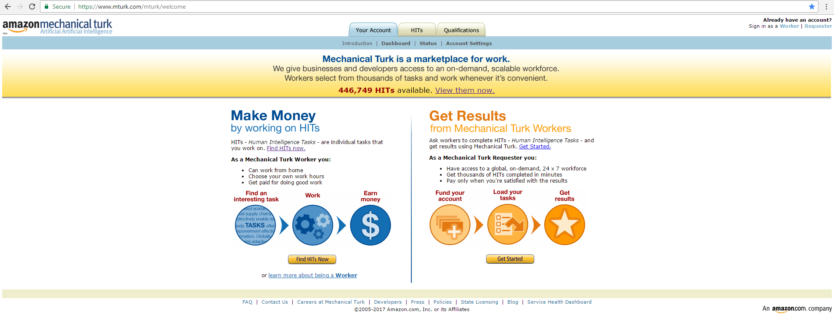
Run the study in the lab or crowdsource
https://www.mturk.com/mturk/welcome

