Slide 1
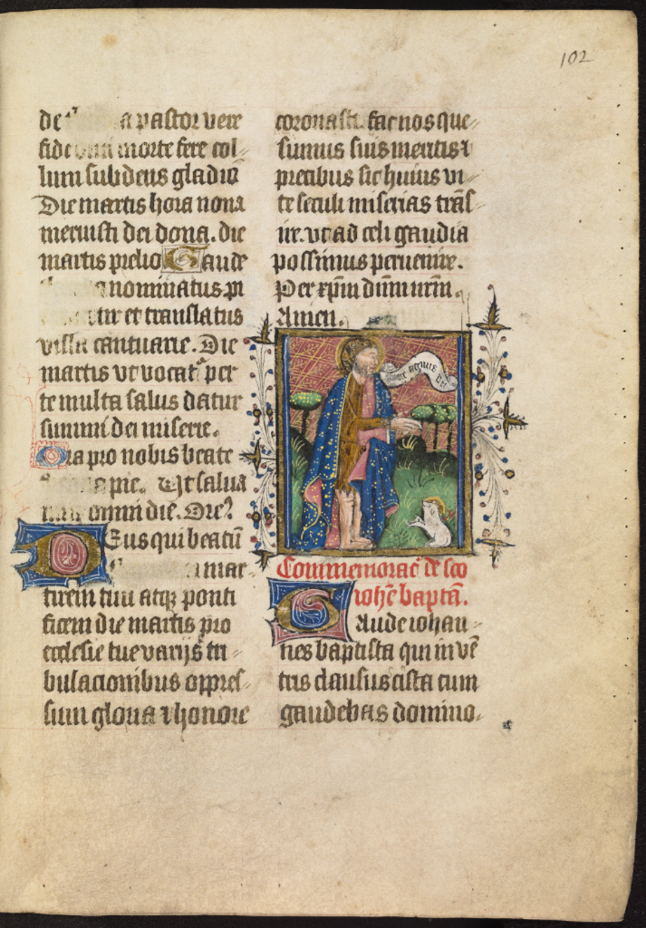


A TaLISMAN: Automatic Text and LIne Segmentation of historical MANuscripts
Ruggero Pintus¹, Ying Yang², Enrico Gobbetti¹ and Holly Rushmeier²
¹CRS4
²Yale University
ruggero.pintus@crs4.it, ying.yang.yy368@yale.edu, enrico.gobbetti@crs4.it, holly.rushmeier@yale.edu

Slide 2
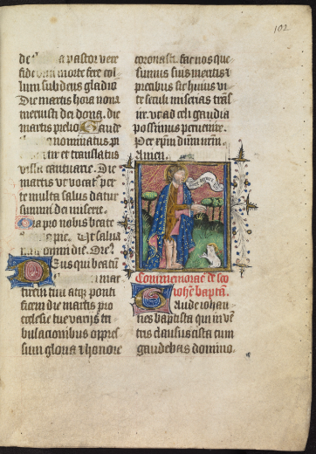
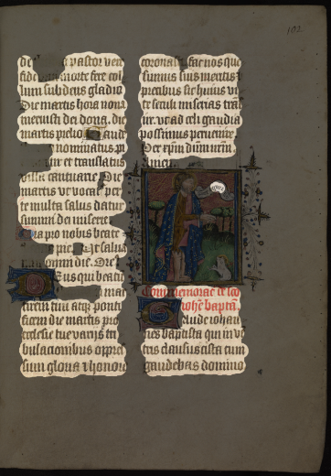
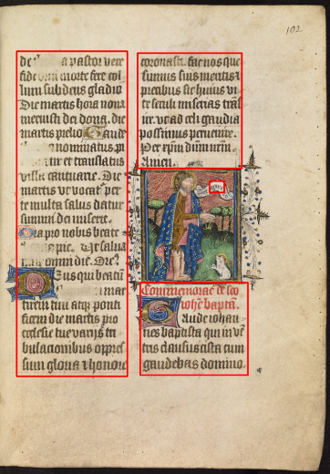
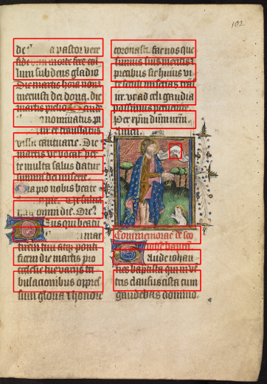
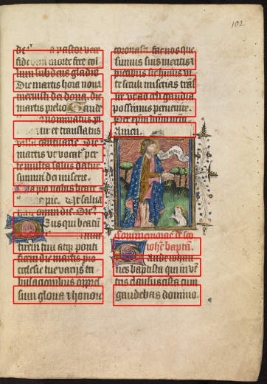
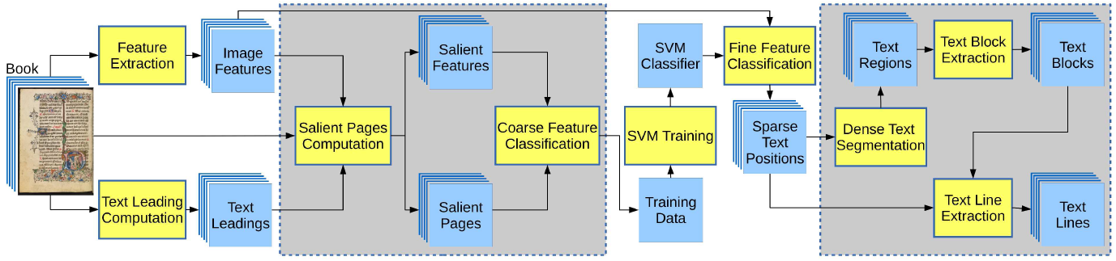
Titel
Original
Text regions
Text blocks
Text lines
Given a book, we extract per-page text leadings and features.
We select the most salient pages and image descriptors, and we compute a rough text segmentation that we use to train a SVM classifier.
We re-launch the prediction to all original features to obtain a fine segmentation.
We convert these sparse text positions into a dense text region representation, and we finally extract text blocks and lines.
Evaluated on a heterogeneous corpus content: ~3K pages, ~4K blocks, ~66K lines
Robust to:
- Different writing styles
- High layout variability - One, two or more columns, marginalia, calendars
- Presence of capital letters, portraits, ornamental bands, graphical contents
- Aging – holes, spots, ink bleed-through, fading, missing parts, damages

