Slide 1
Part 2
Mobile graphics trends
Hardware architectures
Applications

Slide 2
Hardware architectures

Slide 3
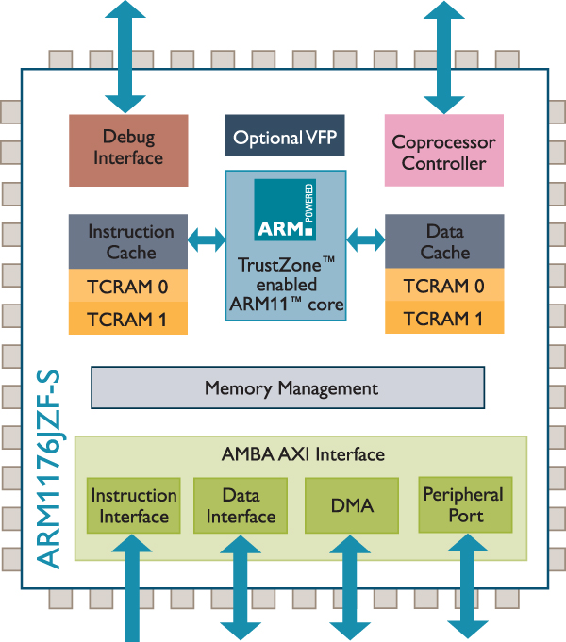
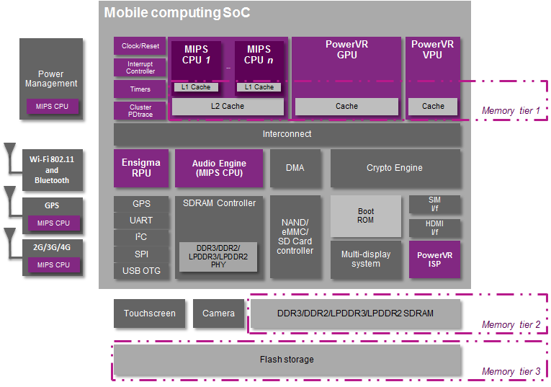
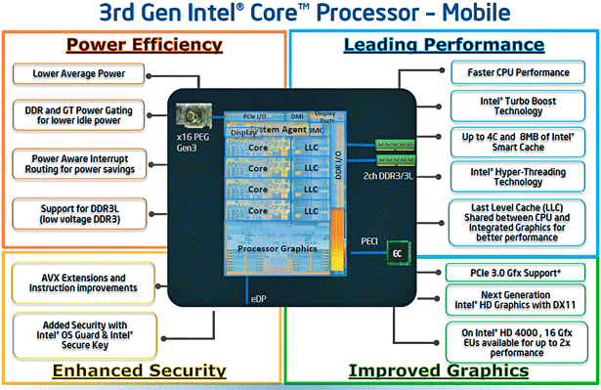
Architectures
ARM
MIPS
x86
Notes:
Intel/ARM
http://www.infoworld.com/d/computer-hardware/intel-vs-arm-two-titans-tangled-fate-237265?page=0,1
AMD
http://www.anandtech.com/show/7514/amd-2014-mobile-apu-update-beema-and-mullins
http://www.enterprisetech.com/2014/05/05/amd-unify-x86-arm-systems-skybridge/

Slide 4
Architectures
x86 (CISC 32/64bit)
Intel Atom Z3740/Z3770
Bay Trail (2W)
AMD Mullins (not yet in the market)
4.5W
ARM
RISC 32/64bit
MIPS
RISC 32/64bit
Acquired by Imagination, Inc. @2014
-Power consumption
+Performance PartOf(desktop class GPU)
+compatibility with old SW ?
+Power efficiency
+Performance/watt
+Smaller area (RISC) → lower cost
+demonstrated its capacities on consoles (PS/PS2/PSP/N64/Wii…), also on SGI ☺
Notes:
Intel/ARM
http://www.infoworld.com/d/computer-hardware/intel-vs-arm-two-titans-tangled-fate-237265?page=0,1
AMD
http://www.anandtech.com/show/7514/amd-2014-mobile-apu-update-beema-and-mullins
http://www.enterprisetech.com/2014/05/05/amd-unify-x86-arm-systems-skybridge/

Slide 5
Architectures – RISC vs. CISC but…
CISC (Complex Instruction Set Computer)
Fast program execution (optimized complex paths)
Complex instructions (i.e. memory-to-memory instructions)
RISC (Reduced Instruction Set Computer)
Fast instructions (fixed cycles per instruction)
Simple instructions (fixed/reduced cost per instruction)
FISC (Fast Instruction Set Computer)
Current RISC processors integrate many improvements from CISC: superscalar, branch prediction, SIMD, out-of-order
Philosophy → fixed/reduced cycle count/instr. (SIMD?)
Discussion (Post-RISC):
http://archive.arstechnica.com/cpu/4q99/risc-cisc/rvc-5.html
Notes:
CISC – fast program execution, complex HW
RISC – fast instructions, simple HW, complexity on the compiler
FISC – starts from RISC, takes from CISC, improve performance at the cost of HW complexity
Intel/ARM
http://www.infoworld.com/d/computer-hardware/intel-vs-arm-two-titans-tangled-fate-237265?page=0,1
AMD
http://www.anandtech.com/show/7514/amd-2014-mobile-apu-update-beema-and-mullins
http://www.enterprisetech.com/2014/05/05/amd-unify-x86-arm-systems-skybridge/

Slide 6
Architectures – X86
Intel (32/64 bit)
Competitive with Bay Trail Atom Z3470 ~4W
Pursuing low power consumption instead of performance
GPU: Intel HD graphics for Bay Trail ~ GF 8600M GT | GF210
Present in many tablets (i.e. Surface) with Windows Phone/Android
Present in a few smartphones
AMD
Not yet competitive in low power > 4W ☹
Good GPU performance (GCN 192 core)
No known smartphone/tablet shipped
Supported on
Android, Windows Phone, Tizen, Firefox OS, Ubuntu Touch,…

Slide 7
Architectures – X86
Typically paired with integrated GPU
Intel HD Graphics
Radeon APU
General strategies
Well known from desktop
Mostly → Cache coherence temporal/spatial ordering
~Typically lower frequency → exploit multi-core
SIMD → MMX/SSE/SSE3/SSE3
Desktop entry-level GPU performance
Although cut down ☹
Notes:
Intel HD4000 4EU instead of 16 on mobile

Slide 8
Architectures – ARM
ARM Ltd.
RISC processor (32/64 bit)
IP (intellectual property) – Instruction Set / ref. implementation
CPU / GPU (Mali)
Licenses (instruction set OR ref. design)
Instruction Set license -> custom made design (SnapDragon, Hummingbird in iPhone 4 & Galaxy S)
Optimizations (particular paths, improved core freq. control,…)
Reference design (Cortex A9, Cortex A15, Cortex A53/A57…)
Licensees (instruction set OR ref. design)
Apple, Qualcomm, Samsung, Nvidia, MediaTek, AMD @<2014…
Few IS licenses, mostly adopting reference design
Manufacturers
Contracted by Licensees
GlobalFoundries, United Microelectronics, TSM, and Intel (@2013) ☺

Slide 9
Architectures – ARM…
Suppported on
Android, iOS, Win Phone, Tizen, Firefox OS, BlackBerry, Ubuntu Phone, …
Biggest mobile market share
Typically paired with mobile GPUs:
Adreno 4x0/5x0 – Qualcomm
PowerVR 8XE (Rogue) – Imagination
Mali T8x0/G51/G71 – ARM
Nvidia Tagra K1/X1
Vivante GC7000/8000
General strategies:
Cache coherence – week sequential code guarantees on multithreading!!
Heavy dependence on compiler → optimize instruction scheduling
Operation dependencies , loop unrolling, etc…
Use SIMD extensions ☺ → NEON

Slide 10
Architectures - MIPS
MIPS
RISC processor (32/64 bit)
IP (intellectual property) – licensing
Recently acquired by Imagination, Inc.
Can provide full solution (SystemOnChip, SoC): wireless/cpu/gpu
Performance/watt should be comparable to that of ARM
GPU from Imagination have demonstrated its value
iDevices have always included its PowerVR SGX / Rogue cores
Good integration with CPU and other components on SoC could provide a very competitive solution (i.e. Qualcomm)
Supported on
Android, Mer (fork from MeeGo)
Knowledge from previous HW (PSP, PS, PS2, WII…)
Pretty much the same with ARM HW

Slide 11
Some notes on multithreading
SMP (Symmetric Multi Processor) – shared memory
Multithreading – two threads on the same core
Code reordering matters (out of order)
We expect
All memory operations are executed in order
All operations on a single processor appear as executed in order
But
X86 provides processor consistency
Loads are not reordered against other loads (same happens with Stores)
Load and Store instructions are not guaranteed in order
ARM provides even weaker sequential guarantees
Load and Stores can be reordered

Slide 12
Architectures
GPU architectures
Notes:
Intel/ARM
http://www.infoworld.com/d/computer-hardware/intel-vs-arm-two-titans-tangled-fate-237265?page=0,1
AMD
http://www.anandtech.com/show/7514/amd-2014-mobile-apu-update-beema-and-mullins
http://www.enterprisetech.com/2014/05/05/amd-unify-x86-arm-systems-skybridge/

Slide 13
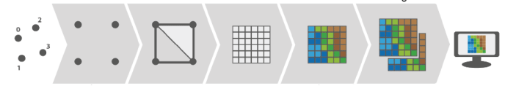
Architectures - GPU
Simplified OpenGL 3D pipeline (ES 2.0 → 3.0)
Primitives
Vertex Processing
Primitive Assembly
Rasterization
Pixel Processing
Framebuffer Operations
Image courtesy of: http://rnd.azoft.com/fluid-dynamics-simulation-on-ios/
Vertex Shader
Fragment
Shader
Tessellation & Geom. Proc.
Tessellation
Eval./Control
Shader
Desktop
Fixed hardware:
Vertex + Pixel Shaders
GPU
Unified Shaders:
Vertex/Pixel -- Compute
Geometry
Shader
Notes:
Typical OpenGL 3D pipeline
2 types:
-fixed vertex / fragment processors (tegra 2/3/4, mali 400, PowerVR SGX 5XX)
-unified shaders (tegra K1/X1, mali 7XX, Snapdragon 400, PowerVR G6XXX)

Slide 14
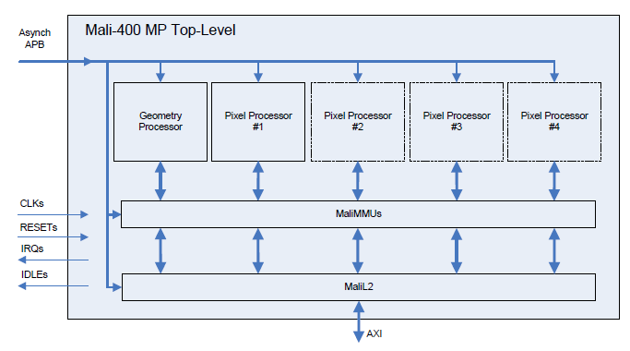
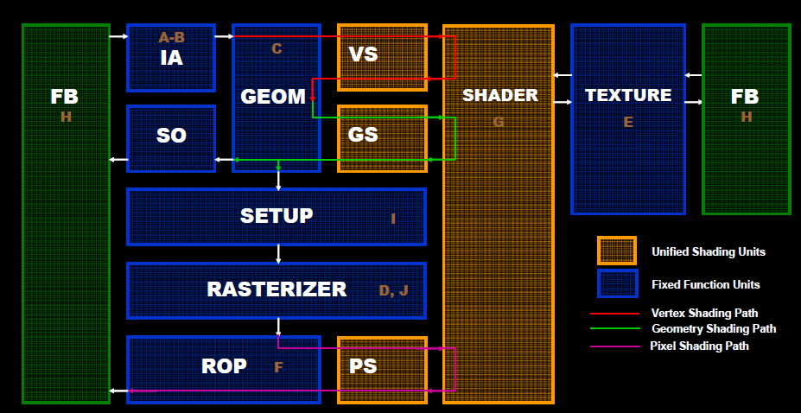
Architectures - GPU
→ (#ALU/MADDs / core)
Dedicated shaders
Vertex Shader + Pixel Shader
Unified architecture (modern)
Shader core
Vertex/Geometry/?/Pixel shader
Texture access
Triangle Assembler
Rasterizer
Notes:
Barrel processor: changes thread every N instructions, shared context or many registers to hold context and avoid context-switching
Mali
http://www.techradar.com/news/phone-and-communications/mobile-phones/arm-mali-mobile-graphics-everything-you-need-to-know-1095888
Adreno
http://www.anandtech.com/show/6112/qualcomms-quadcore-snapdragon-s4-apq8064adreno-320-performance-preview

Slide 15
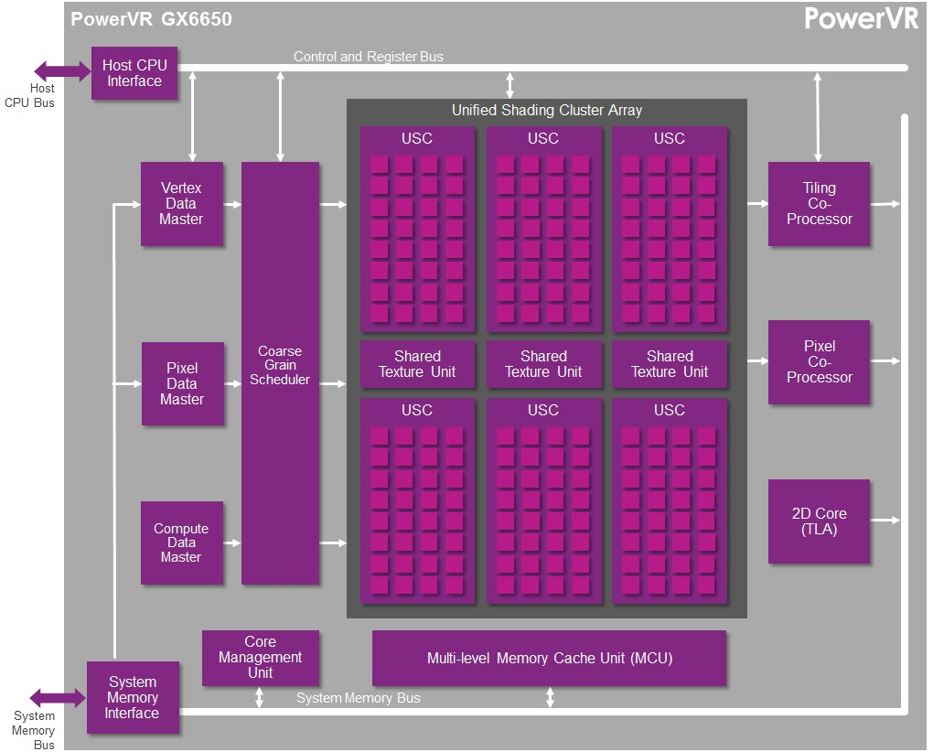
Architectures - GPU
Talking about performance…
What is a GPU core ?
Mobile → typically full core/proc
Replication of HW at high level
Desktop
Compute Units ? ALUs ?...
We’ll try to count ALUs
Nowadays less hard to find info
Mali 400MP4 -> full 4 cores (~proc)!
PowerVR SGX544MP3 → 3 full cores!
Notes:
Typical OpenGL 3D pipeline

Slide 16
Architectures – GPU
Immediate Mode Rendering (IMR)
Tile Based Rendering (TBR)
Tile Based Deferred Rendering (TBDR)
Notes:
IMR / TBR / TBDR
http://blog.imgtec.com/powervr/understanding-powervr-series5xt-powervr-tbdr-and-architecture-efficiency-part-4
http://wenku.baidu.com/view/85ea8fec998fcc22bcd10dcb.html

Slide 17
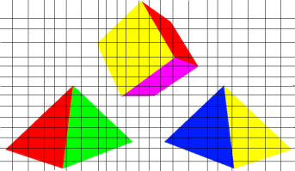
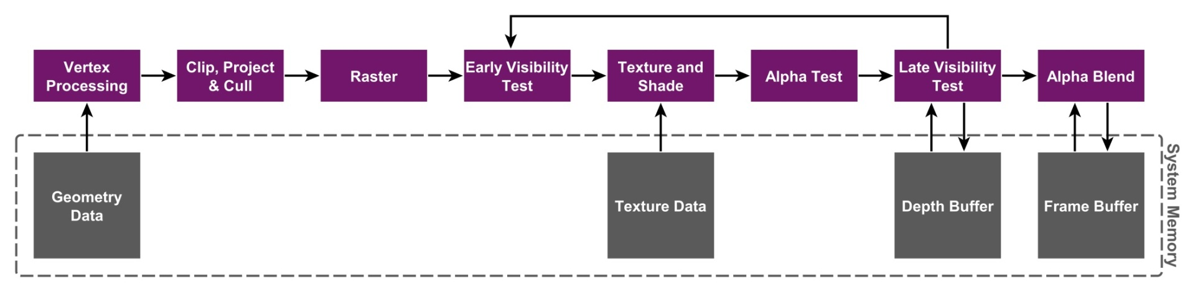
Architectures – GPU
VS
FS
Inmediate Mode Rendering (IMR)
Geometry is processed in submission order
High overdraw (shaded pixels can be overwritten)
Buffers are kept in System Memory
High bandwidth / power / latency
Early-Z helps depending on geometry sorting
Depth buffer value closer than fragment → discard
http://blog.imgtec.com/powervr/understanding-powervr-series5xt-powervr-tbdr-and-architecture-efficiency-part-4
Notes:
IMR / TBR / TBDR
http://blog.imgtec.com/powervr/understanding-powervr-series5xt-powervr-tbdr-and-architecture-efficiency-part-4
http://wenku.baidu.com/view/85ea8fec998fcc22bcd10dcb.html

Slide 18
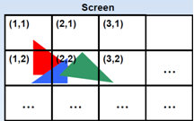
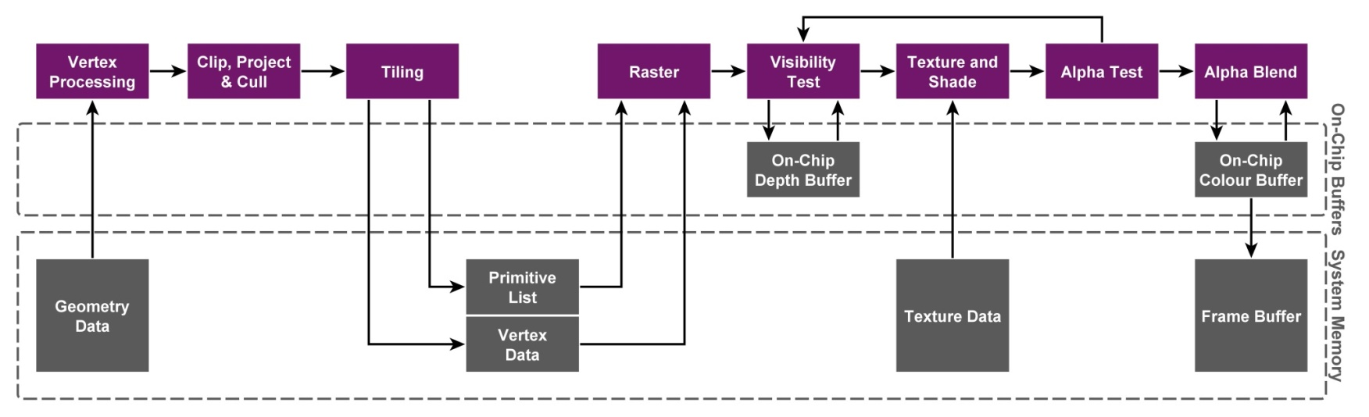
Architectures – GPU
Tile Based Rendering (TBR)
Rasterizing per-tile (triangles in bins per tile) 16x16, 32x32
Buffers are kept on-chip memory (GPU) – fast! → geometry limit?
Triangles processed in submission order (TB-IMR)
Overdraw (front-to-back -> early z cull)
Early-Z helps depending on geometry sorting
http://blog.imgtec.com/powervr/understanding-powervr-series5xt-powervr-tbdr-and-architecture-efficiency-part-4

Slide 19
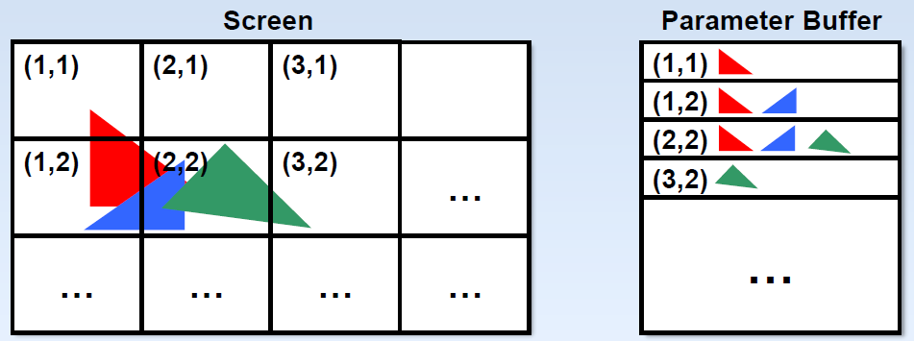
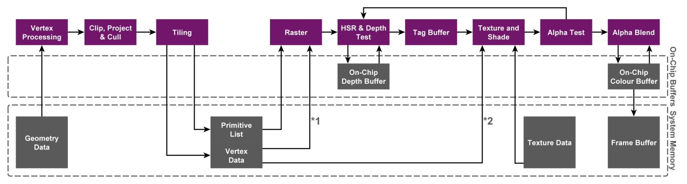
Architectures – GPU
Tile Based Deferred Rendering (TBDR)
Fragment processing (tex + shade) ~waits for Hidden Surface Removal
Micro Depth Buffer – depth test before fragment submission
whole tile → 1 frag/pixel ☺
iPAD 2X slower than Desktop GeForce at HSR (FastMobileShaders_siggraph2011)
Possible to prefetch textures before shading/texturing
Hard to profile!!! ~~~Timing?
Limit: ~100Ktri + complex shader
http://blog.imgtec.com/powervr/understanding-powervr-series5xt-powervr-tbdr-and-architecture-efficiency-part-4
Notes:
http://www.anandtech.com/show/735/3
Rather than process one polygon at a time without knowledge of other polygons in the scene, a tile based renderer first groups polygons together in groups called display lists. These display lists allow a scene to be broken into smaller blocks, known as tiles, which are then rendered independently.
The first advantage to rendering smaller portions of a scene at once is that it allows operations to be performed on-chip without having to access external memory. This allows all z-calculations to be performed without having to access an external z-buffer via the memory bus. Naturally, this eliminates the expensive z-buffer reads and writes that occur constantly on immediate mode renderers.
Rendering small tiles instead of a complete scene also means that pixels that are not visible can be thrown out before the rendering process beings. Since each tile consists of a display list that includes each polygon in that tile, hidden surface removal can occur before any textures are applied. Once again this significantly reduces the amount of information that must travel over the memory bus, as textures for non-visible surfaces do not need to be processed. Also located on chip is a tile buffer which acts as a fame buffer for an individual tile. This allows blending to be performed without costly memory reads and writ

Slide 20
Applications

Slide 21

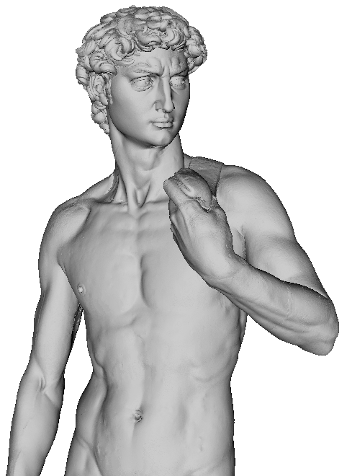
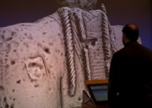
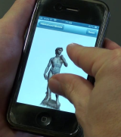
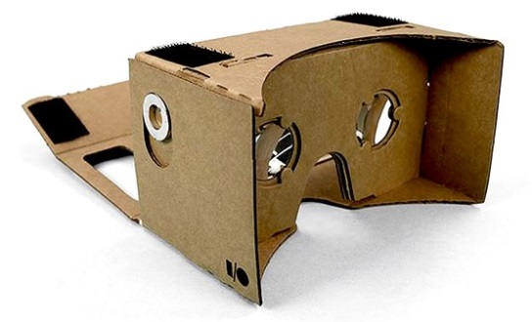
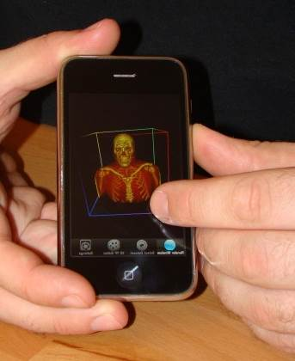
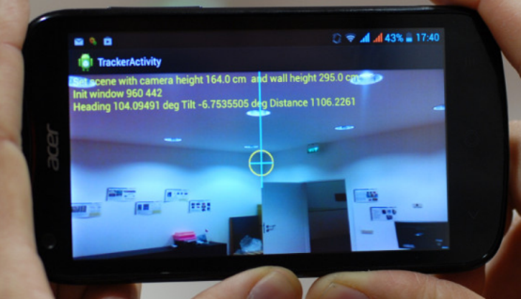
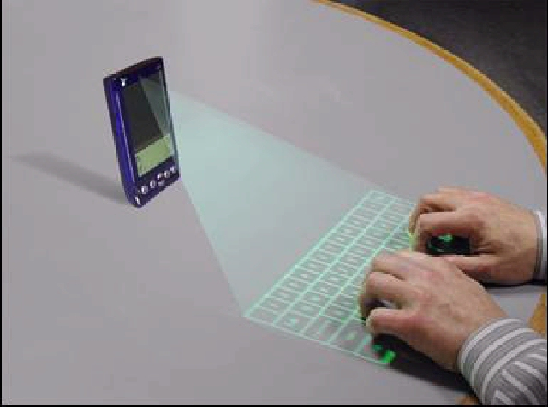
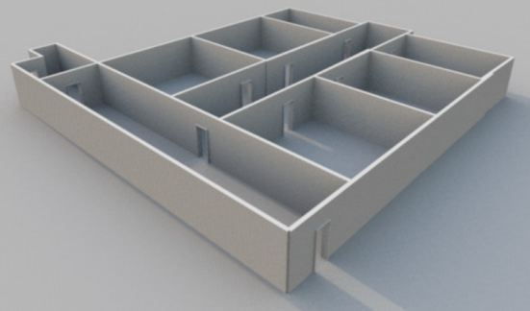
Applications
Wide range of applications
Cultural Heritage
Medical Image
3D object registration
GIS
Gaming
VR & AR
Building reconstruction
Virtual HCI
3D representation
+ additional information

Slide 22
Mobile 3D interactive graphics
General pipeline similar to standard interactive applications
DISPLAY
Frame
DATA
ACCESS
RENDERING
Scene
INTERACTION

Slide 23
Remote rendering
General solution since first PDAs
MOBILE DEVICE
DISPLAY
SERVER
Frame
DATA
ACCESS
RENDERING
Scene
INTERACTION
NETWORK

Slide 24
Remote rendering
3D graphics applications require intensive computation and network bandwidth
electronic games
visualization of very complex 3D scenes
Remote rendering has long history and it is successfully applied for gaming services
Limitation: interaction latency in cellular networks

Slide 25
Mixed Mobile/Remote rendering
As mobile GPUs progress...
MOBILE DEVICE
DISPLAY
SERVER
Frame
DATA
ACCESS
RENDERING
Scene
INTERACTION
NETWORK

Slide 26
Mixed Mobile/Remote rendering
Model based versus Image based methods
Model based methods
Original models
Partial models
Simplified models
Couple of lines
Point clouds
Eisert and Fechteler. Low delay streaming of computer graphics (ICIP 2008)
Gobbetti et al. Adaptive Quad Patches: an Adaptive Regular Structure for Web Distribution and Adaptive Rendering of 3D Models. (Web3D 2012)
Balsa et al.,. Compression-domain Seamless Multiresolution Visualization of Gigantic Meshes on Mobile Devices (Web3D 2013)
Diepstraten et al., 2004. Remote Line Rendering for Mobile Devices (CGI 2004)
Duguet and Drettakis. Flexible point-based rendering on mobile devices (IEEE Trans. on CG & Appl, 2004)

Slide 27
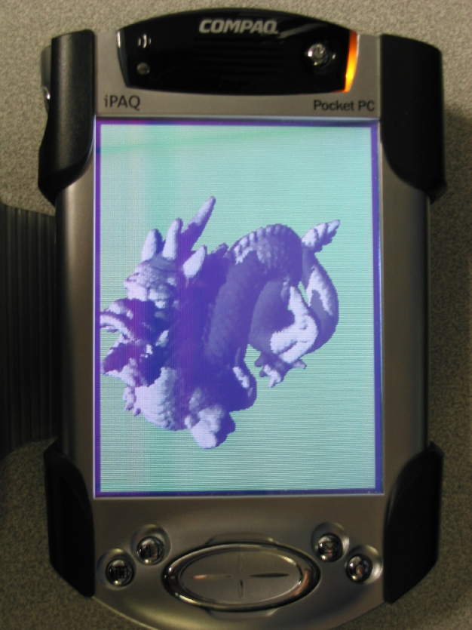
Mixed Mobile/Remote rendering
Model based versus Image based methods
Model based methods
Original models
Partial models
Simplified models
Couple of lines
Point clouds
Eisert and Fechteler. Low delay streaming of computer graphics (ICIP 2008)
Point clouds organized as hierarchical grids.
Tested on PDAs
Gobbetti et al. Adaptive Quad Patches: an Adaptive Regular Structure for Web Distribution and Adaptive Rendering of 3D Models. (Web3D 2012)
Balsa et al.,. Compression-domain Seamless Multiresolution Visualization of Gigantic Meshes on Mobile Devices (Web3D 2013)
Diepstraten et al., 2004. Remote Line Rendering for Mobile Devices (CGI 2004)
Duguet and Drettakis. Flexible point-based rendering on mobile devices (IEEE Trans. on CG & Appl, 2004)

Slide 28
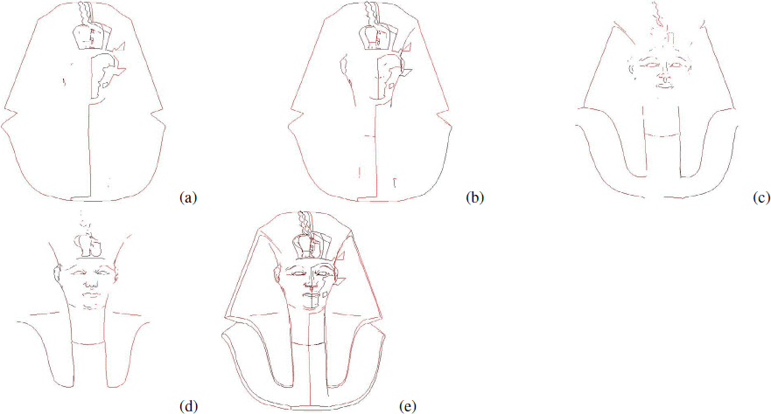
Mixed Mobile/Remote rendering
Model based versus Image based methods
Model based methods
Original models
Partial models
Simplified models
Couple of lines
Point clouds
Eisert and Fechteler. Low delay streaming of computer graphics (ICIP 2008)
Transfer couple of 2D line primitives over the network, which are rendered locally by the mobile device
Gobbetti et al. Adaptive Quad Patches: an Adaptive Regular Structure for Web Distribution and Adaptive Rendering of 3D Models. (Web3D 2012)
Balsa et al.,. Compression-domain Seamless Multiresolution Visualization of Gigantic Meshes on Mobile Devices (Web3D 2013)
Diepstraten et al., 2004. Remote Line Rendering for Mobile Devices (CGI 2004)
Duguet and Drettakis. Flexible point-based rendering on mobile devices (IEEE Trans. on CG & Appl, 2004)

Slide 29
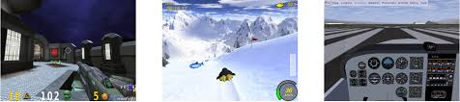
Mixed Mobile/Remote rendering
Model based versus Image based methods
Model based methods
Original models
Partial models
Simplified models
Couple of lines
Point clouds
Eisert and Fechteler. Low delay streaming of computer graphics (ICIP 2008)
Gobbetti et al. Adaptive Quad Patches: an Adaptive Regular Structure for Web Distribution and Adaptive Rendering of 3D Models. (Web3D 2012)
Balsa et al.,. Compression-domain Seamless Multiresolution Visualization of Gigantic Meshes on Mobile Devices (Web3D 2013)
Diepstraten et al., 2004. Remote Line Rendering for Mobile Devices (CGI 2004)
Intercept and stream OpenGL commands
Better performances with respect to video streaming
Duguet and Drettakis. Flexible point-based rendering on mobile devices (IEEE Trans. on CG & Appl, 2004)

Slide 30
Mixed Mobile/Remote rendering
Model based versus Image based methods
Model based methods
Original models
Partial models
Simplified models
Couple of lines
Point clouds
Eisert and Fechteler. Low delay streaming of computer graphics (ICIP 2008)
Gobbetti et al. Adaptive Quad Patches: an Adaptive Regular Structure for Web Distribution and Adaptive Rendering of 3D Models. (Web3D 2012)
Balsa et al.,. Compression-domain Seamless Multiresolution Visualization of Gigantic Meshes on Mobile Devices (Web3D 2013)
Diepstraten et al., 2004. Remote Line Rendering for Mobile Devices (CGI 2004)
More details in Part 5
Duguet and Drettakis. Flexible point-based rendering on mobile devices (IEEE Trans. on CG & Appl, 2004)

Slide 31
Mixed Mobile/Remote rendering
Image based methods
Image impostors
Environment maps
Depth images
Noimark and Cohen-Or. Streaming scenes to mpeg-4 video-enabled devices (IEEE, CG&A 2003)
Lamberti and Sanna. A streaming-based solution for remote visualization of 3D graphics on mobile devices (IEEE, Trans. VCG, 2007)
Bouquerche and Pazzi. Remote rendering and streaming of progressive panoramas for mobile devices (ACM Multimedia 2006)
Zhu et al. Towards peer-assisted rendering in networked virtual environments (ACM Multimedia 2011)
Shi et al. A Real-Time Remote Rendering System for Interactive Mobile Graphics
(ACM Trans. On Multimedia, 2012)
Doellner et al. Server-based rendering of large 3D scenes for mobile devices using G-buffer cube maps ( ACM Web3D, 2012)

Slide 32
Mobile visualization systems
Volume rendering
Point cloud rendering
Moser and Weiskopf. Interactive volume rendering on mobile devices. Vision, Modeling, and Visualization VMV. Vol. 8. 2008.
Noguerat al. Volume Rendering Strategies on Mobile Devices. GRAPP/IVAPP. 2012.
Campoalegre, Brunet, and Navazo. Interactive visualization of medical volume models in mobile devices. Personal and ubiquitous computing 17.7 (2013): 1503-1514.
Rodríguez, Marcos Balsa, and Pere Pau Vázquez Alcocer. Practical Volume Rendering in Mobile Devices. Advances in Visual Computing. Springer, 2012. 708-718.
Balsa et al. Interactive exploration of gigantic point clouds on mobile devices. ( VAST 2012)
He et al. A multiresolution object space point-based rendering approach for mobile devices (AFRIGRAPH, 2007)

Slide 33
Mobile visualization systems
Volume rendering
Point cloud rendering
Moser and Weiskopf. Interactive volume rendering on mobile devices. Vision, Modeling, and Visualization VMV. Vol. 8. 2008.
Noguerat al. Volume Rendering Strategies on Mobile Devices. GRAPP/IVAPP. 2012.
Campoalegre, Brunet, and Navazo. Interactive visualization of medical volume models in mobile devices. Personal and ubiquitous computing 17.7 (2013): 1503-1514.
Rodríguez, Marcos Balsa, and Pere Pau Vázquez Alcocer. Practical Volume Rendering in Mobile Devices. Advances in Visual Computing. Springer, 2012. 708-718.
Balsa et al. Interactive exploration of gigantic point clouds on mobile devices. ( VAST 2012)
He et al. A multiresolution object space point-based rendering approach for mobile devices (AFRIGRAPH, 2007)

Slide 34
Mobile rendering
Nowadays...
MOBILE DEVICE
DISPLAY
Frame
DATA
ACCESS
RENDERING
Scene
INTERACTION

Slide 35
Mobile rendering
Or better...
MOBILE DEVICE
SERVER
DISPLAY
Frame
DATA
ACCESS
RENDERING
Scene
INTERACTION
NETWORK

Slide 36
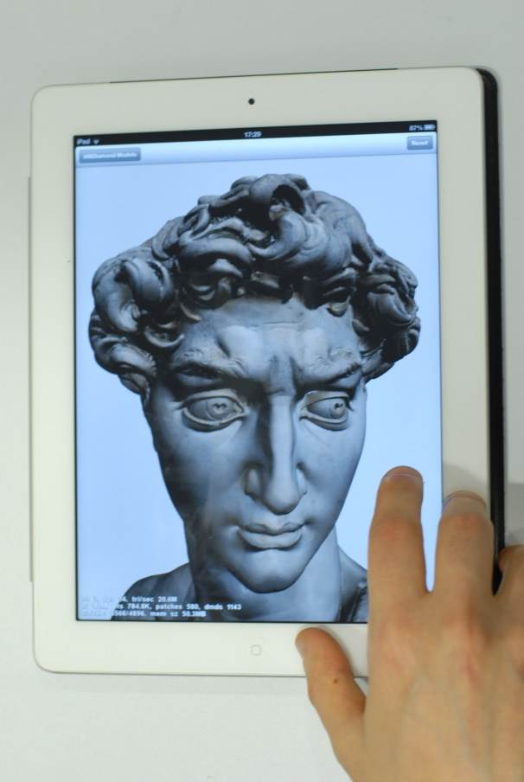
Mobile rendering
Or better...
MOBILE DEVICE
SERVER
DISPLAY
Chunk-based data streaming
(like HuMoRS Balsa et al. 2014)
Limitations: bandwidth consumption (for now)
Frame
DATA
ACCESS
RENDERING
Scene
INTERACTION
NETWORK

Slide 37
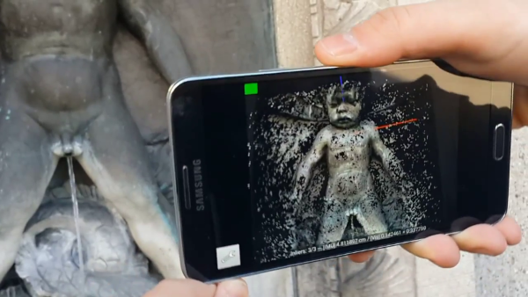
Mobile rendering with capture
Exploiting mobile device sensors...
MOBILE DEVICE
Environment
CAPTURE
DISPLAY
3D scanning with mobile phone
Kolev et al, CVPR 2014
ETH Zurich
Frame
DATA
ACCESS
RENDERING
Scene
INTERACTION
Kolev et al. Turning Mobile Phones into 3D Scanners (CVPR 2014)
Tanskanen et al. Live Metric 3D Reconstruction on Mobile Phones (ICCV 2013)

Slide 38
Trends in mobile graphics
Hardware acceleration for improving frame rates, resolutions and rendering quality
Parallel pipelines
Real-time ray tracing
Multi-rate approaches

Slide 39
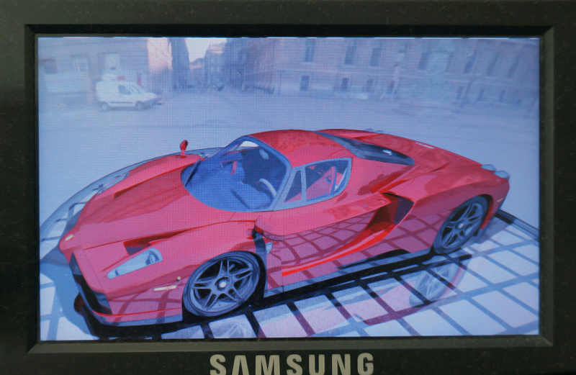
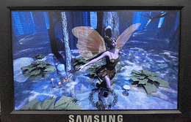
SGRT: Real-time ray tracing
Samsung reconfigurable GPU based on Ray Tracing
Main key features:
an area-efficient parallel pipelined traversal unit
flexible and high-performance kernels for shading and ray generation
Shin et al., Full-stream architecture for ray tracing with efficient data transmission, 2014 IEEE ISCAS
Lee, Won-Jong, et al. SGRT: A mobile GPU architecture for real-time ray tracing. Proceedings of the 5th High-Performance Graphics Conference, 2013.

Slide 40
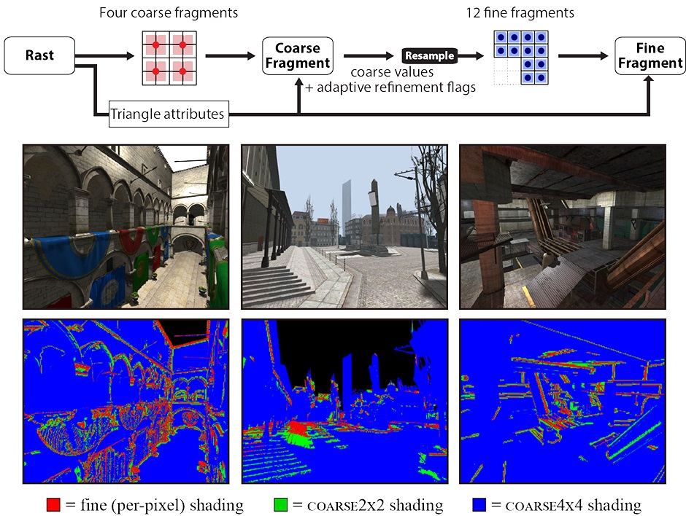
Adaptive multi-rate shading
The multi-rate shading pipeline rasterizes triangles into coarse fragments that correspond to multiple pixels of coverage
Coarse fragments are shaded, then partitioned into fine fragments for subsequent per-pixel shading
If the coarse fragment shader determines an effect should not be evaluated at low sampling rates, these computations are performed in the fine shading stage
Complex pipeline scheduling reduce shading costs to more than three and sometimes up to a factor of five.
He et al. Extending the graphics pipeline with adaptive, multi-rate shading. ACM Transactions on Graphics (TOG) 33.4 , 2014.

Slide 41
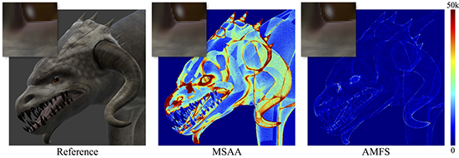
Adaptive multi-frequency shading
Real-time rendering of tessellated geometry is still fairly expensive, as current pixel shading methods, e.g. MSAA), do not scale well with geometric complexity.
Pixel shading is tied to the coarse input patches and reused between triangles, effectively decoupling the shading cost from the tessellation level.
AMFS can evaluate different parts of shaders at different frequencies, allowing very efficient shading.
Clarberg, Petrik, et al. AMFS: adaptive multi-frequency shading for future graphics processors. ACM Transactions on Graphics (TOG) 33.4 , 2014.

Slide 42
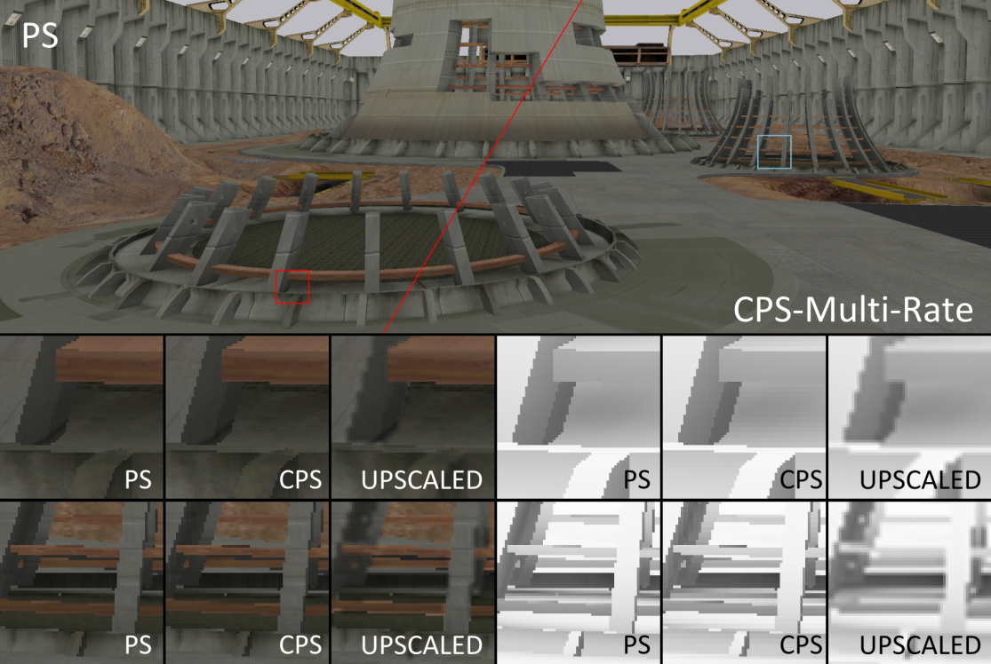
Coarse pixel shading
Architecture for varying shading rates in a rasterization pipeline, while keeping the visibility sampling rate constant
A single rendering pass executes shading code at one or more different rates: per group of pixels, per pixel, and per sample
Vaidyanathan, Karthik, et al. Coarse Pixel Shading. Eurographics/ACM SIGGRAPH Symposium on High Performance Graphics, 2014.

Slide 43
Mobile rendering with capture
Exploiting mobile device sensors...
MOBILE DEVICE
Environment
CAPTURE
DISPLAY
Frame
DATA
ACCESS
RENDERING
Scene
INTERACTION

Slide 44
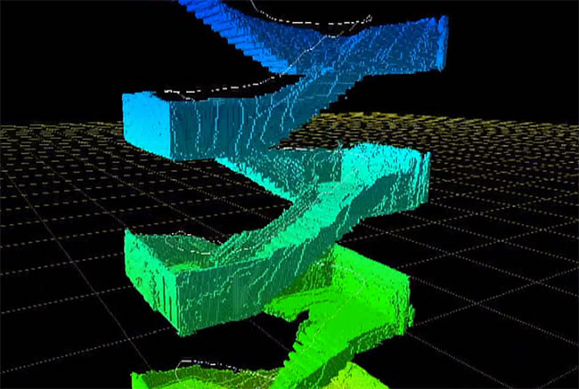
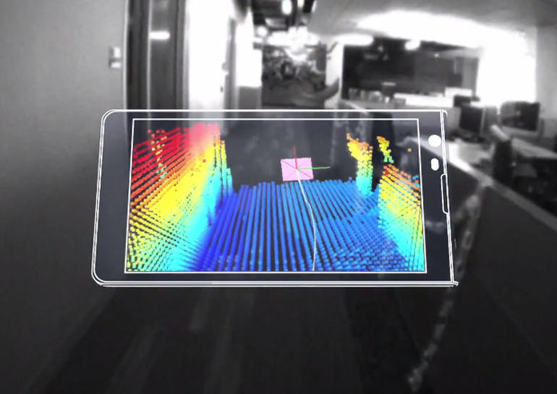
Mobile rendering with capture
Exploiting mobile device sensors...
MOBILE DEVICE
Environment
CAPTURE
DISPLAY
Example:
Google Tango
https://www.google.com/atap/projecttango/#project
Frame
DATA
ACCESS
RENDERING
Scene
INTERACTION

Slide 45
3D acquisition and processing
Live 3D reconstruction on mobile phones
The system allows to obtain 3D models of pleasing quality interactively and entirely on-device
Efficient and accurate scheme for integrating multiple stereo-based depth hypotheses into a compact and consistent 3D model
Tanskanen et al. Live Metric 3D Reconstruction on Mobile Phones (ICCV 2013)
Kolev et al. Turning Mobile Phones into 3D Scanners (CVPR 2014)

Slide 46
Physical simulations
Framework for physically and chemically-based simulations of analog alternative photographic processes
Efficient fluid simulation and manual process running on iPad
Echevarria et al. Computational simulation of alternative photographic processes. Computer Graphics Forum. Vol. 32. 2013.

Slide 47
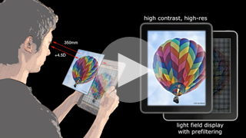
Correcting visual aberrations
Computational display technology that predistorts the presented content for an observer, so that the target image is perceived without the need for eyewear
Demonstrated in low-cost prototype mobile devices
Huang, Fu-Chung, et al. Eyeglasses-free display: towards correcting visual aberrations with computational light field displays.ACM Transactions on Graphics (TOG) 33.4, 2014.

Slide 48

Questions and contacts

