Slide 1
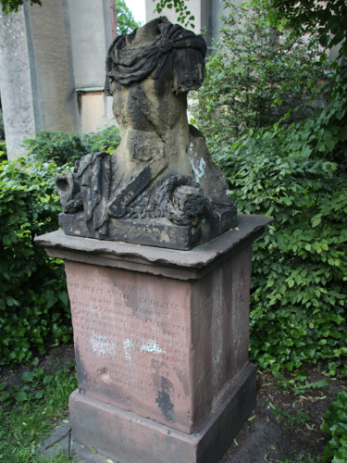
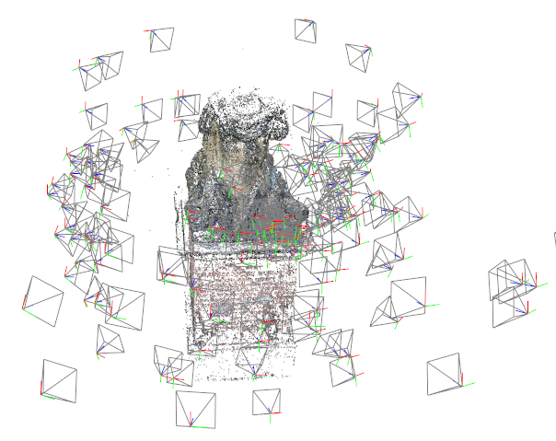
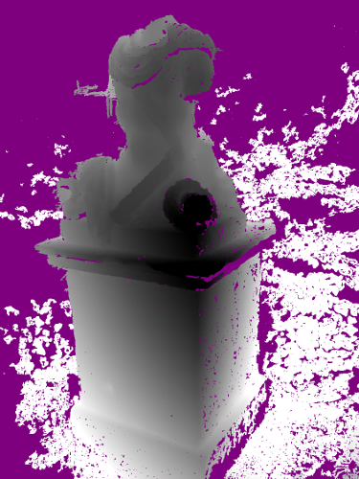
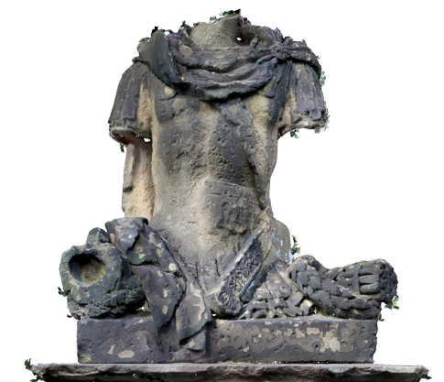
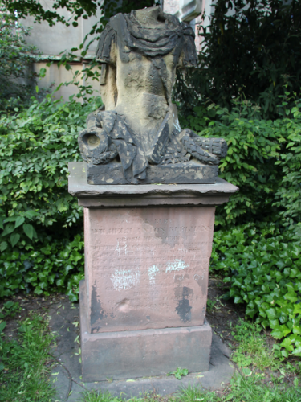
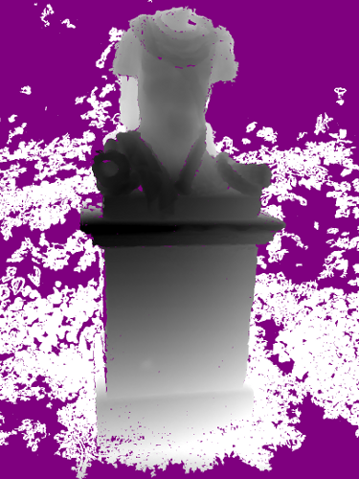
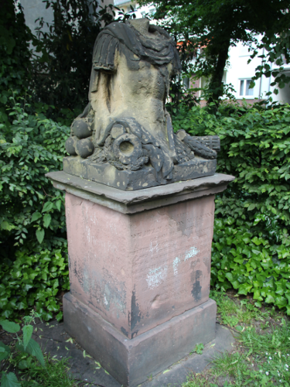
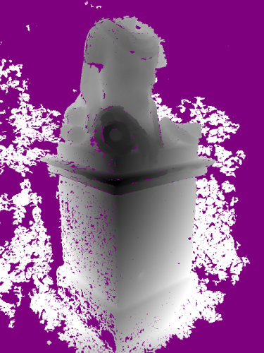
MVE – A Multi-View
Reconstruction Environment
Simon Fuhrmann, Fabian Langguth, Michael Goesele
GCC – Graphics, Capture and Massively Parallel Computing, TU Darmstadt
SfM
MVS
SR
Texturing
Notes:
Thank you for the kind introduction. Hello everybody.
In this presentation I’m going to talk about our software system “MVE – The Multi-View Environment”.
This software has been developed here in our research group over the last couple of years, mostly implemented by myself during my PhD.

