Slide 1




Shape Reconstruction in 2D: From Theory to Practice
EUROGRAPHICS 2022 TUTORIAL
Stefan Ohrhallinger, Amal Dev Parakkat, Jiju Peethambaran
Technische Universität Wien, Austria
LTCI- Telecom Paris, Institut Polytechnique de Paris, France
Saint Mary’s University, Canada

Slide 2
Tutorial Outline
Intro & Proximity Graphs Stefan Ohrhallinger - 25 minutes
History of Algorithms Stefan Ohrhallinger - 25 minutes, Q&A 5 minutes
Specialized Algorithms Amal Dev Parakkat - 25 minutes, break 15 minutes
Benchmark & Demo Amal Dev Parakkat - 25 minutes, Q&A 5 minutes
HVS-based Algorithms Jiju Peethambaran - 25 minutes
Region Reconstruction Jiju Peethambaran - 25 minutes, Q&A 5 minutes

Slide 3
Outline Part 1/3
The Curve Reconstruction Problem
Proximity Graphs
Graph-based Algorithms
Feature size based Algorithms
Presenter:
Stefan OHRHALLINGER
Researcher
Institute of Visual Computing & Human-Centered Technology

Slide 4
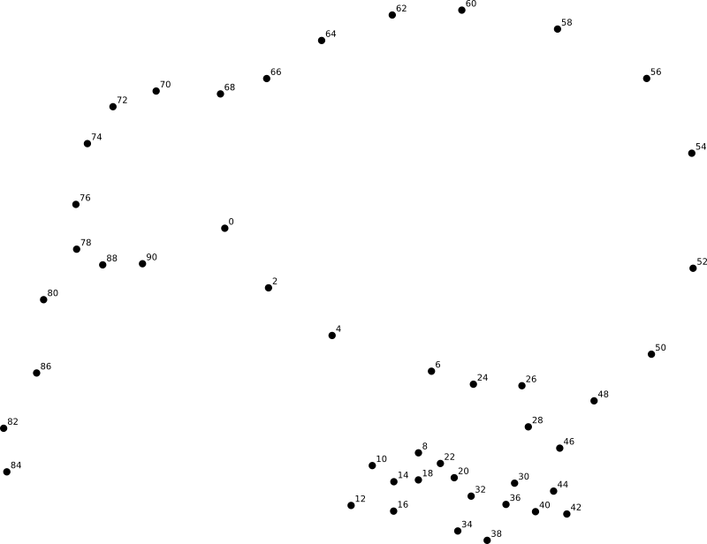
Introduction
The Problem

Slide 5
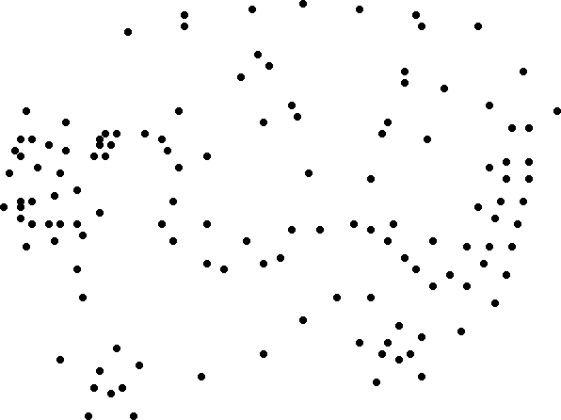
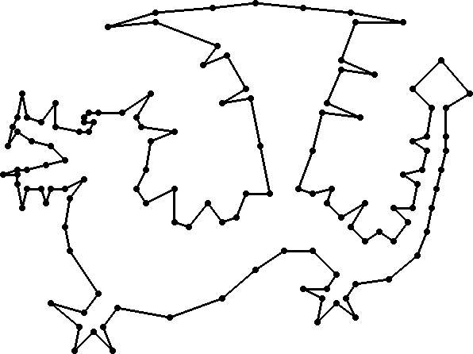
Connect the Dots
Now try without the numbers
Reconstructed polygon

Slide 6



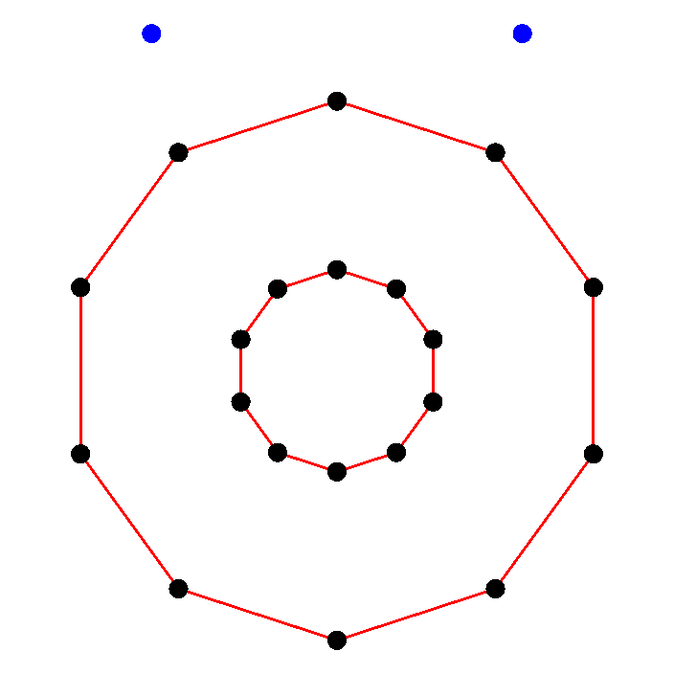
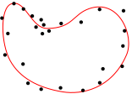

Challenges for Curve Reconstruction
Non-uniform sampling
Sparse sampling
Sharp Corners
Noisy sampling
Outliers, multiple curves
Non-manifold curves

Slide 7
How to Choose a Suitable Algorithm?
DISCUR
VICUR
StretchDenoise
[Lee00a]
α-shapes
Shape-hull Graph
γ-neighborhood
ec-Shape
[Len06]
[AM00]
Connect2D
GathanG
NN-Crust
Crust
Peel
FitConnect
[CFG*05]
[Rup14]
β-skeleton
Crawl
r-regular shapes
[WYZ*14]
Gathan
Concorde
HNN-Crust
Conservative Crust
[FR01]
EMST
Ball-pivoting
Optimal Transport
Robust HPR
[Gie99]
[Aro98]
[Hiy09]
Voronoi Labeling
Edge exchanging

Slide 8
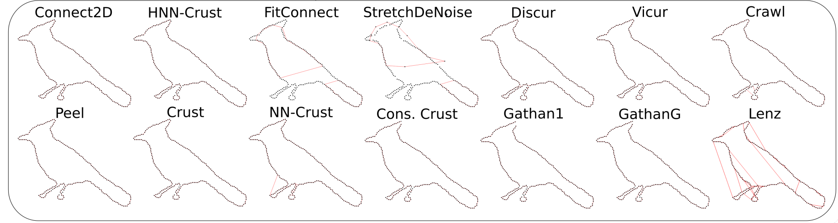
A Benchmark Helps to Decide [OPP*21]
Evaluating algorithms on challenging curves, highlighting strengths & weaknesses
Quantitative analysis on: reconstruction quality & run-time

Slide 9
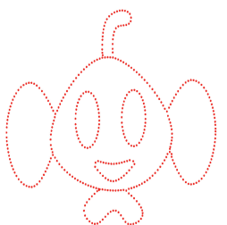
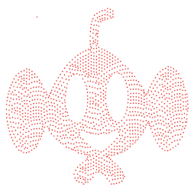
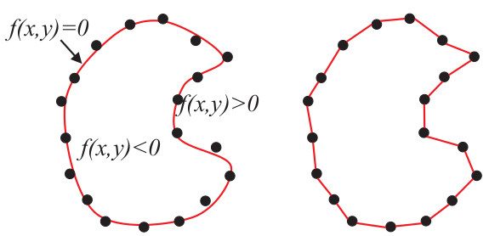
Scope of this Tutorial
We categorize 36 curve reconstruction algorithms:
Boundary samples Area samples
Implicit curve Polygonal curve

Slide 10
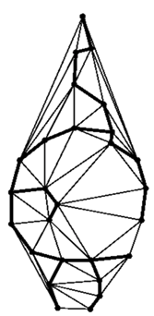
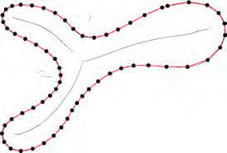
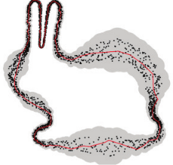
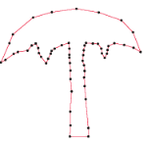
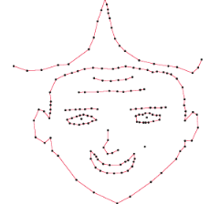
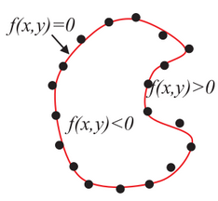
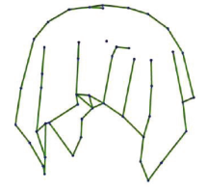
Taxonomy of Algorithms
Graph-based
Feature size based
Noisy fitting
Sharp corners
Non-manifold
HVS-based
Implicit
Region Reconstruction
Notes:
7 categories - note that some overlap

Slide 11
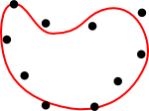
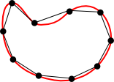
Input Data: Properties
Non-uniform sampling: determines feature size
Noisy sampling: needs fitting
Outliers: needs filtering

Slide 12
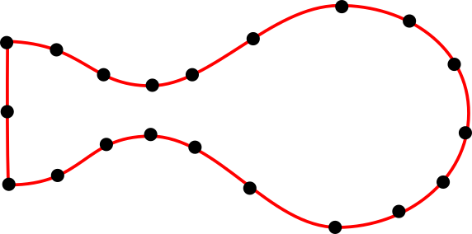
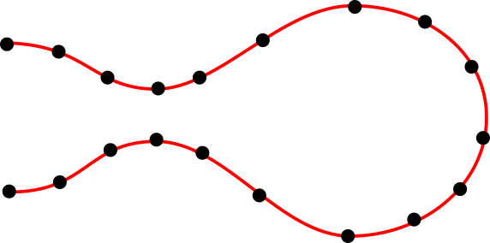
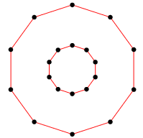
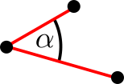
Reconstruction Output: Properties
deg(v)=2
deg(v)≤2
Manifold
Open curves
Multiply Connected
ɑ<90°
ε<0.5
O(n log n)
Sharp Corners
Guarantees
Time Complexity

Slide 13
Capabilities: e.g., noise, outliers, non-uniformity
DISCUR
VICUR
StretchDenoise
[Lee00a]
α-shapes
Shape-hull Graph
γ-neighborhood
ec-Shape
[Len06]
[AM00]
Connect2D
GathanG
NN-Crust
Crust
Peel
FitConnect
[CFG*05]
[Rup14]
β-skeleton
Crawl
r-regular shapes
[WYZ*14]
Concorde
Gathan
HNN-Crust
Conservative Crust
[FR01]
EMST
Ball-pivoting
Optimal Transport
Robust HPR
[Gie99]
[Aro98]
[Hiy09]
Voronoi Labeling
Edge exchanging

Slide 14
Capabilities: e.g., manifold, sharp, O(n log n)
DISCUR
VICUR
StretchDenoise
[Lee00a]
α-shapes
Shape-hull Graph
γ-neighborhood
ec-Shape
[Len06]
[AM00]
Connect2D
GathanG
NN-Crust
Crust
Peel
FitConnect
[CFG*05]
[Rup14]
β-skeleton
Crawl
r-regular shapes
[WYZ*14]
Gathan
Concorde
HNN-Crust
Conservative Crust
[FR01]
EMST
Ball-pivoting
Optimal Transport
Robust HPR
[Gie99]
[Aro98]
[Hiy09]
Voronoi Labeling
Edge exchanging

Slide 15
Definitions Curve
Curve ∑: Simple closed and planar
Smooth curve C: (collection of) twice-differentiable bounded 1-manifolds ∈ ℝ²
Sample set P: n points sampled on ∑ or C

Slide 16
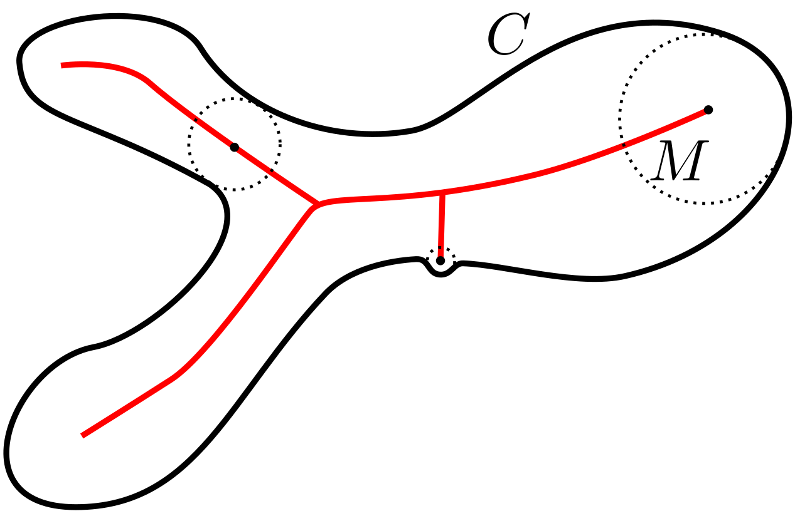
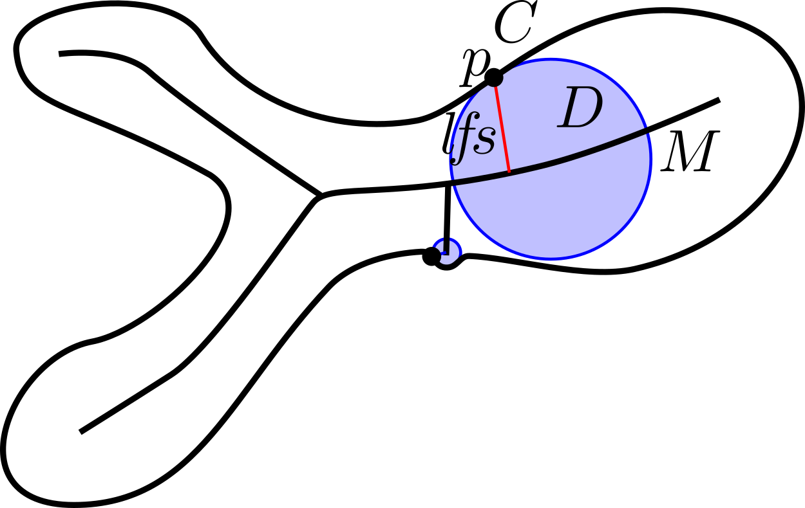
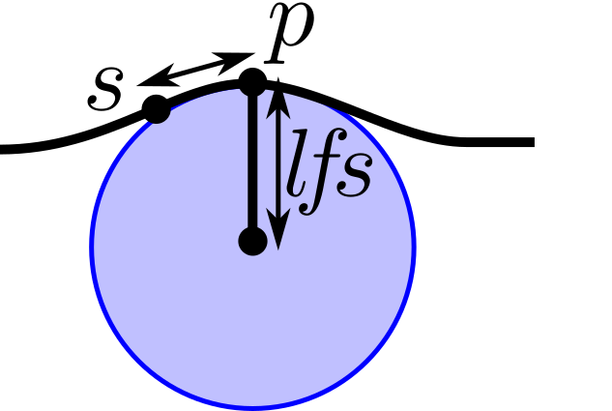
Definitions Sampling
Medial axis M for C [Blum67]: Closure of all points in ℝ² with ≥2 closest points in C
Local feature size lfs(p) [Rup93]: Euclidean distance from p to its closest point m ∈ M
ε-Sampling [ABE98]: ∀p ∈ C, ∃s ∈ S : ||p, s|| < ε lfs(p)

Slide 17
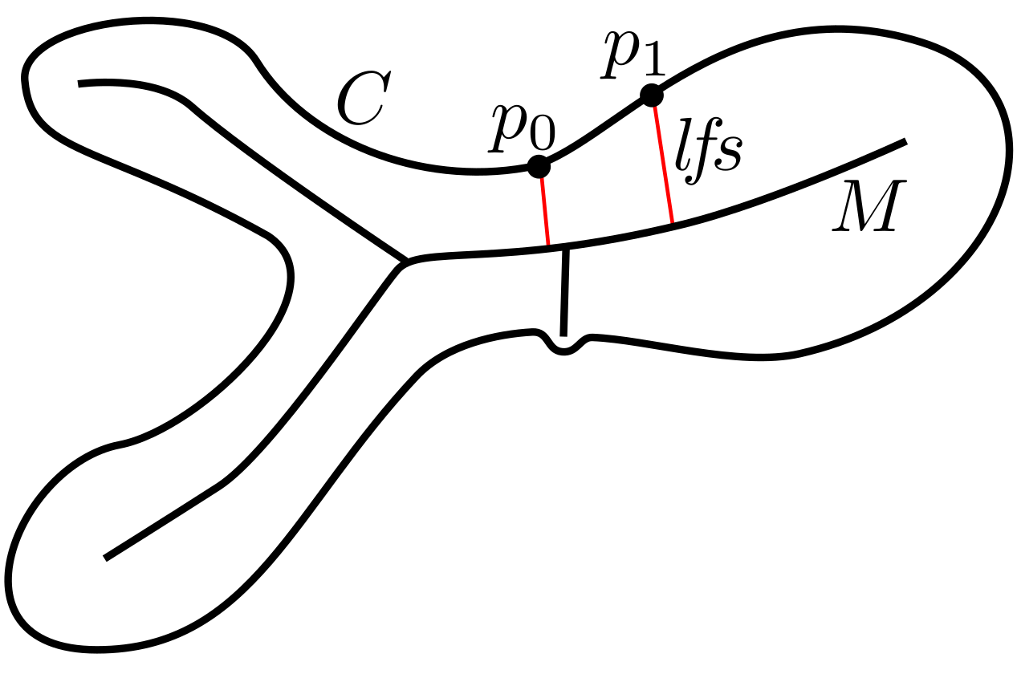
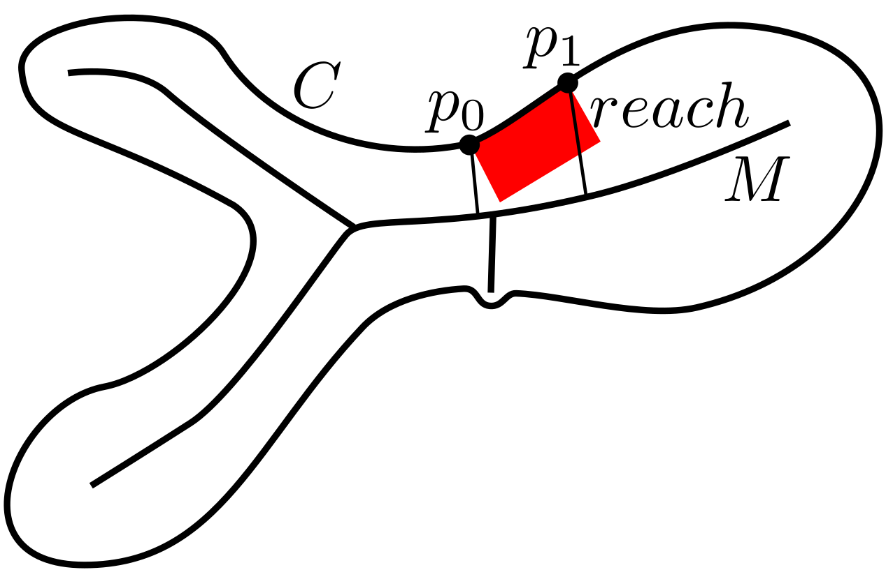
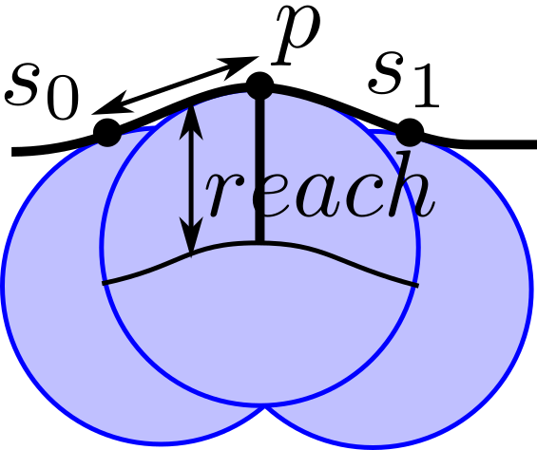
Definitions Sampling
Reach of a curve interval I: inf lfs(p) : p ∈ I [OMW16]

Slide 18
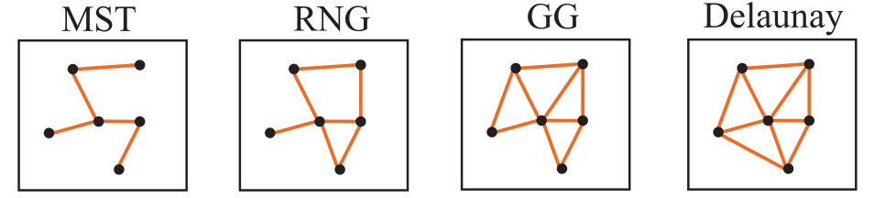
Proximity Graphs for a Point Set
⊆
⊆
⊆
Minimum Spanning Tree: cycle-free graph spanning P with minimum edge weights
Relative Neighborhood Graph: ∀(p,q): d(p, q)≤d(p, x), d(p, q)≤d(q, x) ∀x ∈ P, x≠p,q
Gabriel Graph: All (p,q) with p,q ∈ empty ball centered at (p,q)
Delaunay Triangulation: circumcircles empty of P

Slide 19
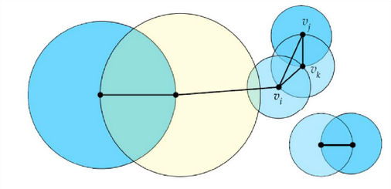
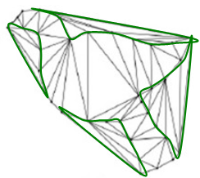
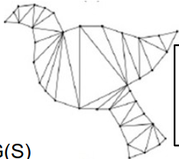
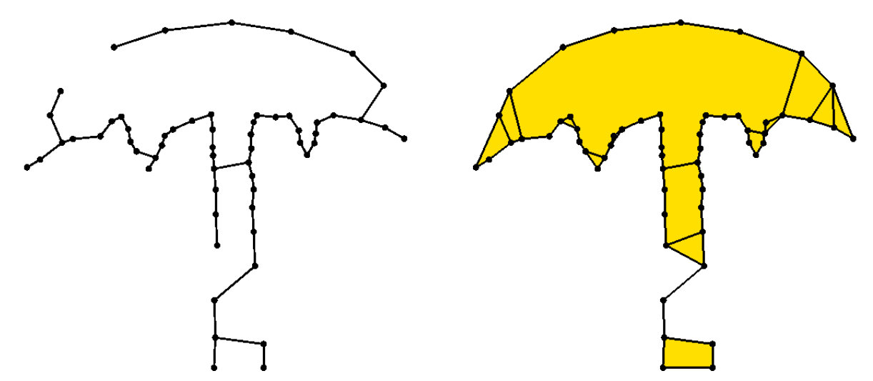
More Proximity Graphs
EMST (d≥1) -> BC₀ (d≥2)
Boundary Complex
SIG edges: r=|v,NN1| overlap
Sphere-of-Influence Graph
DT ∖ divergent concave
Shape-Hull Graph

Slide 20
Algorithms Based on Graphs - Overview
ɑ-shapes [EKS83], Ball-pivoting [BB97]
β-skeleton [KR85]
ɣ-neighborhood [Vel92]
Sculpting [Boi84a]
EMST [FMG94], edge exchange [OM11] and inflating [OM13]
r-regular shape [Att97]
Shape-hull graph [PM15b], Voronoi labeling [PPT*19]
Crawl thru neighbors [PM16]

Slide 21
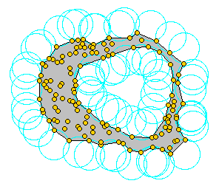
ɑ-Shapes [EKS83]
Disks of radius 1/ɑ
Generalization of convex hull (ɑ=0)
Extracting manifolds [BB97]
Later: Ball-pivoting algorithm [BMR*99]

Slide 22
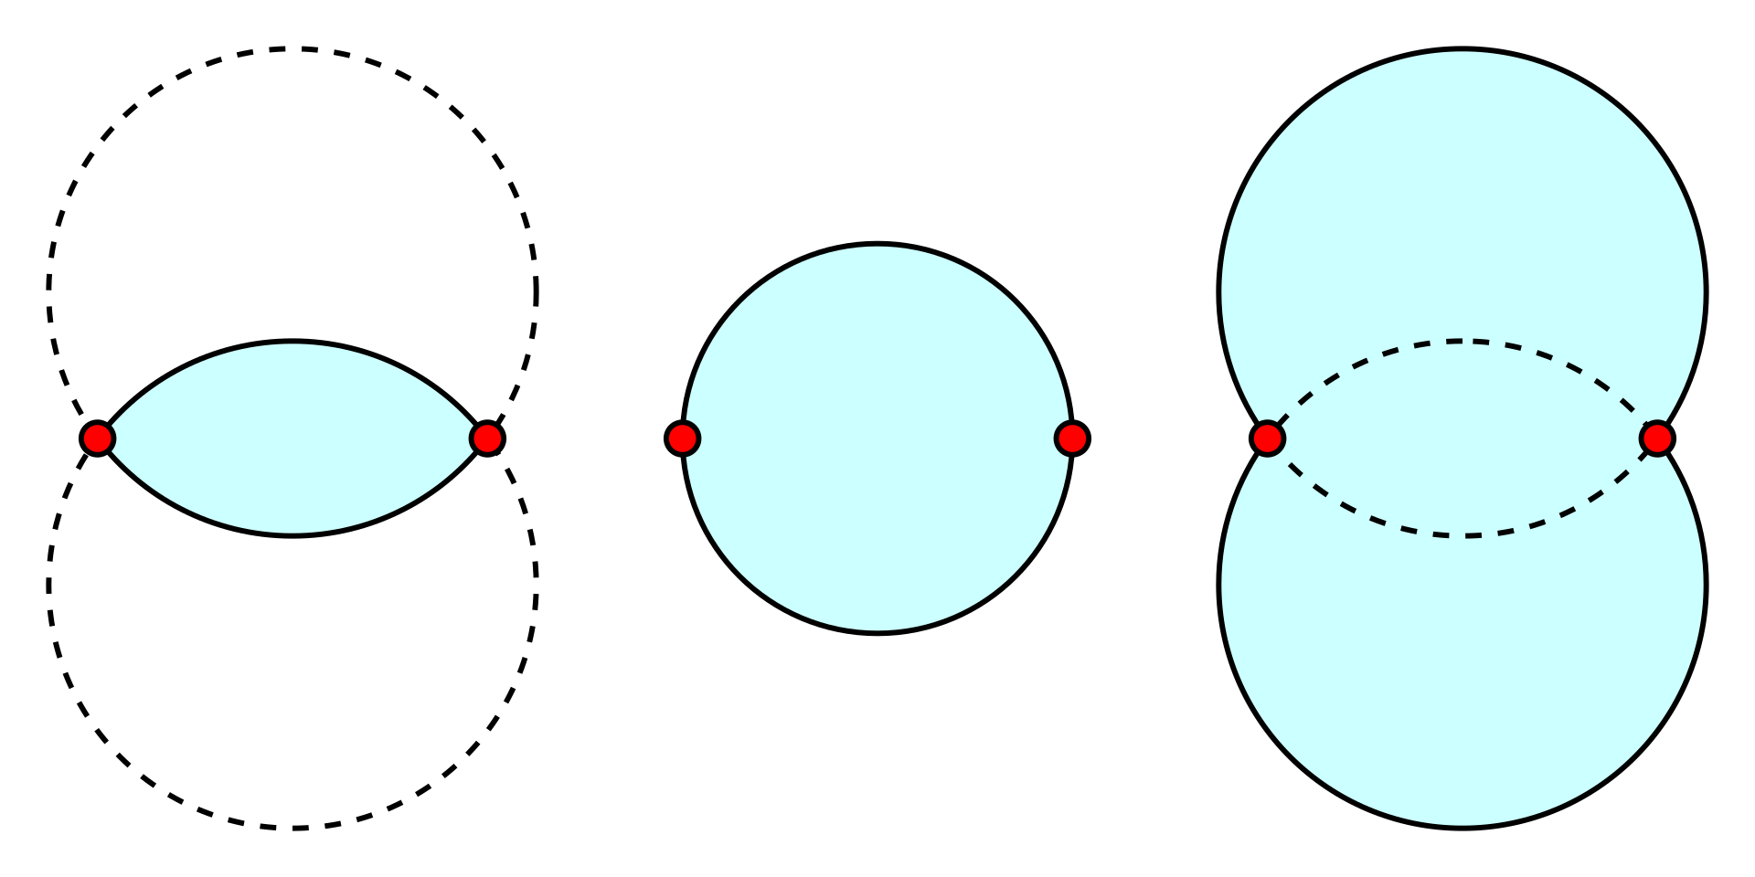
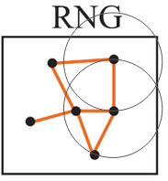

β-Skeleton [KR85]
β<1 β=1 β>1
β=2: Relative neighborhood graph
Empty lens formed with ∡prq<θ
= Intersection/Union of disks

Slide 23
ɣ-Neighborhood [Vel92]
A unification of 12 graphs including convex hull, Delaunay triangulation, Gabriel graph, RNG, MST, nearest neighbor graph, ɑ-shapes and β-skeletons.
ɣ(ɣ₀,ɣ₁) is defined for -1<ɣ₀,ɣ₁<1 and |ɣ₀|≤|ɣ₁|
Contains edges with empty neighborhood defined by disks using ɣ₀,ɣ₁
It can also reconstruct shapes not in the Delaunay graph

Slide 24
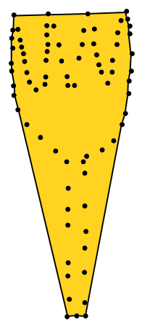
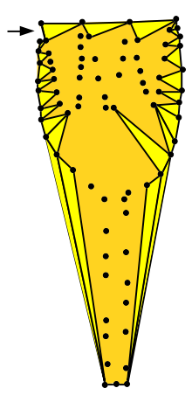
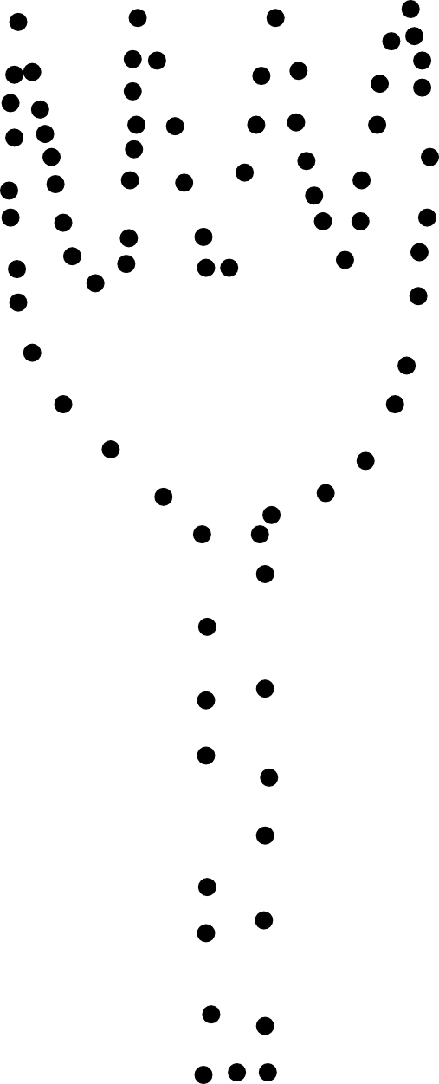
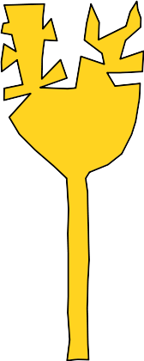
Sculpting [Boi84a]
Points
Convex hull
Sculpting step
Final boundary

Slide 25
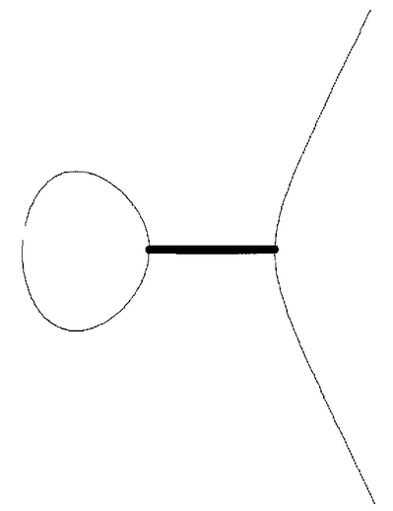
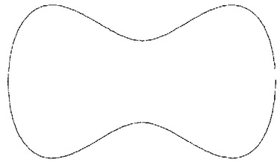
EMST-based Reconstruction [FMG94]
Proves that EMST reconstructs (open) curve from sufficiently dense samples

Slide 26
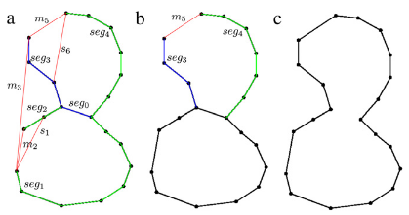
EMST-based Edge-Exchange Reconstruction [OM11]
Transform EMST with “snap” and “move” operations - combinatorial complexity

Slide 27
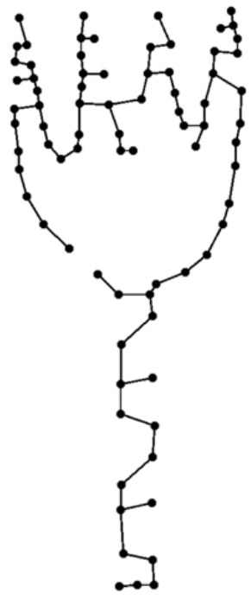
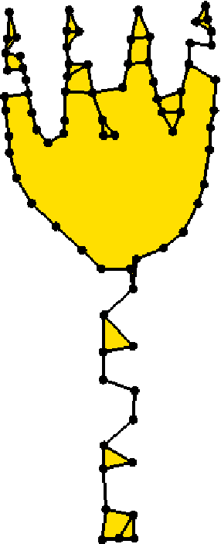
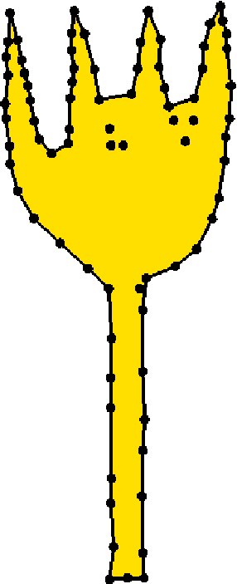
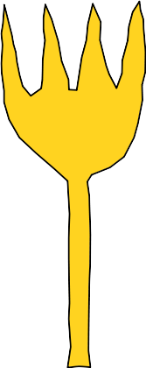
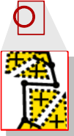
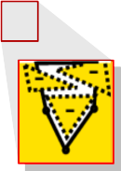
EMST-based Inflating Reconstruction [OM13]
inflate
sculpt
EMST
deg(v)≥2
deg(v)≤2
deg(v)=2

Slide 28
r-regular Shapes [Att97]
An r-regular shape has curvature ≥r everywhere
Requires uniform sampling of boundary
Boundary consists of edges shared by Delaunay circumcircles with property of angle<threshold depending on uniform sampling density and curvature r

Slide 29
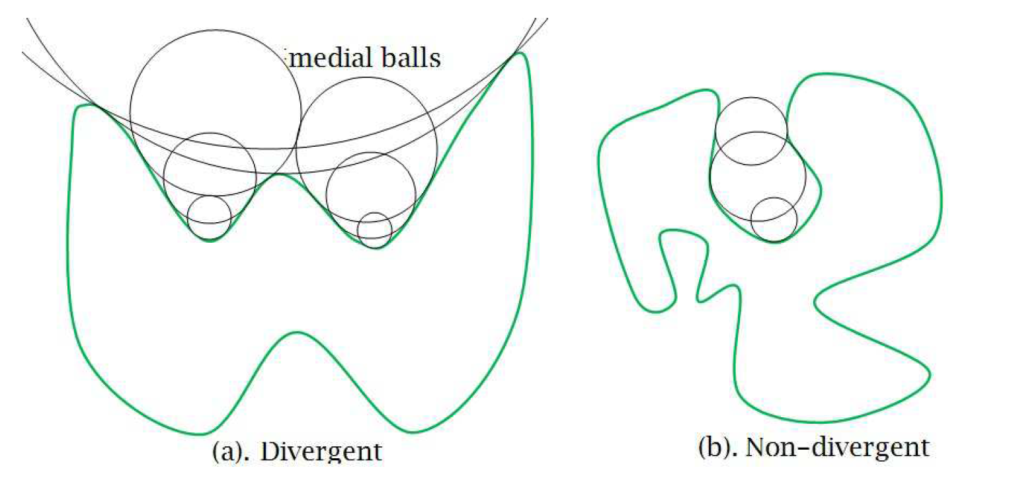

Shape-Hull Graph [PM15b]
Reconstructs smooth curves with divergent concavity
Eliminates Delaunay triangles with circumcenter outside boundary

Slide 30


Voronoi Labeling [PPT*19]
Incrementally labels orientation from estimated normals via Voronoi poles
Guaranteed ε-sampling as well as
bi-tangent neighborhood convergence
Also computes medial axis

Slide 31

Crawl Thru Neighbors [PM16]
Connects neighbors greedily, heuristic decides curve closed/open
Parameter-free: handles open+multiple curves, holes and outliers

Slide 32
Algorithms Based on Graphs - Conclusion
ɑ-shapes [EKS83], Ball-pivoting [BB97], β-skeleton [KR85], ɣ-neighborhood [Vel92], Sculpting [Boi84a], EMST [FMG94], edge exchange [OM11], inflating [OM13], r-regular shape [Att97], Shape-hull graph [PM15b], Voronoi labeling [PPT*19], Crawl thru neighbors [PM16]
They often require a global parameter
Good results mostly for uniformly sampled point density
Delaunay graph is not guaranteed to contain the reconstruction
Reconstruction is often slow or trapped in local minima

Slide 33
Algorithms Based on Feature Size - Overview
Crust [ABE98]
Anti-Crust [Gol99]
NN-Crust [DK99]
Conservative Crust [DMR99]
Lenz [Len06]
Hiyoshi [Hiy09]
HNN-Crust [OMW16]

Slide 34

Crust [ABE98]
Seminal paper: feature sized reconstruction - no more uniform sampling required
ε-Sampling [ABE98]: ∀p ∈ C, ∃s ∈ S : ||p, s|| < ε lfs(p)
extracts DG and Voronoi graph
Proof: ε < 0.252 ≘ α > 151°

Slide 35

Anti-Crust [Gol99]
Extracts the Crust in a single step from the Delaunay graph
Also extracts the medial axis skeleton

Slide 36
NN-Crust [DK99]
Simple and elegant improvement of Crust:
α
First, connects point to nearest neighbor
Then to nearest neighbor in half-space s.t. angle > 90°
Proof: ε < 1/3 , corresponding to α > 141°

Slide 37



Conservative Crust [DMR99]
Filters edges from Gabriel graph
Robust to outliers
Collections of open/closed curves
But requires a parameter
Misses some sharp corners
Crust NN-Crust Conservative Crust

Slide 38


Lenz: Probe Reconstruction [Len06]
Starts with a seed edge and connects edges with a probe shape
Requires an angle parameter
Permits self-intersections
Claims ε < 0.48 but no proof

Slide 39


Hiyoshi: TSP [Hiy09]
Adapts Traveling Salesman Problem to multiple connected curves
Transforms it into maximum-weight 2-factor problem (solvable in P time)
Proof for: ε < ⅓, u < 1.46 (relative uniformity of adjacent edge lengths)

Slide 40




HNN-Crust [OMW16]
Simple variant of NN-Crust, reducing angle from 90° to 60°:
First, connect nearest neighbor
Construct half-space
Connect to nearest neighbor
in opposite half-space

Slide 41




Sampling Conditions of Crust Algorithms
Crust:
ε < 0.252
NN-Crust:
ε < 1/3
HNN-Crust:
ε < 0.47
HNN-Crust:
ρ < 0.9
lfs -> reach: ρ= ε/(1−ε)

Slide 42
Algorithms Based on Feature Size - Conclusion
Crust [ABE98], Anti-Crust [Gol99], NN-Crust [DK99], Conservative Crust [DMR99]
Lenz [Len06], Hiyoshi [Hiy09], HNN-Crust [OMW16]
Guarantees on sampling condition
Work well for non-noisy point sets

Slide 43
Outline
Topic: Specialized algorithms
To be precise, how can we reconstruct:
Objects from noisy point clouds
Objects with sharp corner
Objects with self-intersections
Curve reconstruction and TSP
Presenter:
Amal Dev PARAKKAT
Maitre de Conference
Institut Polytechnique de Paris

Slide 44

Noisy point clouds
What is noise?
What if the input samples are contaminated with noise?

Slide 45


Noisy point clouds
What happens if you use our simple Delaunay filtering algorithms like Crust or Crawl?
How can we deal with this?

Slide 46
Handling noise - Algorithm 1 [Lee00a]
Uses a technique called moving least-squares (MLS) [Lev98]
Iteratively projects points on a curve fitting their local neighborhood by distance-weighted regression
Locally approximated by a line inside a constant-sized neighborhood
The weighting function for the MLS projection considers points only inside a globally constant radius, which could also include unwanted points.
Therefore the connectivity of points is created using the EMST

Slide 47

Handling noise - Algorithm 2 [MTSM10]
An noise-robust extension of the Hidden Point Removal (HPR) operator [KTB07]
Computes local connectivity between points based on a projection onto their convex hull

Slide 48
Handling noise - Algorithm 3&4 [Rup14][CFG*05]
[Rup14]
Sub-samples a noisy point set with minimum (globally constant) density
Relocation of the sub-samples
Eliminates points which do not have exactly two neighbors in a density-sized neighborhood
Order after hundreds of iterations
[CFG*05]
Resample a thinned point set from noisy points
Prove on an impractical (due to its restrictive sampling density constraints) probabilistic sampling
Apply NN-Crust

Slide 49

Handling noise - Algorithm 5 [WYZ*14]

Slide 50

Handling noise - Algorithm 6 - FITCONNECT
An noise-robust extension of the Hidden Point Removal (HPR) operator [KTB07]
Computes local connectivity between points based on a projection onto their convex hull

Slide 51

Handling noise - Algorithm 7 - STRETCHDENOISE
An noise-robust extension of the Hidden Point Removal (HPR) operator [KTB07]
Computes local connectivity between points based on a projection onto their convex hull

Slide 52

Reconstructing sharp corners
Revisiting 𝜀-sampling
Drawback of 𝜀-sampling

Slide 53
Reconstructing sharp corners
Solution??
Come up with a new sampling strategy
But ε-sampling is too good!!!
So why can’t we modify ε-sampling to handle sharp corners?
Exactly what Dey and Wenger thought about - GATHAN

Slide 54

Reconstructing sharp corners - Algorithm 1 - GATHAN
So, what exactly did they do?
Modified sampling: A sampling p on C must have a sample point within ε<1 times the radius of the larger circle between C1 and C2

Slide 55

Reconstructing sharp corners - Algorithm 1 - GATHAN
Modifies the nearest neighbor strategy to handle sharp corners
While selecting an edge e, the improved algorithm takes into account:
the angle between the dual Voronoi edge and estimated normal of e
ratio of its dual Voronoi edge length to its length
the degree of all the vertices
Later on, extended it by carefully structuring it to provide a theoretical guarantee

Slide 56

Reconstructing sharp corners - Algorithm 2 [FR01]
Came up with a new sampling criteria instead of imposing extra conditions
Correct reconstruction for a smooth curve + relaxed criterion at corner points to generate a weak sampling around it
Explores potential corner edges and are then merged with the smooth edges to give the final reconstructed result

Slide 57

Reconstructing self-intersections
Point sets generated from sketches and images introduce another issue :
Self-intersections!!!

Slide 58

Reconstructing self-intersections - Algorithm 1 [DGCSAD11]
Formulates and solves as an optimal transport problem
From Delaunay triangulation, they generates a coarse mesh in a greedy fashion with the objective of minimizing the total cost
Intelligent vertex relocation - can withstand noise and outliers - simplified shape
No degree/manifold constraints

Slide 59

Reconstructing self-intersections - Algorithm 2 - PEEL
Reconstruct in two steps:
Delaunay filtering with degree constraints
Restoring self-intersections at vertices with degree 1
Self-intersections are detected by analyzing the one ring neighborhood with the help of a parameter

Slide 60

Reconstructing self-intersections - Is that all?
Only these two algorithms can be used?
Answer is - NO!!!
Some algorithms does not impose any degree constraints - in some cases they capture self-intersections
Example - Crust, NN-Crust

Slide 61

Travelling Salesman Problem
What is Travelling Salesman Problem (TSP)?
The salesman wishes to make a *minimum-cost* tour, or hamiltonian cycle, visiting each city exactly once and finishing at the city he starts from [Introduction to Algorithms - Cormen et al.]
Is it related to curve reconstruction??
*WikiPedia

Slide 62
Methods related to Travelling Salesman Problem
Giesen [Gie99] showed an existence guarantee - dense sampling can be reconstructed using Euclidean TSP (ETSP) - proposed 2 algorithms, but no results
Althaus et al. [AM00] showed that it also works for non-uniform sampling - also, under ε-sampling, ETSP terminates in polynomial time - ε < 1/20 (angles > 174.27◦)
Time consuming - faster approximation gives poor visual quality O’Rourke [O’R81] proposed minimal volume polyhedra for Surface reconstruction
Boissonnat [Boi84b] showed by a simple example that this minimum is not always visually pleasing

Slide 63
Outline
Topic: Benchmark and Demo
To be precise:
What all our benchmark has?
How to use our benchmark?
What all we evaluated?
What are our conclusions?
Presenter:
Amal Dev PARAKKAT
Maitre de Conference
Institut Polytechnique de Paris

Slide 64

The Benchmark
Our benchmark contains: Algorithms, Dataset, Sampling tools, Evaluation criterias, and Test scripts

Slide 65

The Benchmark - Algorithms
We included 15 publicly available algorithms
Contains algorithms from late 90s (Crust family) to 2018
CRUST, NNCRUST, CCRUST, GATHAN, GATHANG, LENZ, DISCUR, VICUR, OPTIMALTRANSPORT, CONNECT2D, CRAWL, HNNCRUST, FITCONNECT, STRETCHDENOISE, PEEL
We removed OPTIMALTRANSPORT from experiments since it simplifies curves

Slide 66





The Benchmark - Dataset
Our dataset contains more than 2500 point sets containing:
Classic data - Collected from various papers (using WebPlotDigitizer)
Image data - Samples obtained from the silhouette images (taken from MPEG7 CE Shape-1, Edinburgh, 1070-shape image databases)
Synthetic data - Analytical (shapes with sharp corners, & self-intersections) and 𝜀-sampled points
Classic Data
Image Data
LFS sampling
Non-manifold
Sharp corners

Slide 67





The Benchmark - Dataset
We also provide ground truths (linear approximation) as:
Ordered vertices: A loop of vertices - for simple closed curves
Edge list: List of edges - for complex curves
Grouped under the following categories:
Moreover, we provide an interactive ground truth generation tool
Manifold
Sharp
Non-manifold
Open curves
Multiple curves

Slide 68





The Benchmark - Sampling tools
LFS-sampling tool:
Samples are made from input Bezier curve representation
Maximal empty disks are computed to create a medial axis approximation
Estimate LFS at each sample and use it to pick a set of samples satisfying the 𝜀-sampling condition
Contour sampling tool:
Binary image contour is extracted to generate a set of samples
Starting from a random sample, iteratively remove all samples within a user defined distance r
A Bezier curve and its LFS-based sampling
A binary image
Extracted contour
Samples with r=20
Samples with r=50

Slide 69







The Benchmark - Evaluation criteria
Let closest point correspondences be D and D’ of two curves C and C’
where M and M’ be the respective non-bijective shortest distance maps
We use the following metrics to compare two curves:
s₁
s₂
s₃
t'₁
t'₂
t'₃
t₁
t₃
s'₁
s'₃
t₂
s'₂
Hausdorff distance
Root mean squared distance

Slide 70

The Benchmark - Test scripts
Driver program can be run with various arguments and options
A set of test scripts for quantitatively & qualitatively evaluate the algorithms
Each test script has a list of algorithms and test data, designed for the specific experiment:

Slide 71

Evaluation - Sampling density as 𝜀-sampling

Slide 72

Evaluation - Noise robustness (BB Diagonal)

Slide 73

Evaluation - Noise robustness (LFS)

Slide 74

Evaluation - Noise robustness (𝜀-sampling + LFS)

Slide 75

Evaluation - Outlier

Slide 76

Evaluation - Running time

Slide 77

Evaluation - Qualitative Comparison

Slide 78

Evaluation - Qualitative Comparison

Slide 79

Evaluation - Qualitative Comparison

Slide 80

Evaluation - Qualitative Comparison

Slide 81

Evaluation - Qualitative Comparison

Slide 82

Evaluation - Qualitative Comparison

Slide 83
Evaluation - Overview
In short, we evaluate the robustness of various algorithms based on:
Sampling density as ε-sampling
Noise robustness as δ of bounding box diagonal
Noise robustness as δ of lfs
Noise+sampling density as ε-sampling and δ of lfs
Outliers robustness in % of samples
Average runtimes (in s)

Slide 84

Evaluation - Summary

Slide 85

Outline
Topic: Shape Characterization
Problem Definition
HVS based Algorithms
Delaunay based Algorithms
Sampling Models
Evaluation Practices
Future Directions
Presenter:
Jiju Peethambaran
Assistant Professor
Saint Mary’s University

Slide 86

Shape Characterization or Region Reconstruction
Given a finite set of points sampled from a planar object or region, construct a polygonal boundary that best approximates the object or region.
Inputs are known as dot pattern/area samples/region samples
Outputs: graphs or polygons
Compared to curve reconstruction, more signals (or samples) about the shape is available
Point set
Reconstructed shape

Slide 87


Applications
Computer graphics- geometric modeling
Identification of island failure regions in the design space of reliability-based crash optimization

Slide 88



Applications
Map generalization- e.g., aggregation of points representing buildings to form single polygon
Land cover change detection
Outline of trees or flock of birds

Slide 89

Challenges
Ill-posed problem – a precise mathematical definition for ‘shape’ is almost impossible
Rich variety of shapes
Heterogeneity of point set sampling (density and distribution)
Different interpretations for ‘shape’ based on human cognition, visual perception and application demands

Slide 90



Region Reconstruction Criteria
Should every member fall within the region or outliers permitted?
Should any points fall on the boundary, or they must fall in the interior?

Slide 91


Region Reconstruction Criteria
Should the region boundary be topologically regular?
Should the region be simply connected?

Slide 92


Region Reconstruction Criteria
Should the region boundary be polygonal, or can it be smooth and curved?
Should the region boundary be a simple polygon?

Slide 93
Classification
Shape Characterization
Delaunay based
Non-Delaunay based
Alpha shape, A-shape, Chi-shape, RGG, EC-shape…
Concave hulls
Proximity graphs
Statistical/HVS

Slide 94
Human Visual Perception
Gestalt Laws of visual perception
Proximity
Continuity
Closure

Slide 95



DISCUR[ZNYL08]
A vision function that encodes p’s relation to T_{q} and the edge (r, q)
If d(p, q) < E [p, T_{q}], connect p to q
Parameter free algorithm
Open/closed curves, multiple curves, sharp corners
Dense sampling at sharp corners
p
?
q
r
T_{q}
DISCUR result
A failure case

Slide 96




VICUR[NZ08]
DISCUR limitation: arbitrary selection of candidate points
Vision function that encodes proximity and continuity
Candidate point with highest E value is connected
Sensitive to parameters, e.g., c balances the smoothness and nearness
p₅
p₃
p₄
p₂
r
p₁
p₀
VICUR result [NZ08]

Slide 97


Notations and Symbols

Slide 98

Simple Shape
Good shape according to HVS based on how the concavities are perceived
Start from the convex hull and carve out the concavity by replacing an outer edge by two new edges, edge selection is based on
Closeness criteria
Edge length criteria
Angular constraints

Slide 99


Simplicial Complex
k-simplex( ) : non-degenerate convex hull of k+1 geometrically distinct points in in R^{d} where k <= d.
Simplicial Complex:
0-simplex
1-simplex
2-simplex
3-simplex

Slide 100


Regular Simplicial Complex
Regular 2-simplicial complex:

Slide 101






Alpha Shape
exposed simplex: A k-simplex is exposed if there exists an empty ball with

Slide 102









A-Shape
Let is a finite set of points
is generated by connecting if there is an empty circle that passes through p, q and a
Two parameter family of point sets
is a local density measure
level of detail of the shape

Slide 103

Chi Shape
Simple polygon that characterizes the shape of point set.
Start with the DT(S).
Repeatedly remove longest boundary edges greater than a threshold l subjected to regularity constraints.
Generates a regular polygon that contains S.

Slide 104

Divergent Concavity
Closed, planar and positively oriented curve
Inflection points and curvature
Concave portion (green colored)
BT-bi-tangent, BTP-bi-tangent points
BT
BTP
BTP
IP
IP
Concavity

Slide 105
Divergent Concavity
Closed, planar and positively oriented curve
Inflection points and curvature
Concave portion (green colored)
BT-bi-tangent, BTP-bi-tangent points
Pseudo-concavity
BT
BTP
Pseudo-concavity
BTP

Slide 106

Divergent Concavity
Extremal Vs Non-extremal BT

Slide 107

Divergent Concavity
Medial balls
Divergent pseudo-concavity

Slide 108
Divergent Concavity
Medial balls
Divergent
Non-divergent
If all the pseudo-concavities are divergent, then the curve is divergent

Slide 109



Divergent Concavity
Implications
Point set, S sampled from
a divergent concave curve
DT(S)
Triangles in divergent concave region

Slide 110


Divergent Concavity
Triangles in divergent concave regions are:
Obtuse
Longest edge placed towards the extremal BT

Slide 111


Relaxed Gabriel Graph
Consists of all Gabriel edges and a few non-Gabriel edges
RGG(S) retains a non-Gabriel edge (p, q) of DT(S) if it satisfies either of the following:
DT(S)
RGG(S)

Slide 112

r-sampling
A point set S sampled from an object O is said to be r-sample if
Every pair of adjacent boundary samples p, q lies at a distance of at most 2r.
Every pair of samples p, q from the interior of O lies at a minimum distance of 2r.

Slide 113
Directed Boundary Sample
Directed boundary sample is an r-sampling of object O which possess a divergent boundary
Theoretical analysis and topological correctness of RGG is provided under directed boundary sample
Lemma: Let S be a (r, ↑)-sample of an object O, ∂RGG(S ) contains an edge between every pair of adjacent samples of ∂O.

Slide 114



EC-shape
Exterior triangle and exterior edge
Circle constraint: diametric, chord and midpoint circles
Regularity constraints

Slide 115



EC-shape

Slide 116



EC-shape
Under r-sampling, EC-shape is homeomorphic to a simple closed curve

Slide 117

CT-shape
Single pass, input-independent algorithm
Coordinated triangles: If the circumcenters of neighboring triangles lie on the same half plane made by the shared edge
Skinny triangles: non-obtuse triangle with base less than the distance between its circumcenter and incenter
Degree constraints: for vertices with degree >2, two shorter edges are retained.

Slide 118


CT-shape
Mark all the shared edges of the coordinated triangles, two longer edges of the skinny triangles
Create a graph consisting of all unmarked edges
Apply degree constraints to get the final shape
Theoretical guarantees under r-sampling

Slide 119
Minimal Reach Sampling
Interval I(p) = [p₀, p₁] is the set of curve points between p₀, and p₁
Reach of a curve interval I: inf lfs(p) : p ∈ I

Slide 120


Minimal Reach Sampling
Consider pseudo-concavities with extremal bi-tangent points as the intervals
Local feature size is computed w.r.t exterior medial axis
Compute the minimum reach of all the pseudo-concave intervals
MRS: the closest neighboring point of any p in S lies at exactly

Slide 121

Minimal Reach Sampling
Under MRS, only the edges with petal ratio (longest/shortest) <=2 are part of the shape
The algorithm retains all such edges to obtain the final shape

Slide 122

Evaluation Practices
Quantitative analysis based on L² error norm
O: original object, R(S): reconstructed polygon
L² error norm of zero🡪 both the areas are equal, and the boundaries are structurally alike.

Slide 123

Feature based Comparisons
Typical features: simple closed curve, multiple components, holes, outliers, sharp corners

Slide 124

Point Set Density

Slide 125

Point Distributions
SBSI
SBDI
DBSI
DBDI

Slide 126


Chi Shape Software
Snapshots of software interface
Point set generation of country maps and English Alphabets

Slide 127

Other Software
Alpha shape in CGAL Library
C++ and CGAL predicates

Slide 128
Future Directions
Improving and simplifying sampling conditions, especially for non-smooth and self-intersecting curves, and region reconstruction
Reconstructing curves from hand drawn sketches with varying stroke thickness and intensity
Deep learning on curves and shapes
Reconstruct parametric curves instead of piece-wise polygonal curves
Reconstruction of surfaces from networks of 3D curves
Kinetic shapes: Shapes of moving points?

Slide 129
Thank you!!!

