Slide 1
Consultation on Visualisation for a File Retrieval Interface
Saiful Khan
Karl J Proctor
Simon Walton
Rene Banares-Alcantara
Min Chen

Slide 2
Outline
Explaining the background of this consultation
  treemaps and file system visualisation
  glyphs and multivariate visualisation
  several design options for visualising search results
  about 20 minutes
Consultation A: complete a small questionnaire
  14 questions in 4 sections
  about 20 minutes
Consultation B: open discussions
  about 20 minutes

Slide 3
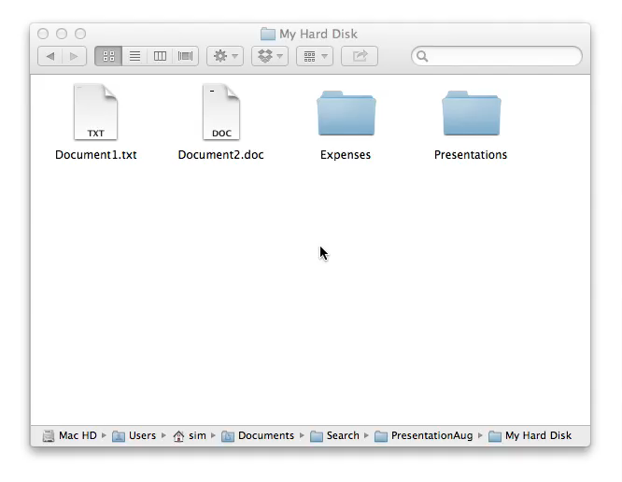
Browsing a Typical Filesystem

Slide 4
A ‘tree’ Representation of a Hard Disk
My Hard Disk
Expenses
Presentations
Document1.txt
Document2.doc
Flights.pdf
Food_drink.pdf
Mywork.ppt
Conference.ppt
Tutorial.ppt
Root
Level 1
Level 2

Slide 5
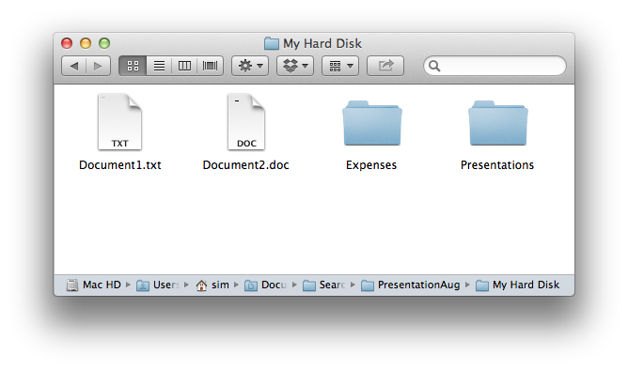
Treemap – Root Level
My Hard Disk
Expenses
Presentations
Document1.txt
Document2.doc

Slide 6
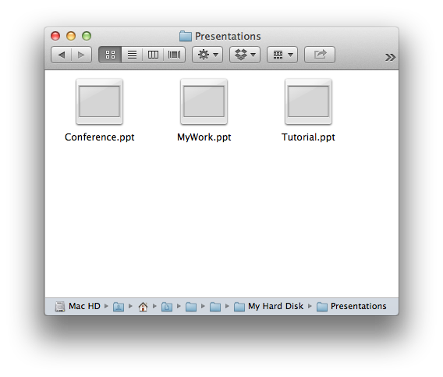
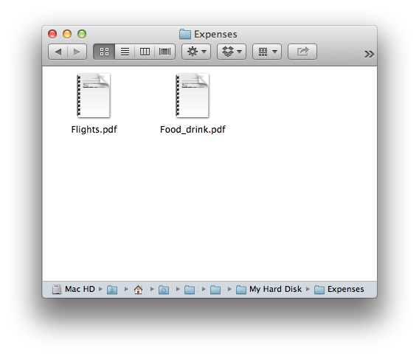
Treemap – 2nd Level
My Hard Disk
Expenses
Presentations
Document1.txt
Flights.pdf
Conference.ppt
MyWork.ppt
Document2.doc
Food_drink.pdf
Tutorial.ppt

Slide 7
Pause for Questions

Slide 8
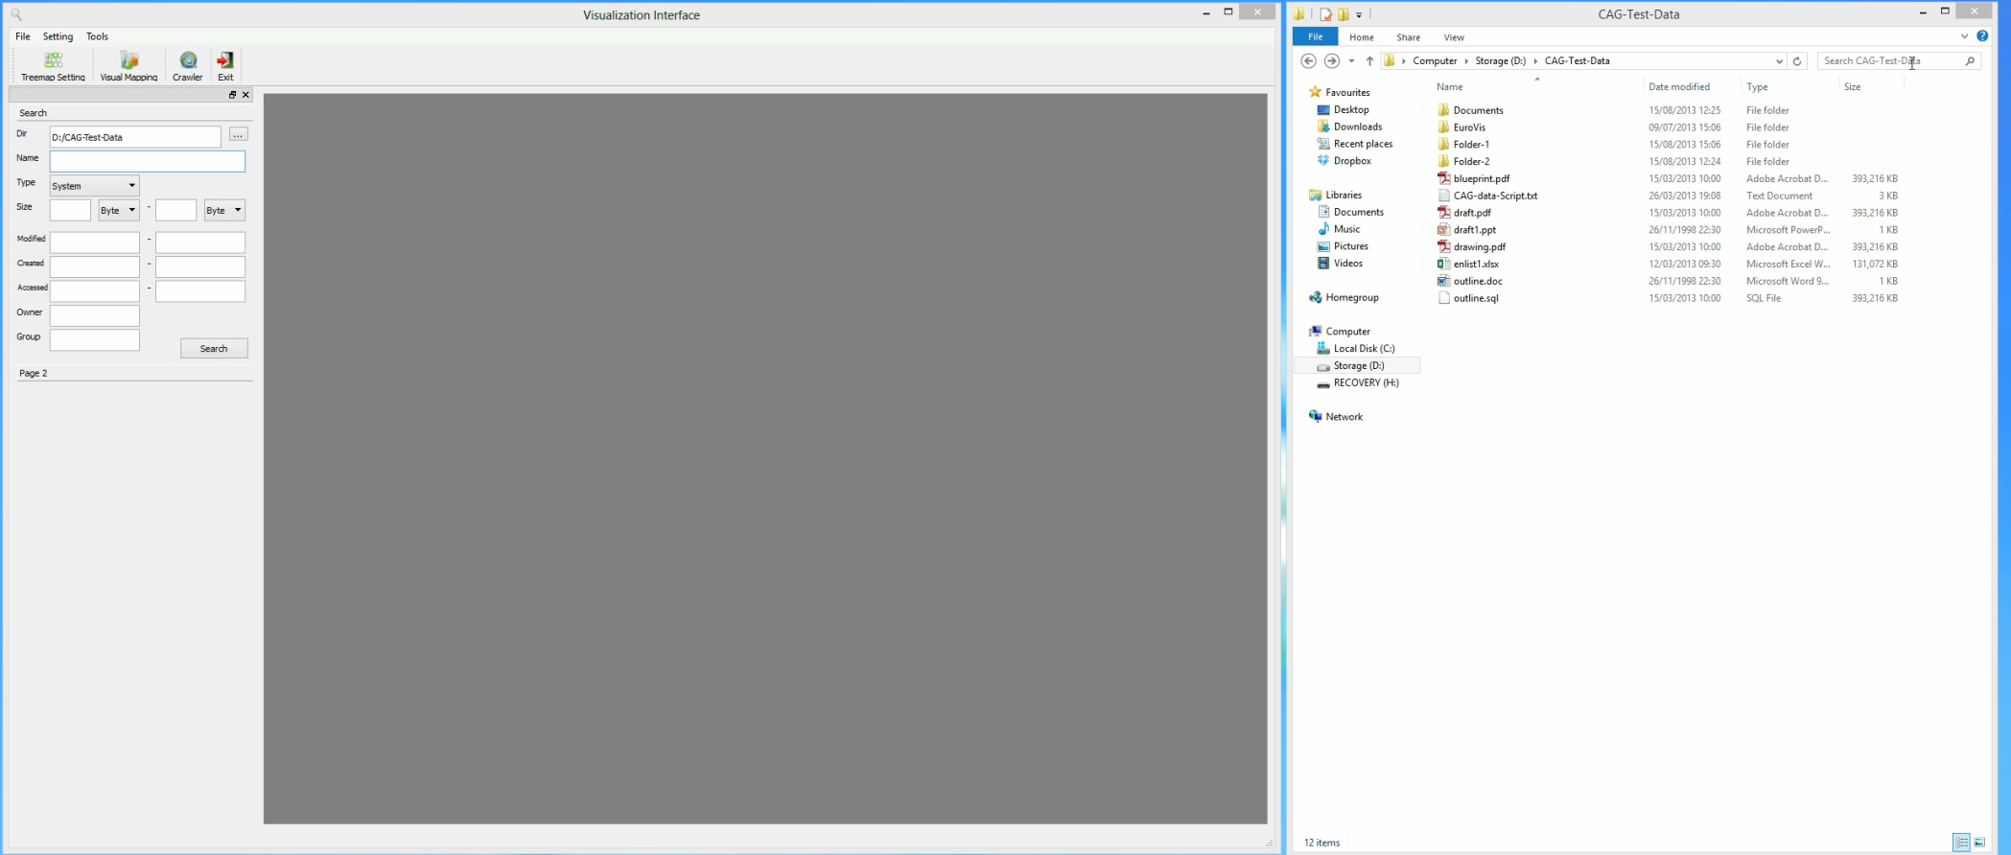
Visualizing Search Results

Slide 9
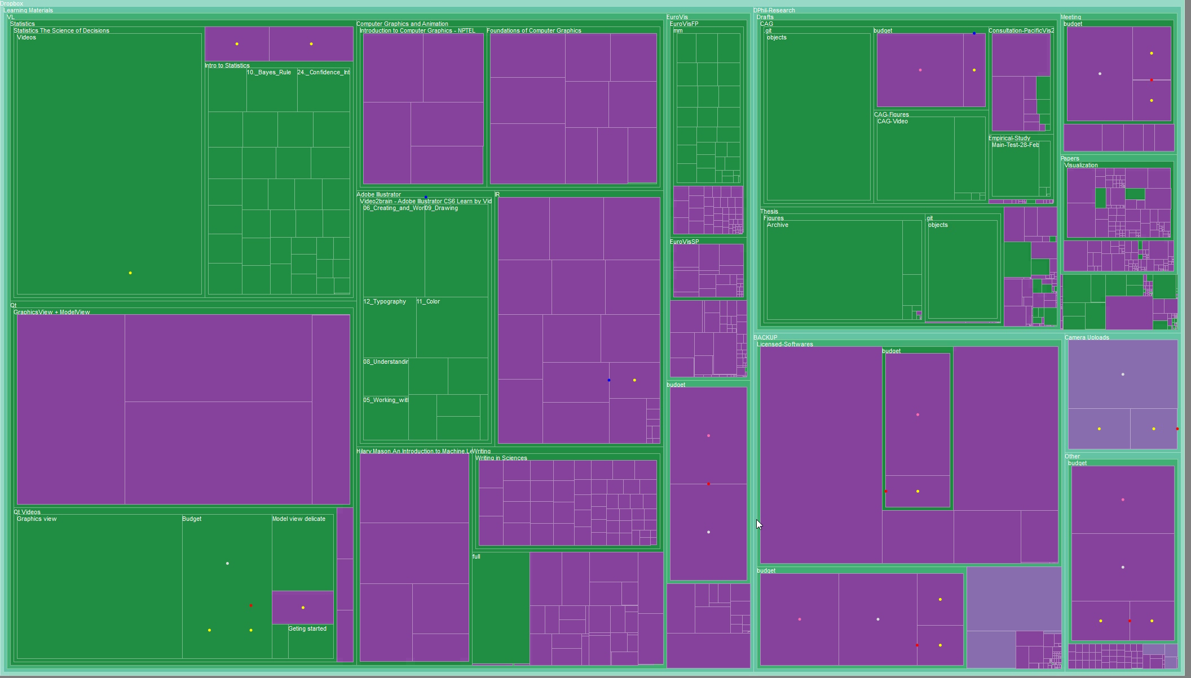
Using a popup with dots or glyphs for details

Slide 10
Typical Application Scenarios
A group of users need to search for files in a large distributed file system frequently to construct a portfolio.
The file system may contain several millions of files which are organised into many levels.
Normally the treemap shows only a few levels at the top.
Typically the search engine may return many results.
Using popup windows can be slow
Design goal is to help users to perform their tasks fast:
  determine if a search specification is good enough, and if not refine the search specification accordingly.
  find the relevant files required to build a specific portfolio.

Slide 11
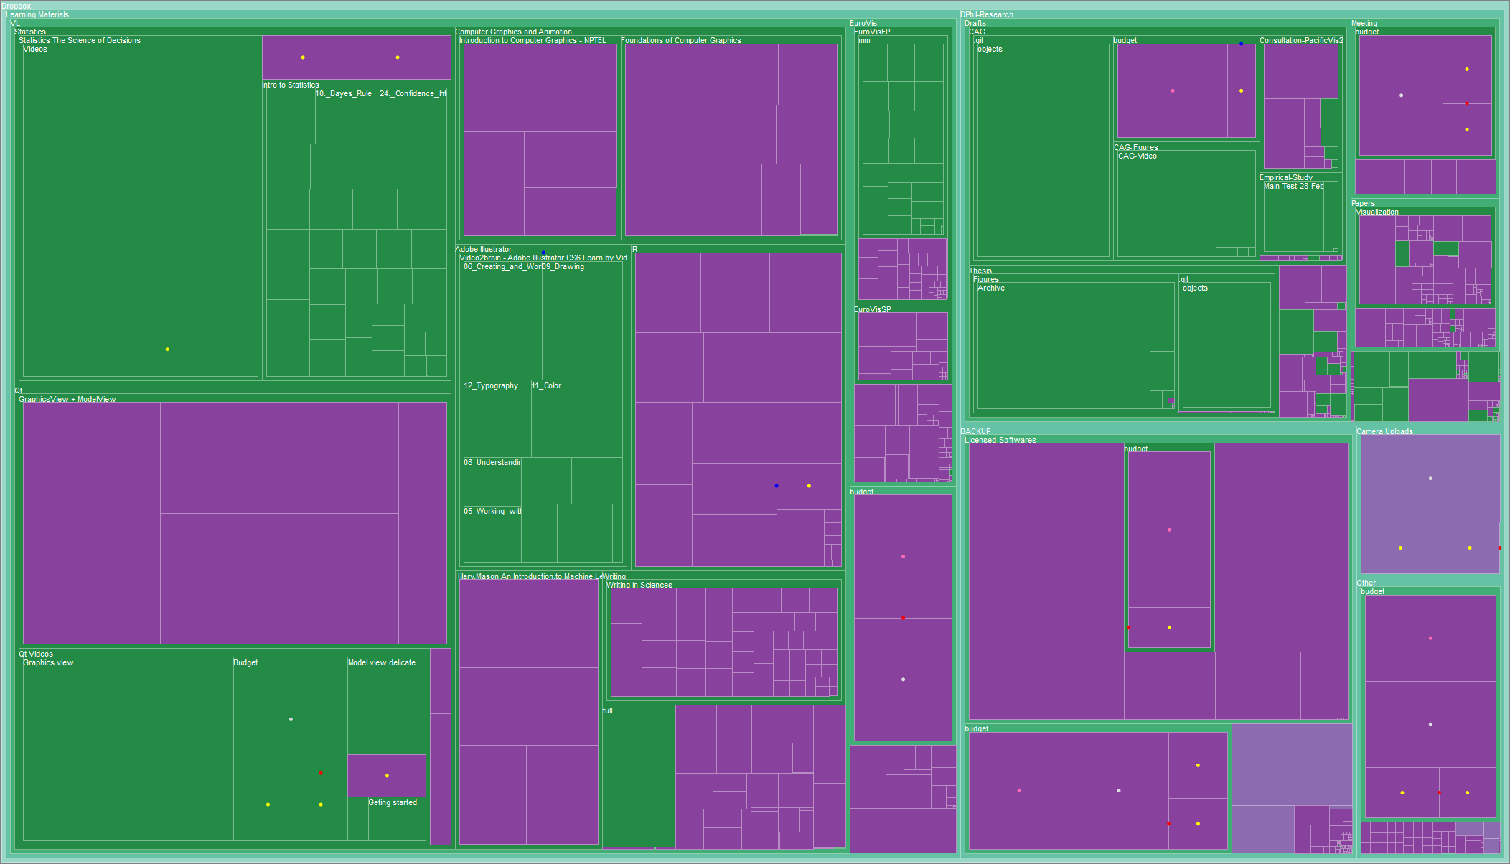
A: Show Search Results as Static Dots

Slide 12
Preliminary Assessment of Static Dots
Possible Advantages
Possible Disadvantages
Intuitive visual representation.
No need to learn and memorise the encoding scheme.
May not be easy for users to locate all dots.
A cluster of dots may cause minor occlusion of the underlying treemap.
A dot can encode a limited amount of information, so using popup window may be essential for every dot.

Slide 13
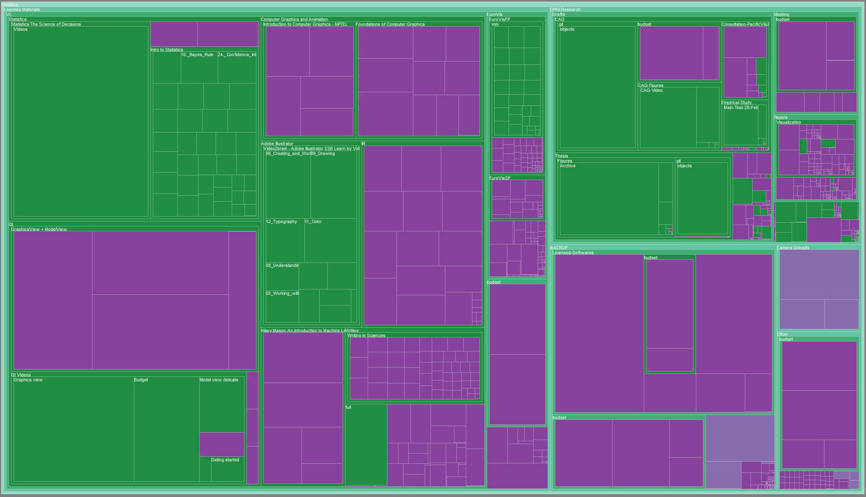
B: Show Search Results as Animated Dots

Slide 14
Preliminary Assessment of Animated Dots
Possible Advantages
Possible Disadvantages
Intuitive visual representation.
No need to learn and memorise the encoding scheme.
It draws users’ attention, so
  dots can be found quickly,
  it may be less likely to miss an animated dot.
It may solve or alleviate the occlusion problem.
A dot can encode a limited amount of information, so using popup window may be essential for every dot.
It may be annoying to some users.
It may need extra time to confirm a dot after it is located, as it may disappear as part of the animation cycle.

Slide 15
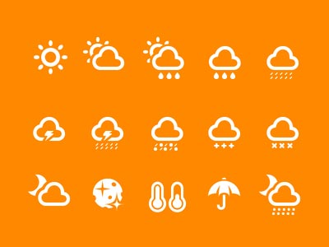
Glyphs
Glyphs are similar to icons
Weather forecasts use them (right)
Simple example: an arrow:
Original
+Direction
+Width
+Fill
+Outline

Slide 16
A Glyph for Search Result Information

Slide 17

C: Show Search Results as Static Glyphs

Slide 18
Preliminary Assessment of Static Glyphs
Possible Advantages
Possible Disadvantages
Easy to find as it is bigger.
It can encode multivariate attributes, e.g., type, size, date, etc.
Earlier elimination of some search results may be possible, e.g., by file size.
It may reduce the need to read details in pop-up window
  less hovering around
  less reading
Less intuitive visual representation.
Need to learn and memorise the encoding scheme.
More likely to cause occlusion.

Slide 19
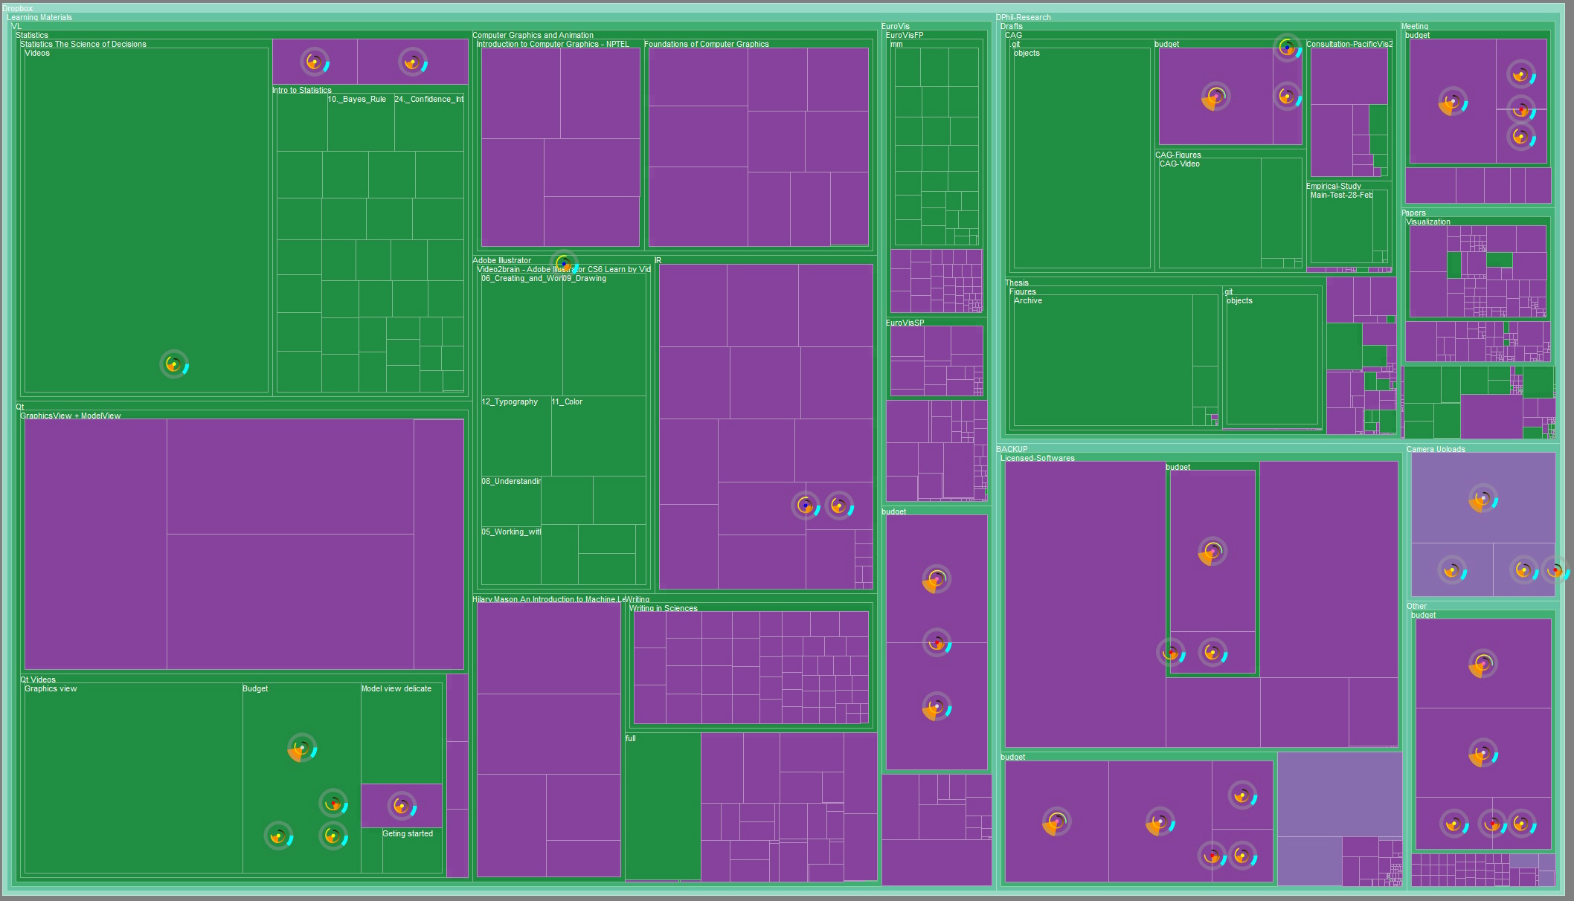
D: Show Search Results as Animated Glyphs

Slide 20
Preliminary Assessment of Animated Glyphs
Possible Advantages
Possible Disadvantages
Easy to find as it is bigger and animating
  they can be found quickly,
  it may be much less likely to miss an animated glyph.
It can encode multivariate attributes, e.g., type, size, date, etc.
Earlier elimination of some search results may be possible, e.g., by file size.
It may reduce the need to read details in pop-up window
  less hovering around
  less reading
It may solve the occlusion problem.
Less intuitive visual representation.
Need to learn and memorise the encoding scheme.
It may be annoying to some users.
It may need extra time to view an animated glyph, as some part of it may change or disappear as part of the animation cycle.
Comparing two animated glyphs may be more difficult than comparing two static glyphs.

Slide 21
Pause for Questions

Slide 22
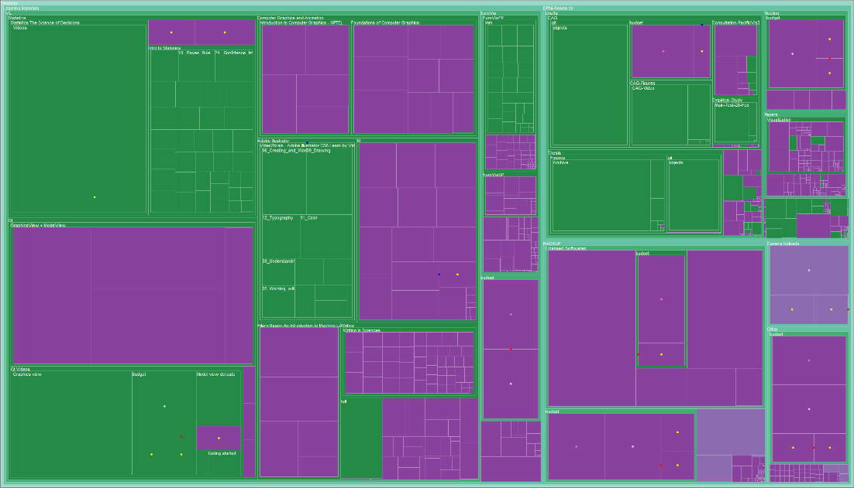

Section 1
Animated Dots
Static Dots

Slide 23


Section 2
Static Glyphs
Static Dots

Slide 24


Section 3
Animated Glyphs
Static Glyphs

Slide 25


Section 4
Animated Glyphs
Animated Dots

Slide 26
Thank you very much!
Your time is very much appreciated!

