Slide 1
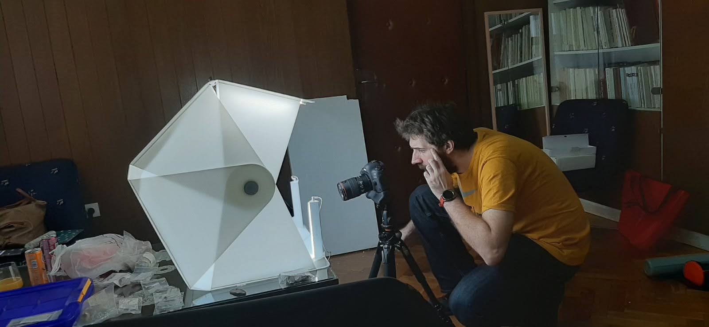
PHOTOGRAMMETRY. TAKING IMAGE

Slide 2
equipment

Slide 3
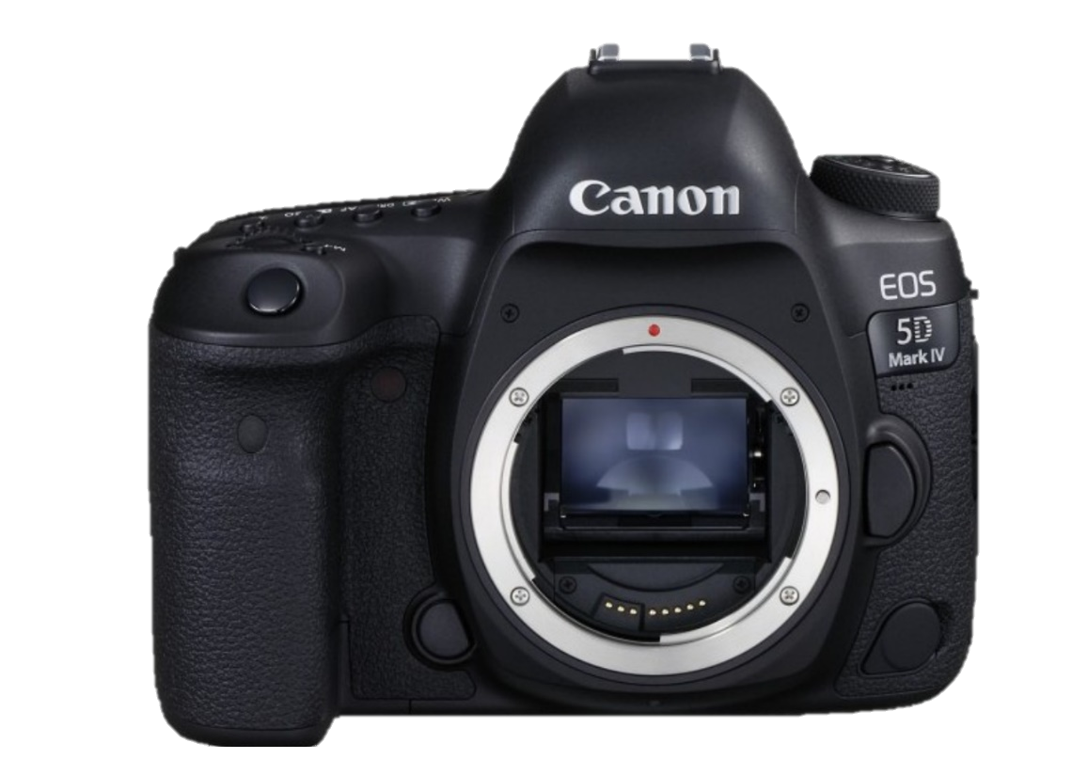
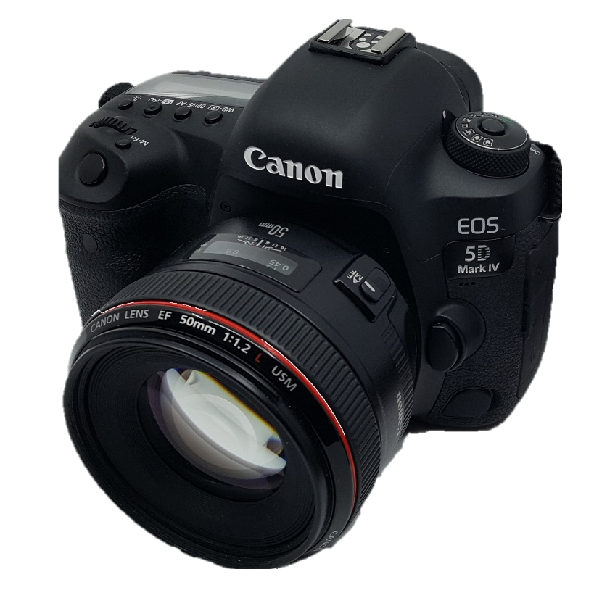
canon eos 5d mark iV
Approximate price: 4.500 KM

Slide 4
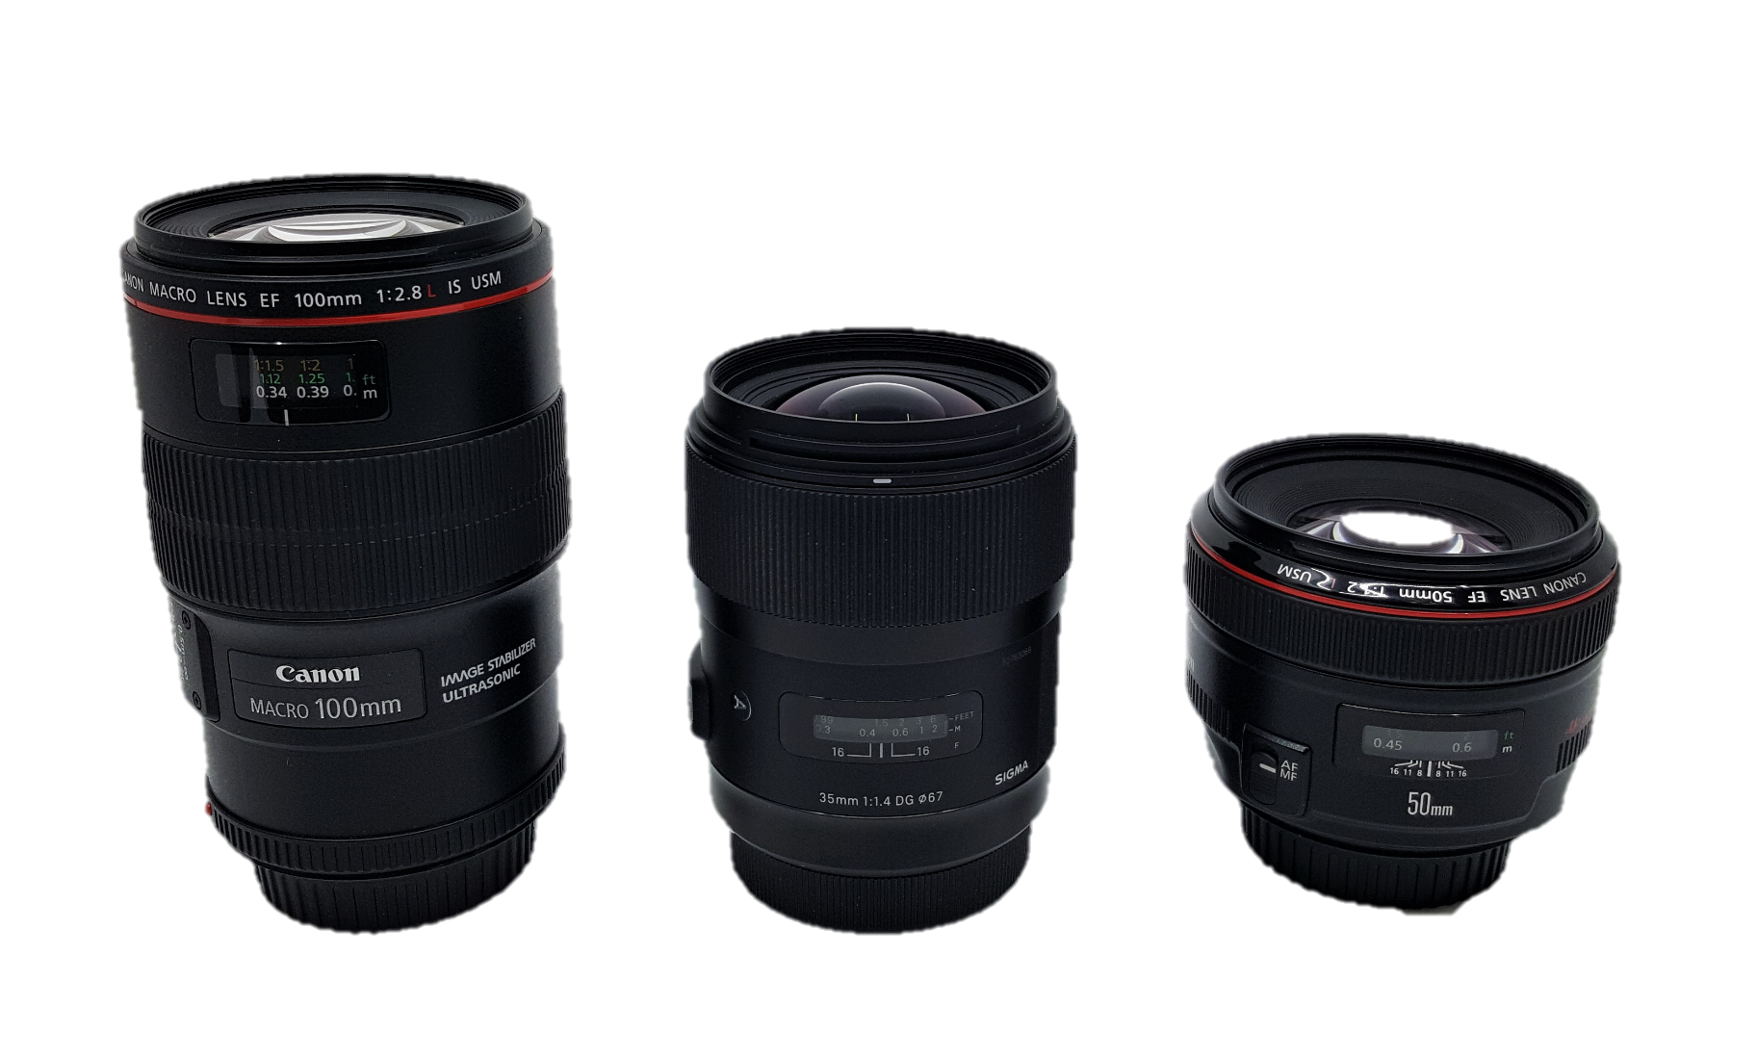
LenS Canon Ef 100mm F/2.8 Macro
LenS Canon EF 50mm f1.4 lenS Sigma 35 mm/F 1,4 DG

Slide 5
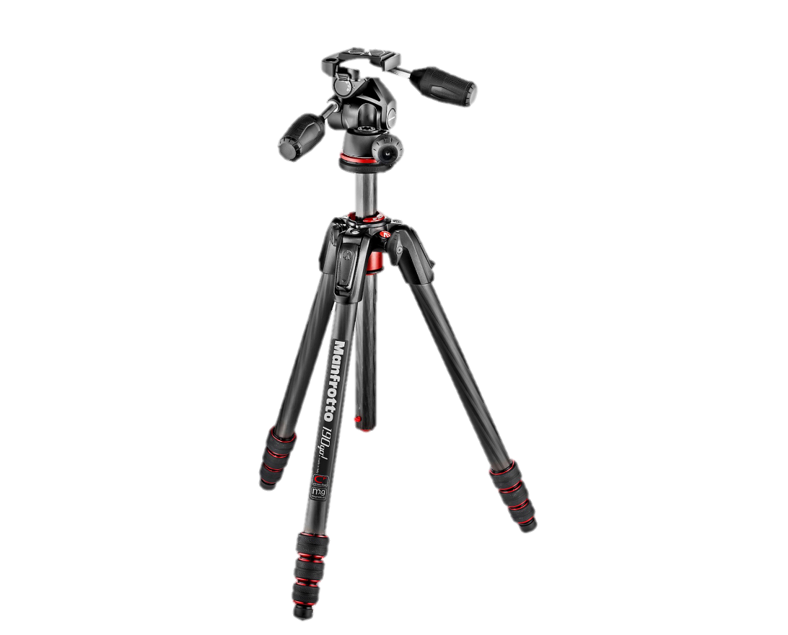
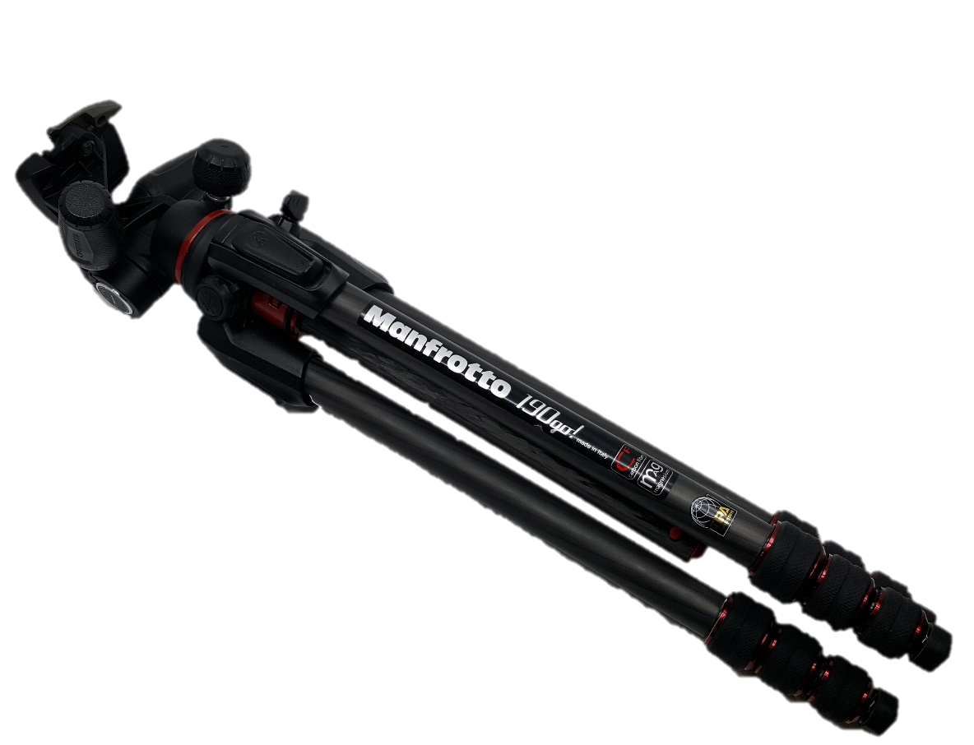
Tripod manfrotto 190go! photo head 3D Mark II 804
Aproximate price: 600 KM

Slide 6
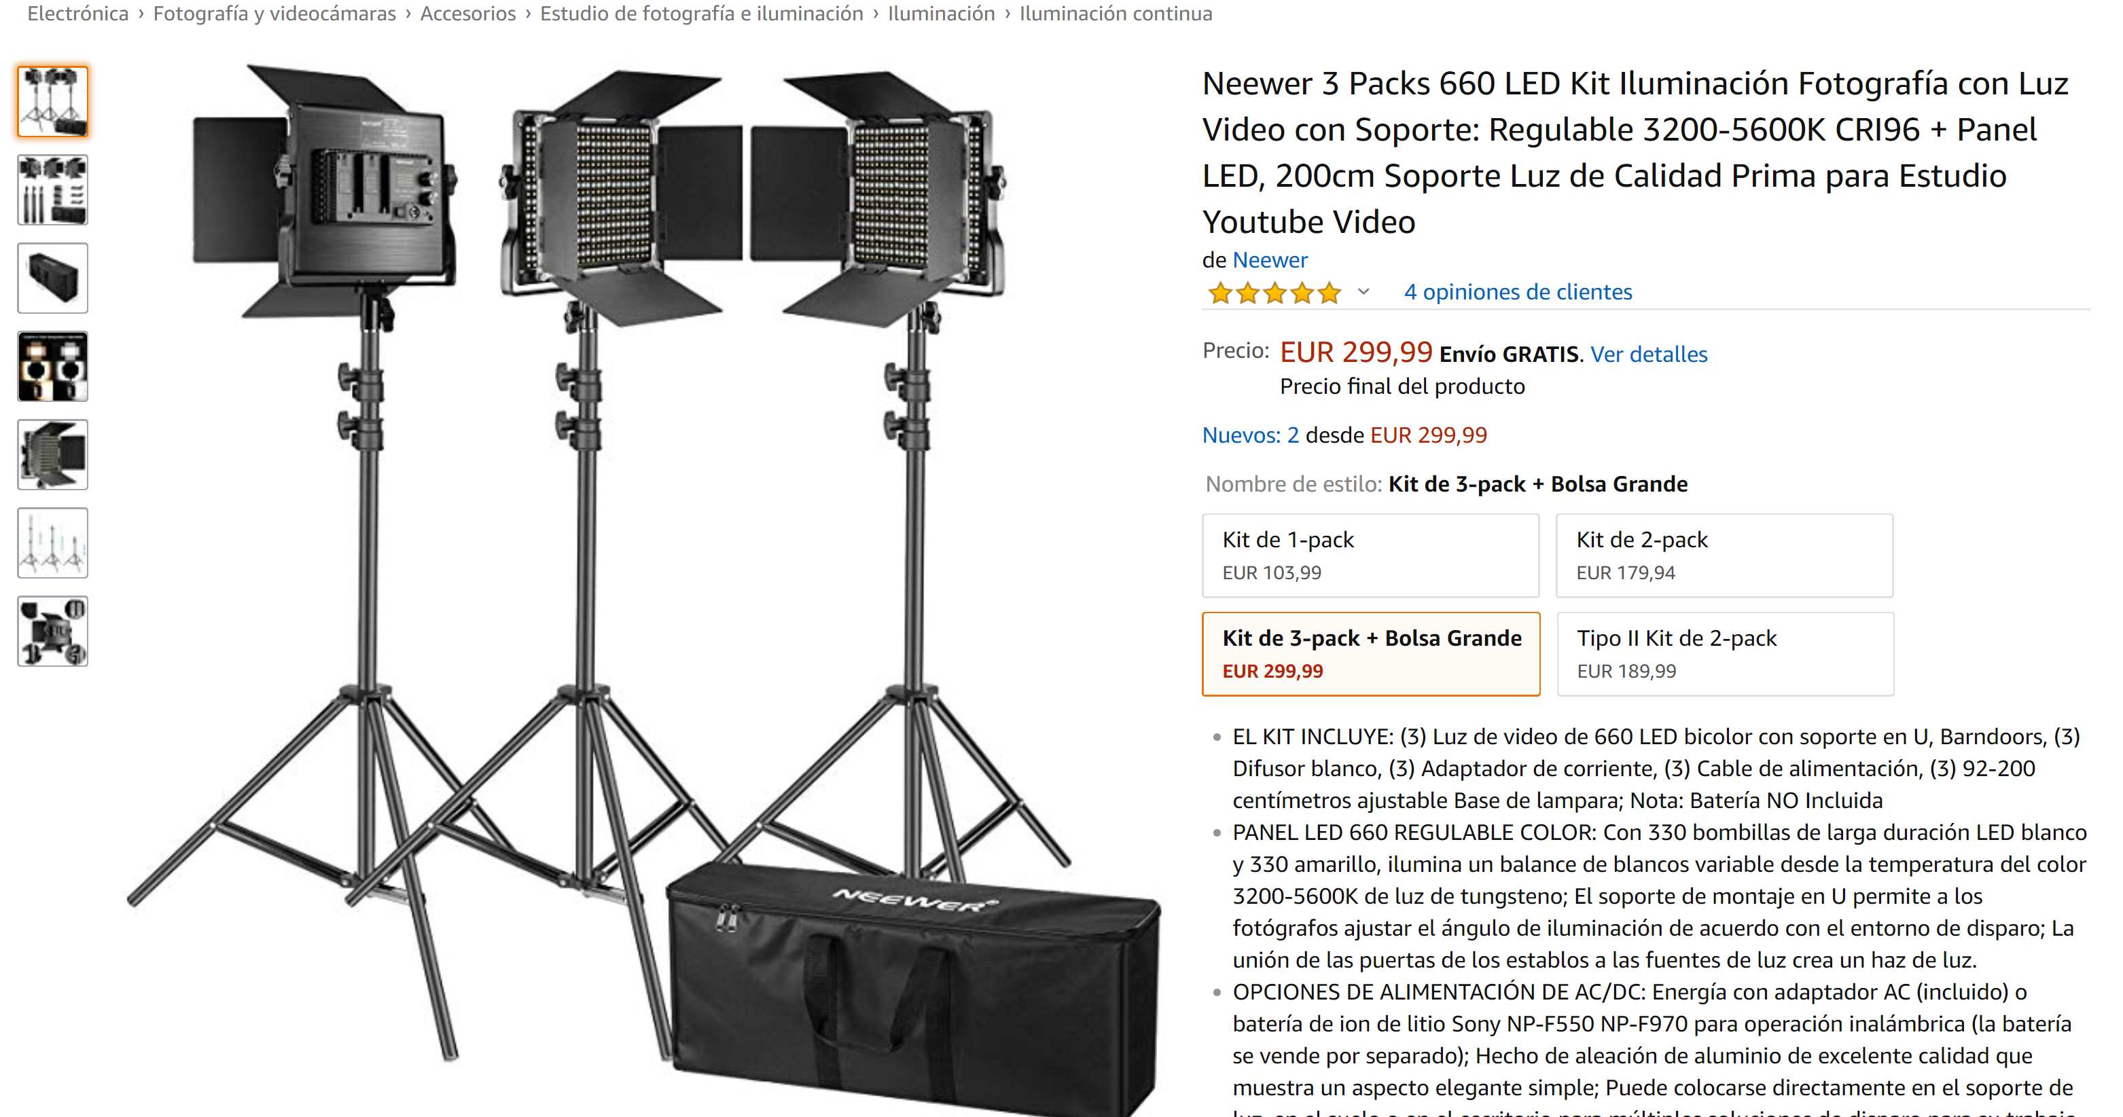

Slide 7
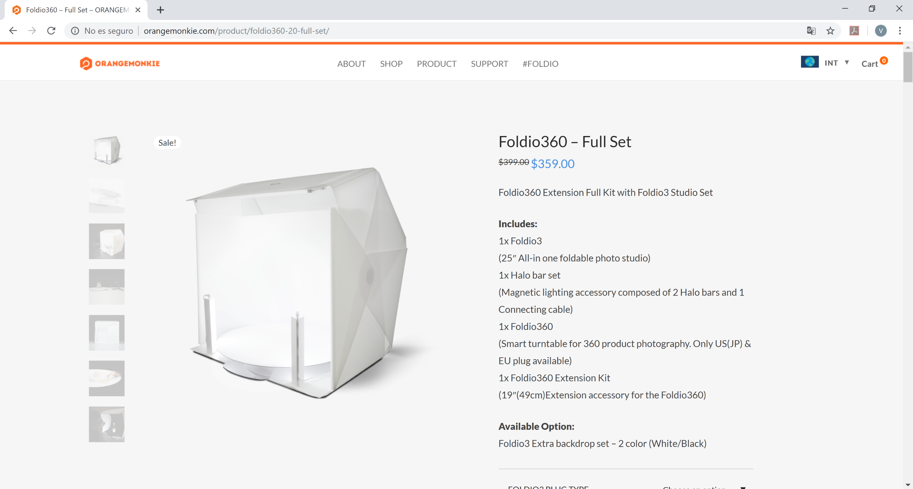

Slide 8
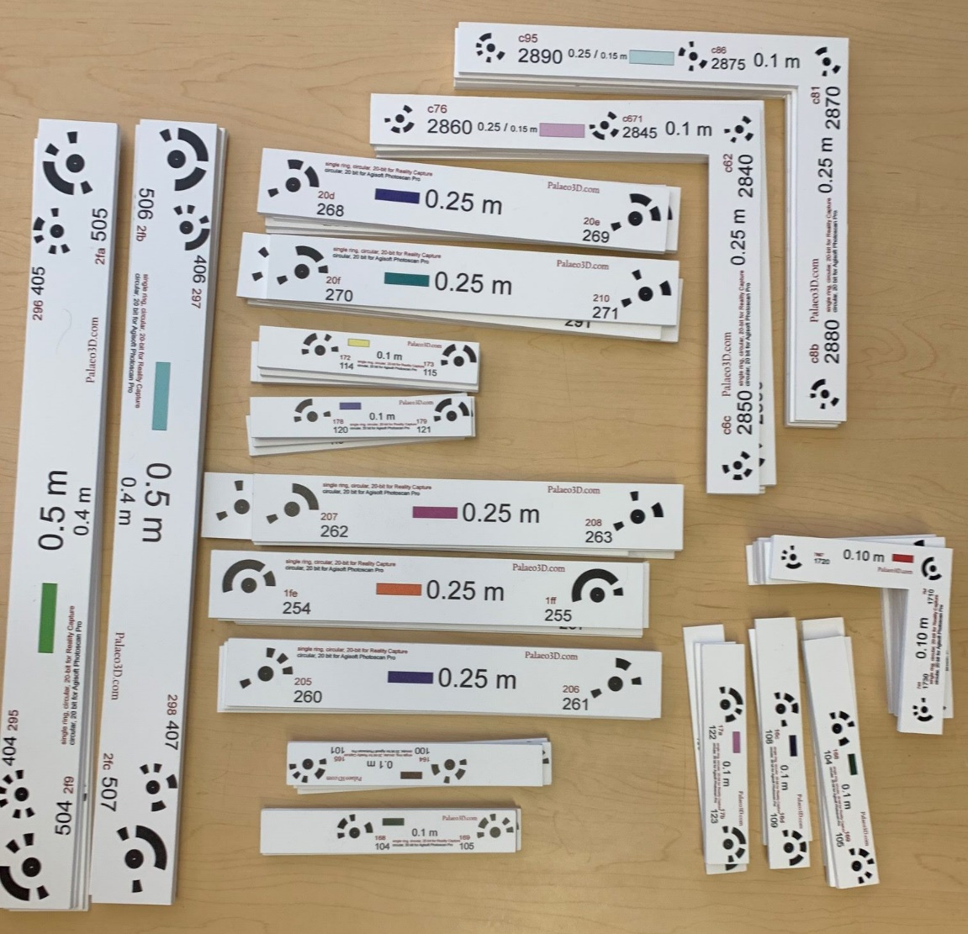
Heinrich Mallison. http://palaeo3d.de/
scales

Slide 9
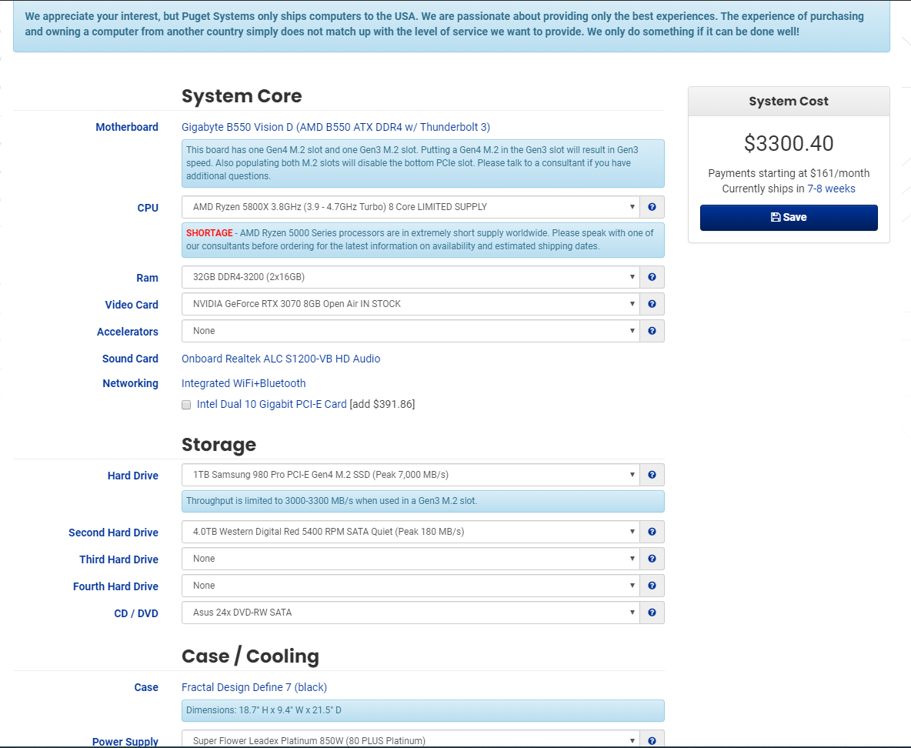
WORK
Station

Slide 10
DIGITIZE Large OBJECTS

Slide 11
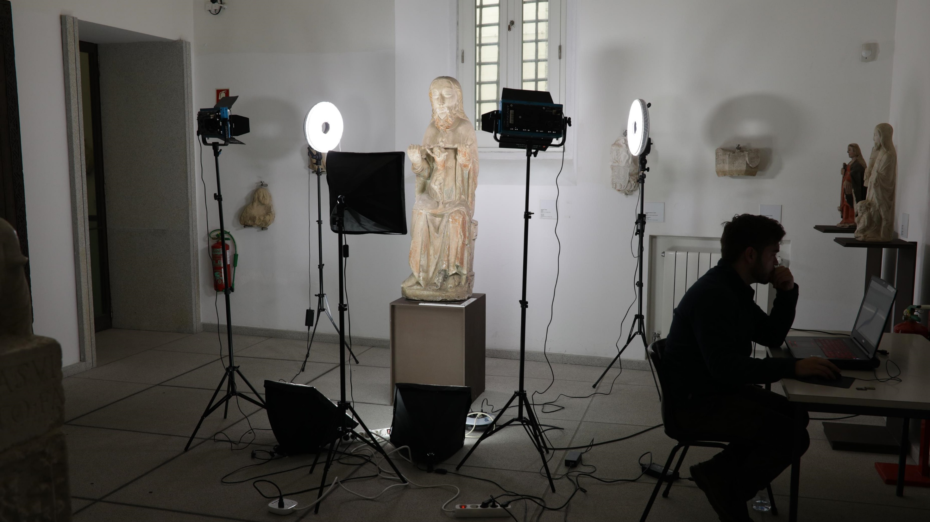

Slide 12
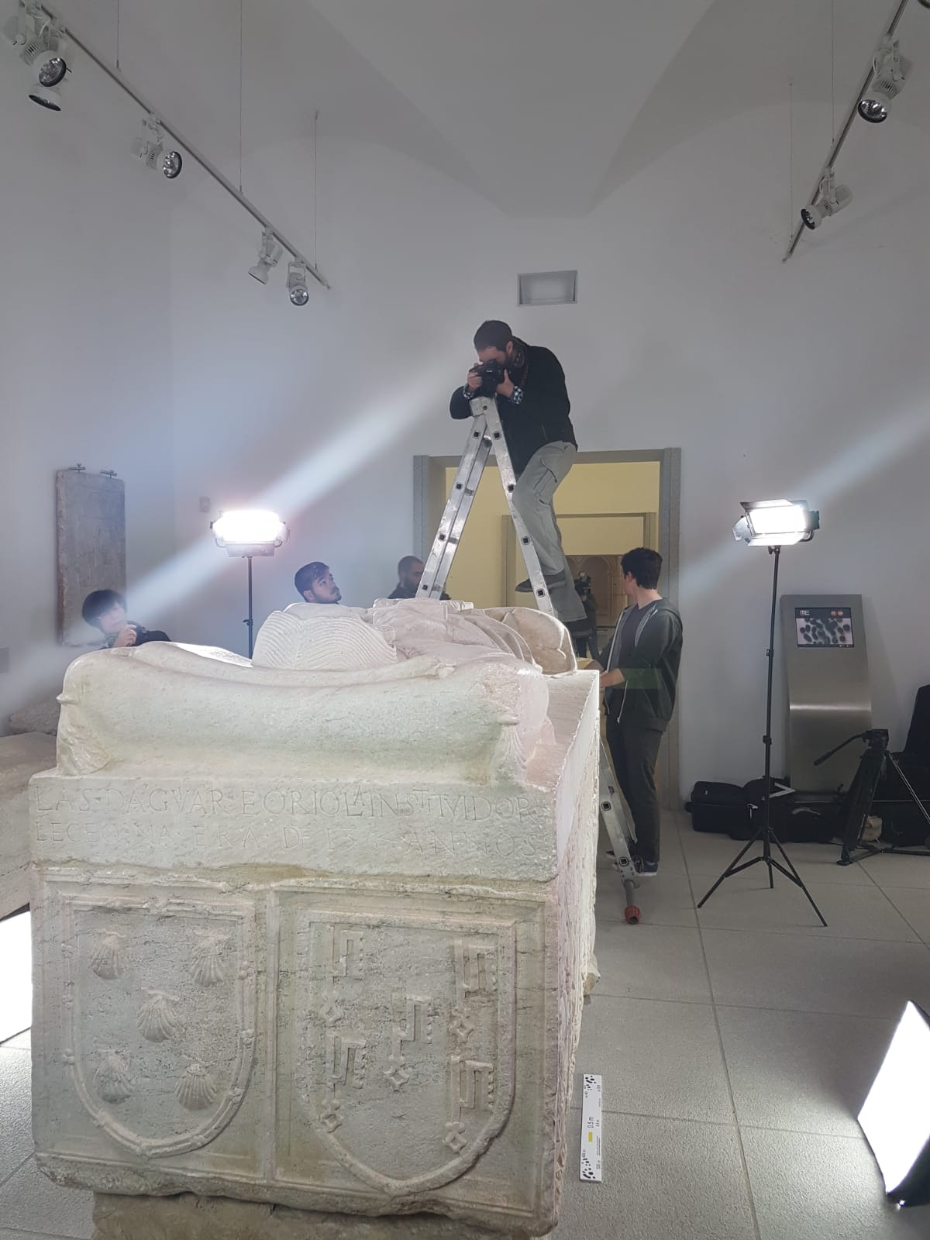
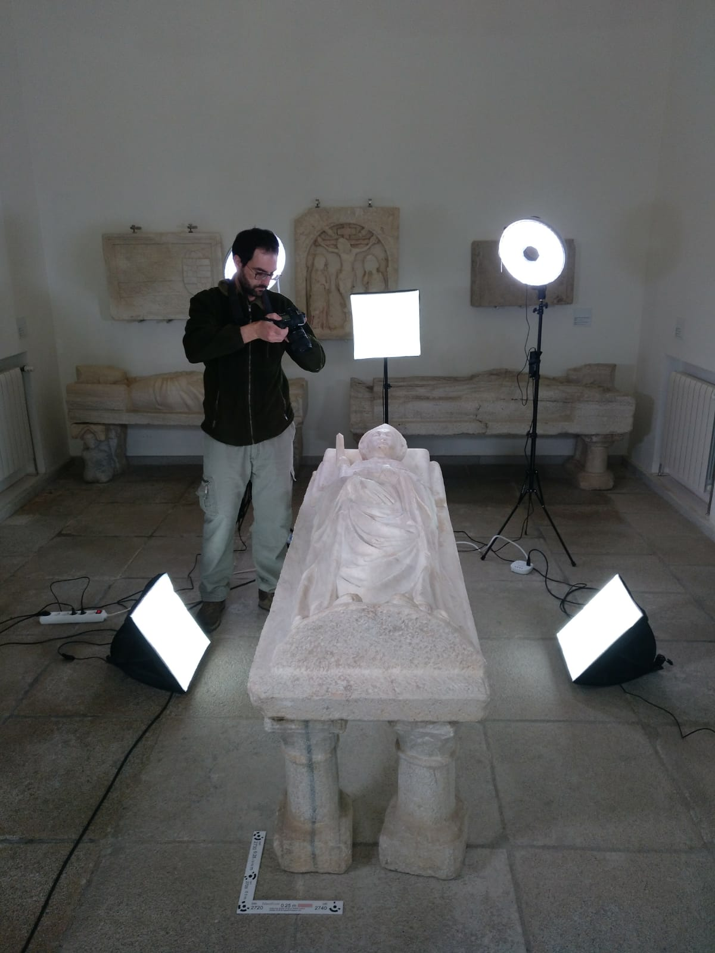

Slide 13
Digitize Small OBJECTS

Slide 14
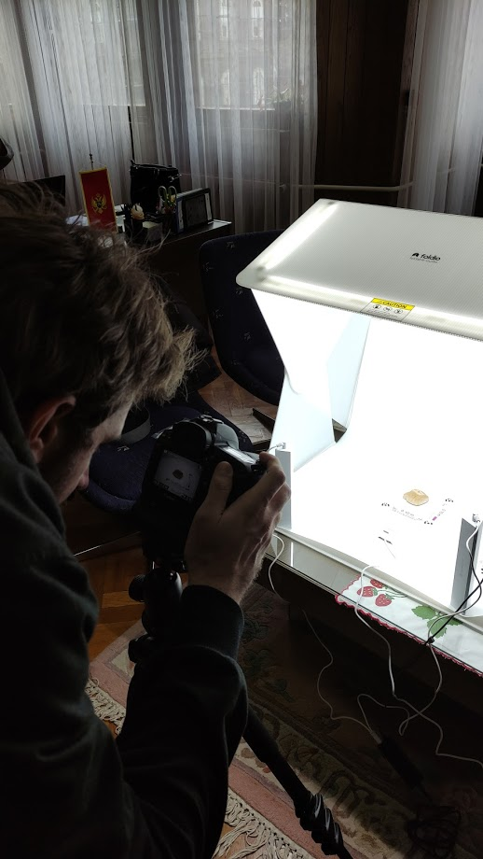
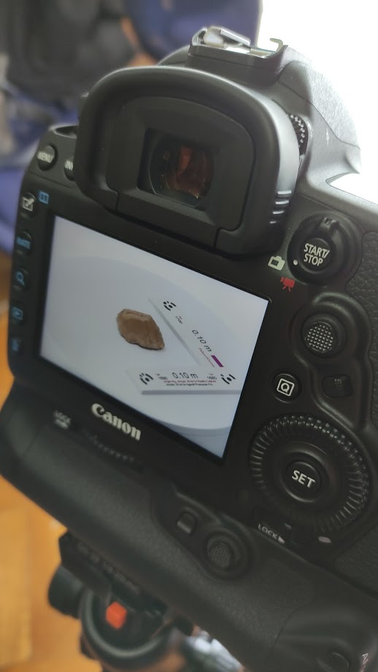

Slide 15
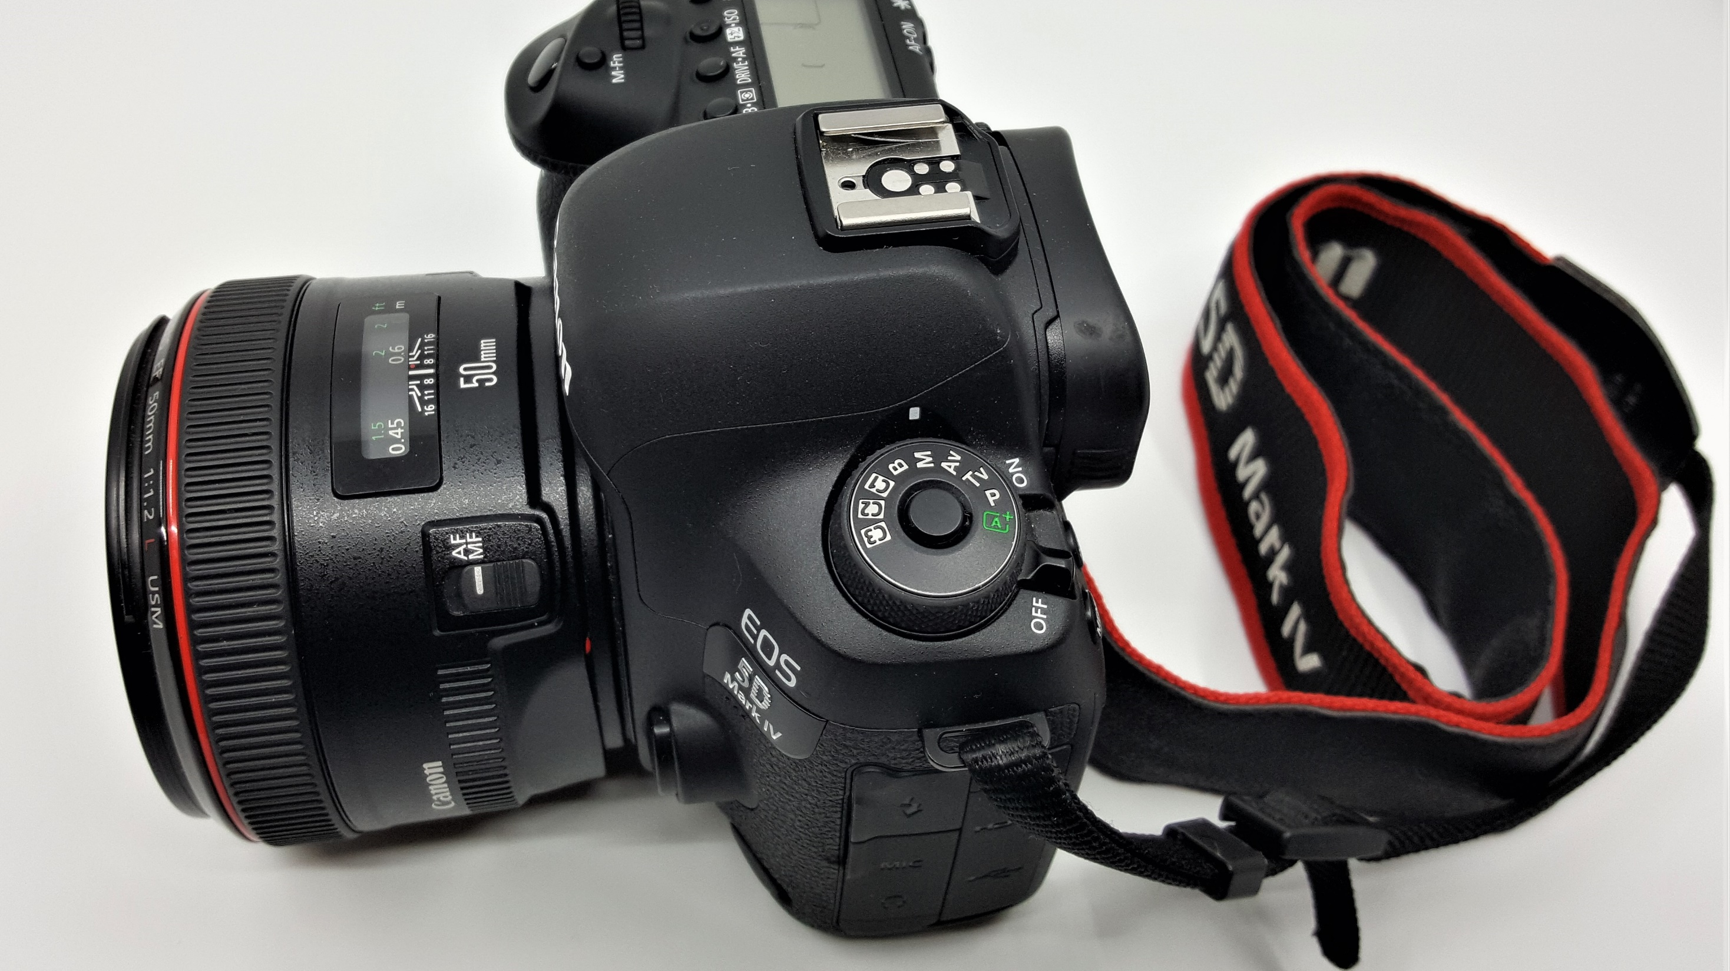


Slide 16
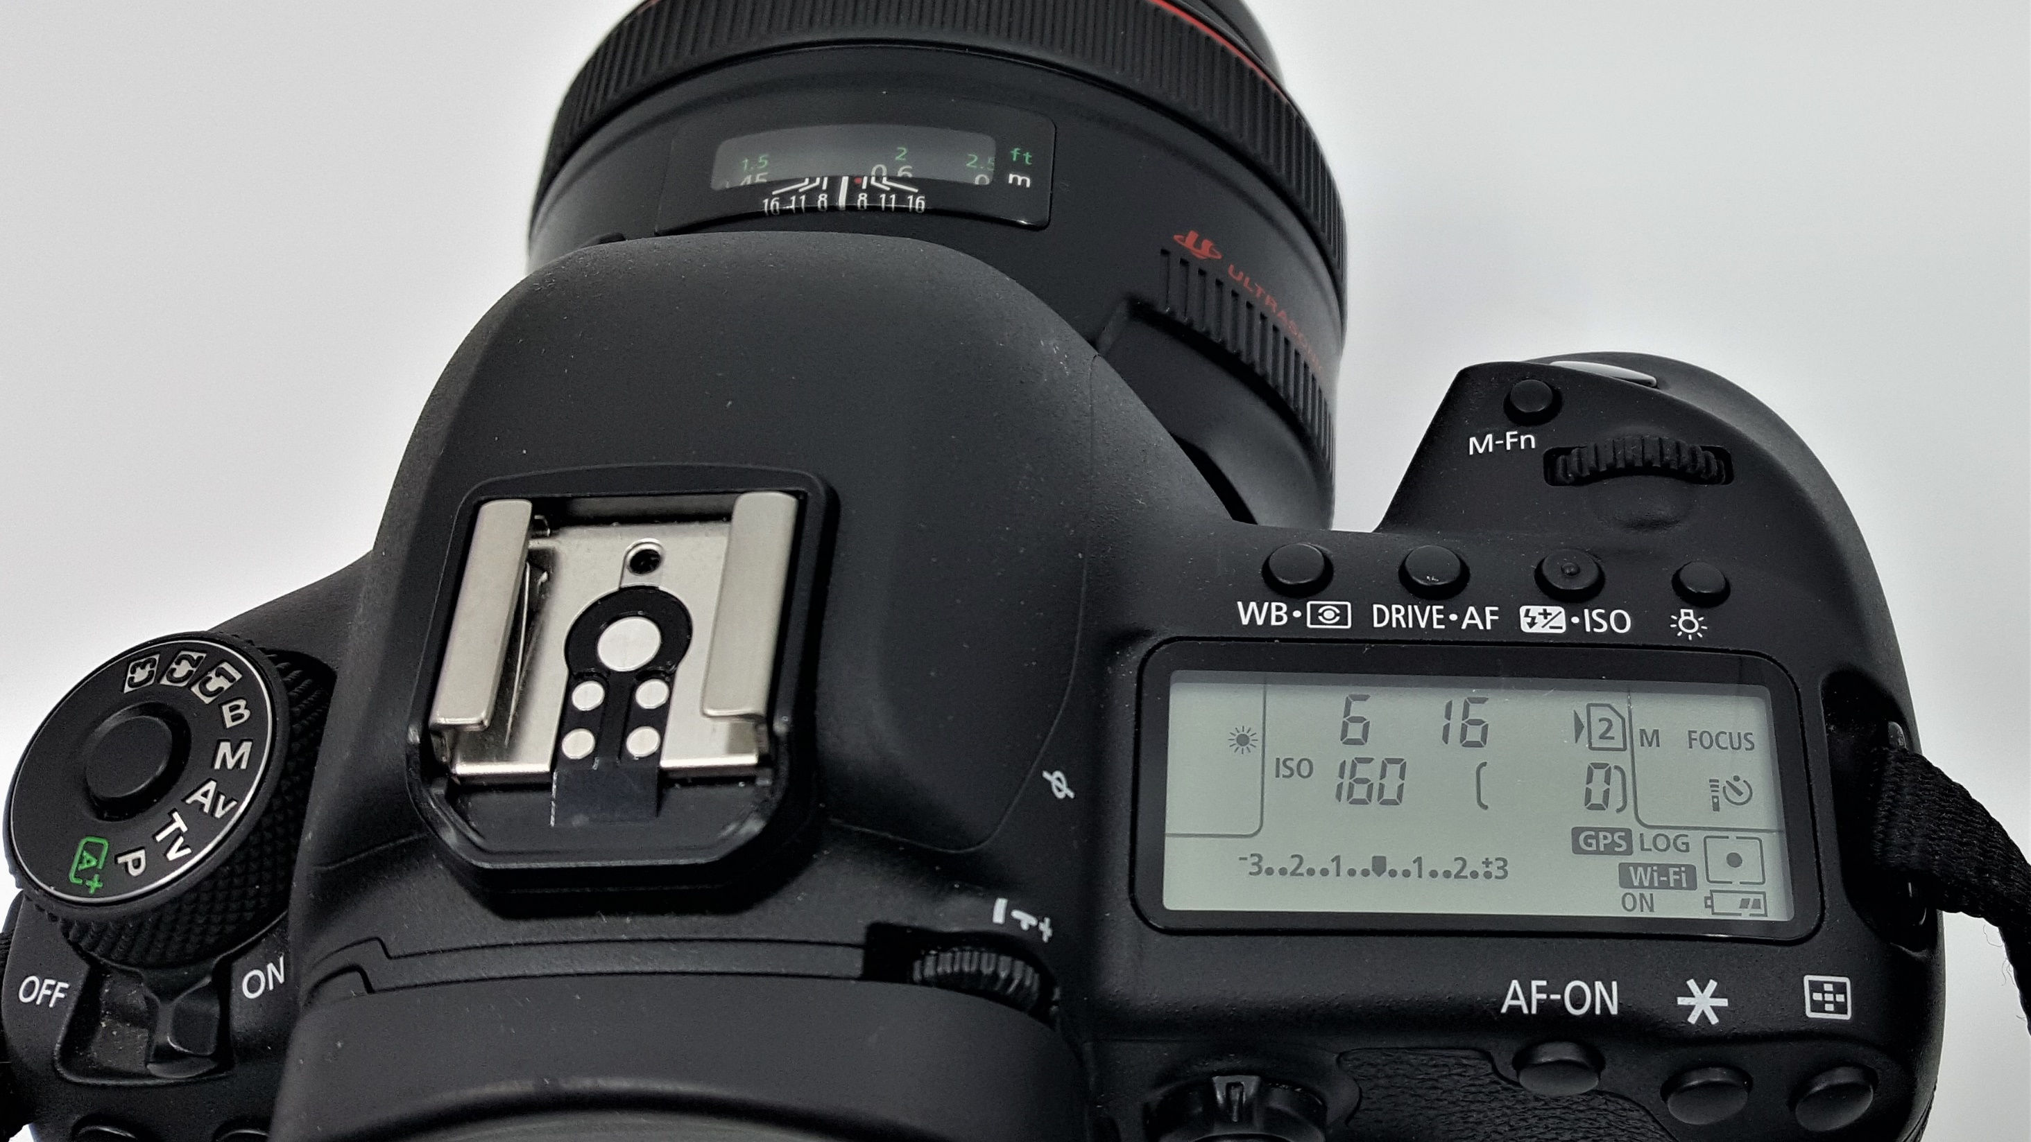

Slide 17
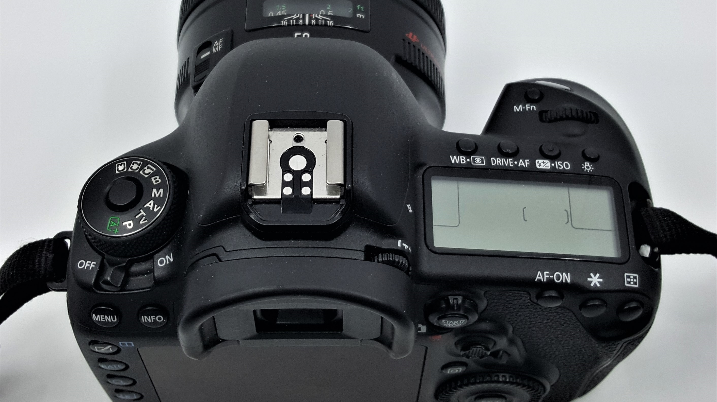

Slide 18
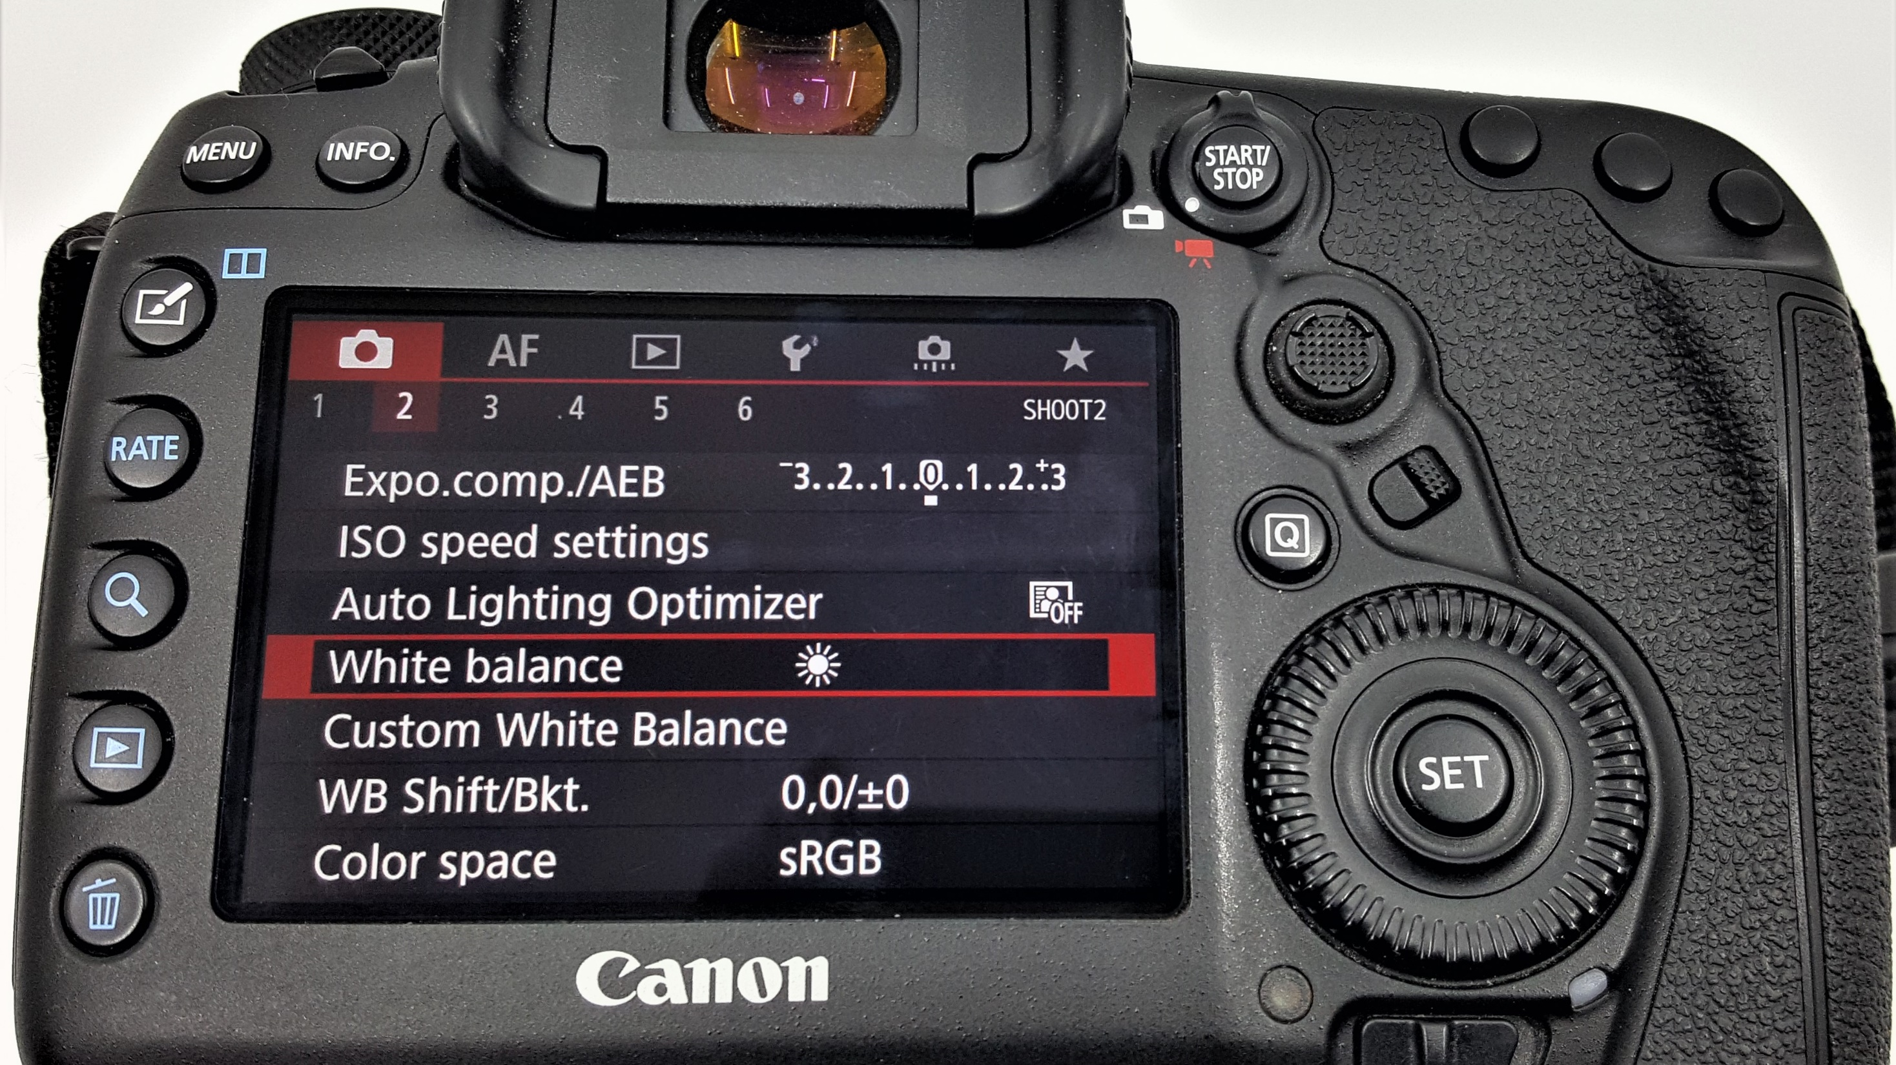

Slide 19
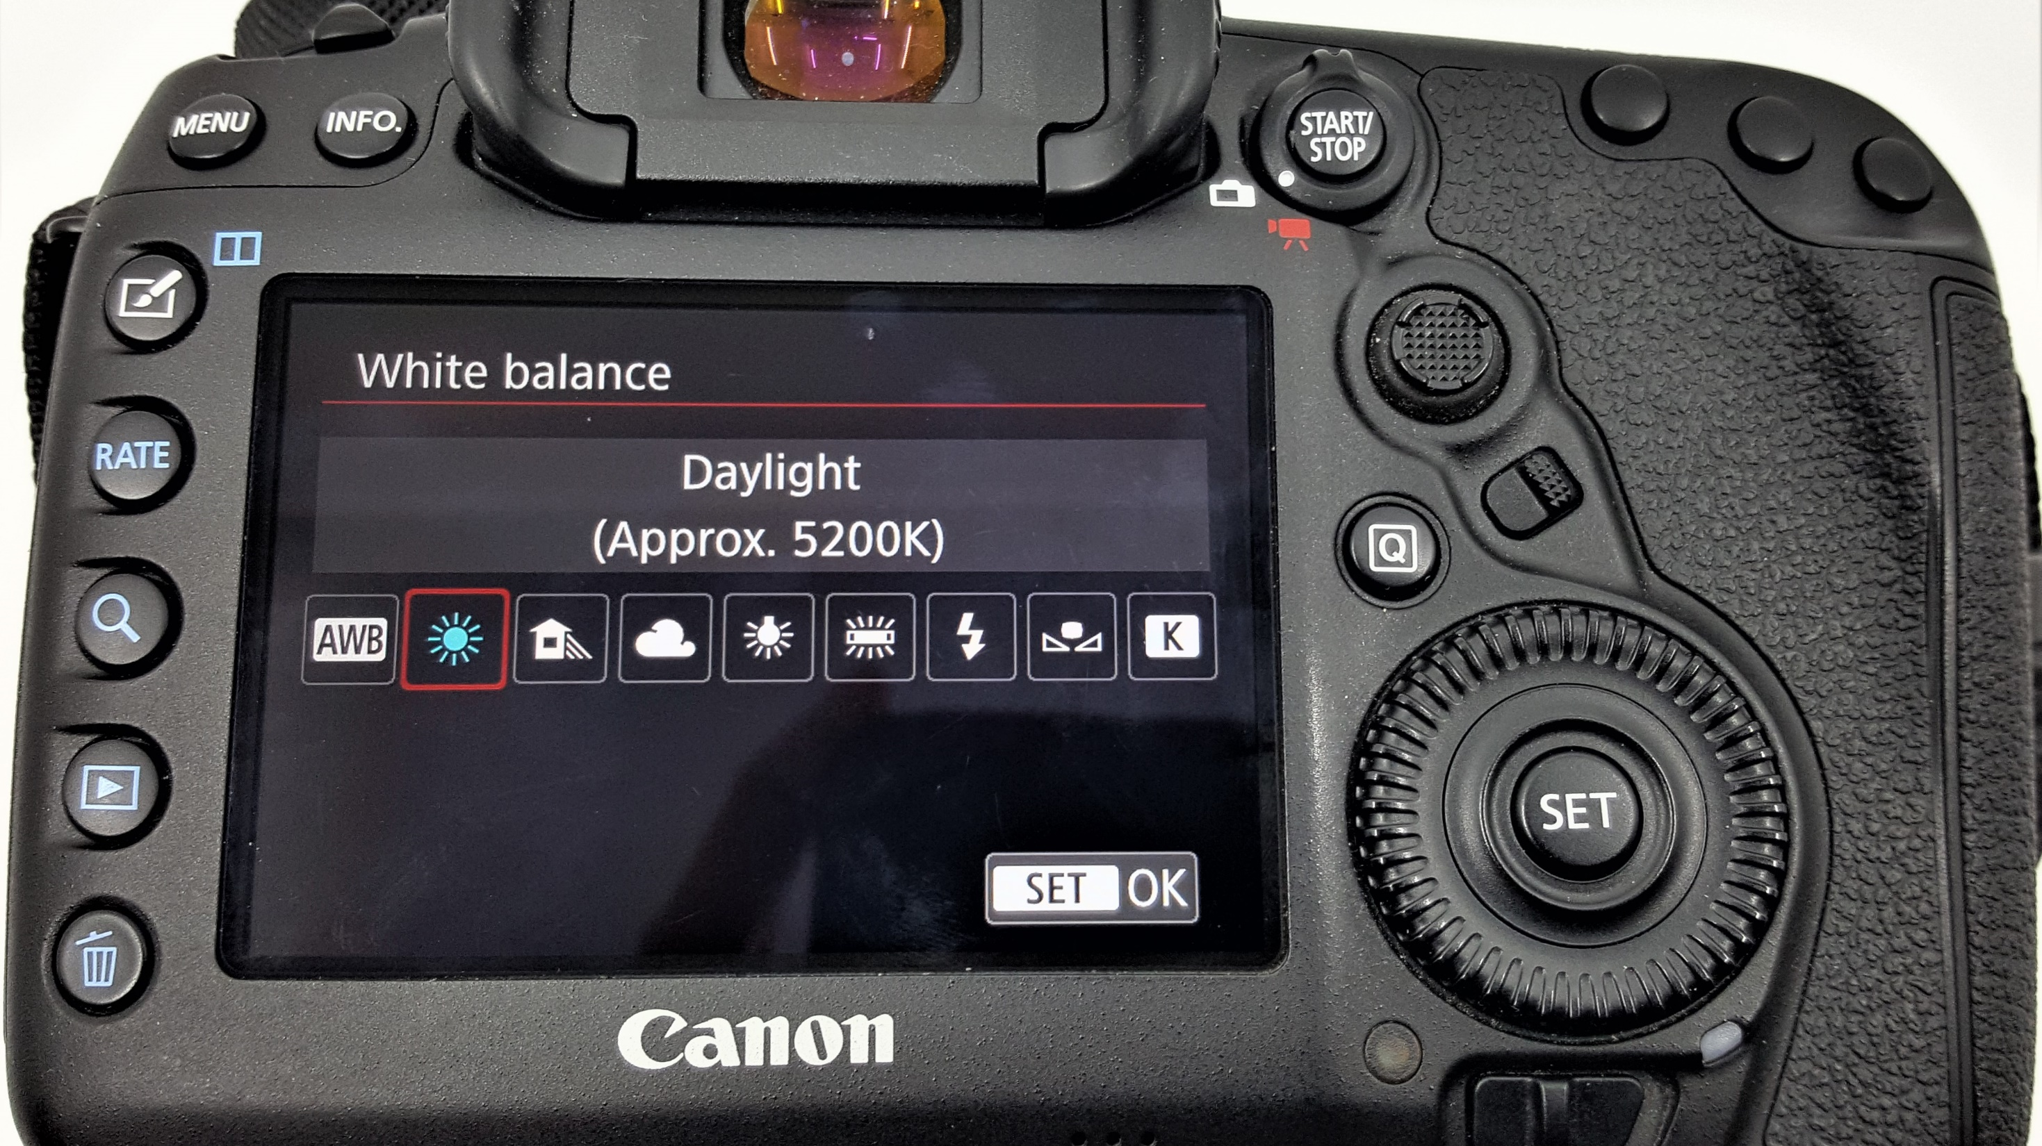

Slide 20
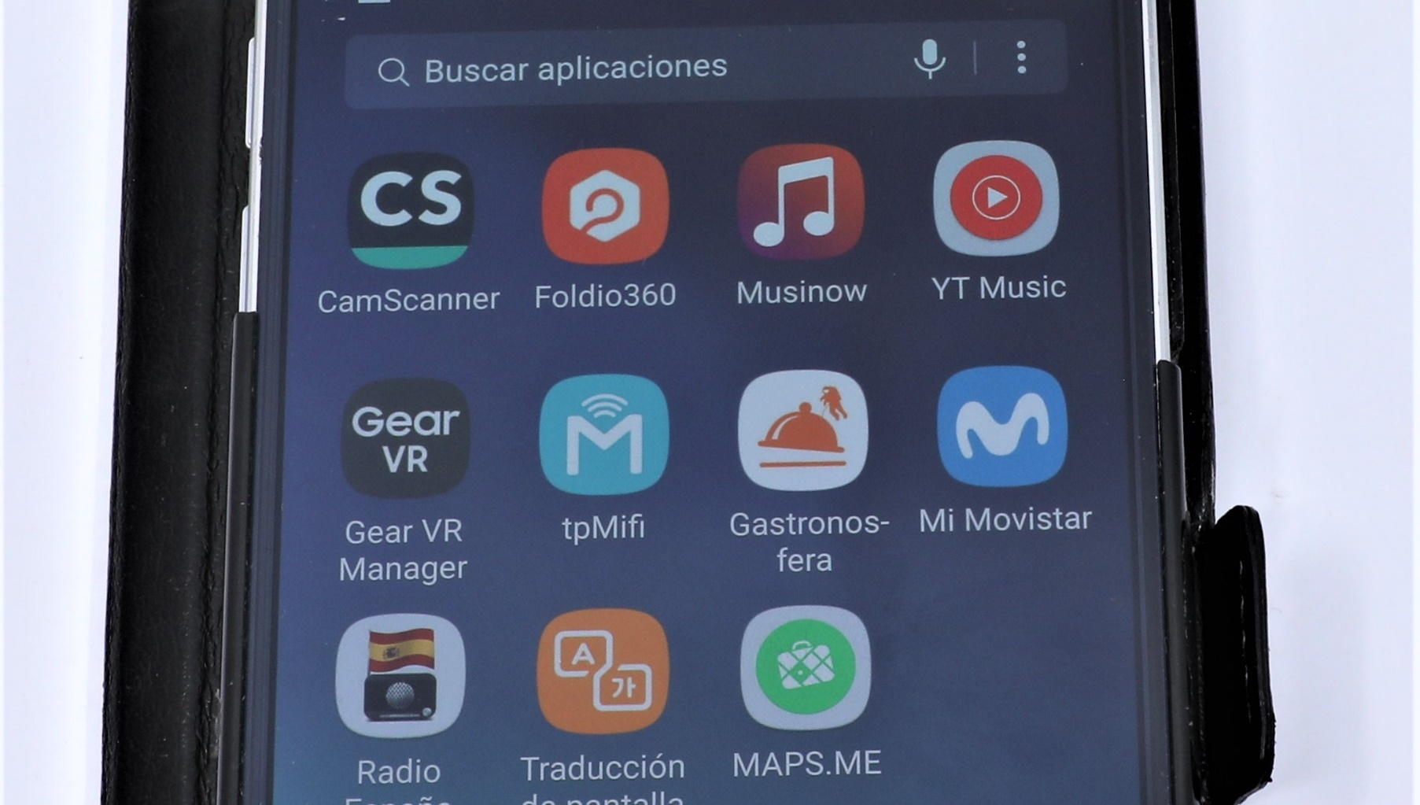


Slide 21
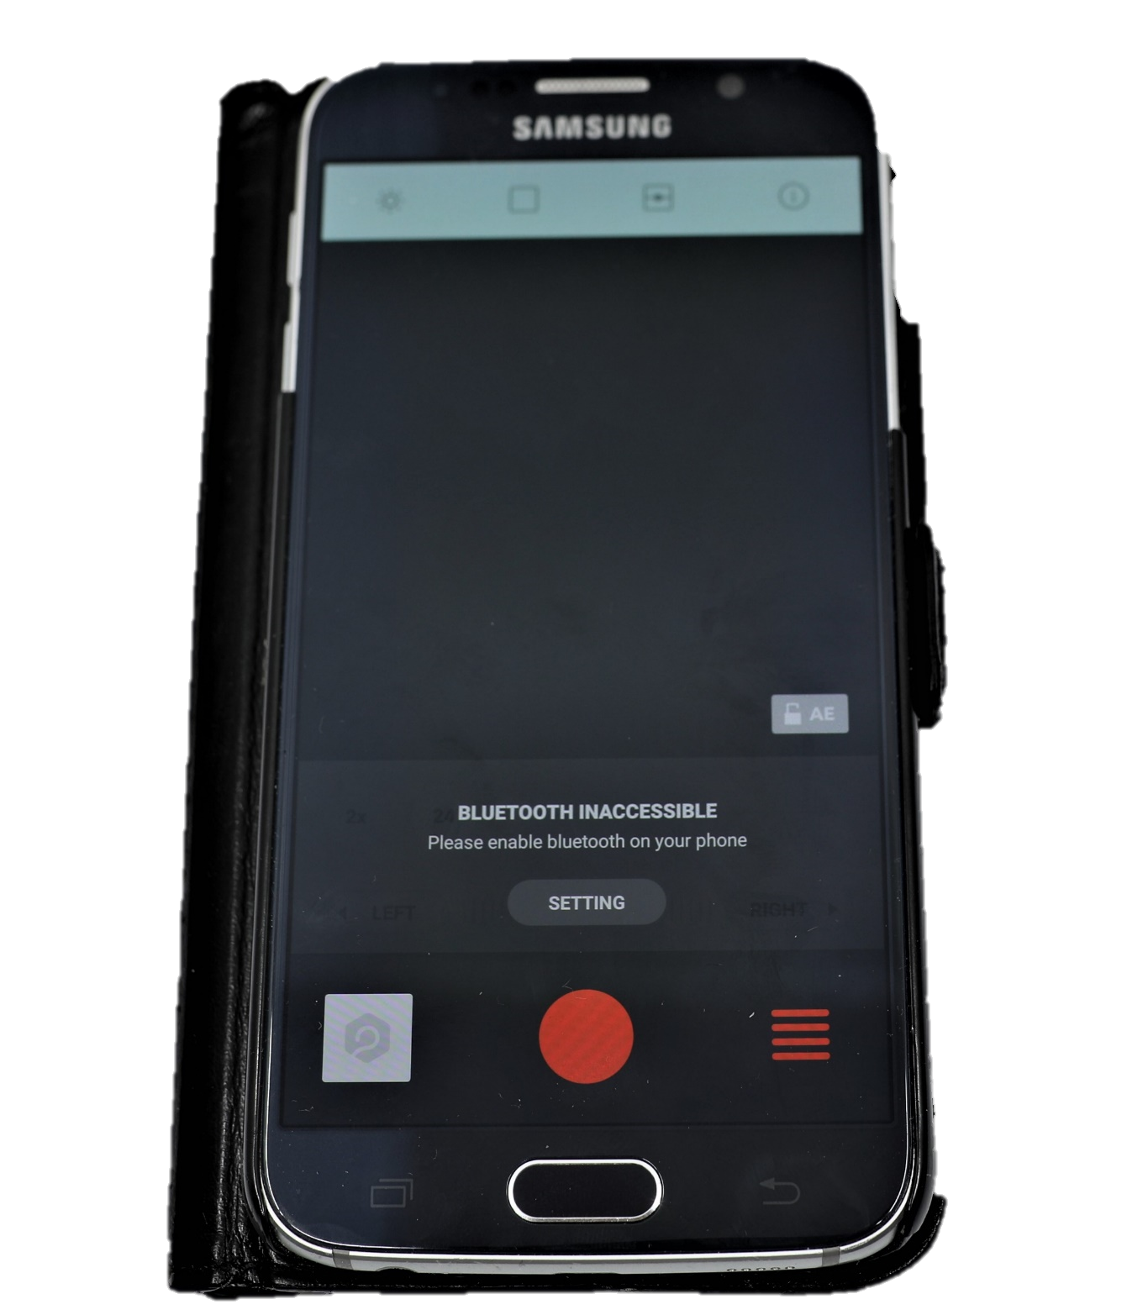
Connect the phone's bluetooth

Slide 22
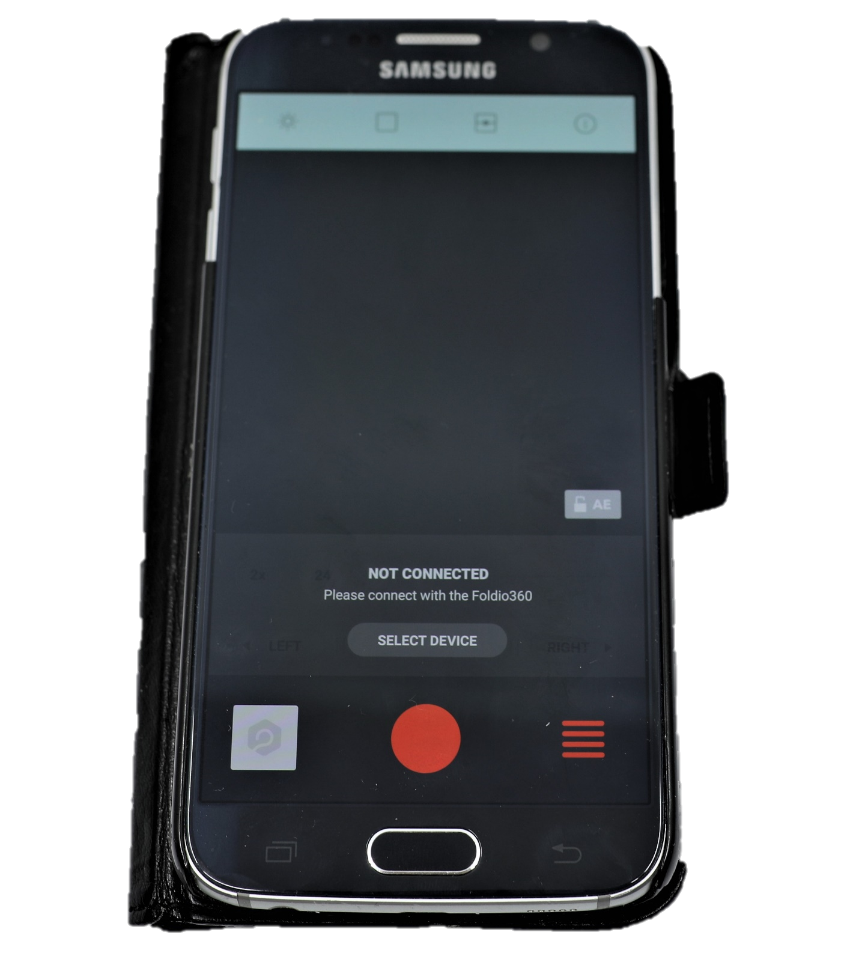
Click on select device

Slide 23
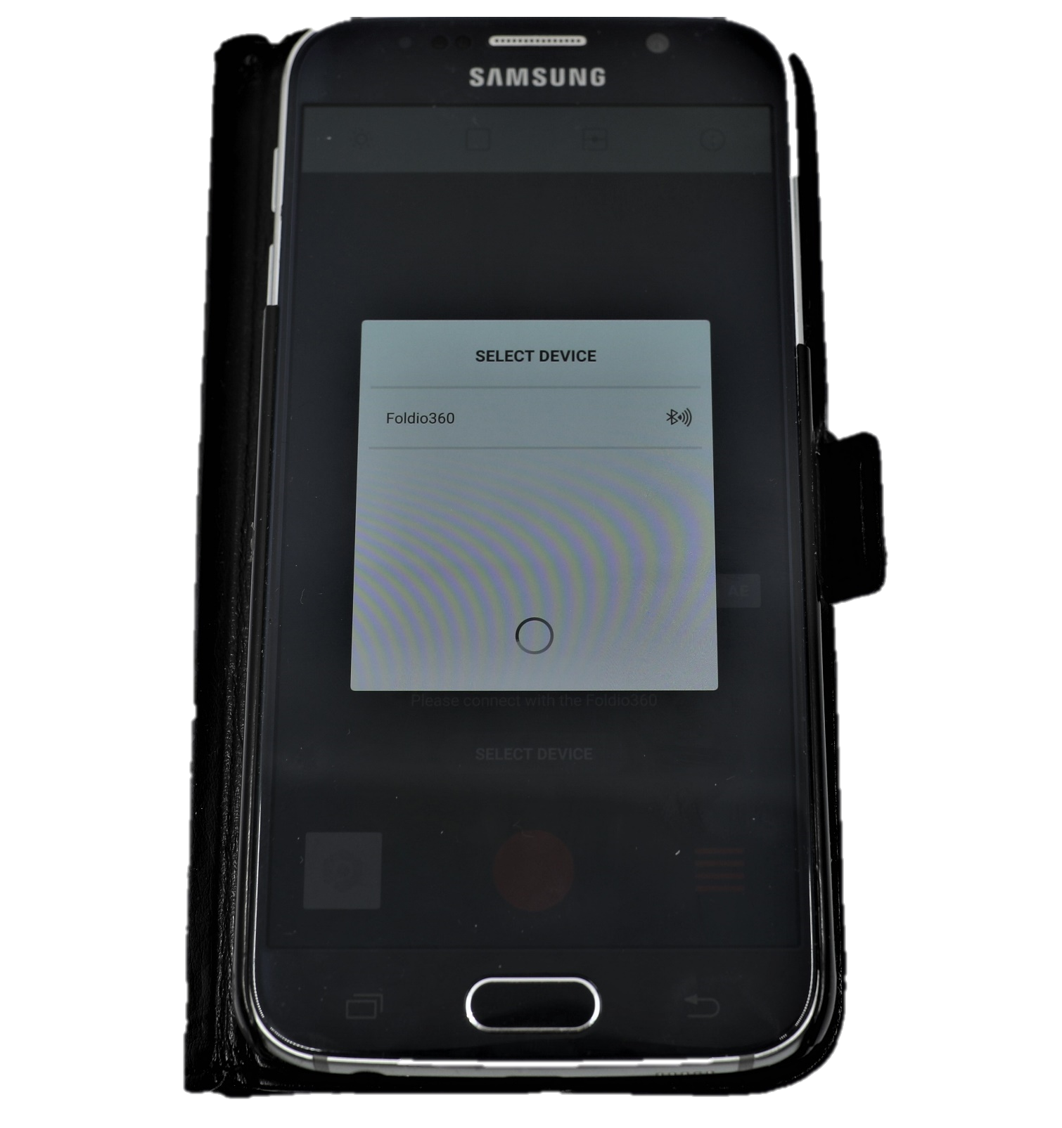
select foldio360

Slide 24
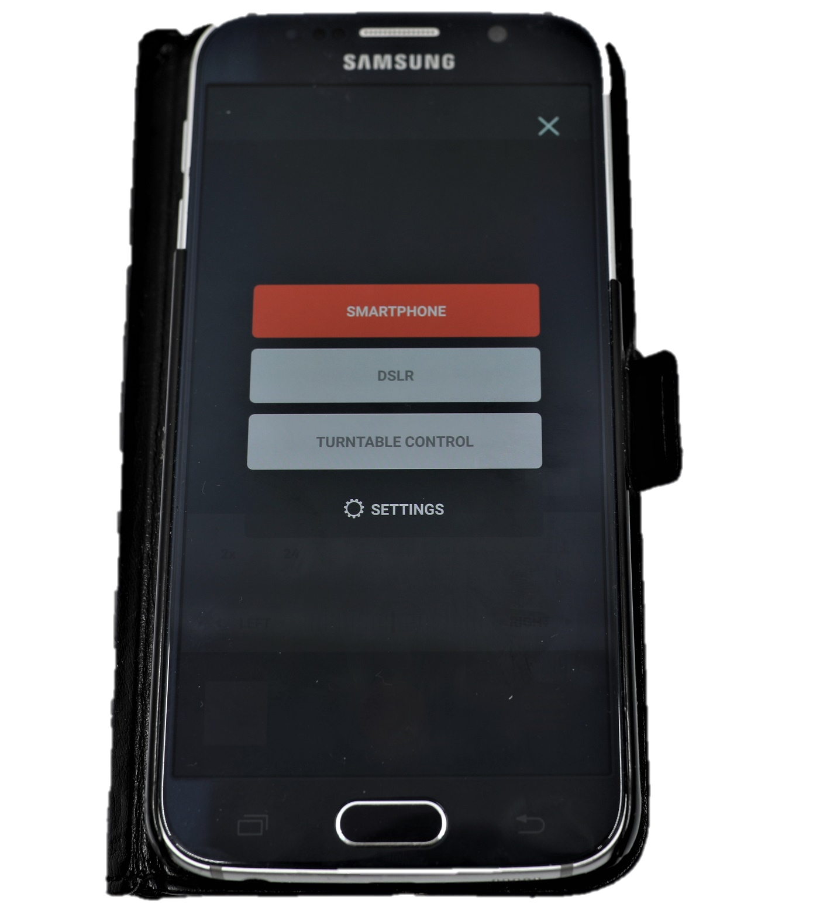
Select dslr

Slide 25
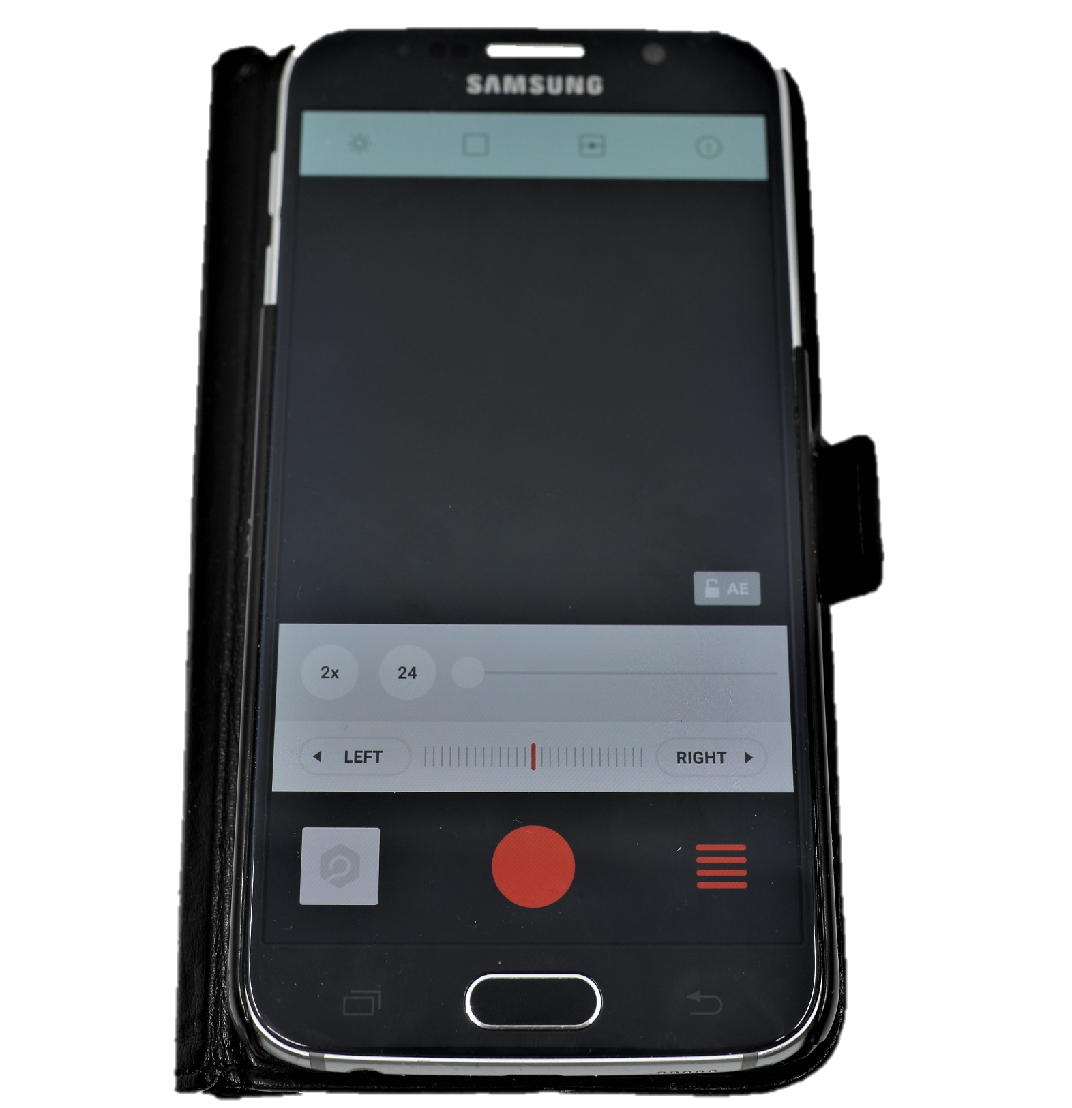
Click on the 4 horizontal red bars

Slide 26
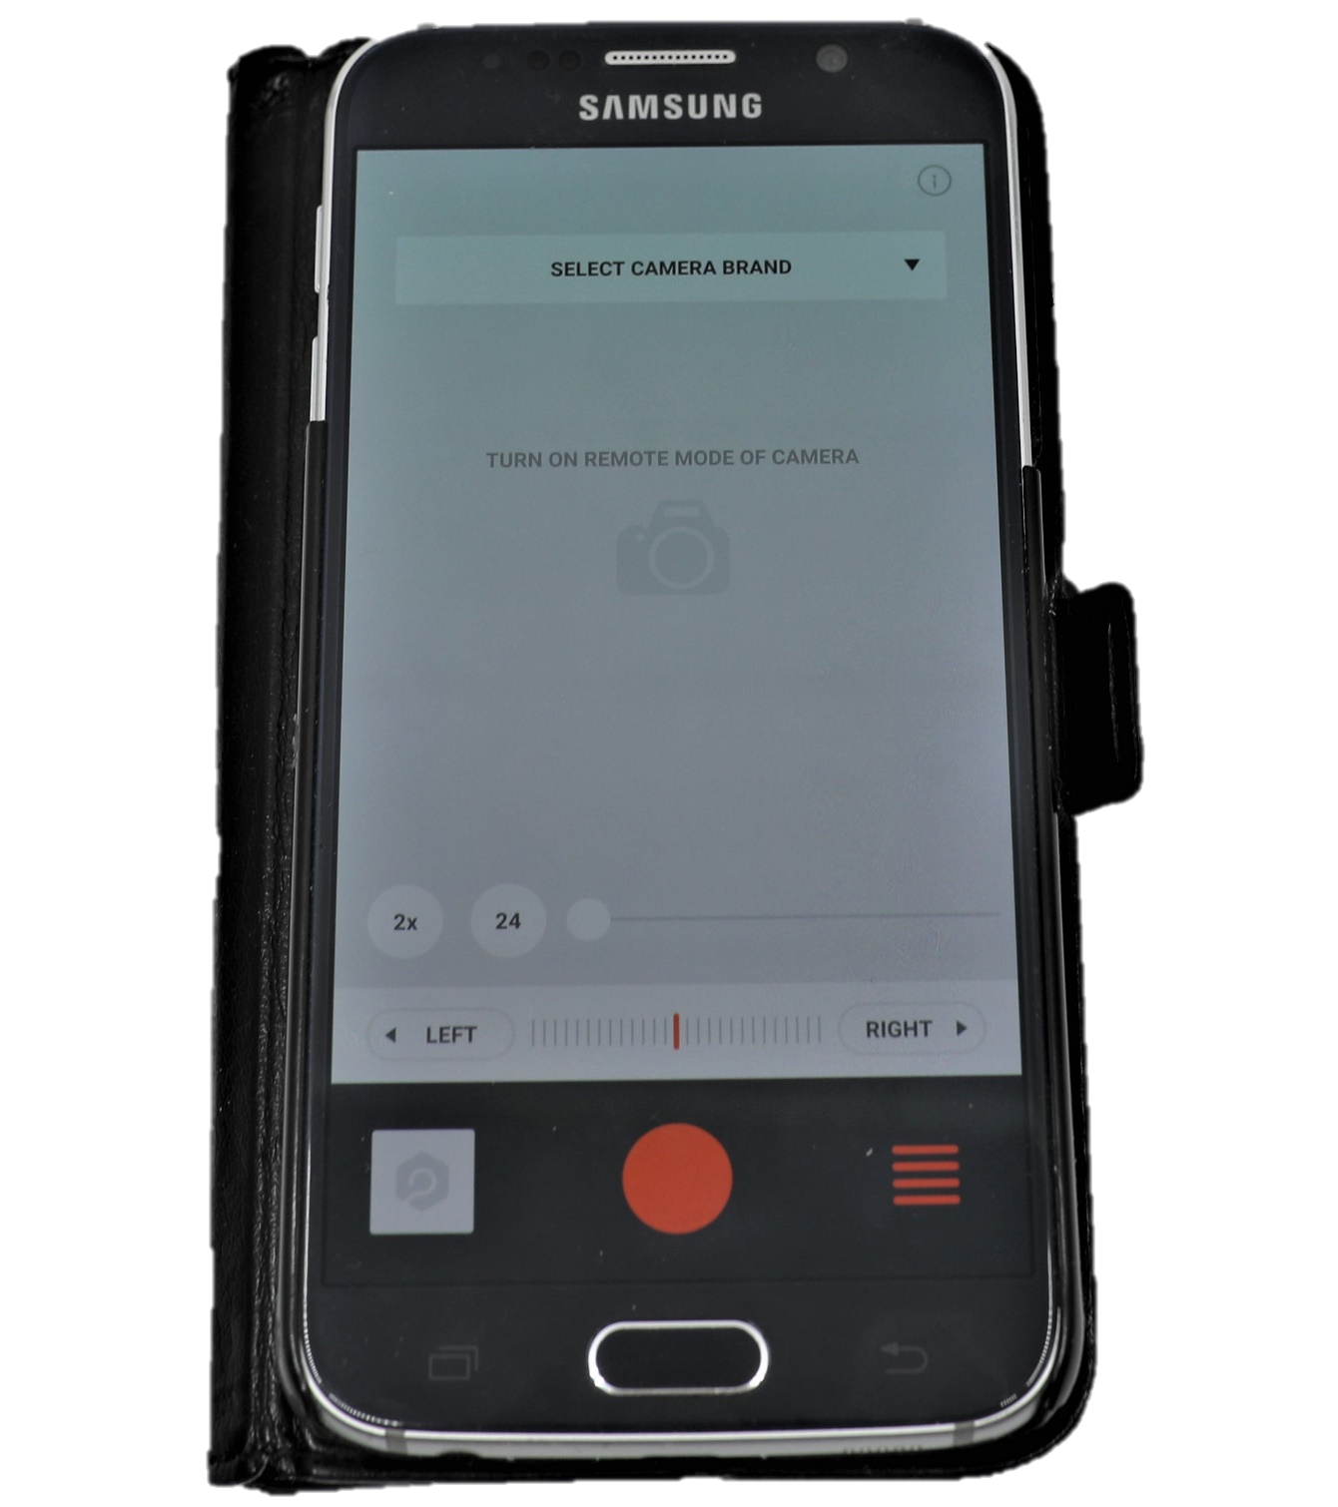
Click on select camera brand

Slide 27
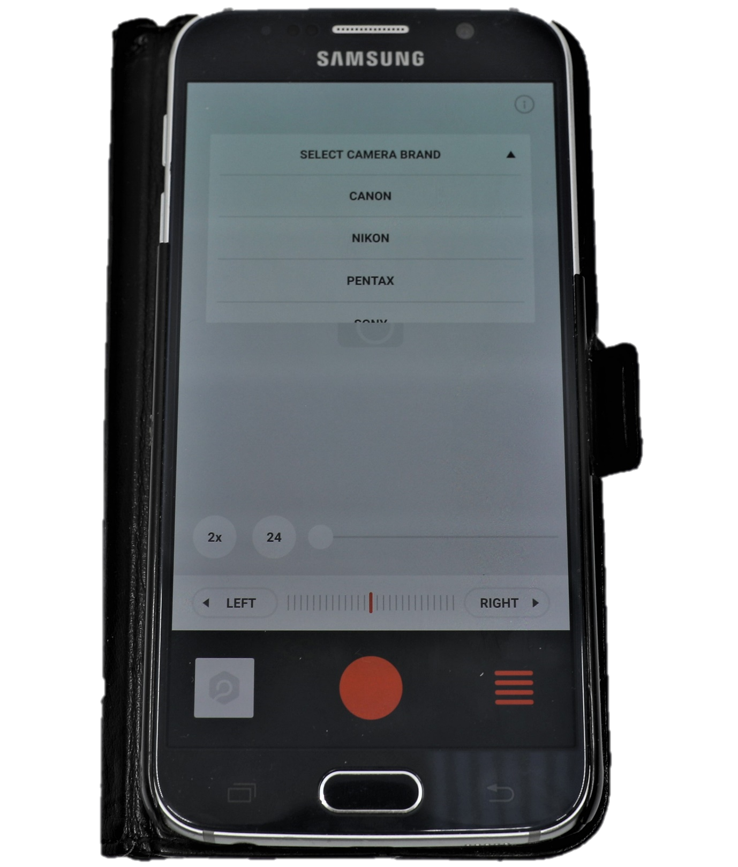
Select camera brand

Slide 28
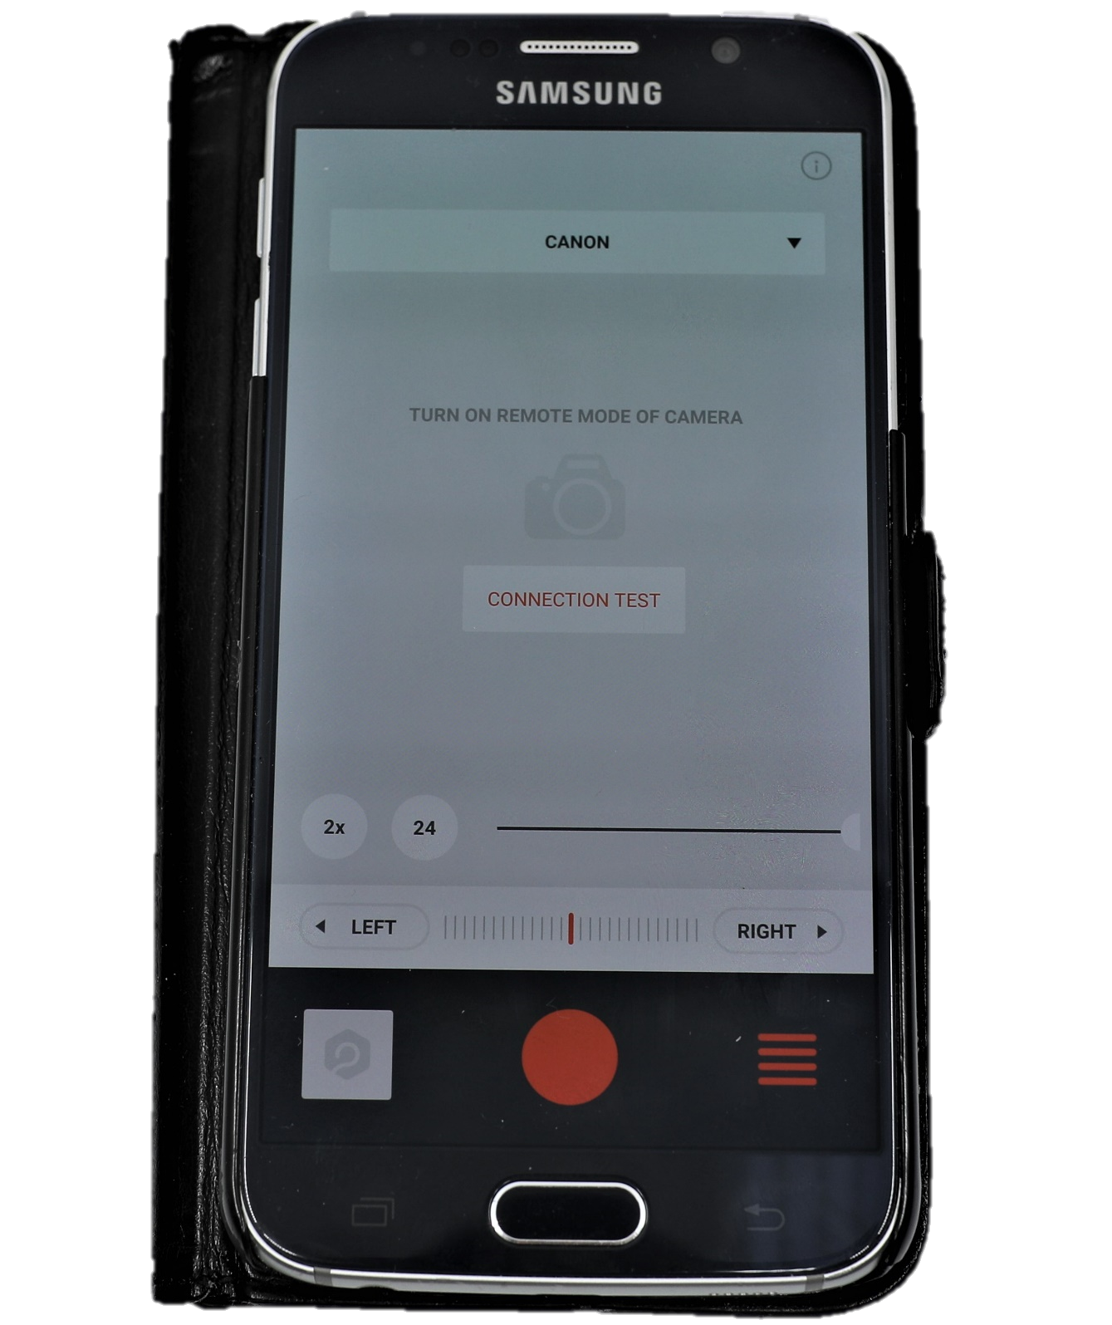
Shift the white circle to the right

Slide 29
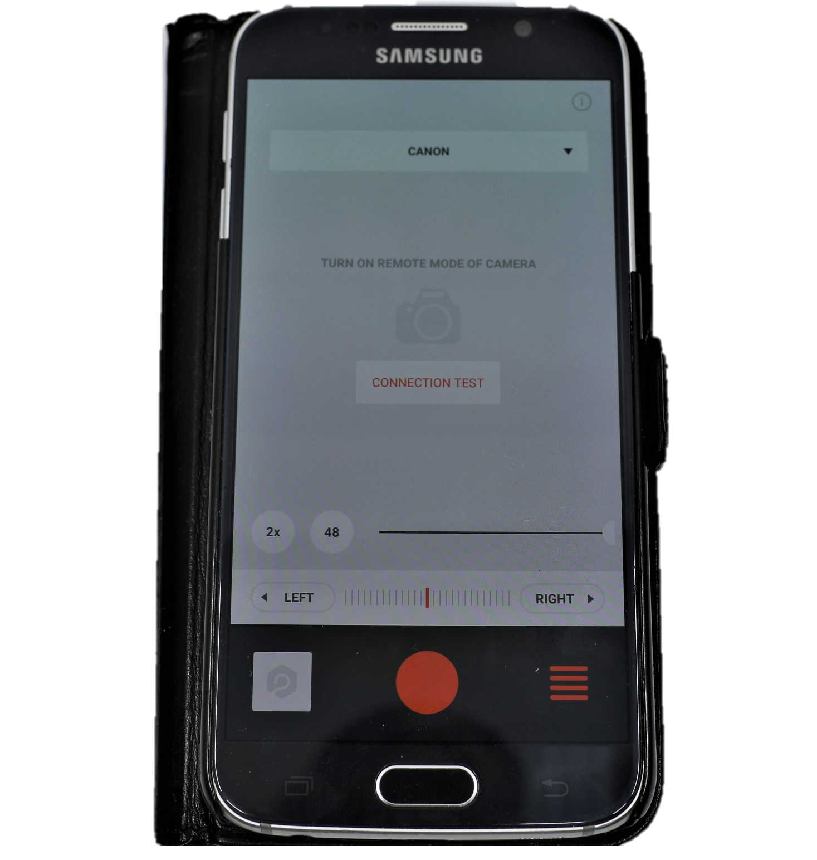
select 48 POSITIONS

Slide 30
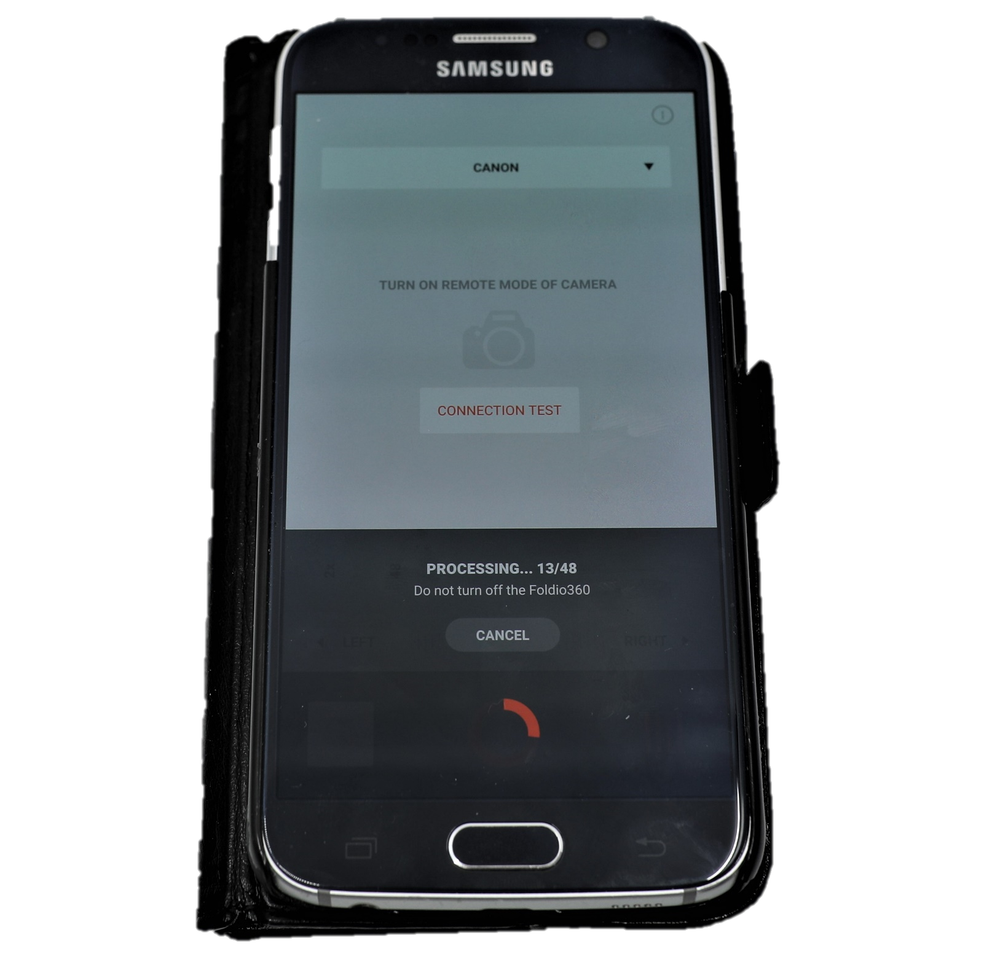
The screen shows us how many photos we have taken and the total of photos we have chosen to take

Slide 31
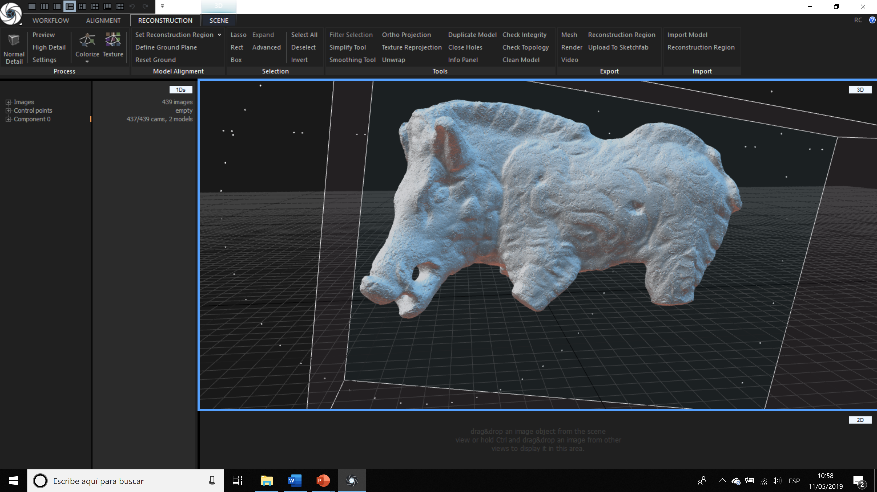
Photogrammetry. IMAGES PROCESSING
REALITY CAPTURE

Slide 32

REALITY CAPTURE
https://www.capturingreality.com/

Slide 33
System Requirements
RealityCapture runs on x64bit machines with at least 8GB of RAM,
64bit Windows 7 / 8 / 8.1 / 10 (or Windows Server 2008+), graphics card with NVIDIA CUDA 2.0+ GPU and at least 1GB RAM. The CPU is required to support SSE4.2 or higher.*

Slide 34
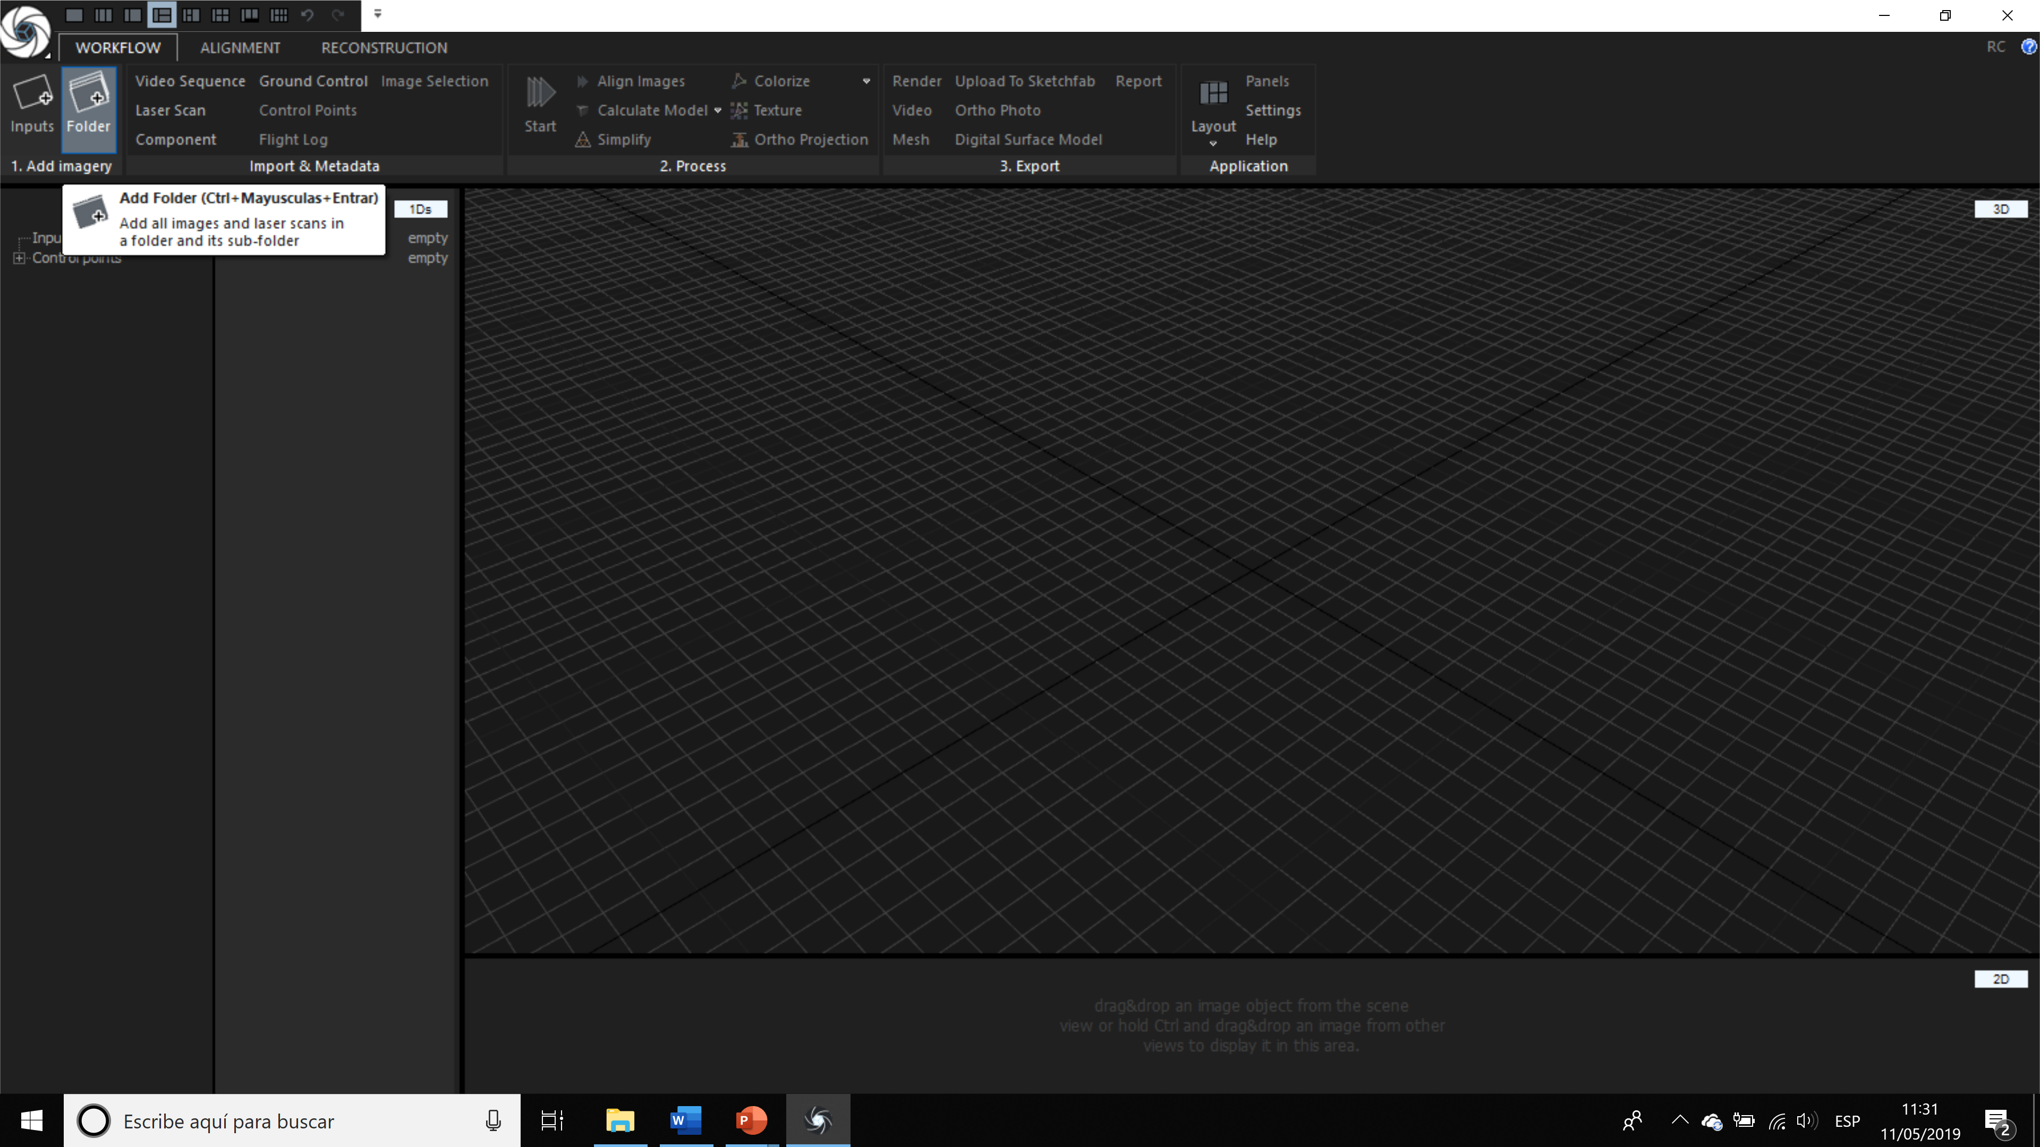

Slide 35
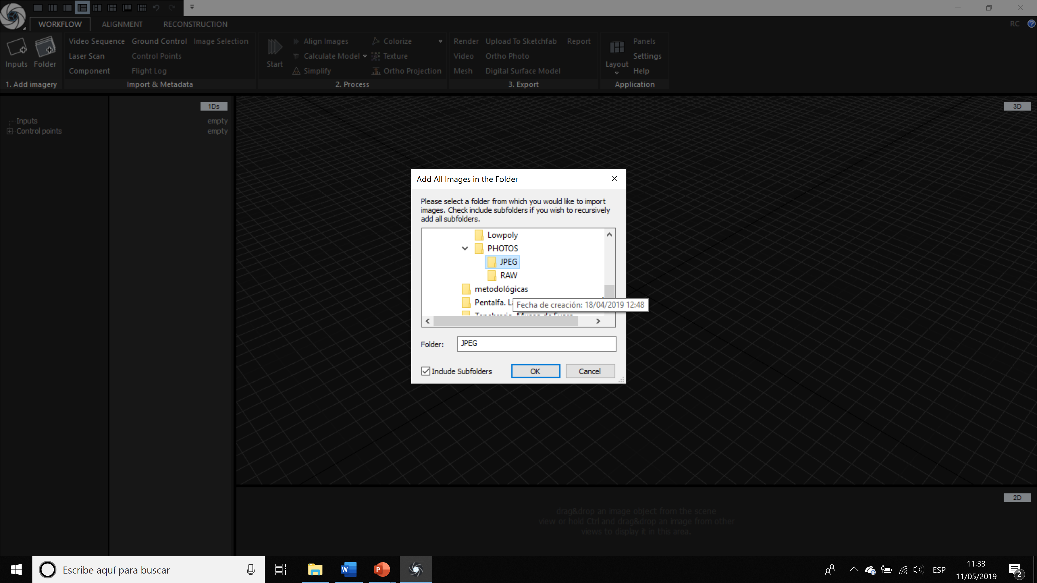

Slide 36
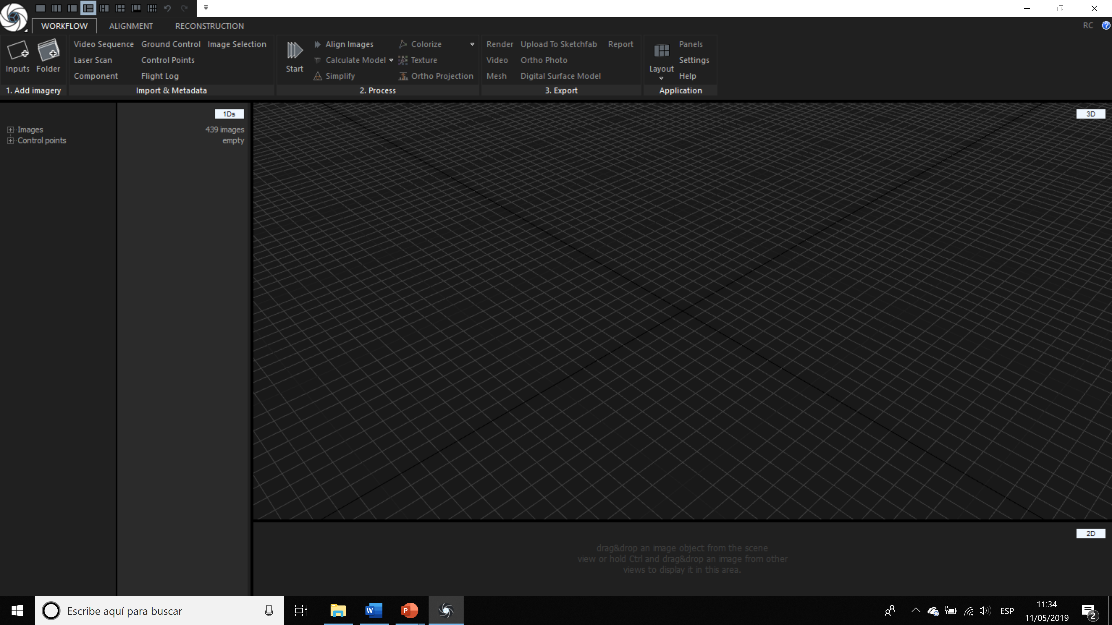

Slide 37
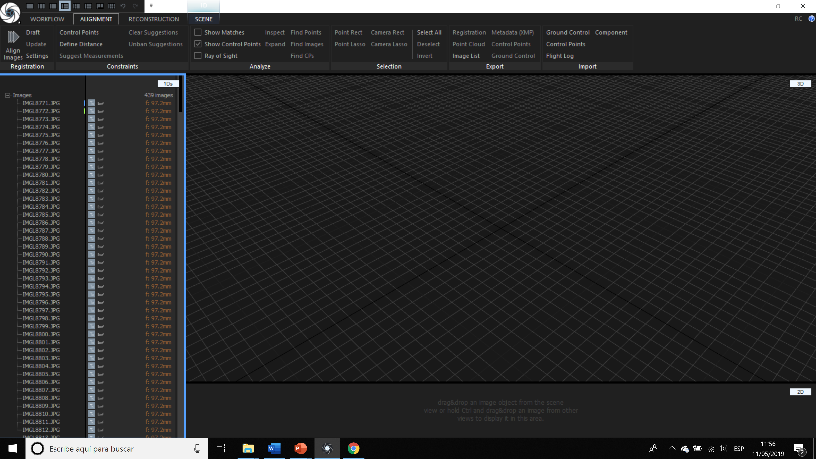

Slide 38
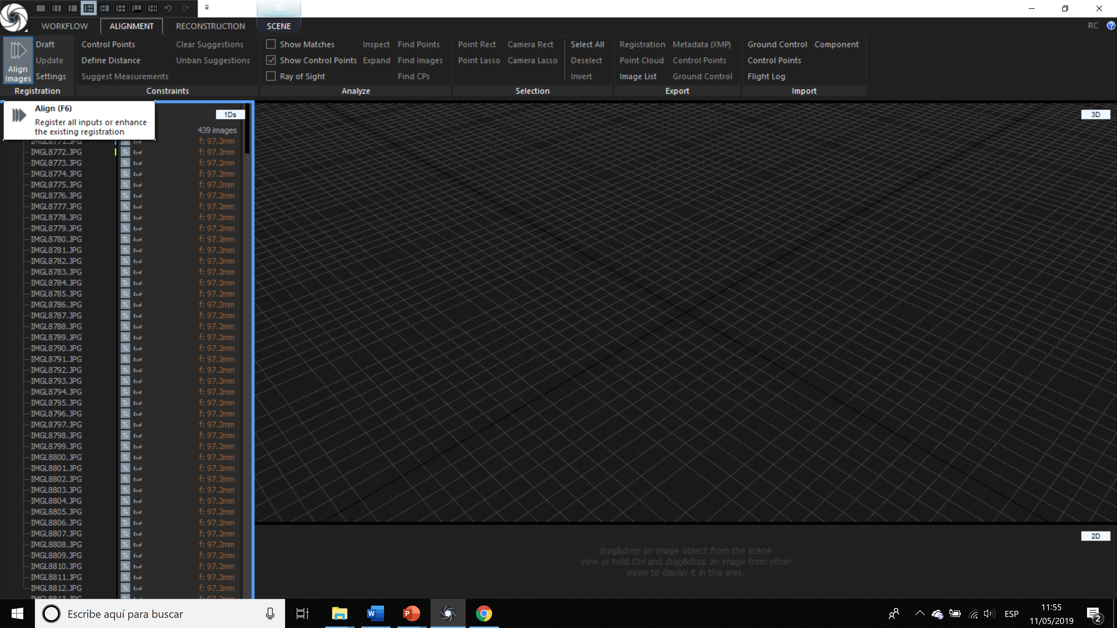

Slide 39
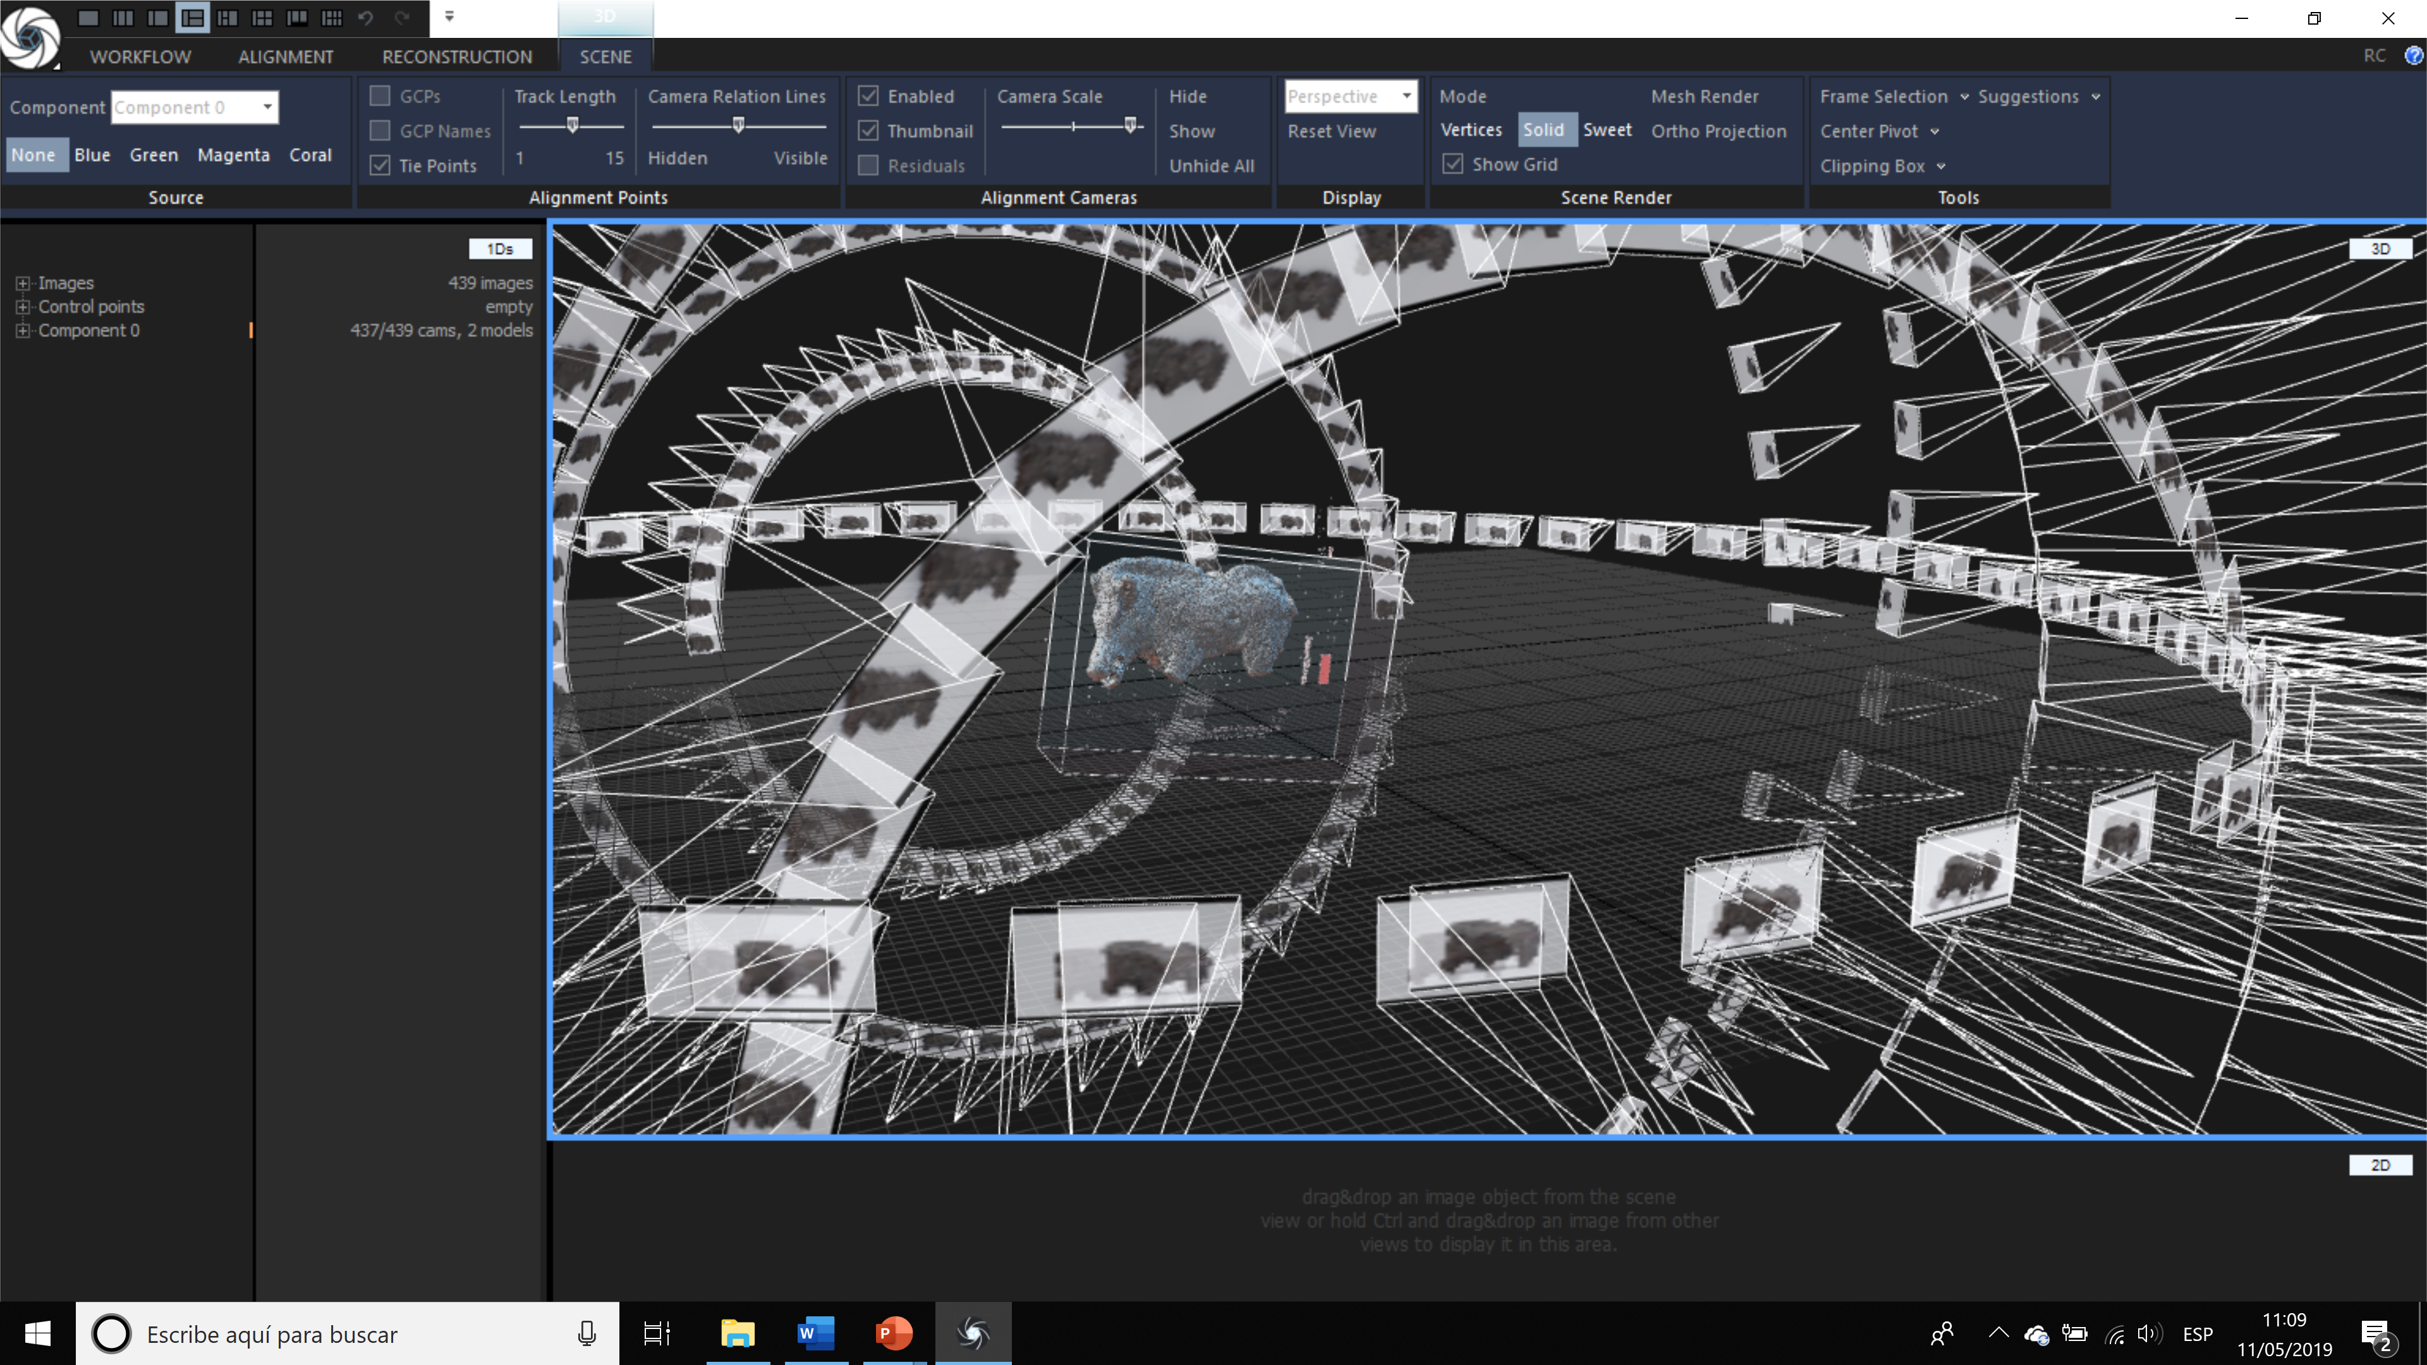

Slide 40
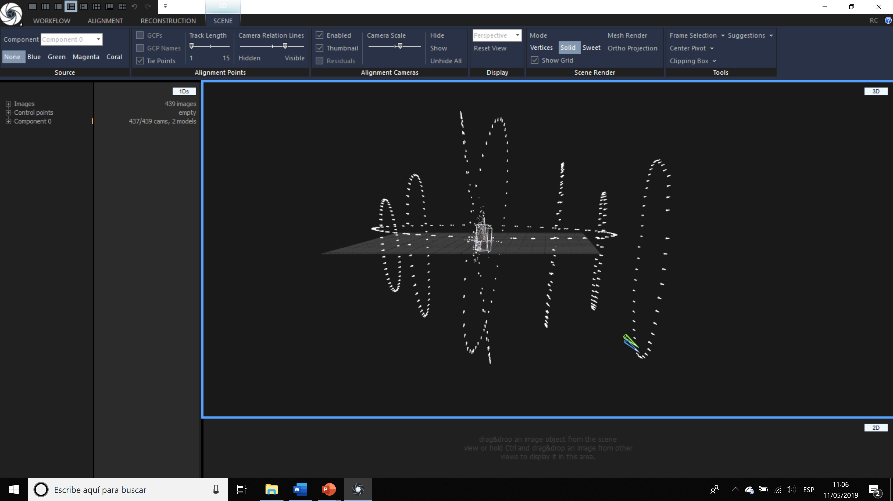

Slide 41
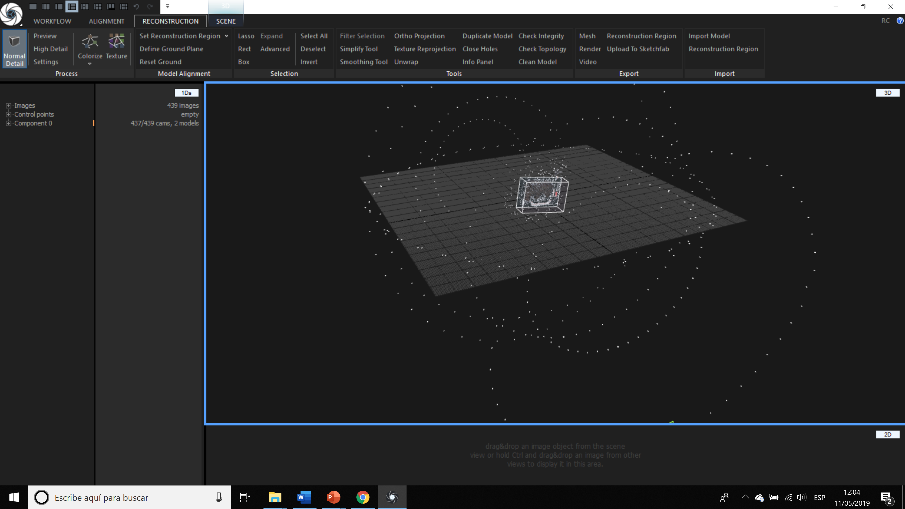

Slide 43
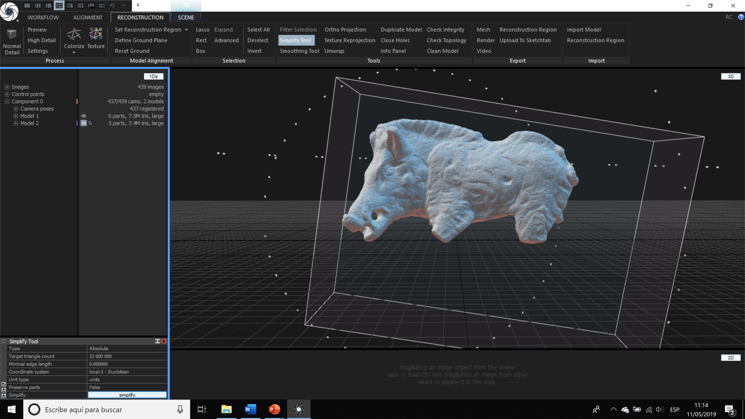


If the model had more than 32 million triangles (32M) you would have to manually write 32,000,000 in the Target triangle count section. Then click on Simplify below

Slide 44
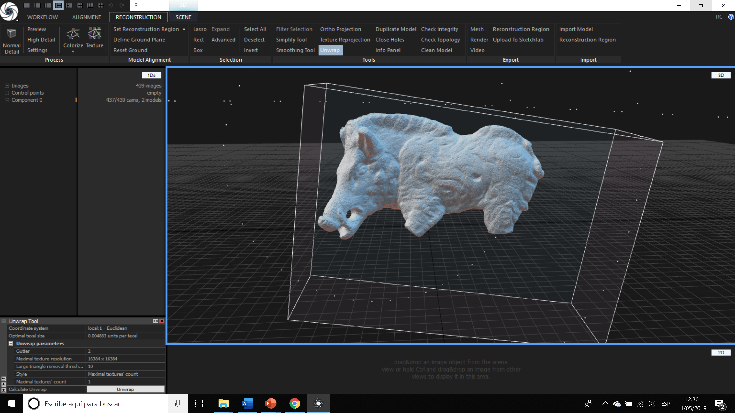

Slide 46
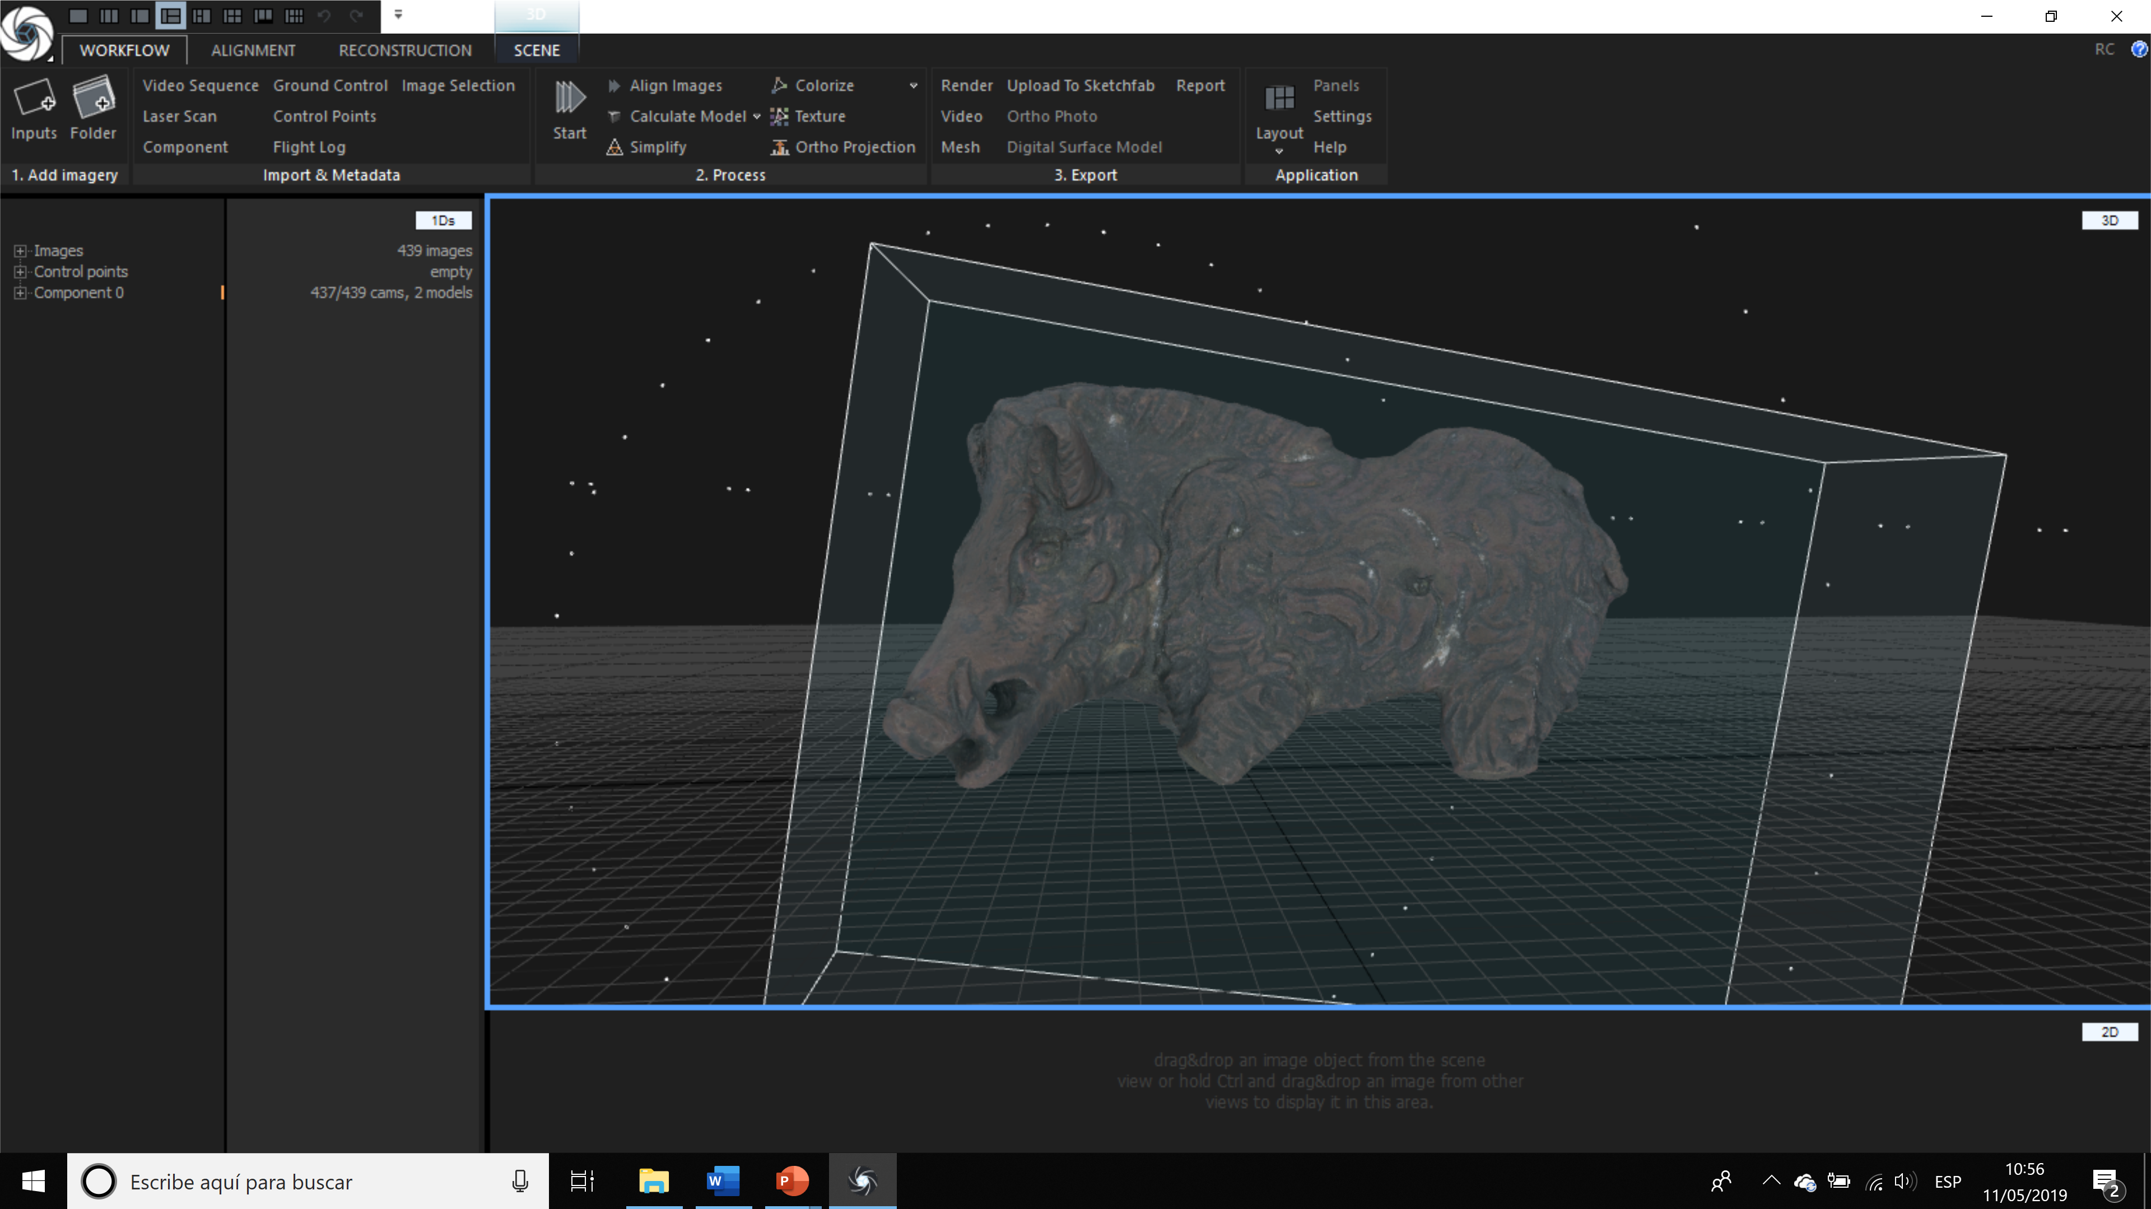

Slide 47
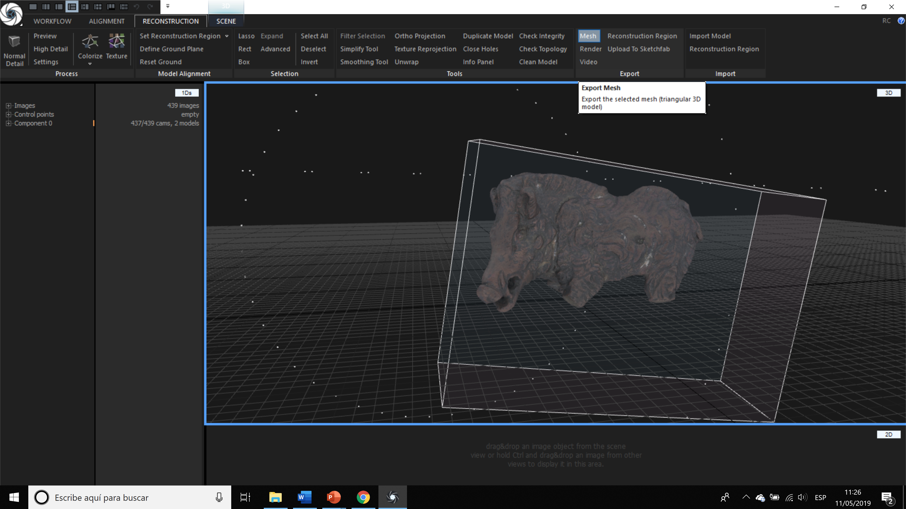

Slide 48
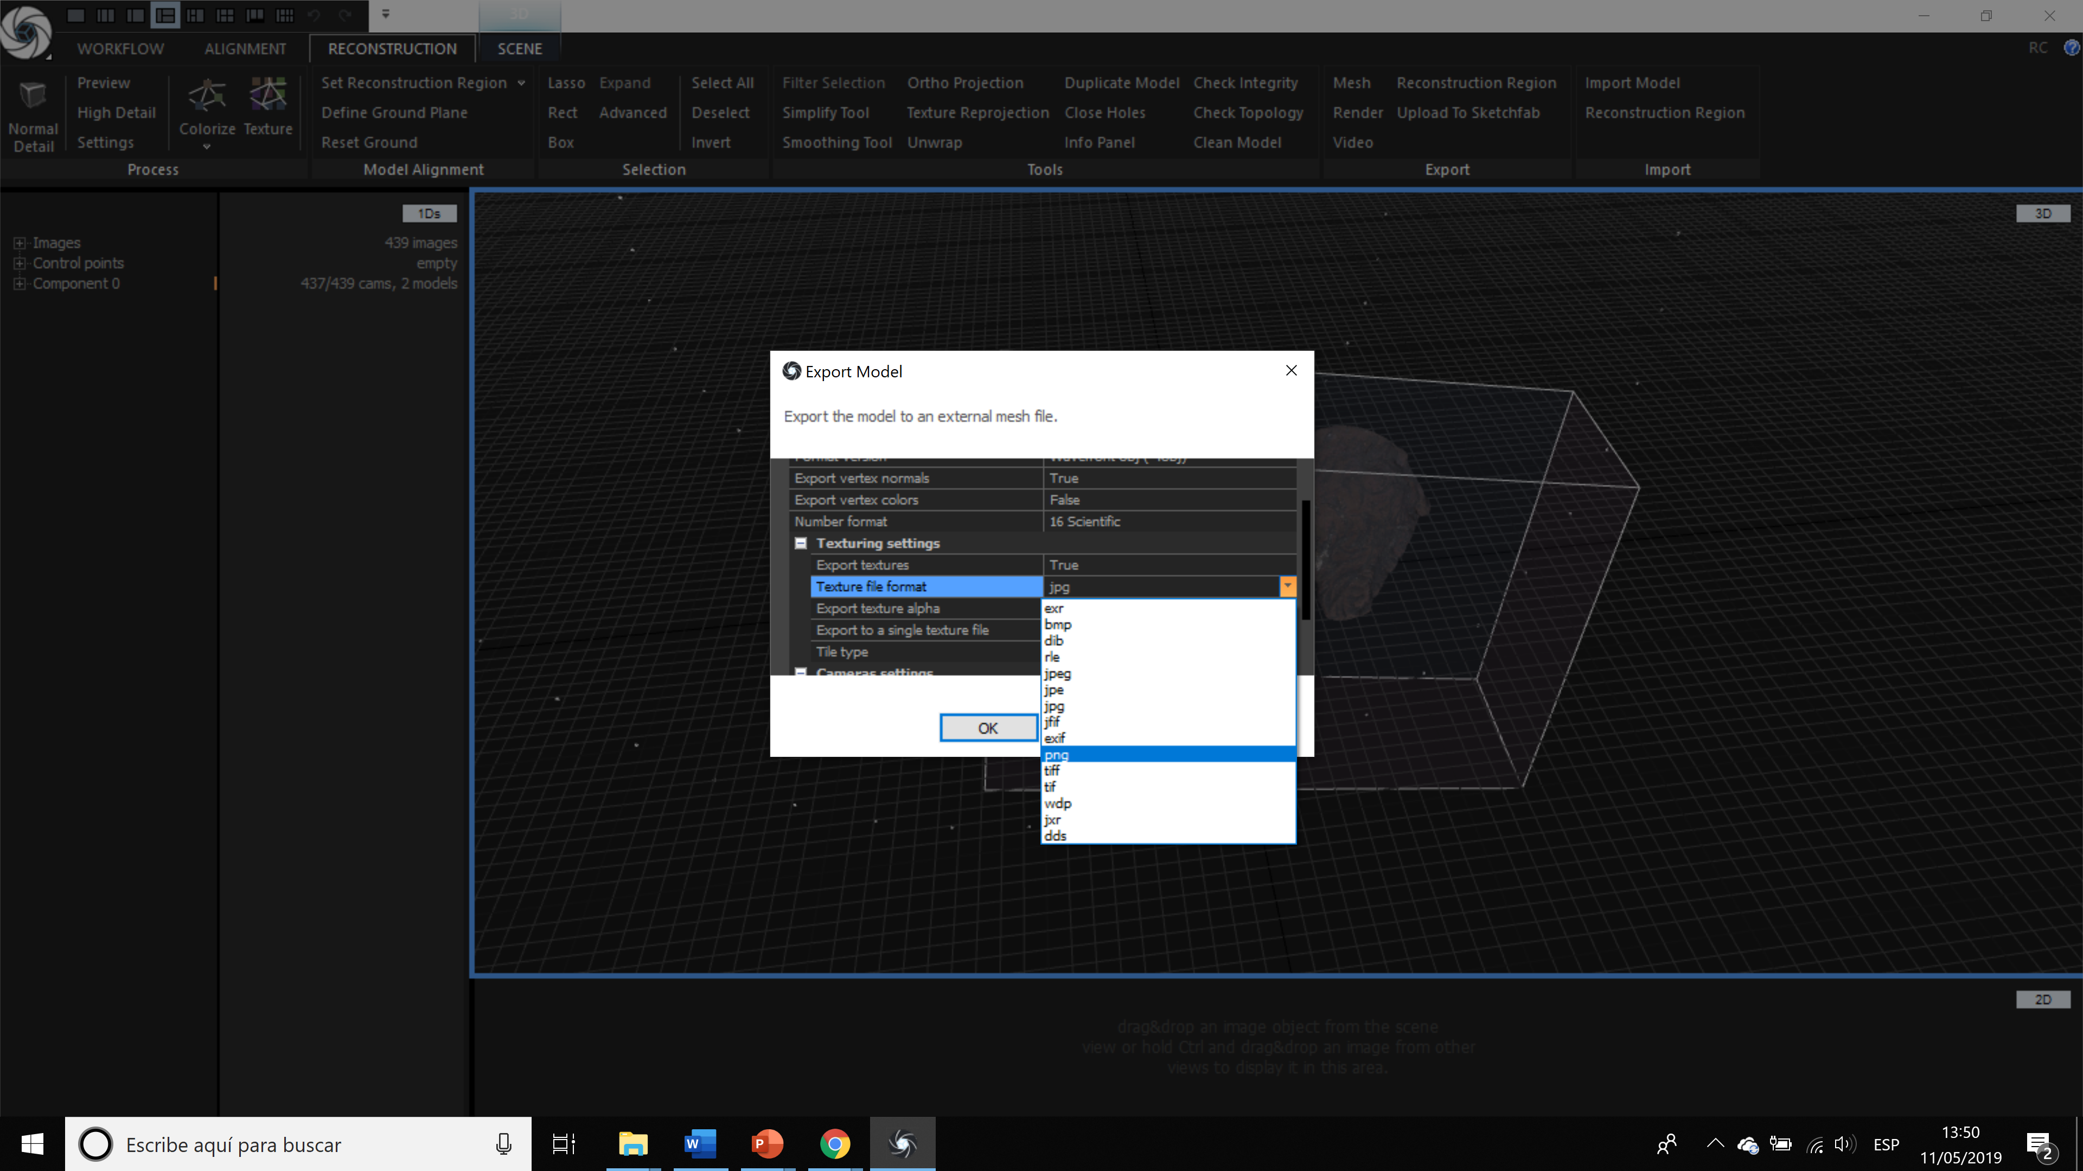

Slide 49
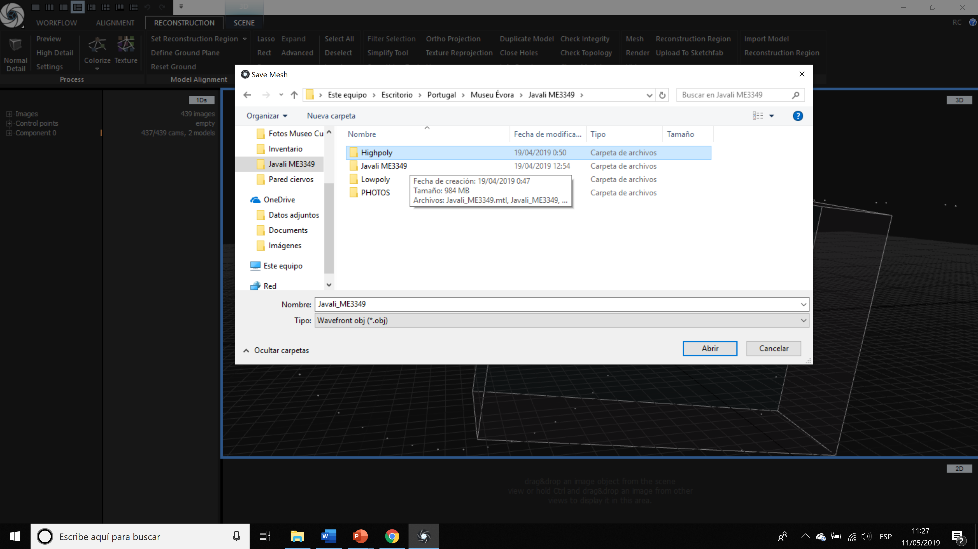

Slide 50
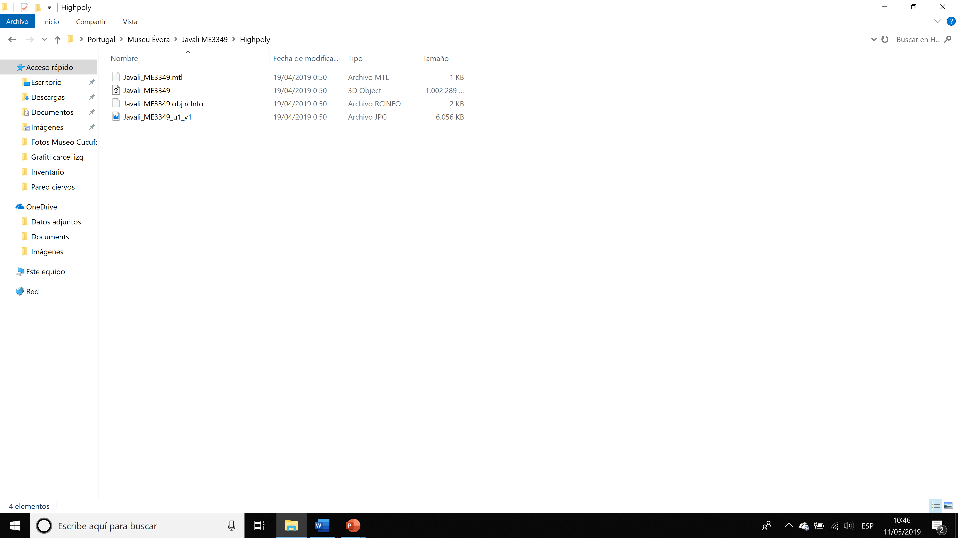

Slide 51
tutorials
RealityCapture basic tutorials
https://www.youtube.com/watch?v=QSqZyvKhw3U
https://www.youtube.com/watch?v=9vohjg7_voY
https://www.youtube.com/watch?v=zfW-8v87Bag
RealityCapture advance tutorial
https://www.youtube.com/watch?v=53HuHjGy5u0

