Slide 1
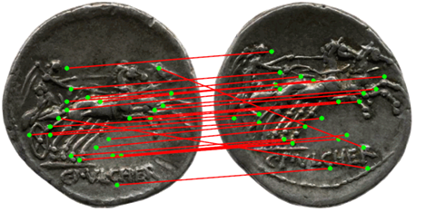
A Large-Scale Evaluation of Correspondence-Based Coin Classification on Roman Republican Coinage
Sebastian Zambanini, Martin Kampel
Computer Vision Lab, Vienna University of Technology, Austria
{zamba,kampel}@caa.tuwien.ac.at}

Slide 2
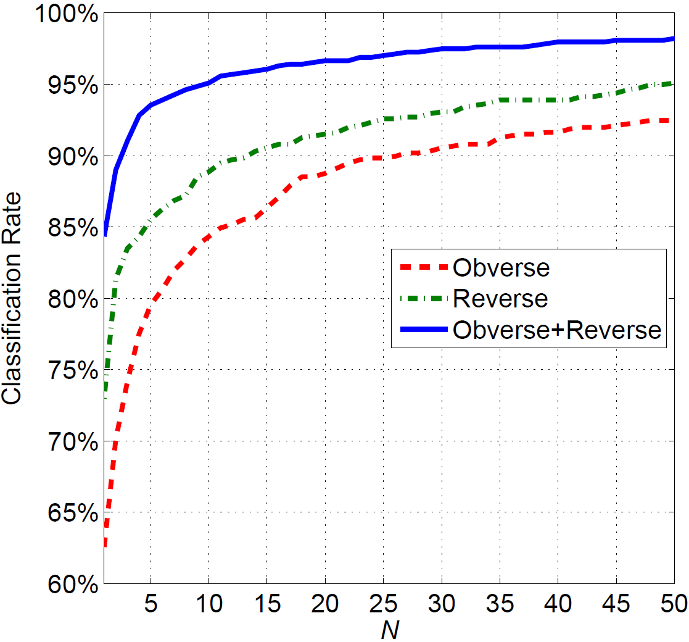
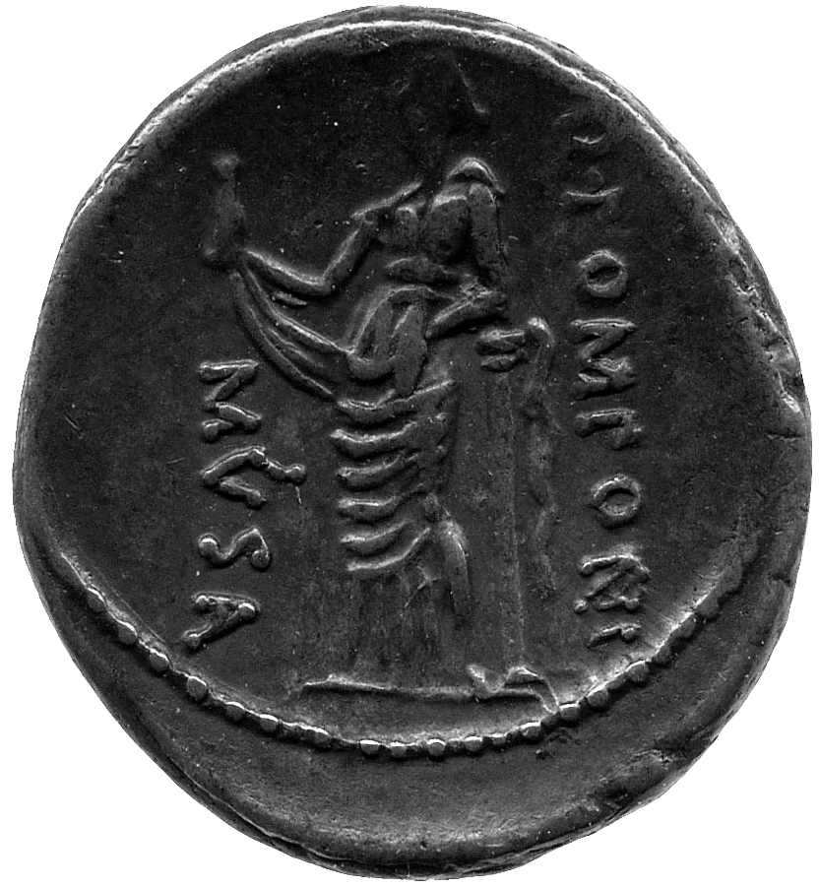
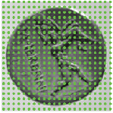
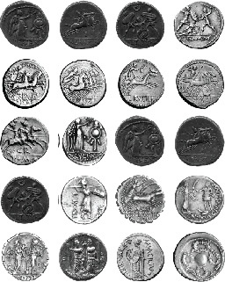
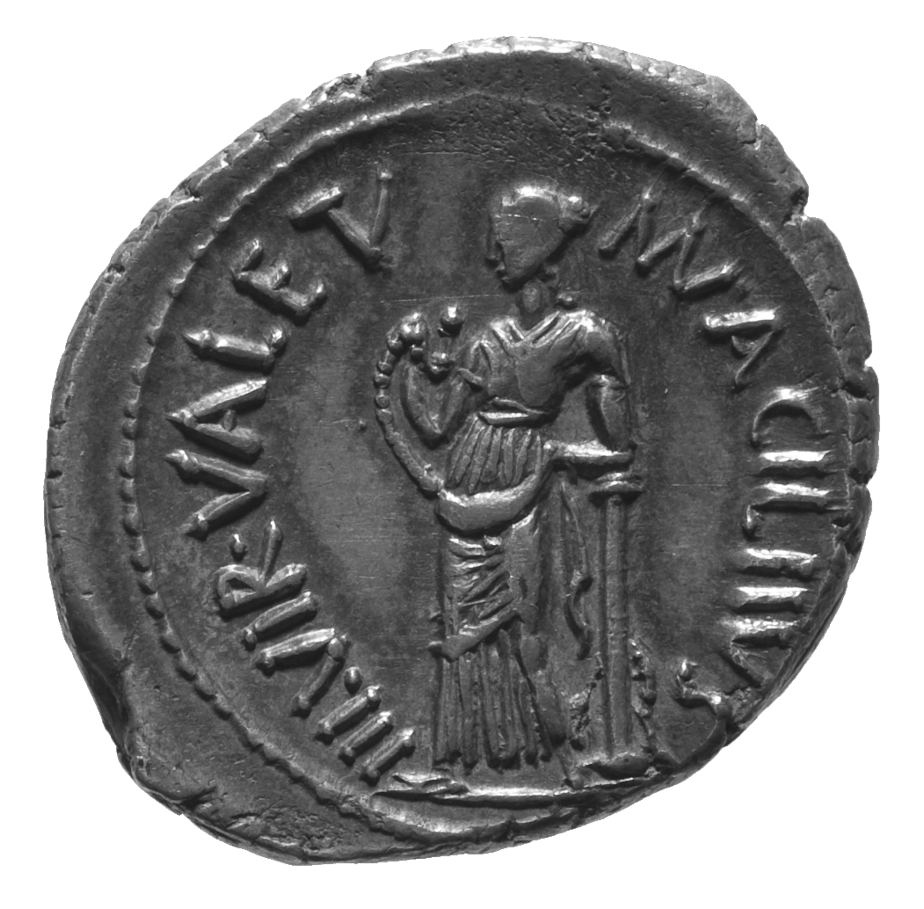

Titel
Motivation
Methodology
Results
Ancient coin classification is a challenging task, even for human experts
Support by automatic image-based method
We evaluate the top-performing method of [ZKK14] on a large scale dataset
Goal: investigation of real world practicability
[ZKK14] ZAMBANINI S., KAVELAR A., KAMPEL M.: Classifying ancient coins by local feature matching and pairwise geometric consistency evaluation. In Proc. of ICPR (2014).
  Dataset: Rom. Rep. coins, 418 classes, 2 images of obv. & rev. side per class
  Correct class is under top 5 classes in 93.5% of the cases
Exemplar
images
Compare
Low inter-class variation
Class ID
High intra-class variation
Intra-class variations: non-rigid deformations

