Slide 1
Enhancement of multispectral images of ancient manuscripts
Fabian Hollaus, Robert Sablatnig
Vienna University of Technology
Computer Vision Lab
{holl, sab}@caa.tuwien.ac.at

Slide 2
TitlE Slide With picture right
Authors Name 1, Name 2, Name 3 until this end
Affiliations
{E-Mail}

Slide 3
TitlE – slide Without Picture
Authors Name 1, Name 2, Name 3
Affiliations
{E-Mail}

Slide 4
Titel & SubtiTle Without picture
Authors Name 1, Name 2, Name 3 until this end
Affiliations
{E-Mail}

Slide 5
Titel
Heading 1
Heading 1
Heading 1
Heading 2 / Text until this end
  Heading 3 / Text
    Heading 4 / Text
      Heading 5 / Text
Heading 2 / Text until this end
  Heading 3 / Text
    Heading 4 / Text
      Heading 5 / Text
Heading 2 / Text until this end
  Heading 3 / Text
    Heading 4 / Text
      Heading 5 / Text

Slide 6
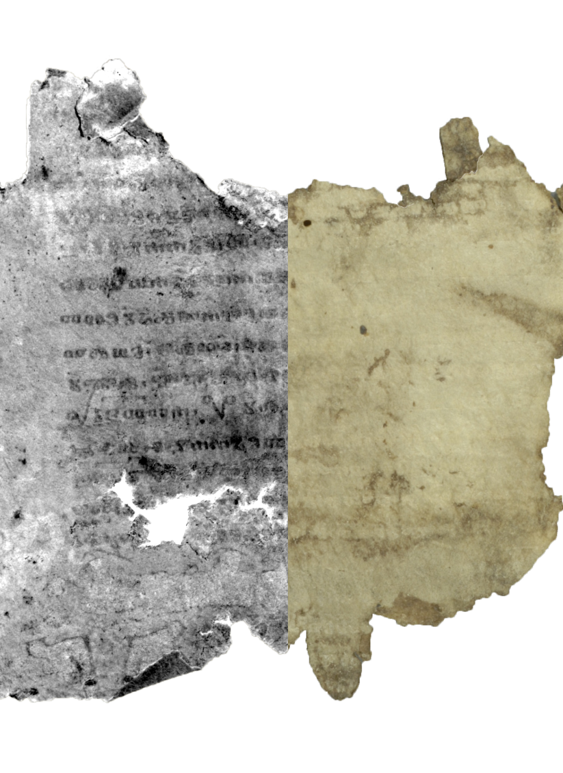
Titel
Motivation
Labeling
Enhancement result
Ancient manuscripts
    Faded out ink
    Background clutter
    Palimpsests (twice written manuscript)
  MultiSpectral Imaging
    Used for legibility increasement
  Dimension reduction can be used for further enhancement
    Applied Linear Discriminant Analysis (LDA)
    Requires labeling of training data
LDA is a supervised dimension reduction technique
    Requires labeling
Automated labeling based on document analysis techniques:
    Binarization
    Text line detection

Slide 7
Titel
Motivation
Picture 1
Ancient manuscripts
    Faded out ink
    Background clutter
    Palimpsests (twice written manuscript)
  MultiSpectral Imaging
    Non-Invasive technique
    Used for legibility increasement
  Dimension reduction can be used for further enhancement
    Applied Linear Discriminant Analysis
    Requires labeling of training data
Labeling
Heading 1
Based on document analysis techniques
  Binarization
  Text line detection
Heading 2 / Text until this end
  Heading 3 / Text
    Heading 4 / Text
      Heading 5 / Text

Slide 8
Titel
Heading 1
Heading 1
Picture 1 AND / OR Video 1
Heading 2 / Text until this end
  Heading 3 / Text
    Heading 4 / Text
      Heading 5 / Text
Heading 2 / Text until this end
  Heading 3 / Text
    Heading 4 / Text
      Heading 5 / Text

Slide 9
Titel

