Slide 1
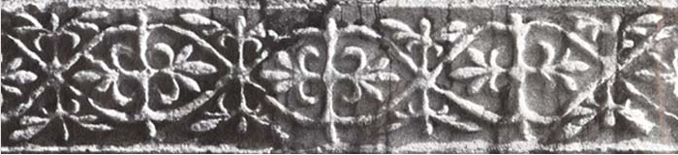

Cultural Heritage Digitalization and Virtual Presentation
Prof. Dr Selma Rizvić
Faculty of Electrical Engineering Sarajevo, University of Sarajevo,
Bosnia and Herzegovina

Slide 2
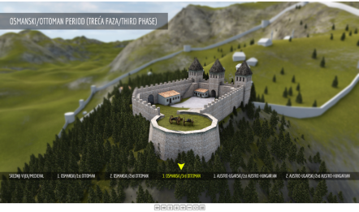
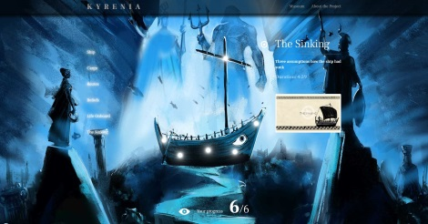
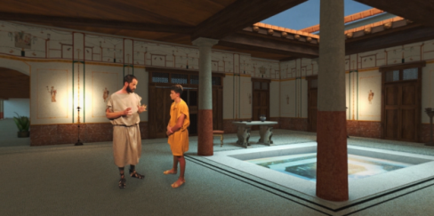
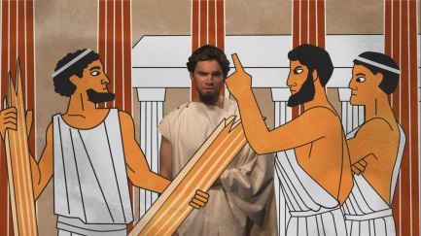
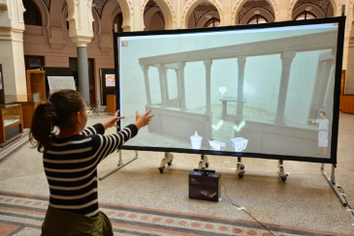
Sarajevo Graphics Group
founded in 2004 at the Faculty of Electrical Engineering, University of Sarajevo, Bosnia and Herzegovina
research areas: computer graphics, computer animation, visual arts, multimedia, interactive digital storytelling, virtual reality
in 2010 we founded the NGO DIGI.BA
members: computer scientists, artists, archaeologists, historians, writers, film and video professionals, musicians
projects:
cultural heritage virtual presentations
virtual museums
VR movies
https://youtu.be/VmpXcOYU1XI

Slide 3
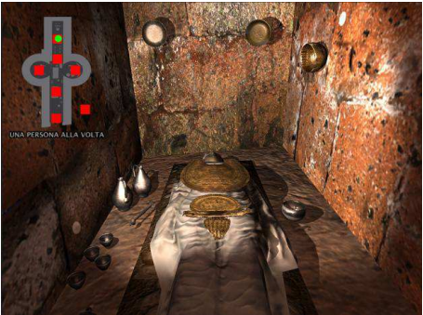
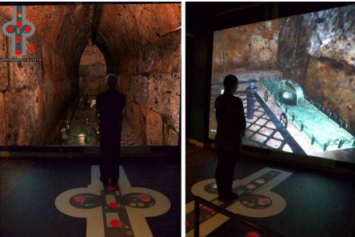
Digital storytelling
interactive 3D models of cultural monuments interconnected with digital stories about their past
online applications, museum setups, onsite installations
enhances cultural heritage presentations
1. PIETRONI E., PAGANO A., RUFA C.: The Etruscanning project: Gesture-based interaction and user experience in the virtual reconstruction of the Regolini-Galassi tomb. Digital Heritage International Congress 2013 2 (2013), pp 653–660

Slide 4
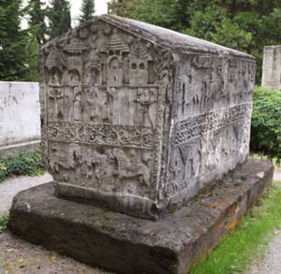
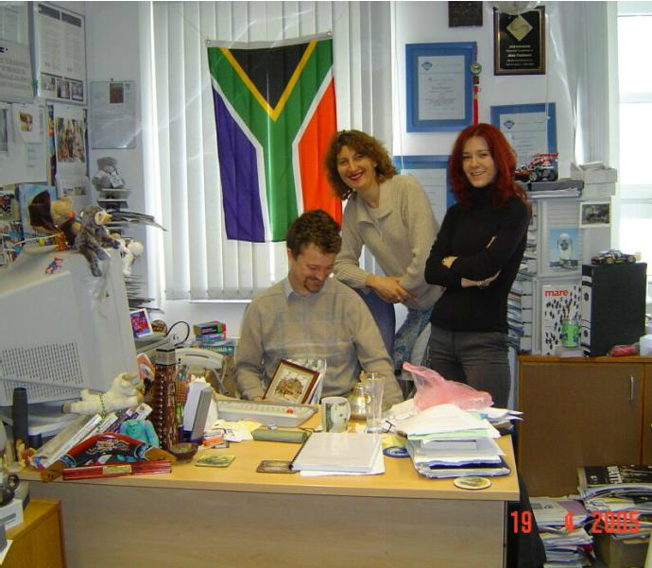
Stećak, UNESCO participation project (2005)
our first 3D digitization project
stećak – medieval gravestone
stećak from Donja Zgošća – 14th century
partner: University of Bristol, UK

Slide 5
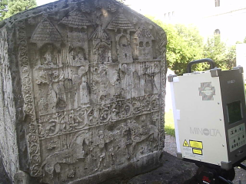
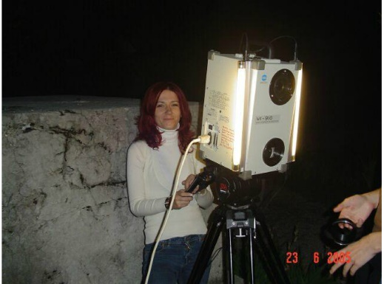
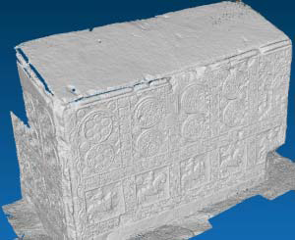
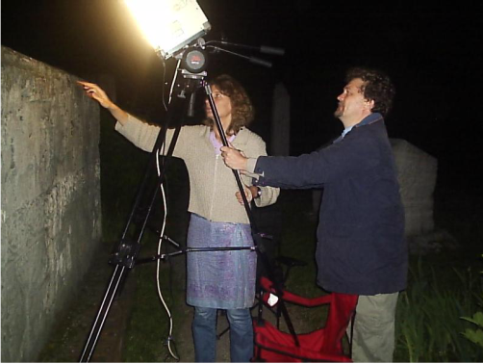
Stećak, digitalization
one corner damaged
3D model created by laser scanning
Minolta 910 laser scanner – laser triangulation
optimization and surface reconstruction

Slide 6
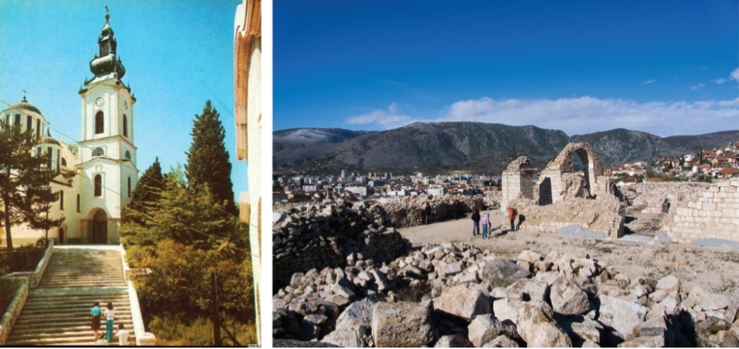
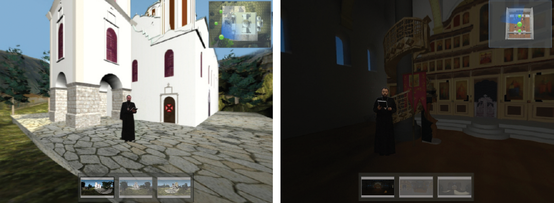
Digital storytelling - SGG
virtual reconstruction – Church of the Holy Trinity in Mostar
completely destroyed in 1992

Slide 7
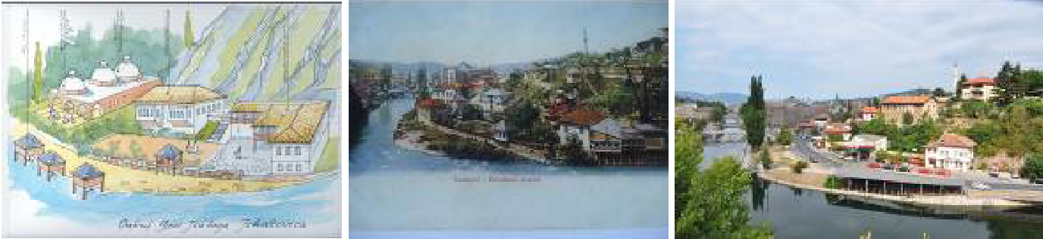
Digital storytelling - SGG
virtual reconstruction – Isa bey’s endowment
mentioned in the oldest written document about Sarajevo
last object of the complex destroyed in 1957

Slide 8
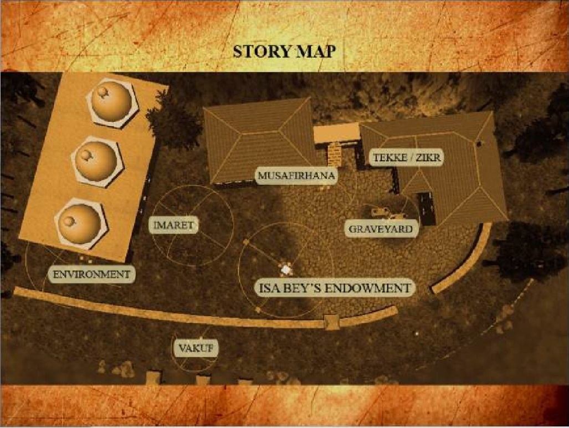
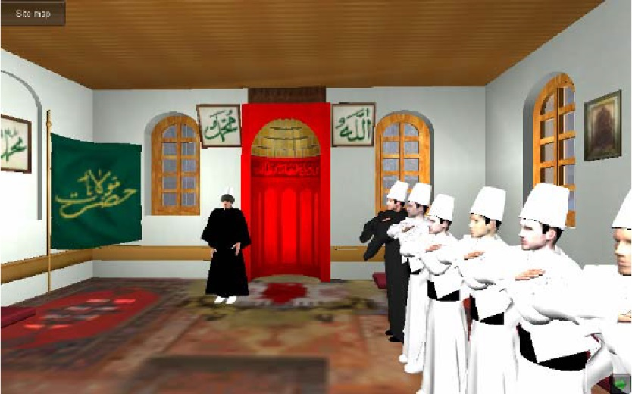
Digital storytelling - SGG
virtual reconstruction – interactive computer animation

Slide 9
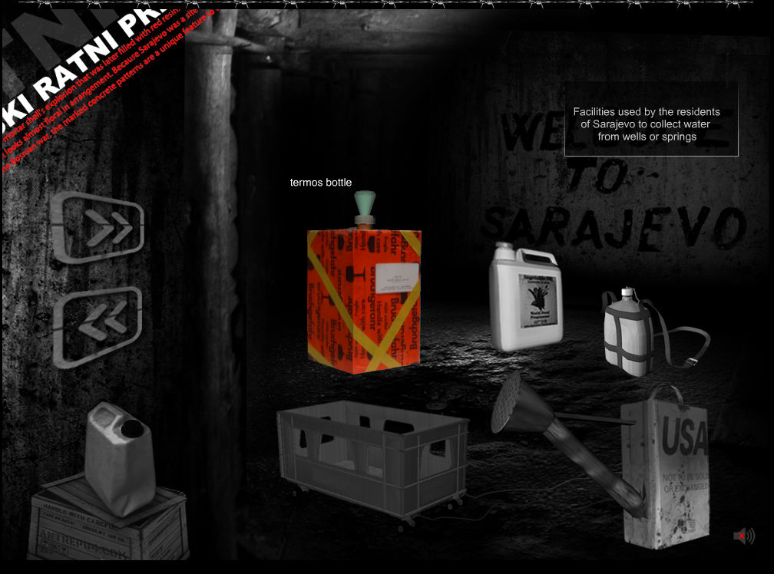
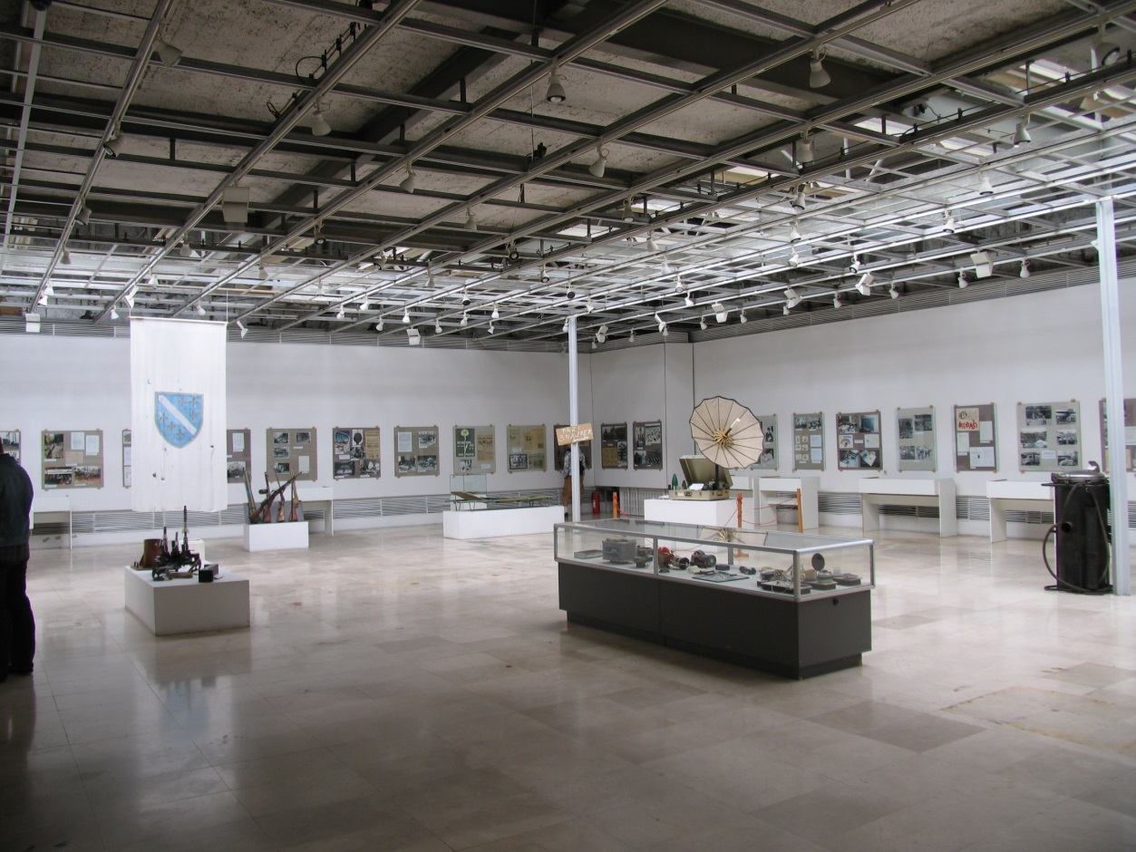
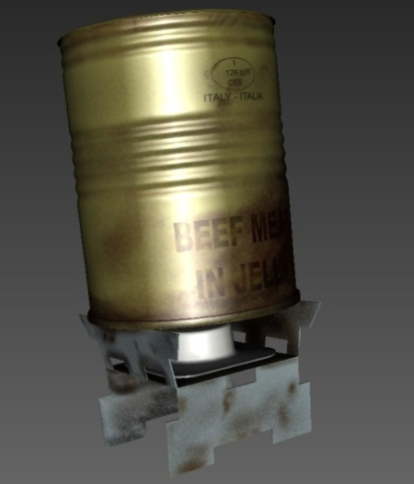
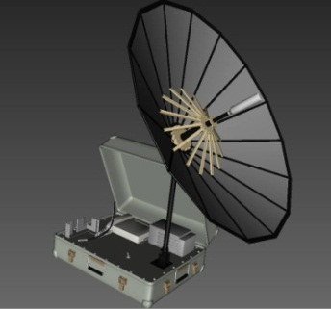
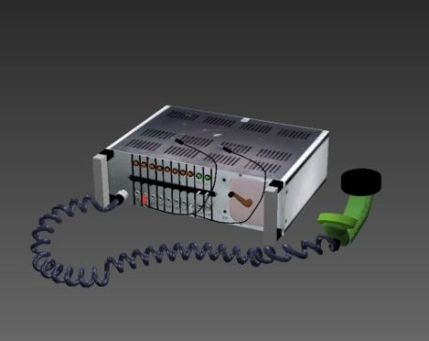
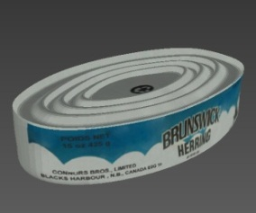
Digital storytelling - SGG
Sarajevo survival Tools – VM of Sarajevo Siege

Slide 10
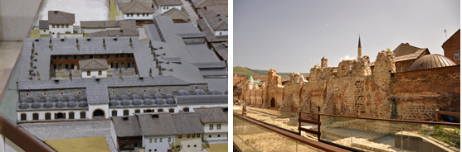
Tašlihan project
Tašlihan - largest inn in Sarajevo during the Ottoman period
built between 1540 and 1543 as an endowment of Gazi Husref Bey, governor of Bosnia
today exists only one wall

Slide 11
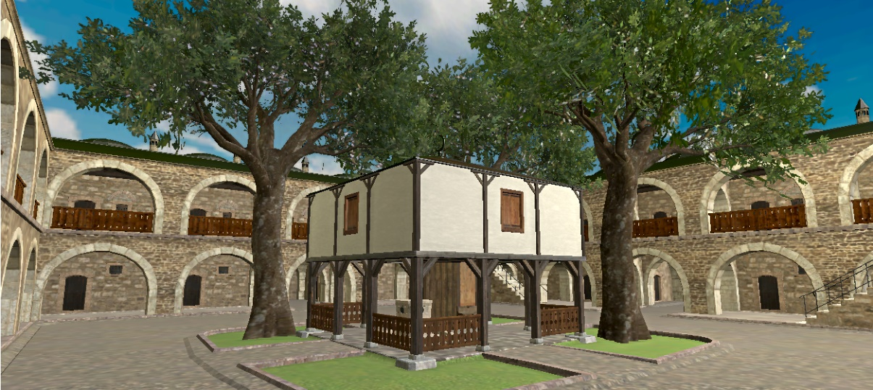
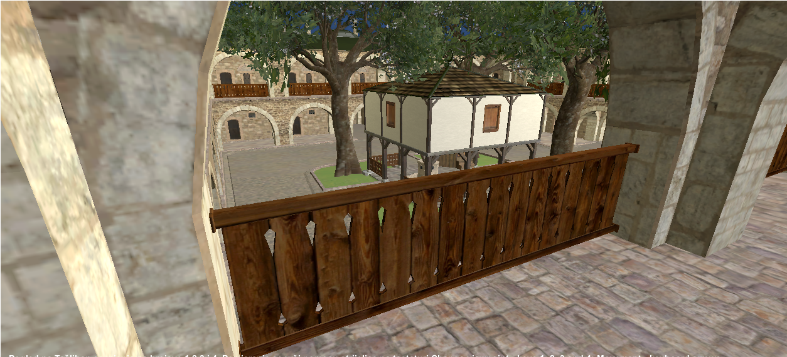
Tašlihan project
virtual reconstruction
3D model created in Maya
interactivity added in Unity 3D

Slide 12
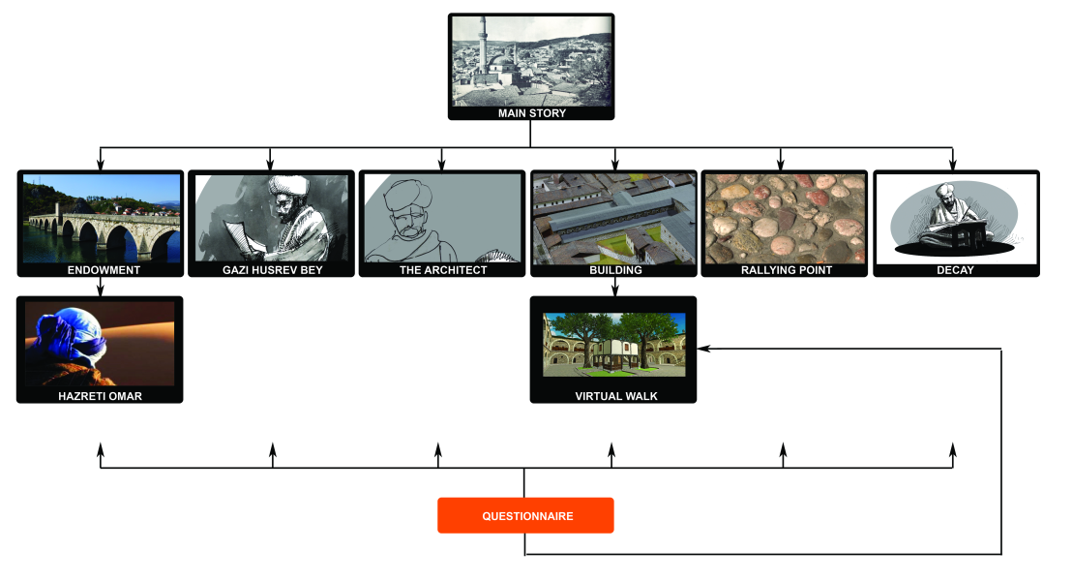
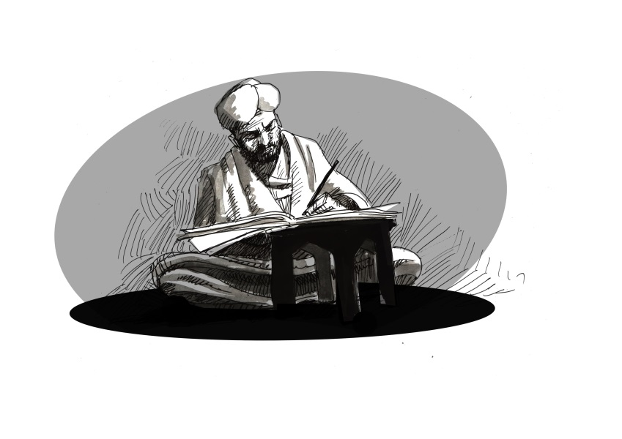
Tašlihan project
digital stories
written by a professional novelist
combination of video footage, old photos, hand drawn illustrations and renders of the 3D model
cover the main aspects of endowment concept, history of the object and related important characters
“told” by Murad bey Tardić, best friend of Gazi Husref bey
divided in sub-stories
INTERACTIVE

Slide 13
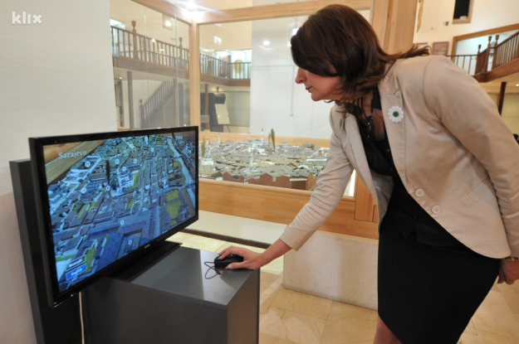
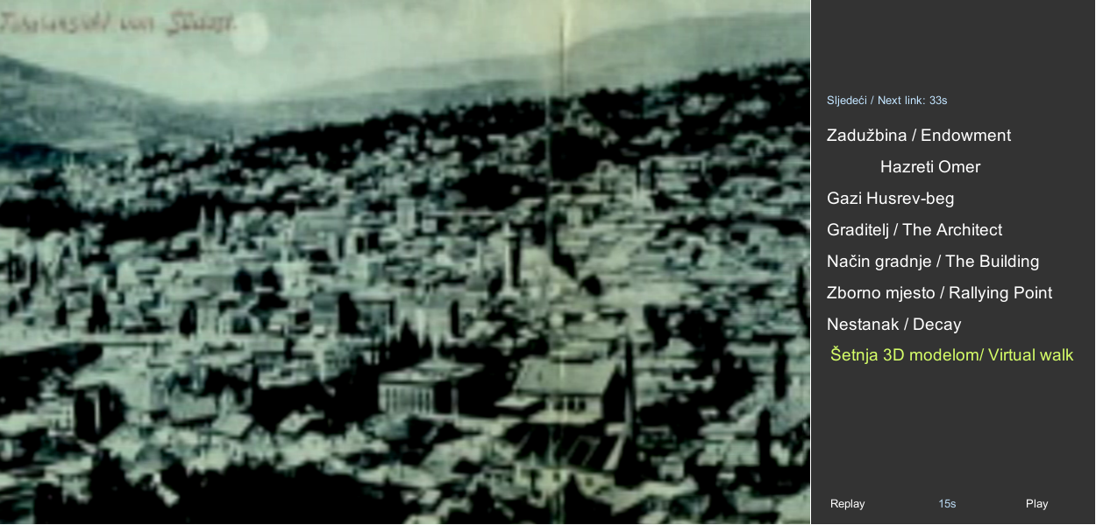
Tašlihan project
implementation
documentary
interactive story
serious game
set up in the Museum of Sarajevo and online

Slide 14
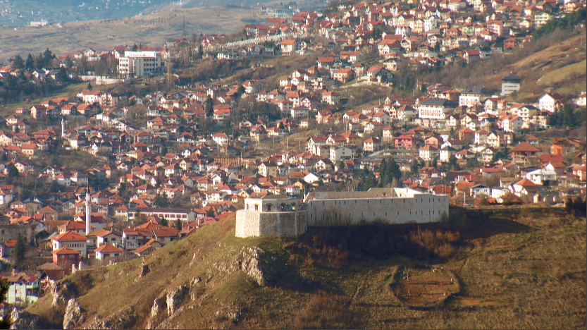
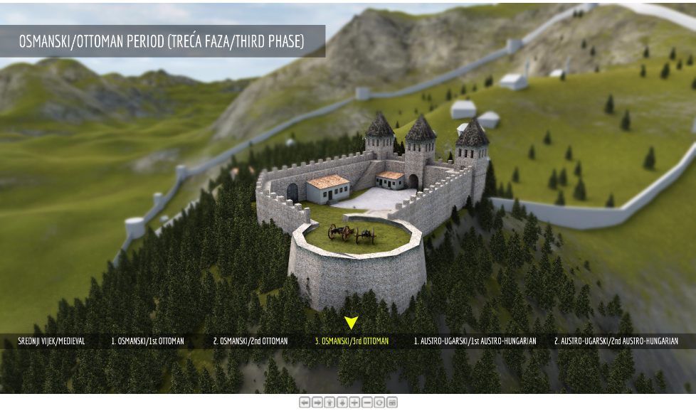
White Bastion project
aims to present the historical development of this cultural heritage object through digital stories combined with interactive 3D models of the Bastion in various time periods
models contain digitized findings from the site and their 3D reconstructions
coproduction with BH Radiotelevision
budget: 3000 eur

Slide 15
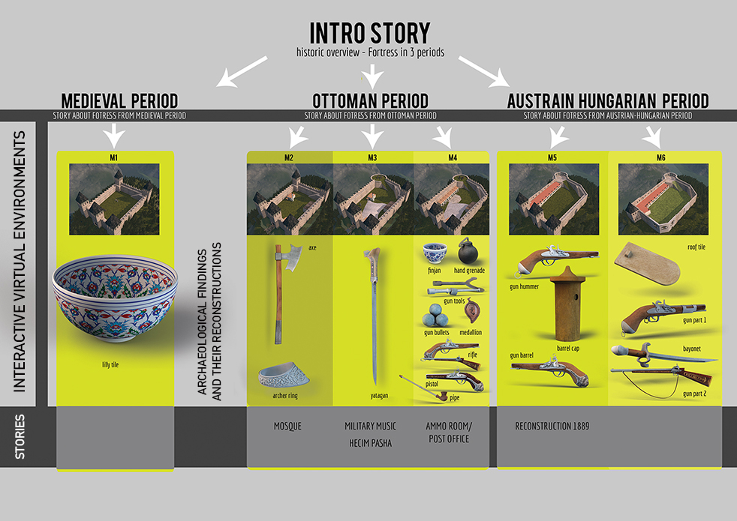
White Bastion project
Digital storytelling method
improved implementation in White Bastion project
interactive virtual environments interlinked with stories into a common hyper-structure
intro story presents an overview of the object’s history, while stories about medieval, Ottoman and Austro-Hungarian period give more details on the object’s transformation during these historic periods.
6 interactive models of different phases of the fortress as well contain digital stories
digitized artifacts and their virtual reconstructions are inside interactive virtual environments

Slide 16
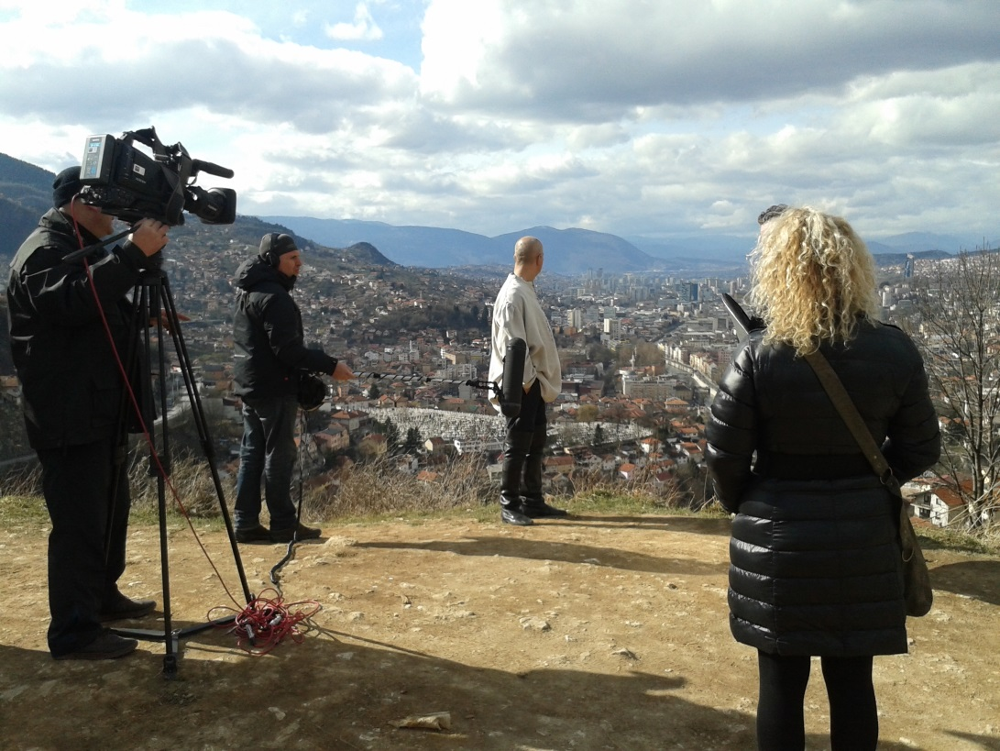
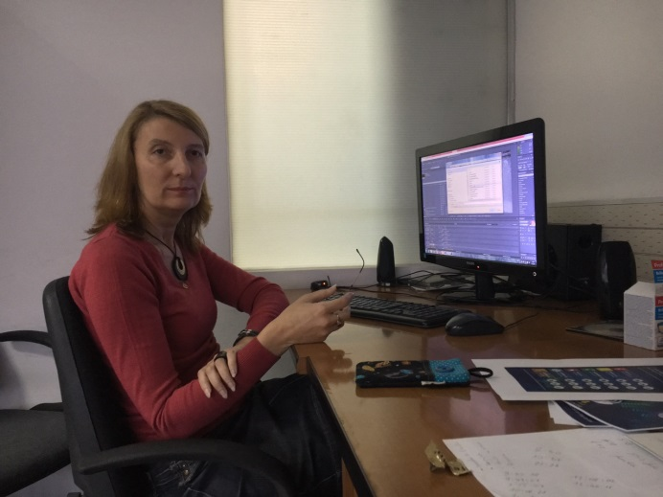
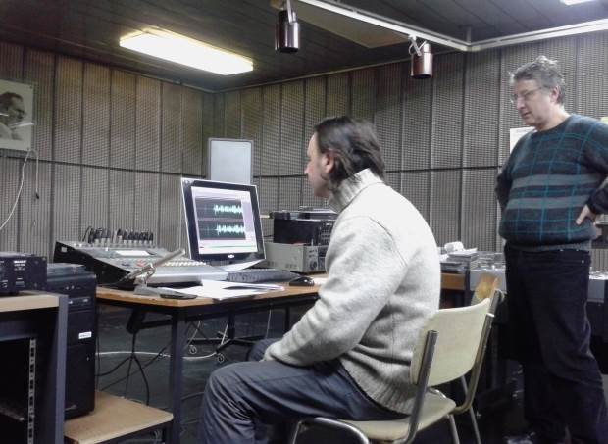
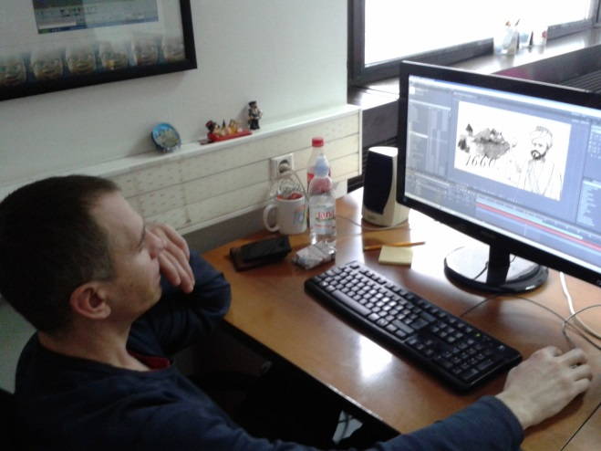
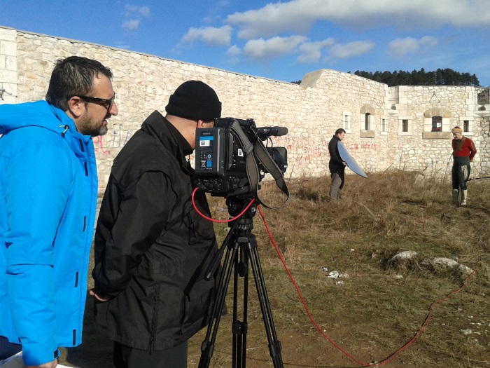
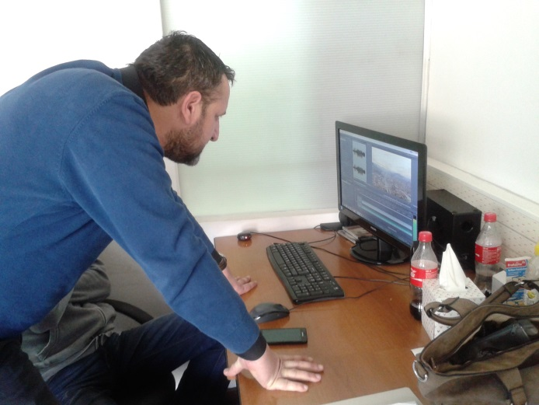
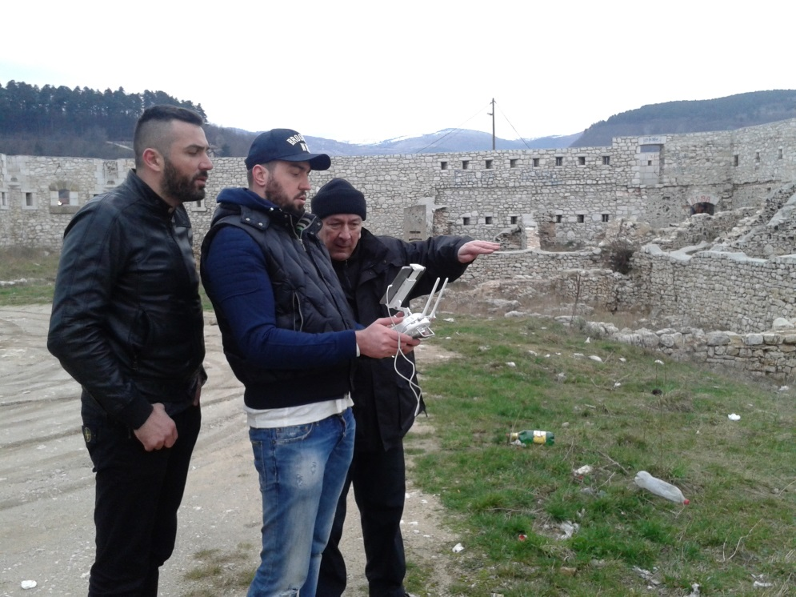
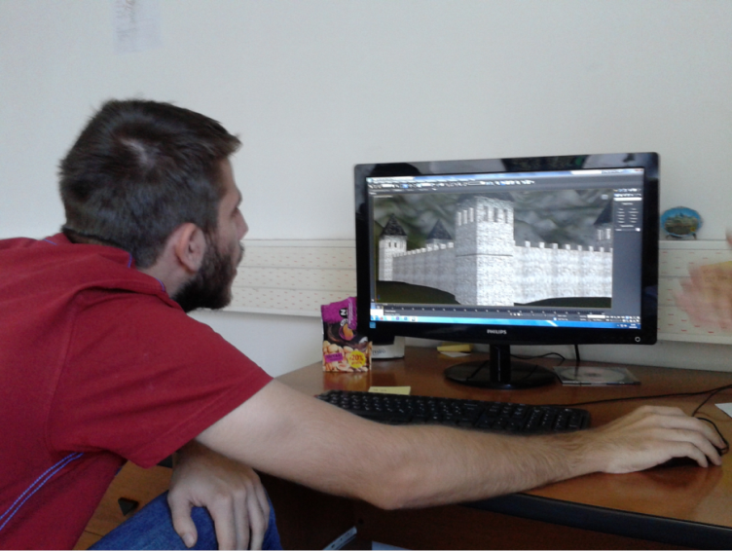
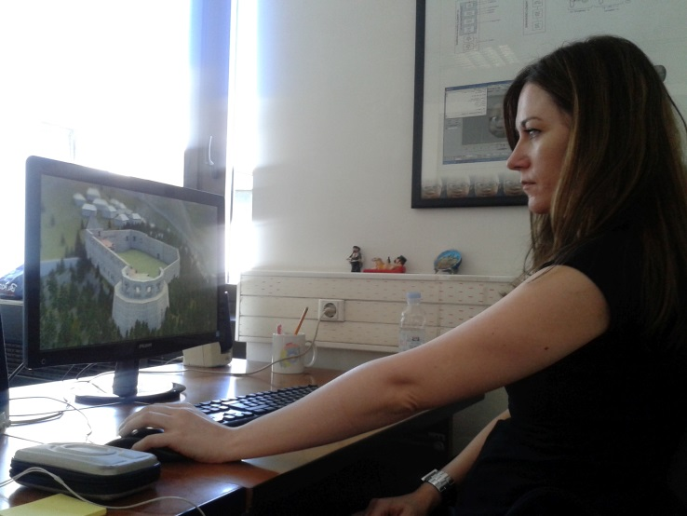
White Bastion - team
aims to

Slide 17

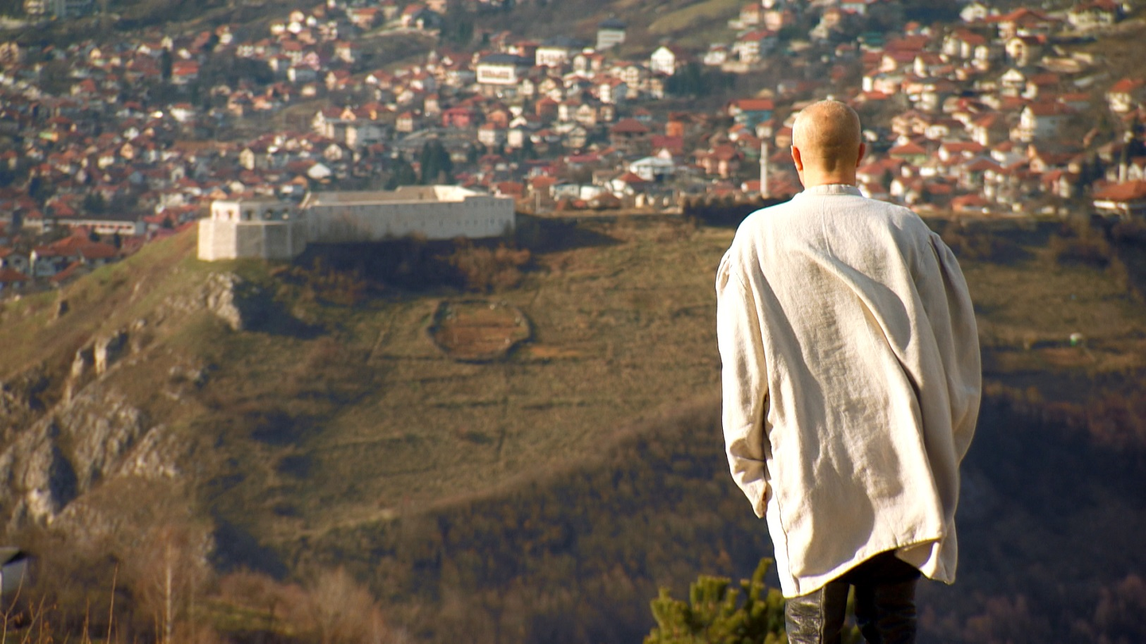
White Bastion project

Slide 18
EU projects
FP7 Network of Excellence 270404: V-MusT.net - Virtual Museum Transnational Network, 2011-2015
CA COST Action CA16213 New Exploratory Phase in Research on East European Cultures of Dissent, 2017-2021
Horizon 2020 project i-MARECULTURE - Advanced VR, iMmersive serious games and Augmented REality as tools to raise awareness and access to European underwater CULTURal heritagE, 2016-2019
CA COST Action CA16213 New Exploratory Phase in Research on East European Cultures of Dissent, 2017-2021
EACEA Creative Europe Real Heroes, 2020-2022
IPA CBC BH-MNE Amusing Museums (2019-2021)
INTERREG ADRION EMOUNDERGROUNDS (2022)
EACEA Creative Europe SHELeaders, 2022-2025

Slide 19

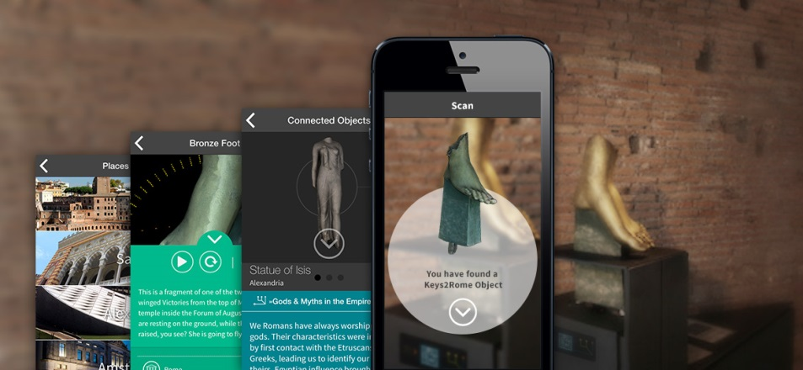
V-MusT.net (2011-2015)
Virtual Museum Transnational Network
Synthesis of knowledge about virtual museums
Keys to Rome
international multimedia exhibition on Roman culture held in 2014 in Rome, Amsterdam, Alexandria and Sarajevo

Slide 20

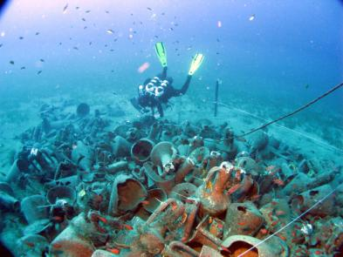
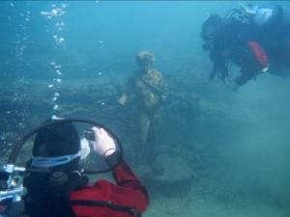
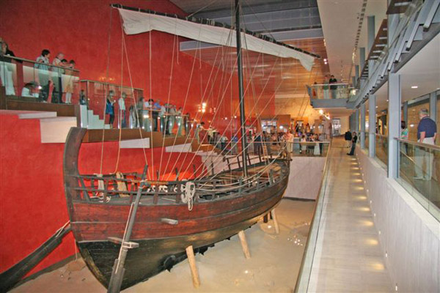

H2020 iMARECulture (2016-2019)
Advanced VR, iMmersive serious games and Augmented REality as tools to raise awareness and access to European underwater CULTURal heritagE
GOAL: to raise public awareness of European identity by focusing in maritime cultural heritage, which by default bridges different civilizations. In particular

Slide 21
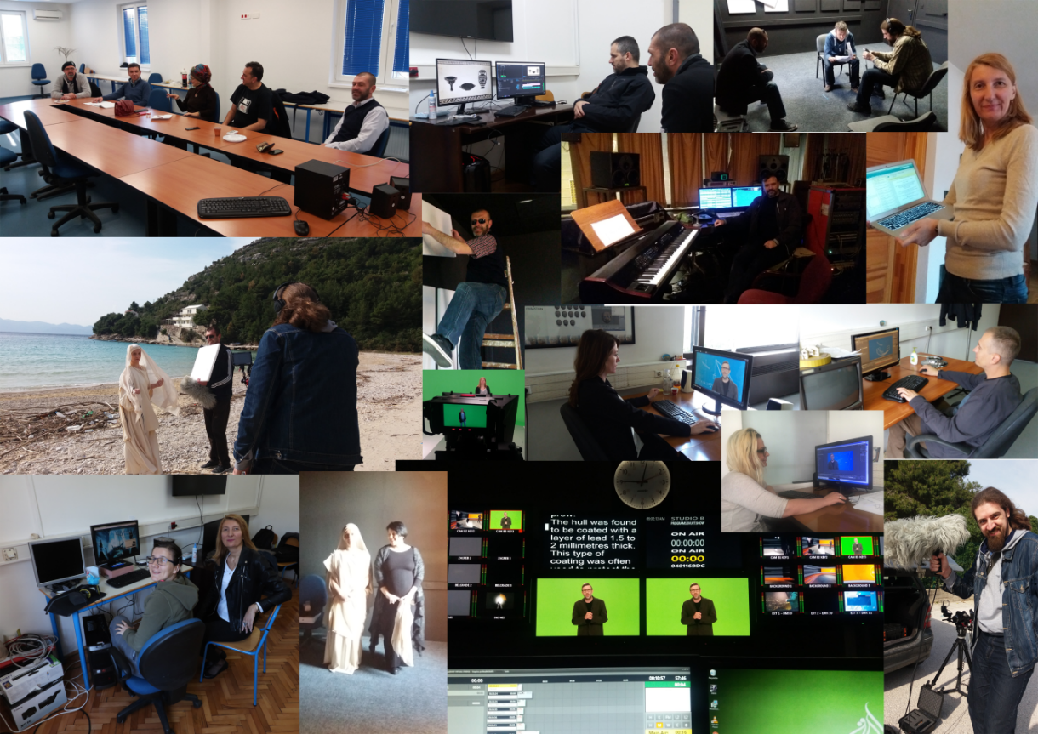
SGG in iMARECulture
responsible for the interactive digital storytelling
leads the task concerning the analysis of pedagogical and cognitive theories and devloping a new method for interactive digital storytelling
Storytelling deliverables
Kyrenia pilot
Seafaring game
Dry visits applications
UW excavation game
https://youtu.be/YvDIrxhnLfE

Slide 22




Mostar cliff diving VR (2018)
300 years old tradition
Old Bridge in Mostar - UNESCO world heritage site
Built in 16th century, destroyed in 1993, rebuilt in 2004
competitions every summer

Slide 23







Mostar cliff diving VR (2018)
GOAL – edutainment
VR user interface
VR video stories
3D quiz
Cliff dive simulation

Slide 24






Roman Heritage in the Balkans (2019-2021)
virtual presentation of Roman heritage in Bosnia, Albania, Serbia and Montenegro
selected locations:
BH: Roman villa and terme in Ilidža near Sarajevo, villa Mogorjelo near Čapljina
Serbia: Roman military camp and city Viminacium and fortress Lederata near Požarevac
Montenegro: Municipium S. near Pljevlja and Doclea near Podgorica
Albania: Durres amphitheater and Butrint
actress Selma Alispahić
https://www.youtube.com/watch?v=_Hqast47F4Y

Slide 25








Sarajevo 5D (2020)
AR application displaying objects which do not exist any more or exist just in fragments
reconstructions and info shown over mobile device camera picture
applications leads the user to the original locations of selected objects
https://youtu.be/793MAji7SfE

Slide 26



Old crafts Virtual Museum (2020)
over 80 crafts existed once in Baščaršija (Sarajevo)
many are today extinct
the goal of the project: to draw attention to the old cratfs and help their preservation
VM presents last brushmaker, boza maker and tailor decorater
actor Adnan Hasković, music Emir Bukovica (Emir and Frozen Camels)
first VR music video in BH

Slide 27




(2021)
digitization of Hidden Galleries exhibition
stories about torture of believers by Soviet secret police
collaboration with School of Society, Politics and Ethics, University College Cork, Ireland
8 stories, desktop VR
https://youtu.be/R9QxnXhn7IY

Slide 28




Battle on Neretva VR (2021)
one of the most important battles of WWII
in collaboration with the Museum in Jablanica
the user joins the battle and meets comrade Tito
https://youtu.be/uFCHoMdgNa8

Slide 29

Crvena stijena (2021)
archaeological site close to Nikšić, Montenegro
in collaboration with the Museum of Nikšić
virtual visit to the site, storytelling and gameplay
https://youtu.be/xL5hQUzerwI

Slide 30

Ilhamija VR movie (2021)
VR movie about the dissidents from Ottoman and socialist period
our second VR movie
challenges of VR filming
ground for future research
https://youtu.be/_W9mKBye5G0

Slide 31

LogVR (2022)
VR presentation of the mosque built for WWI soldiers in Log pod Mangartom, Slovenia
https://youtu.be/d8L9Hqo-Rzk

Slide 32
LogVR (2022)
VR presentation of the mosque built for WWI soldiers in Log pod Mangartom, Slovenia
https://youtu.be/d8L9Hqo-Rzk

Slide 33





Trebinje Fortresses VR
Four fully reconstructed models of fortresses around Trebinje.
User can explore around each fortress.
Gameplay – become a pigeon and carry a letter.

Slide 34
Wrecks4all VR
Brings unreachable underwater sites closer to tourists.
Audio stories about most important points around sites.
Collaboration between BiH, Croatia and Montenegro.

Slide 35
Battle of Kozara VR
Become a part of this famous battle
Story telling and 5 different gameplays
Walk around Kozara monument 3D model in VR environment

Slide 36

Thank you!
Sarajevo Graphics Group
http://people.etf.unsa.ba/~srizvic/sgg.htm

