Slide 1


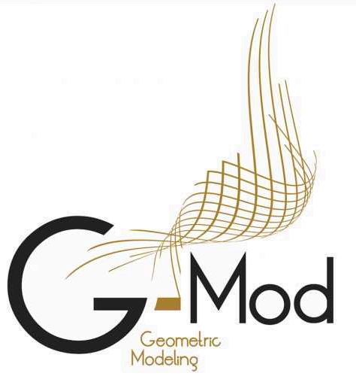




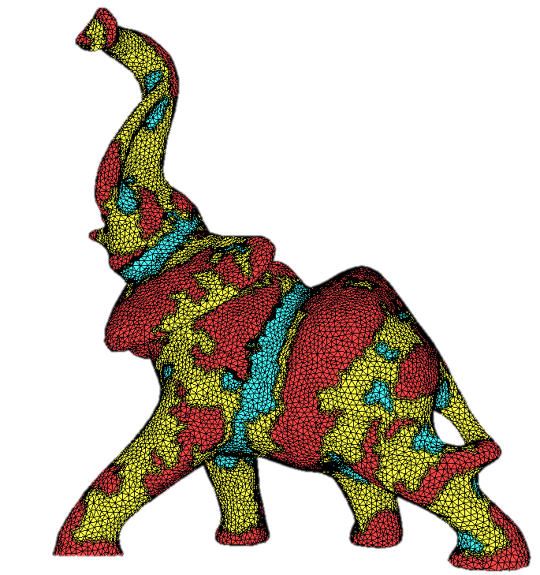
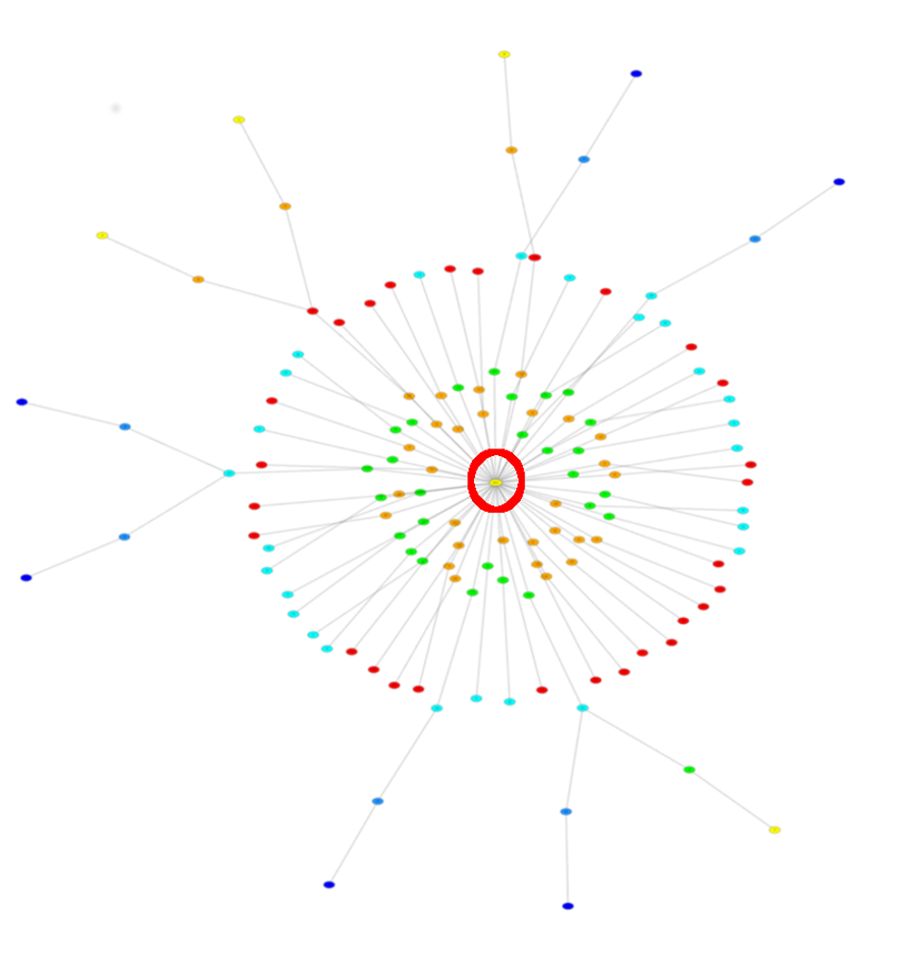
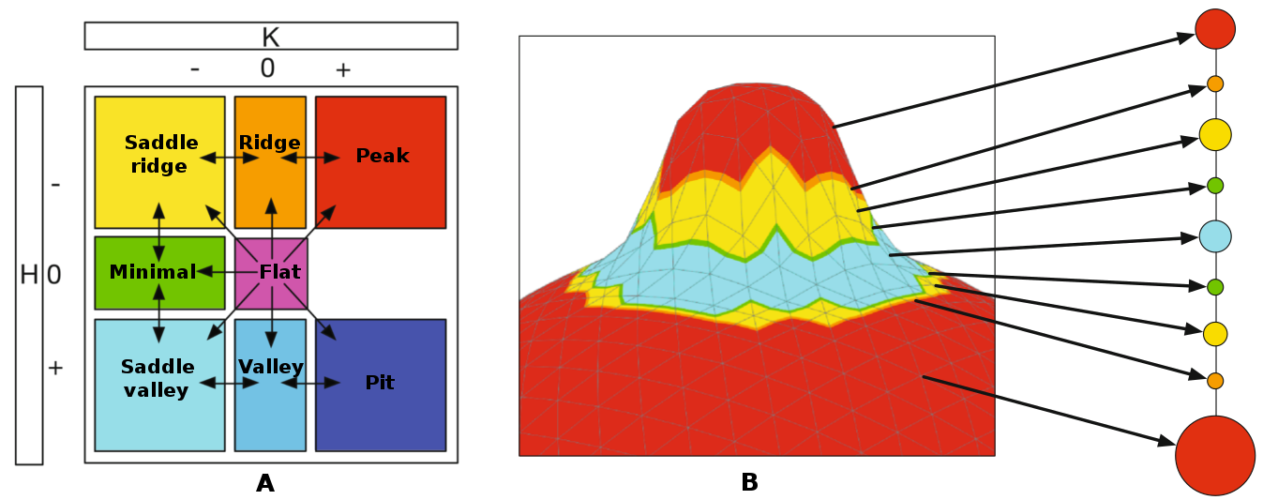
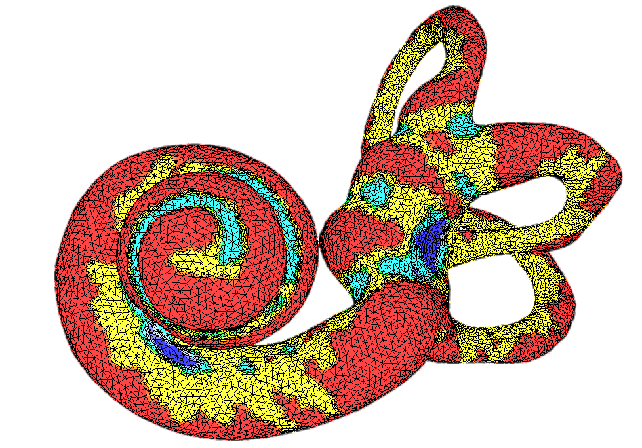
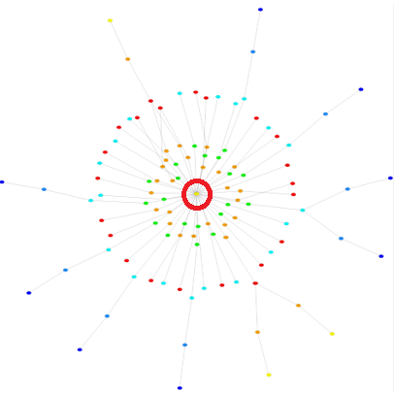
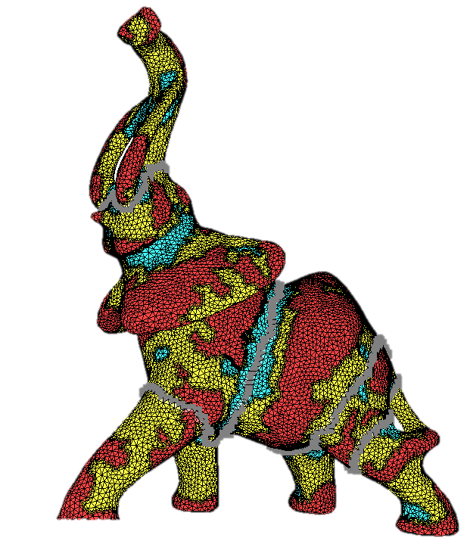
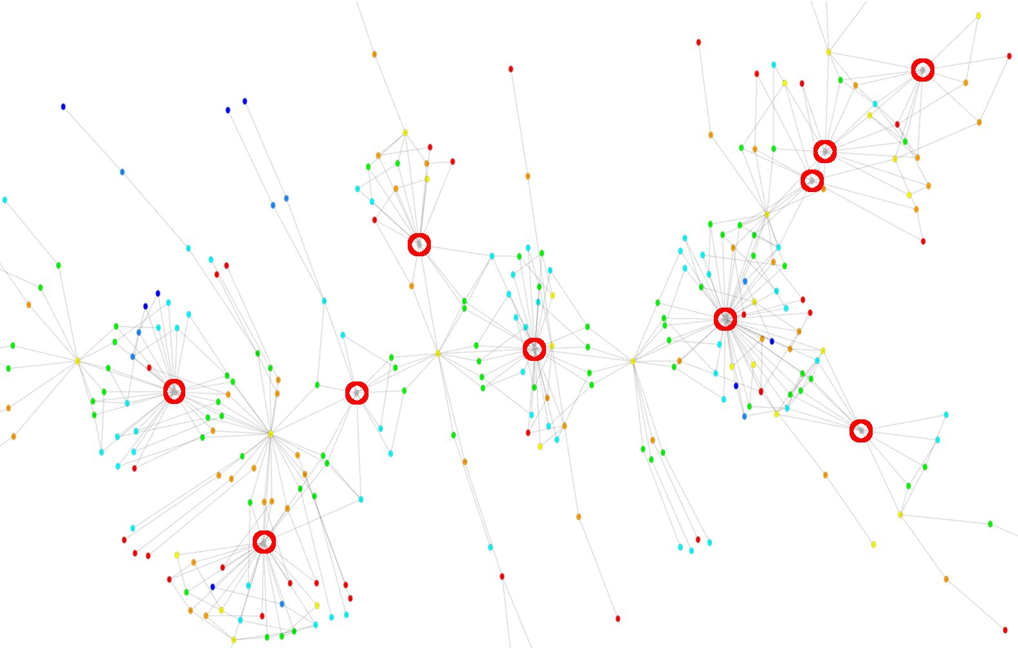
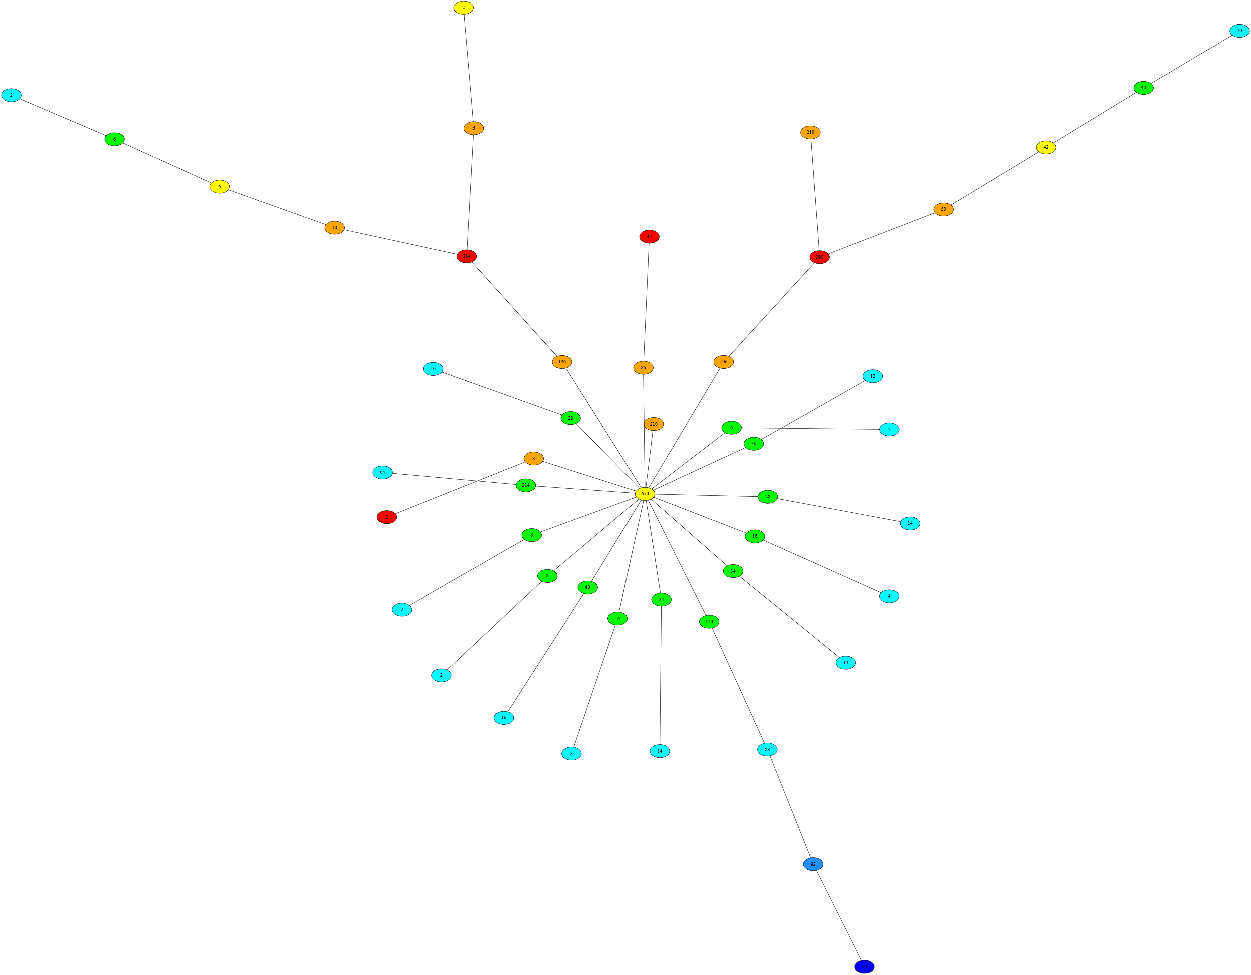
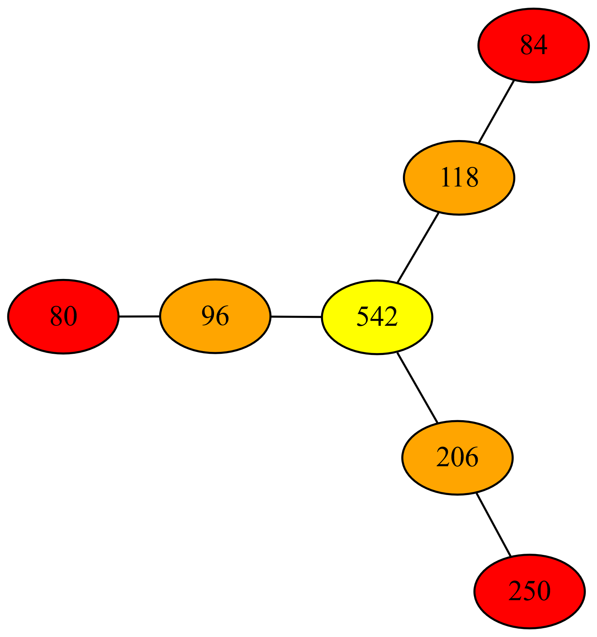
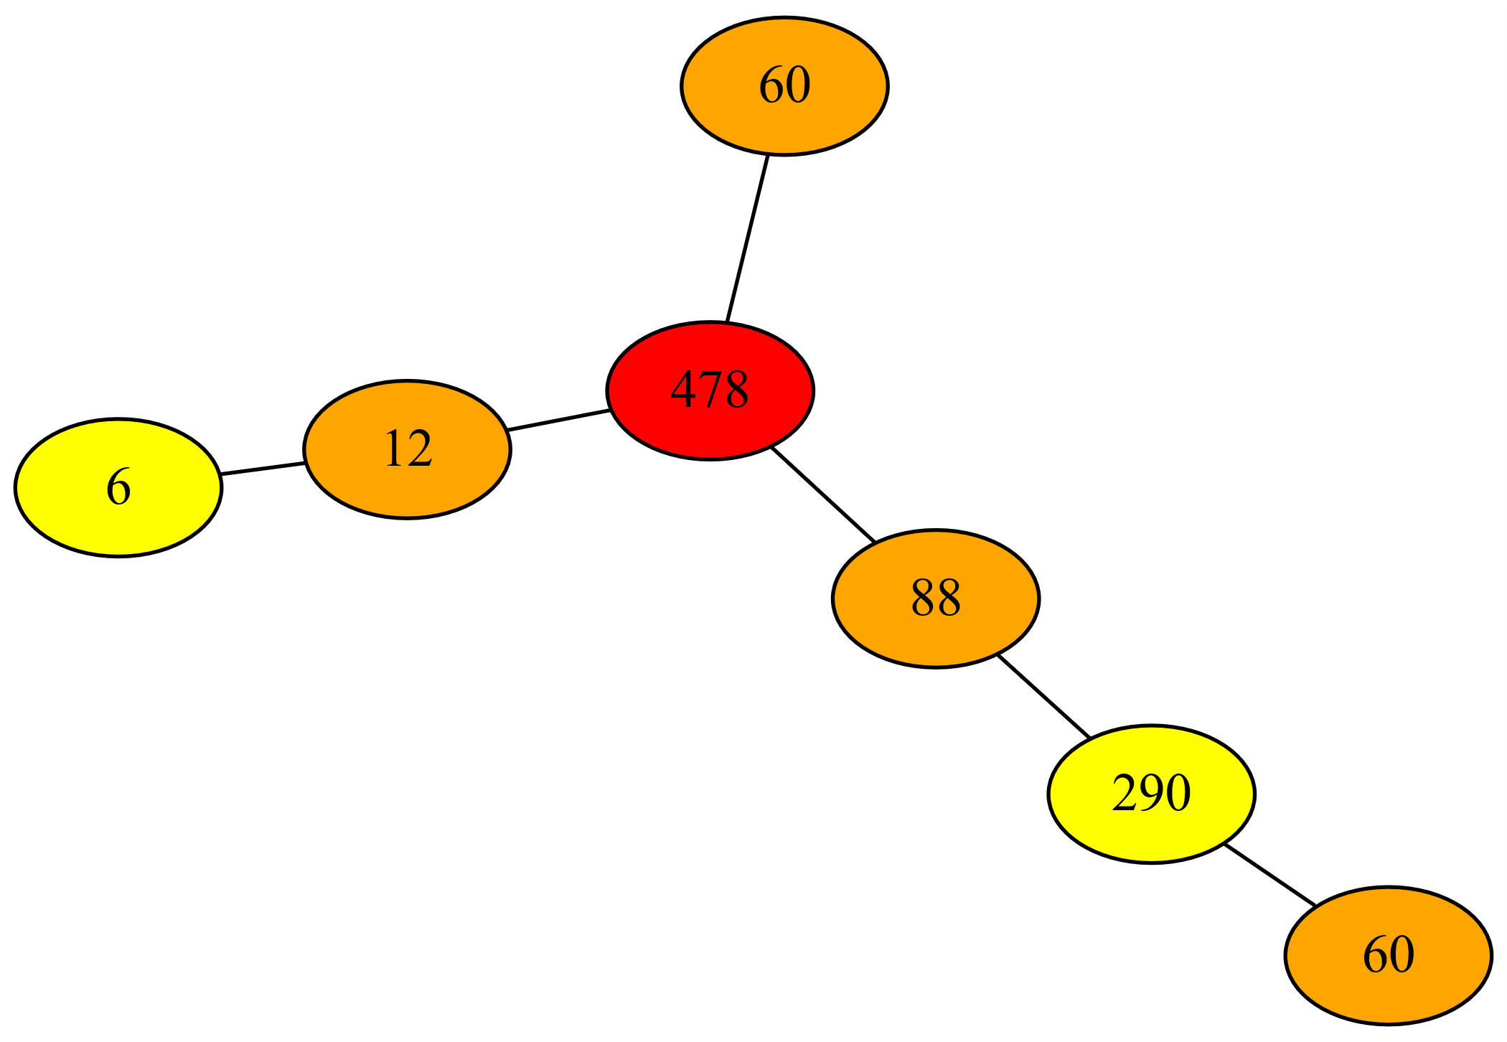
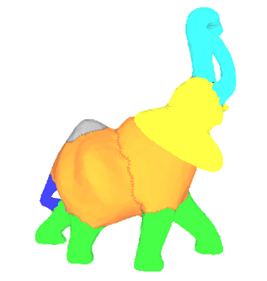
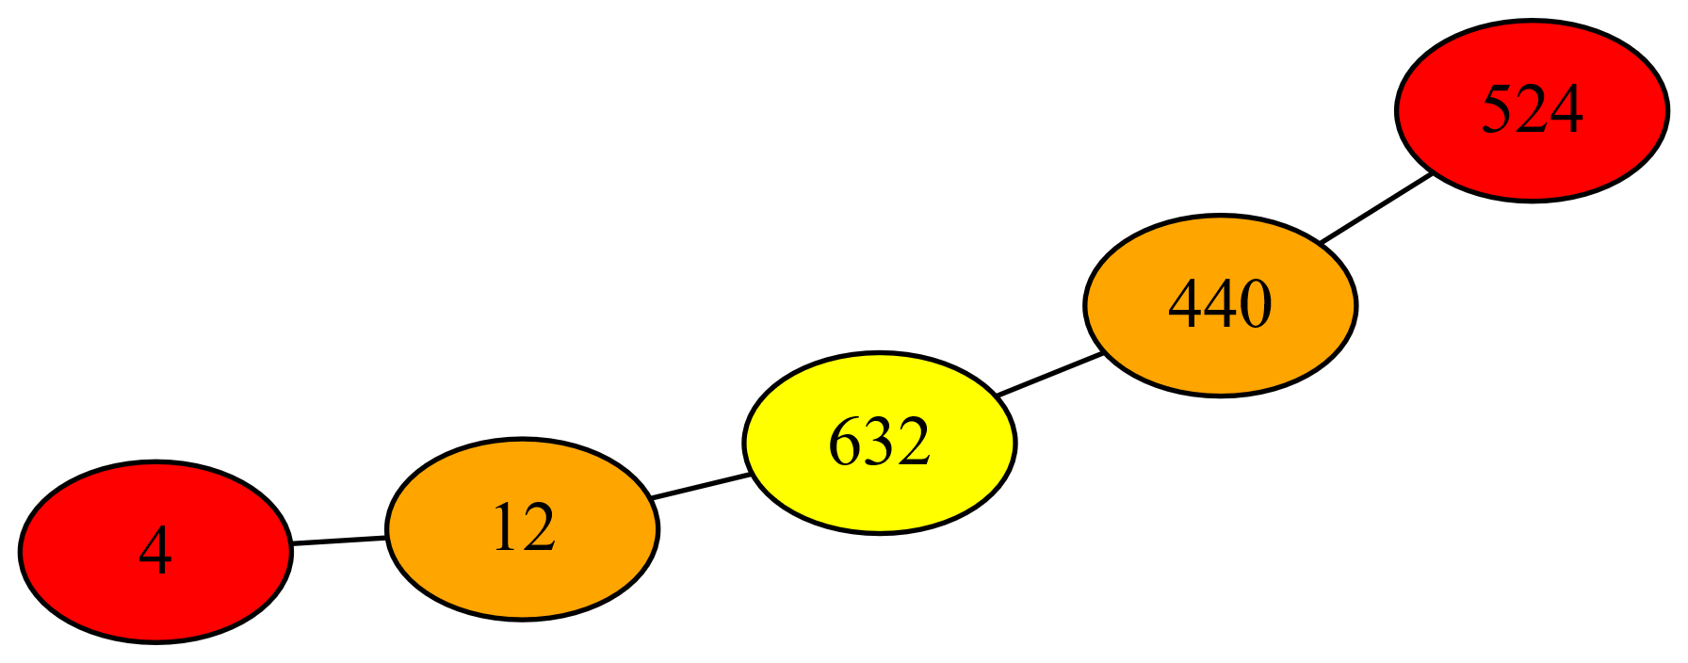
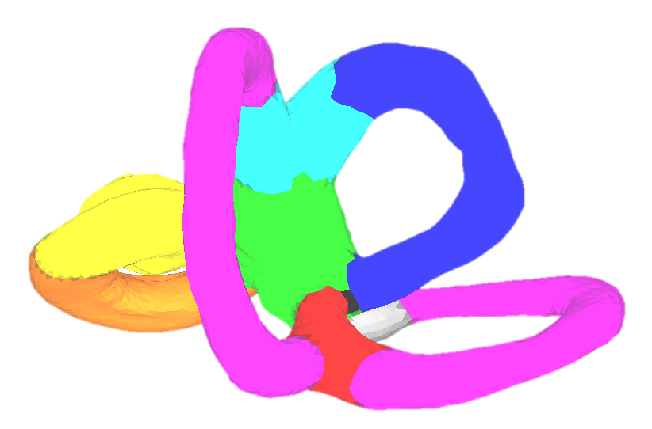
3D Mesh Description using «Subdivided Shape-Curvature-Graphs»
Florian Beguet^{1,2}, Jacques De Guise², Thierry Cresson², Matthieu Schmittbuhl³, Jean-Luc Mari¹
1.Aix Marseille Univ, Université de Toulon, CNRS, LIS, Marseille, France
2.Ecole de Technologie Supérieure de Montréal, Canada
3.Faculté de médecine dentaire, Université de Montréal, Canada
Motivations
Construction of a
Subdivided Shape-Curvature-Graph
Most mesh descriptors using the local curvature cannot extract and pair similar local shapes on a mesh.
The Shape-Curvature-Graph method proposed by [POL17] makes it possible to find all the occurrences of a particular subgraph resulting from a known shape and according to a threshold of similarity.
Construction of an initial Shape-Curvature-Graph [POL17] based on the adjacency rules.
Shape-Curvature-Graph’s adjacency rules between the patches. [POL17]
The Shape-Curvature-Graph of complex and closed meshes creates a particular node in the center of the graph (circled in red).
Fragmentation of the central node by creating a new type of patch (gray) from SDF segmentation.
Results
Each color on each of the meshes represents a group of subgraphs of matched shapes for a similarity greater than 80%.
Leg segments of the elephant were put in the same cluster; the two segments of the elephant's body as well.
Two of the inner ear canals paired together; the third canal has not been associated because of its more angular shape.
Extraction of all subgraphs from the main graph. Previous segmentation nodes are considered as bounds of each subgraph.
Conclusion
Comparison of subgraphs to each other. To define a similarity value between two graphs, a similarity matrix is constructed assuming that two nodes are considered similar if the neighbor nodes of the first graph can be associated with similar neighbor nodes of the second one. [NIK12]
A new 3D descriptor for complex shapes.
The choice of the mesh segmentation method has consequences on the robustness of the approach.
As future work, we plan to store more topological information to reduce the chances of false positives.
[POL17] Polette, A, Meunier, J, Mari, JL. “Shape-Curvature-Graph”: Towards 95 a New Model of Representation for the Description of 3{D} Meshes. In 4th International Conference on Augmented Reality, Virtual Reality and Computer Graphics (AVR 2017), Ugento, Italy. Springer, Lecture Notes in Computer Science, LNCS 10325, 2017, pp.369-384
[NIK12] NIKOLIC M.: Measuring similarity of graph nodes by neighbor matching. Intell. Data Anal. 16, 6 (Nov. 2012), 865–878
The 40th Annual Conference of the European Association for Computer Graphics − Genova 2019

