Slide 1
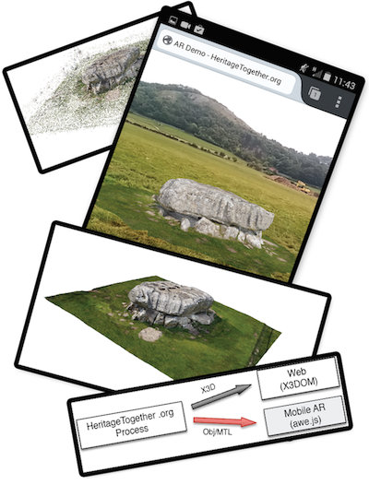
Community-driven generation of 3D and augmented web content for archaeology
P.D. Ritsos¹, A.T. Wilson¹, H.C. Miles², L.F. Williams¹, B. Tiddeman², F. Labrosse², S. Griffiths³, B. Edwards³, K. Möller⁴, R. Karl⁴ and J.C. Roberts¹
¹School of Computer Science, Bangor University, UK
²Department of Computer Science, Aberystwyth University, UK
³Department of History, Politics and Philosophy, Manchester Metropolitan University, UK
⁴School of History, Welsh History and Archaeology, Bangor University, UK

