Slide 1



Geometric Analysis in cultural heritage
Ruggero Pintus¹, Kazim Pal³, Ying Yang²,
Tim Weyrich³, Enrico Gobbetti¹ and Holly Rushmeier²
¹CRS4
²Yale University
³University College London
ruggero.pintus@crs4.it, kazim.pal@gmail.com, ying.yang.yy368@yale.edu, t.weyrich@ucl.ac.uk, enrico.gobbetti@crs4.it, holly.rushmeier@yale.edu

Slide 2
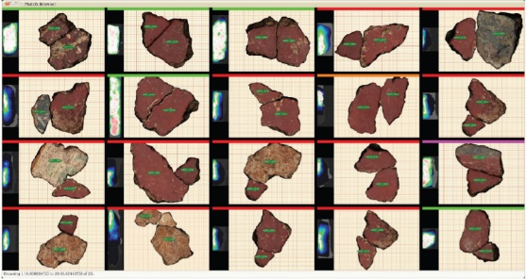
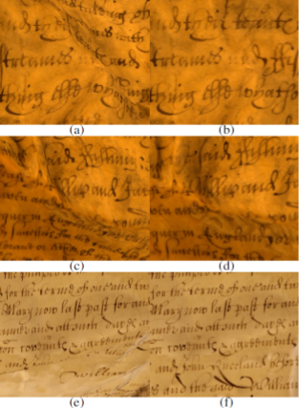
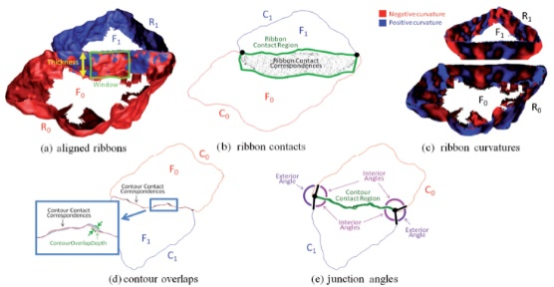
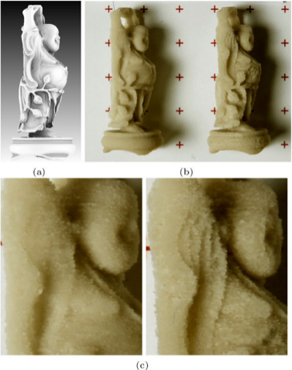
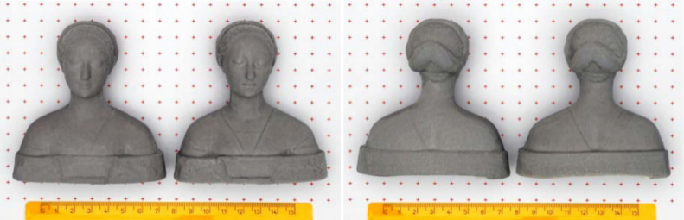
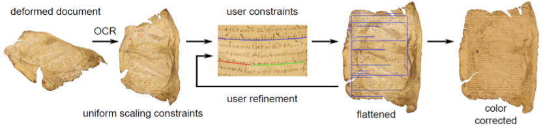
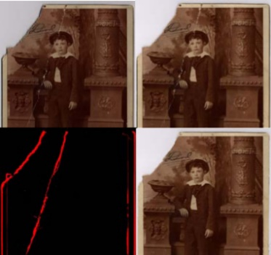
Titel
Review of recent techniques for geometric analysis in cultural heritage applications
Classification criteria based on:
- the geometric scale at which the analysis is performed
- the cardinality of the relationships among studied object parts
The problems considered include:
- Shape perception enhancement
- Restoration and preservation support
- Monitoring over time
- Object interpretation
- Collection analysis
We discuss open problems and future perspectives

