Slide 1
360° video
NEW MEDIA FORMAT

Slide 2
Video shooting
„Classic” camera which shoots space in front of it and is always positioned to see the action in front of the camera.
Frame is the space in which all the action happens.
Frame in photo and video is definied by lens focal length.
Mise-en-scène refers to everything that appears before the camera and its arrangement—composition, sets, props, actors, costumes, and lighting. The various elements of design help express a film's vision by generating a sense of time and space, as well as setting a mood, and sometimes suggesting a character's state of mind. "Mise-en-scène" also includes the composition, which consists of the positioning and movement of actors, as well as objects, in the shot.

Slide 3
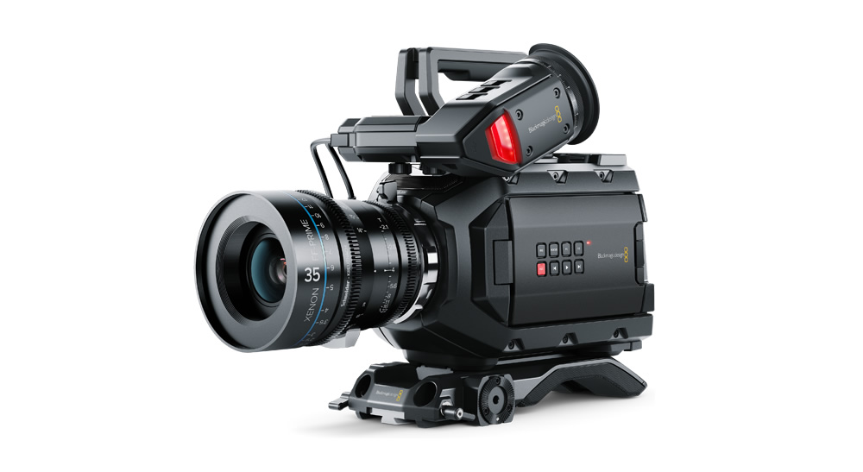
Video shooting
Some types of cameras have fixed lenses while other allow for change of lenses.
Different lenses allow us to control apterture and depth of field.

Slide 4
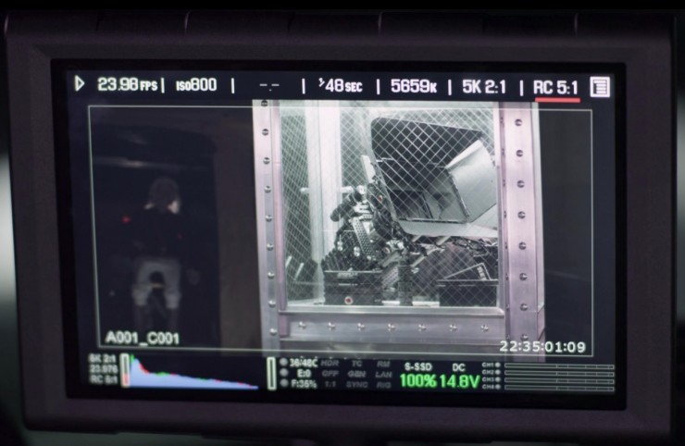
Camera bacis setup
Aperture (f-stop)
White balance
ISO
Shutter speed
Frame rate
Focus
Resolution

Slide 5
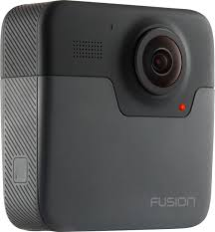
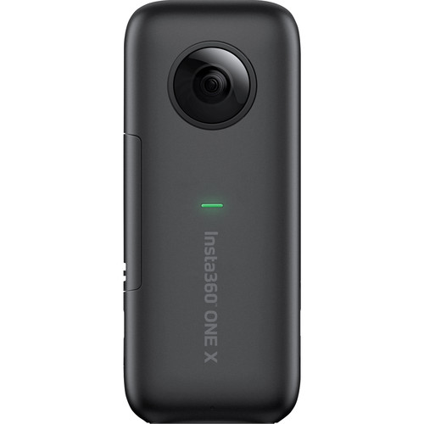
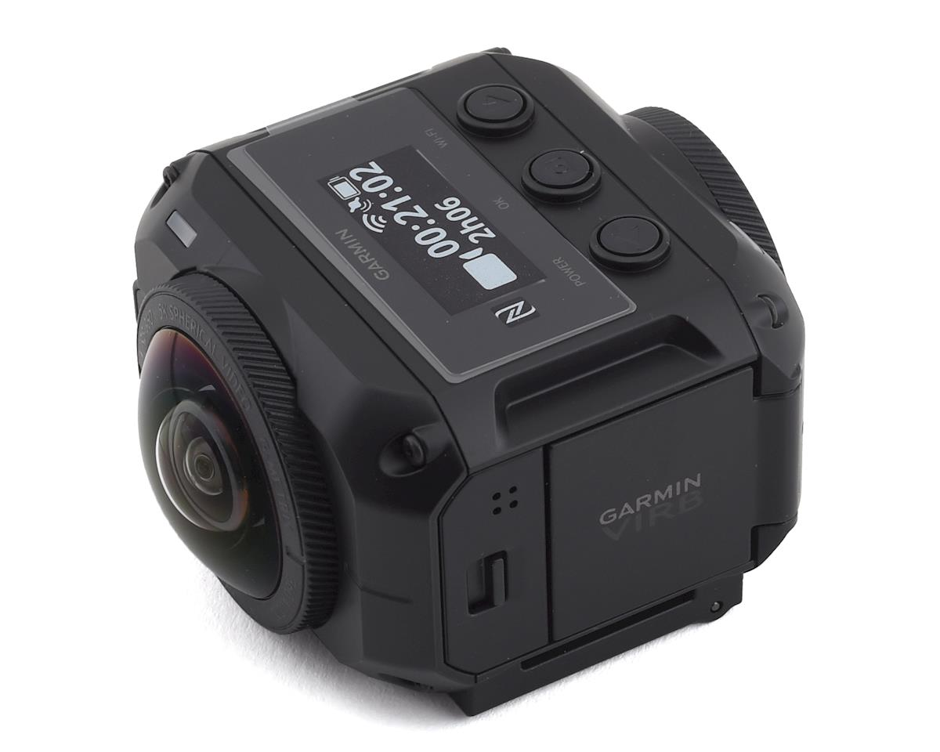
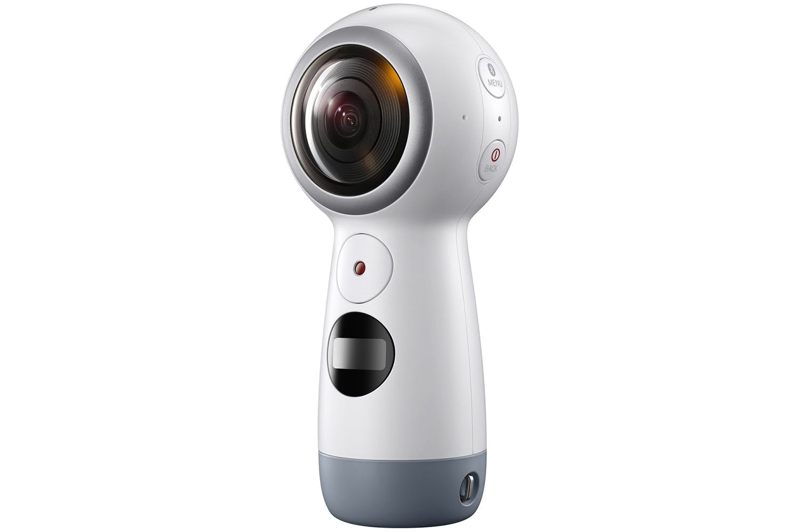
360 cameras
These cameras have the ability to record image or video in full 360 degrees.
These videos can be watched using VR headsets.
Youtube allows watching of 360 videos.
360 cameras market is growing.

Slide 6
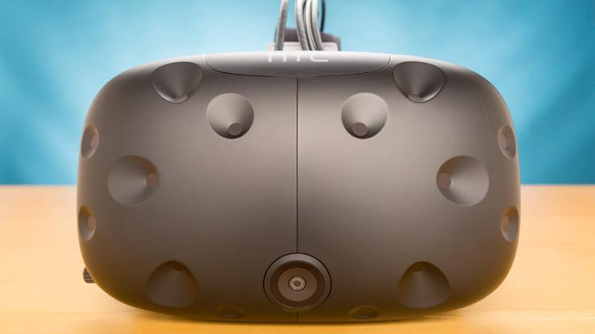
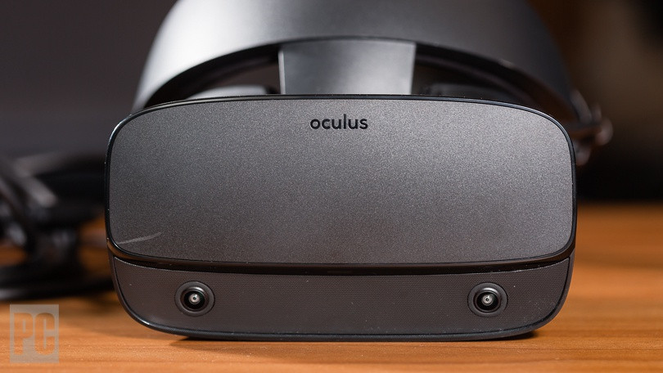
VR Headsets
A virtual reality headset is a head-mounted device that provides virtual reality for the wearer. Virtual reality (VR) headsets are widely used with video games but they are also used in other applications, including simulators and trainers.
They comprise a stereoscopic head-mounted display (providing separate images for each eye), stereo sound, and head-motion-tracking sensors
HTC and Oculus launched their consumer level VR devices in 2016.

Slide 7
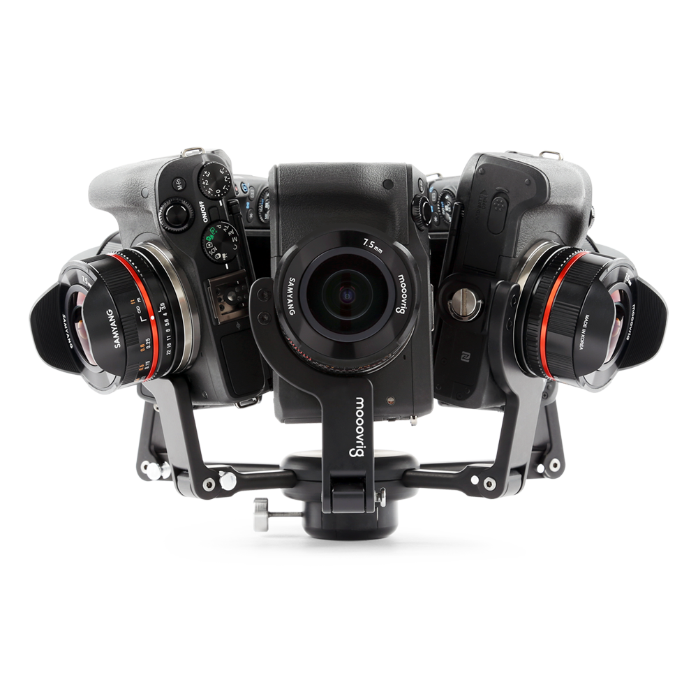
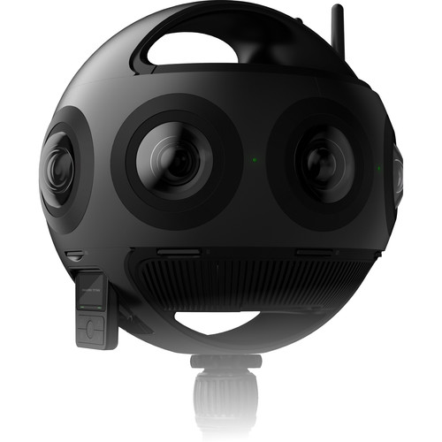
360 camera challenges
Professional 360 cameras are still rare and expensive.
Filming challanges:
Placement of crew
Placement of lights
Sound recording
Moving and positiong of the camera while filming.
Hardware for editing and reproduction

Slide 8
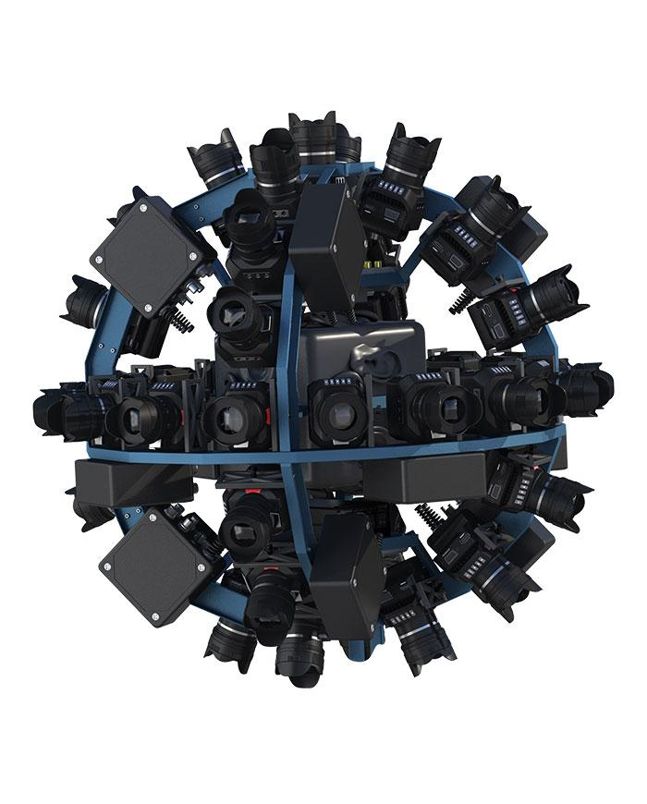
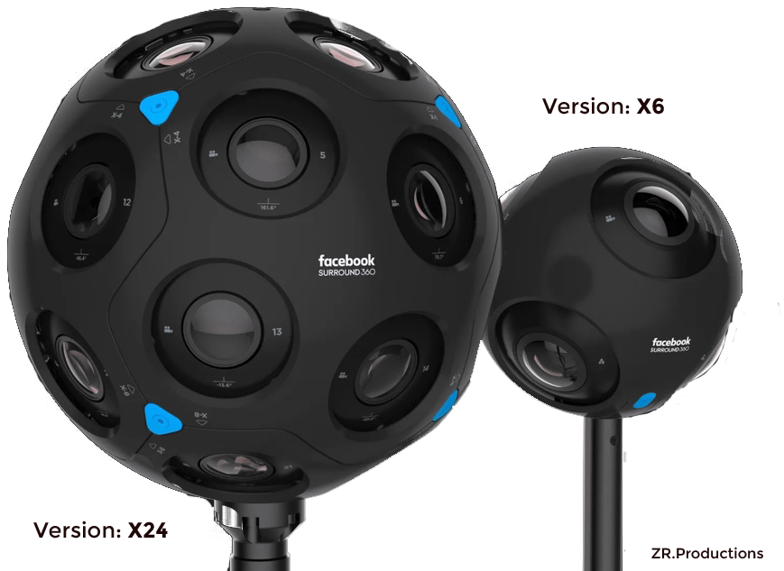
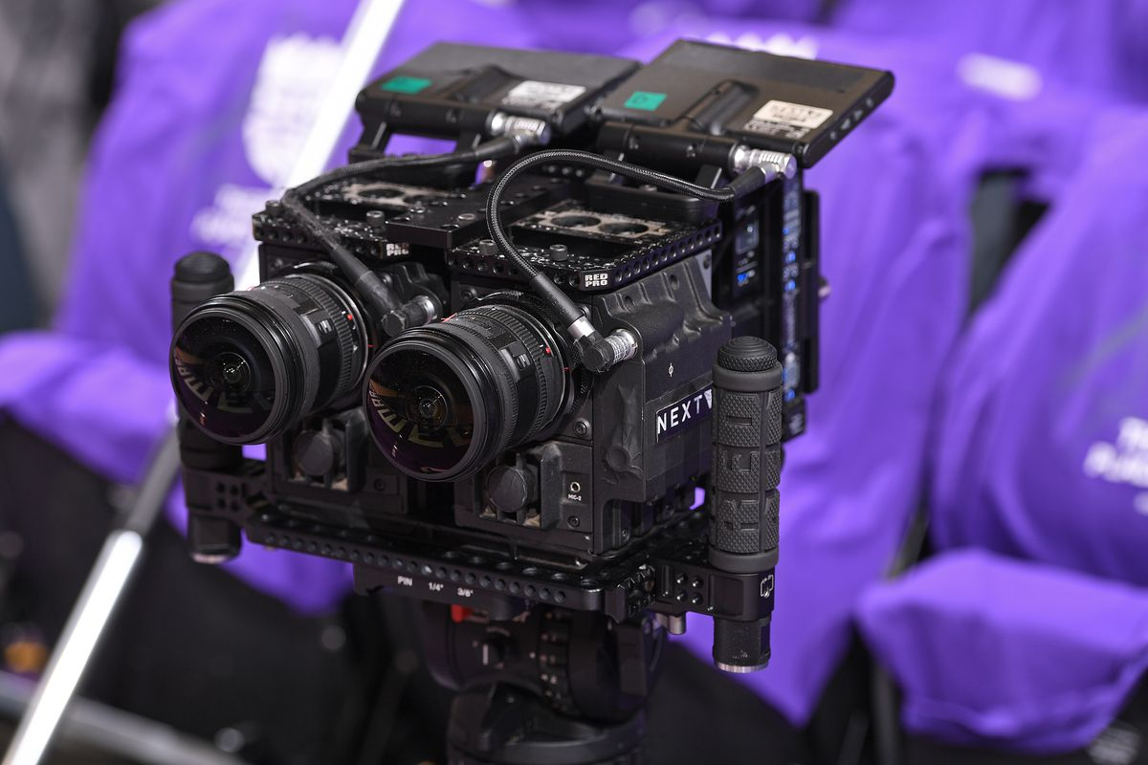
360 cameras future
Development of cheaper and more advanced 360 cameras.
Rise of VR systems.
Development of 6DOF (Six degrees of freedom) cameras.
Six degrees of freedom (6DOF) refers to the freedom of movement of a rigid body in three-dimensional space.

Slide 9
360 camera prices
Consumer level 360 cameras:
GoPro Fusion – 350$
Samsung Gear 360 – 250$
Garmin Virb360 – 800$
Insta360 One X – 500$
Rylo 360 – 500$
Professional 360 cameras and rigs:
Insta360 Titan – 15.000$
Facebook Surround 360 – 30.000$
Z CAM V1 Pro – 34.000$
Mooovr rig (5x Canon) – 13.000$
EYE rig (42x Blackmagic) – 155.000$
NextVR rig (6x RED) – 200.000$

Slide 10
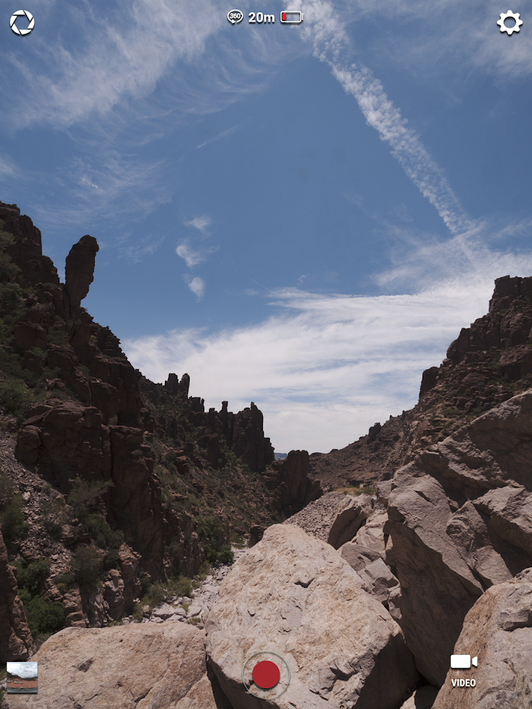
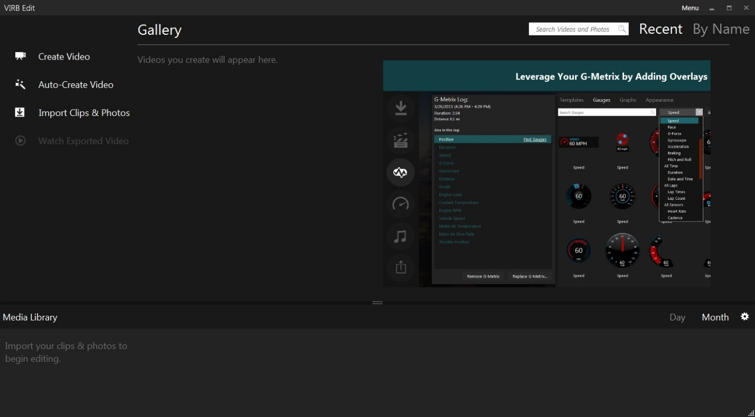
360 video recording and editing
360 cameras use tablets and smarphones for image preview
Recorded footage usually needs to be stiched and software designed by the camera creators can help a lot.

Slide 11
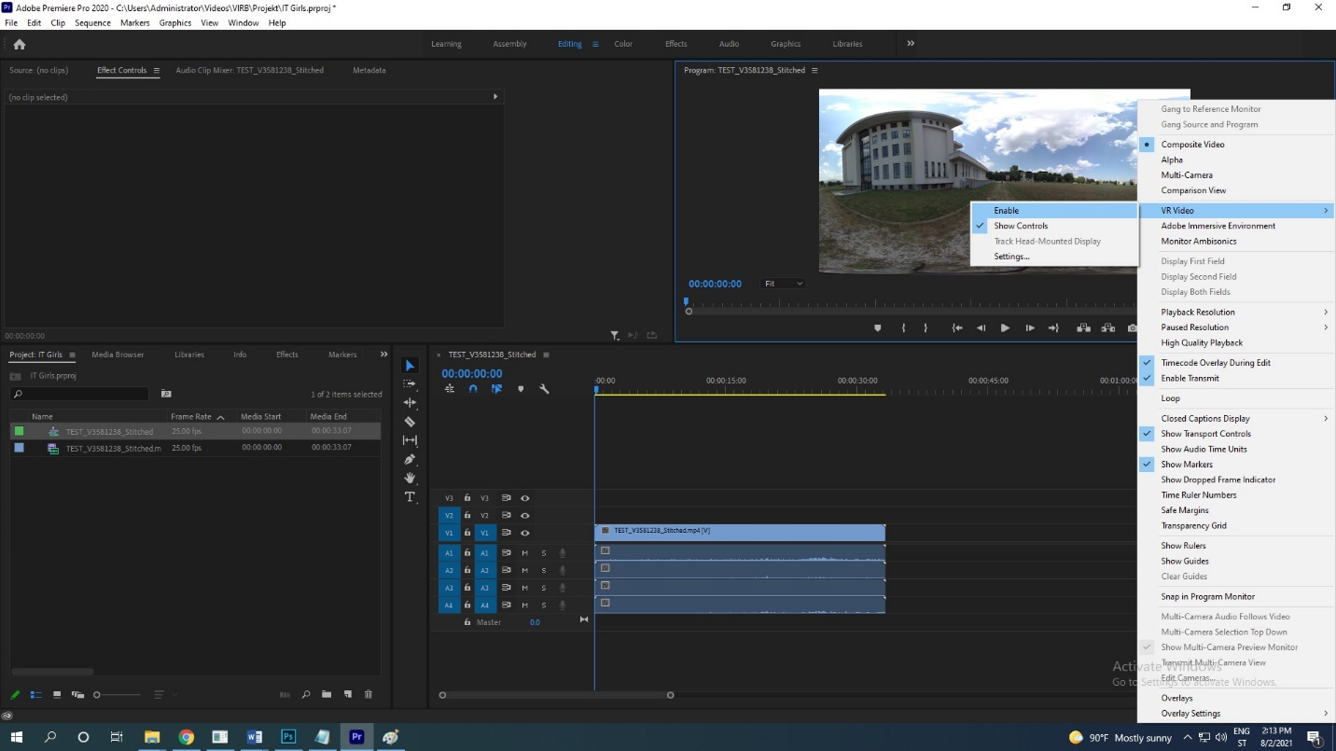
360 video recording and editing
Editing softwares can work with 360 video in the similar way as working with standard 2D video.
Videos can be exported as 360 videos after editing.

