Slide 1
Supplementary images

Slide 2
Sub-area Sampling
x
C(g)
n(g)
….
A(g)
….
g_{i}
g₀
g
g₄
g₂
g₁
g₁₀
L(g)=L(g₁)=L(g₂)…
V(x,g)=V(x,g₁)=L(x,g₂)…
n(g)=n(g₁)=n(g₂)…

Slide 3
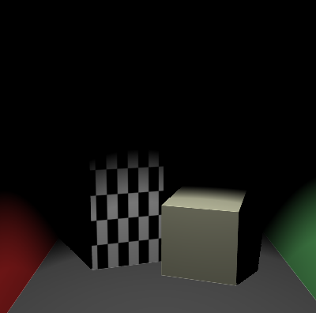
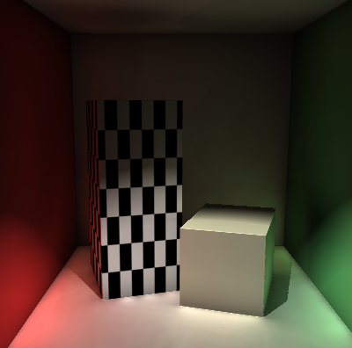
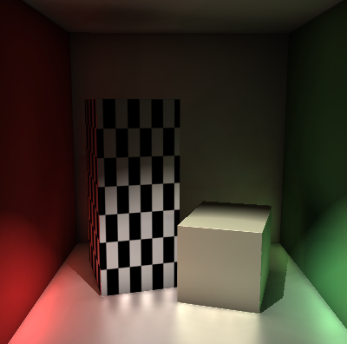

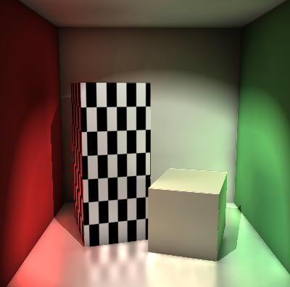
Cornell Box
(a)
(b)
(c)
(d)
(e)

Slide 4
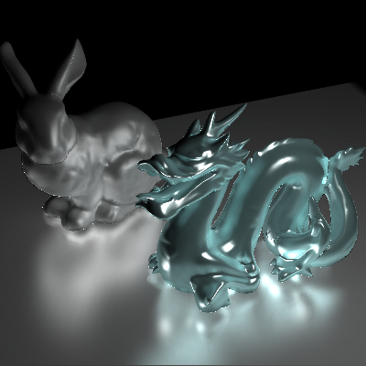
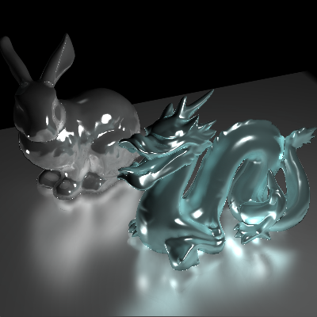
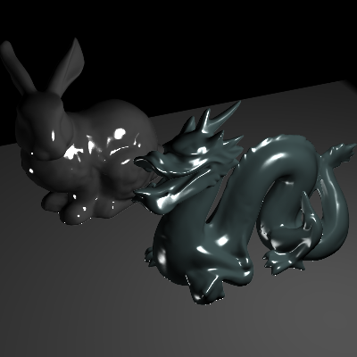
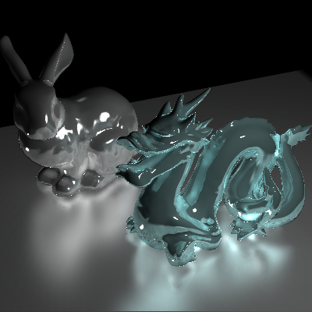
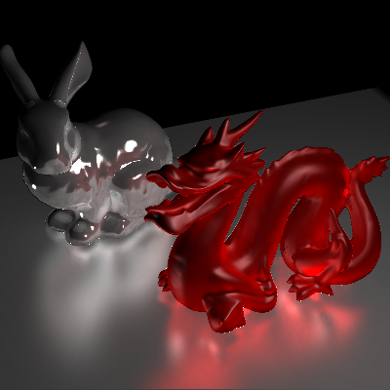
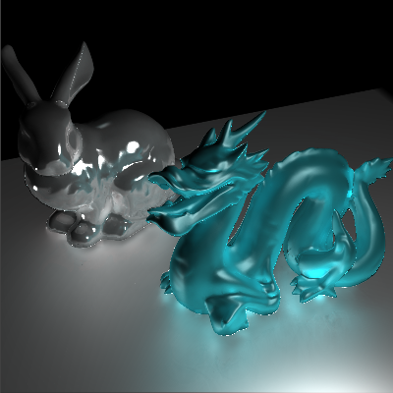
Tableau

Slide 5

Still-life

Slide 6
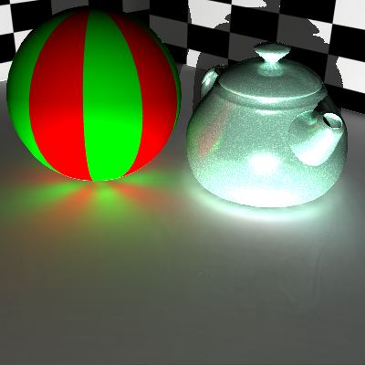
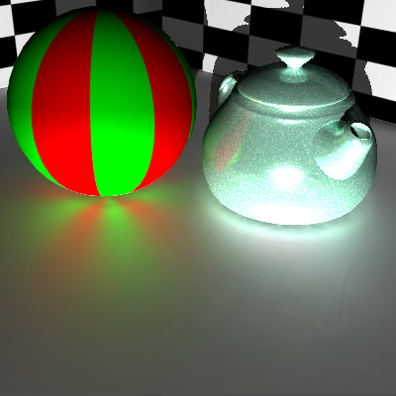
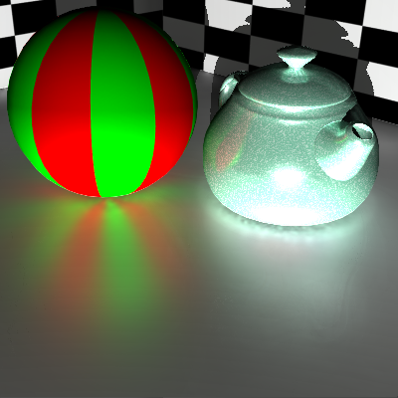

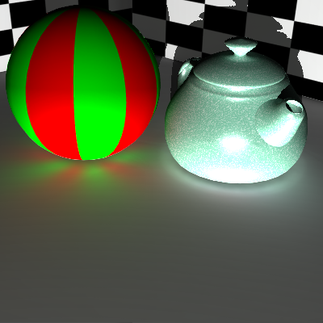
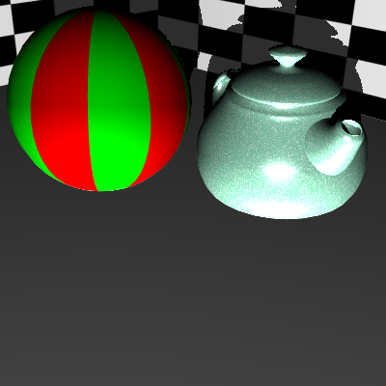
Teapot
gamma =1
gamma =10
gamma =30
gamma =100
diffuse indirect only
direct only

Slide 7
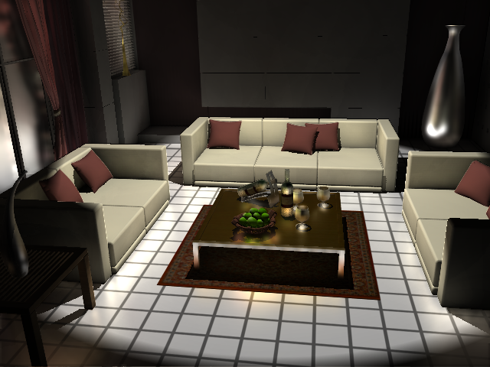
Interior grid floor

Slide 8
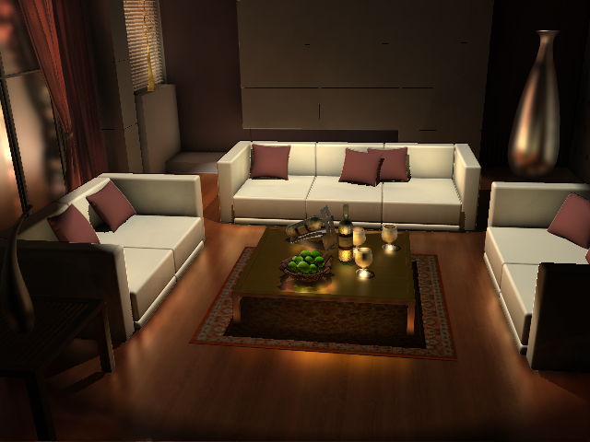
Interior wood floor

Slide 9

Comparison
reference
our method
difference

