Slide 1
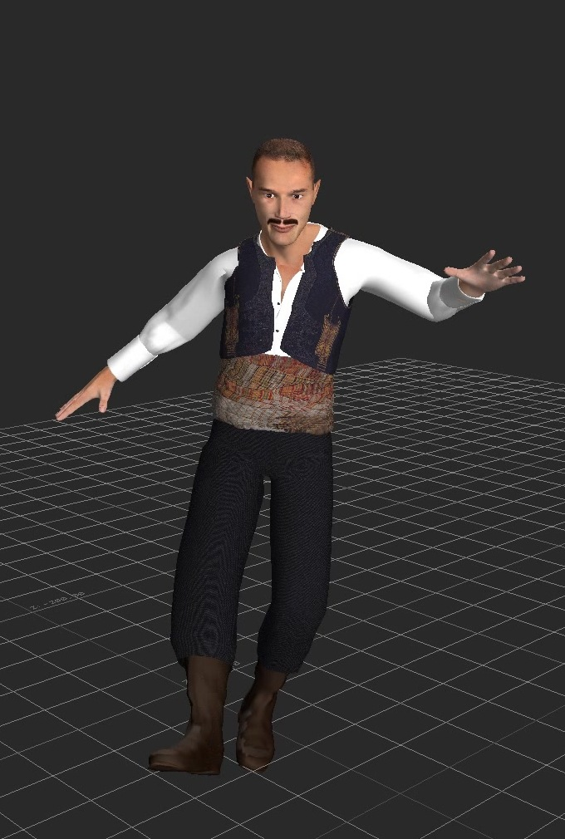
Motion Analysis for Folk Dance Evaluation
Andreas Aristidou, Efstathios Stavrakis, Yiorgos Chrysantou
University of Cyprus
{a.aristidou@ieee.org}

Slide 2

Titel

