Slide 1
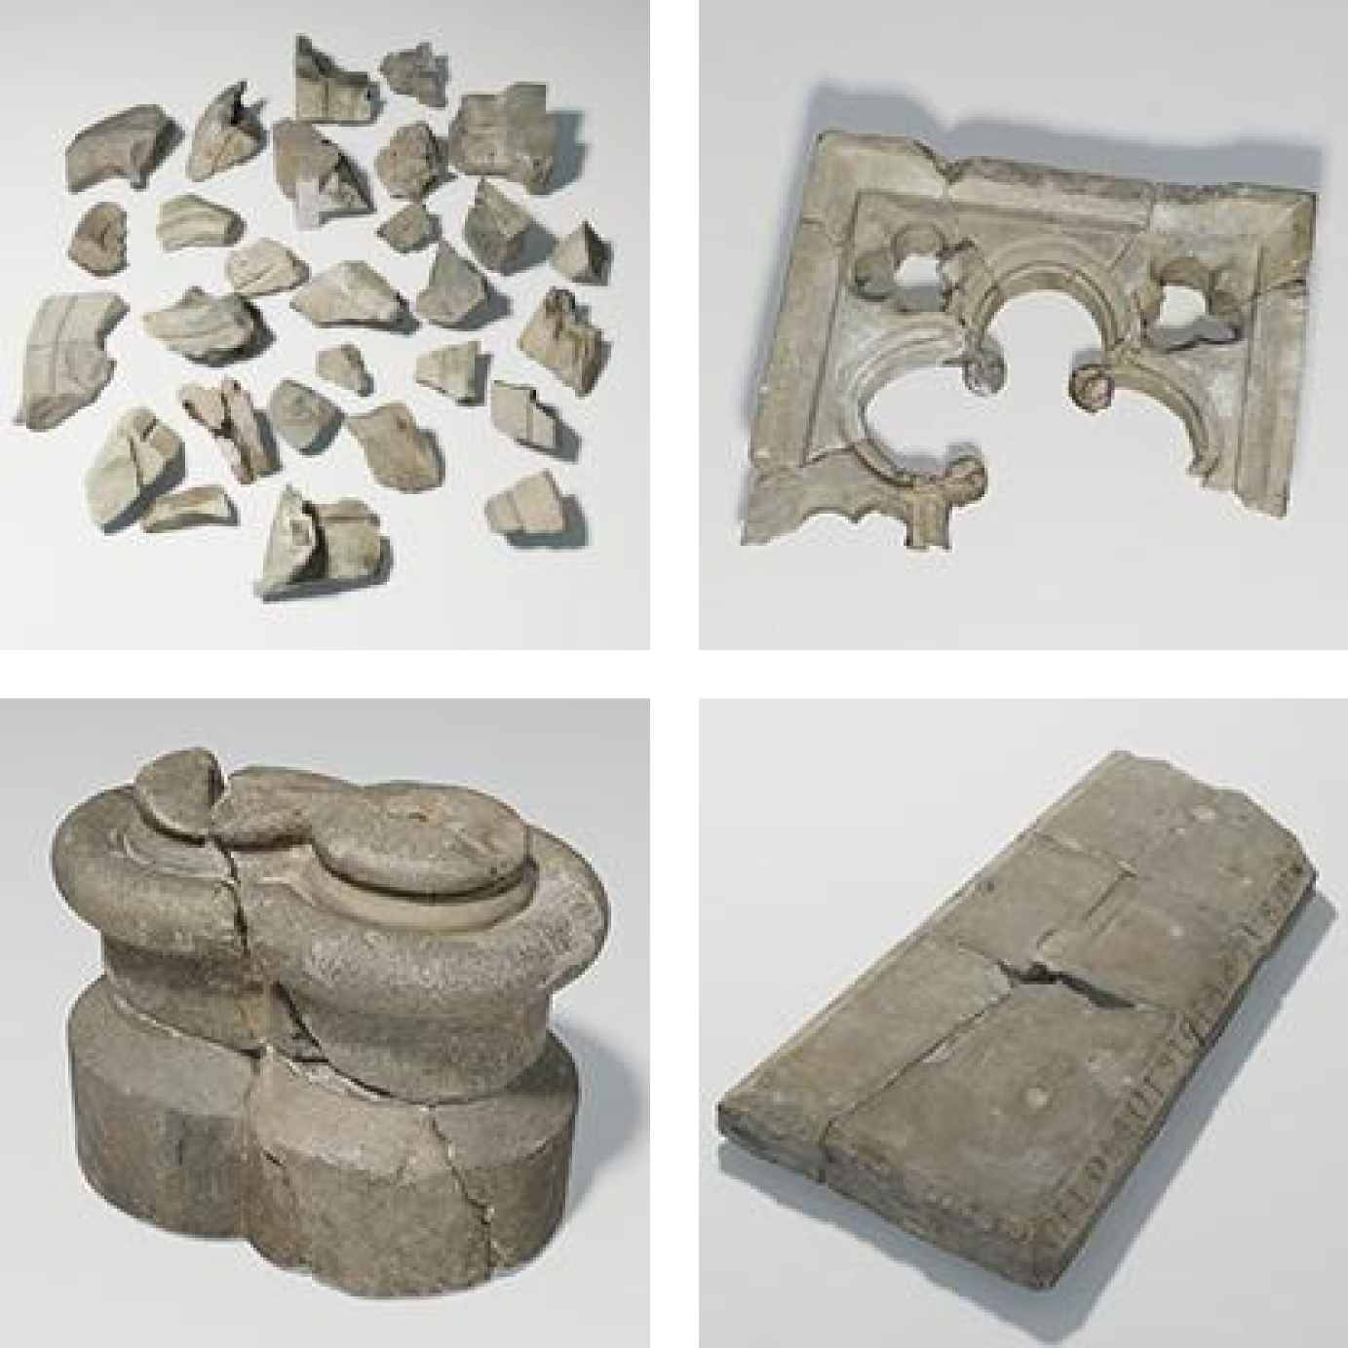
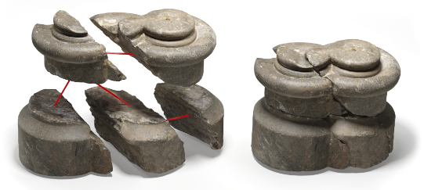
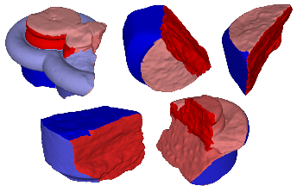
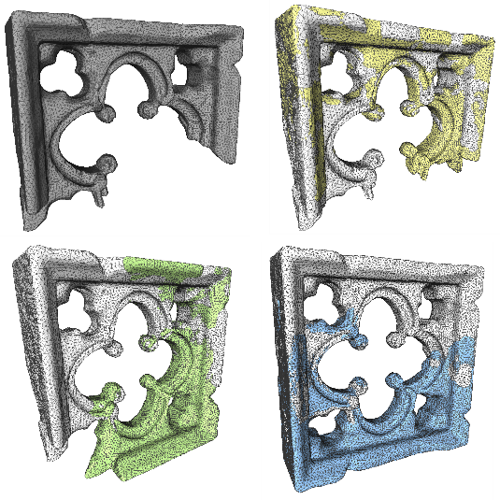
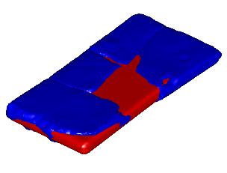
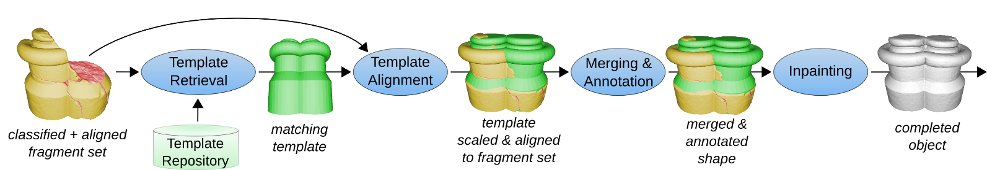
Towards AUTOMATED 3D RECONSTRUCTION OF DEFECTIVE CH OBJECTS
R. Gregor¹, I. Sipiran¹, G. Papaioannou², T. Schreck¹, A. Andreadis², P. Mavridis²
¹ University of Konstanz
² Athens University of Economics and Business

Slide 2
Titel
Towards Automated 3D Reconstruction of Defective CH Objects
R. Gregor¹, I. Sipiran¹, G. Papaioannou², T. Schreck¹, A. Andreadis², P. Mavridis²
¹ University of Konstanz, ² Athens University of Economics and Business
A New Challenge in Postprocessing and Analysis of 3D CH Objects
Classification of encountered physical defects
Brief survey of related, similarity-driven techniques
A conceptual workflow for automated 3D reconstruction that applies, extends and combines existing techniques
First results
Guidelines for evaluation
Future work

